Slide 1
Update
Spent time on spark code.
Spark memory management
Accounting for tasks
Balancing execution and storage, etc.
Making all memory “spillable”
Memory layout
Actual execution code paths
JVM memory management

Slide 2
Java Object layout: Questions
What affects layout of each record?
What determines the ~8k Bytes inter-record distance in each partition?
What causes batching during multi-threaded execution?

Slide 3
Spark
State: RDDs
Execution: RDD transformations
Narrow
Wide

Slide 4
Spark Example
RDD x = LoadFromHDFS()
x1 = x.map(c1)
x2 = x1.map(c2)
y = x2.sortBy(key)
y1 = y.map()
…

Slide 5
Spark Example
RDD x = LoadFromHDFS()
x1 = x.map(c1)
x2 = x1.map(c2)
y = x2.sortBy(key)
y1 = y.map()
…
Stage 1
Shuffle
Stage 2

Slide 6
Spark Example
RDD x = LoadFromHDFS()
x1 = x.map(c1)
x2 = x1.map(c2)
y = x2.sortBy(key)
y1 = y.map()
…
C = Load + c1 + c2
for each partition in y:
for each record:
r = C()
Shuffle write/shuffle read
…
Stage 1
Shuffle
Stage 2

Slide 7
Record spread (Key and Value offset)
C1: record =>
(record.slice(0,10), record.slice(10,100)
RDD x = LoadFromHDFS()
x1 = x.map(c1)
y = x2.sortBy(key)

Slide 8
Record spread (Key and Value offset)
C1: record =>
(record.slice(0,10), record.slice(10,100)
Object Layout
RDD x = LoadFromHDFS()
x1 = x.map(c1)
y = x2.sortBy(key)
Tuple
(24 B)
Key
(32 B)
Value
(112 B)

Slide 9
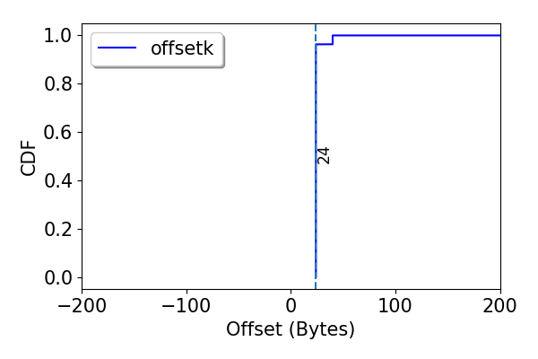
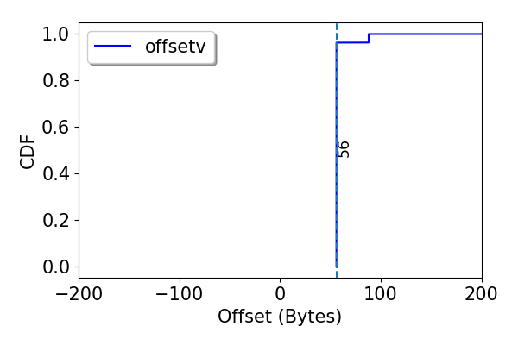
Record spread (Key and Value offset)
C1: record =>
(record.slice(0,10), record.slice(10,100)
Object Layout
RDD x = LoadFromHDFS()
x1 = x.map(c1)
y = x2.sortBy(key)
Tuple
(24 B)
Key
(32 B)
Value
(112 B)

Slide 10
Record spread (Key and Value offset)
C1: record =>
dummy = array( 450B )
k = record.slice(0,10)
dummy = array ( 50B )
v = record.slice(10,100)
(x, y)
RDD x = LoadFromHDFS()
x1 = x.map(c1)
y = x2.sortBy(key)

Slide 11
Record spread (Key and Value offset)
Object Layout
C1: record =>
dummy = array( 450B )
k = record.slice(0,10)
dummy = array ( 50B )
v = record.slice(10,100)
(x, y)
RDD x = LoadFromHDFS()
x1 = x.map(c1)
y = x2.sortBy(key)
Dummy
(450 B)
Key
(32 B)
Dummy
(50 B)
Value
(112 B)
Tuple
(24 B)

Slide 12
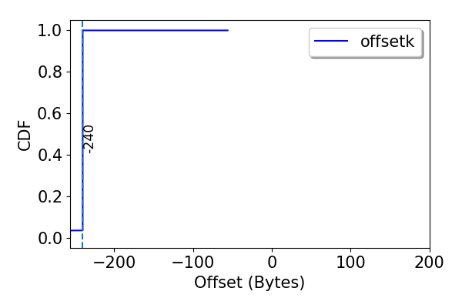
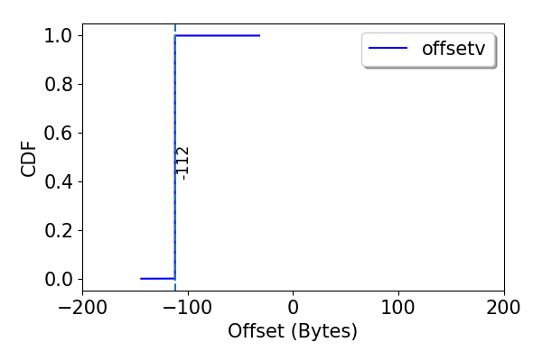
Record spread (Key and Value offset)
Object Layout
C1: record =>
dummy = array( 450B )
k = record.slice(0,10)
dummy = array ( 50B )
v = record.slice(10,100)
(x, y)
RDD x = LoadFromHDFS()
x1 = x.map(c1)
y = x2.sortBy(key)
Dummy
(450 B)
Key
(32 B)
Dummy
(50 B)
Value
(112 B)
Tuple
(24 B)

Slide 13
Record spread
Relates to how we implement closures
What happens when objects are referenced?
Look at other common spark workloads.

Slide 14
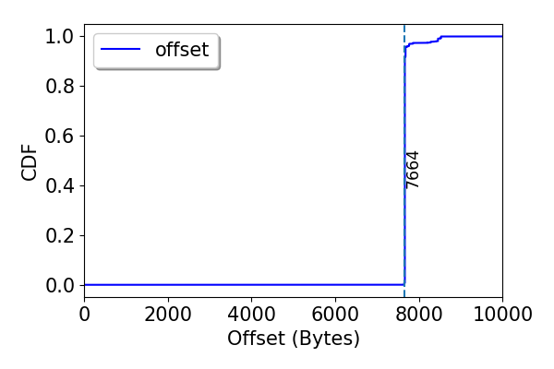
Partition spread

Slide 15
Spark Example
RDD x = LoadFromHDFS()
x1 = x.map(c1)
x2 = x1.map(c2)
y = x2.sortBy(key)
y1 = y.map()
…
C = Load + c1 + c2
for each partition in y:
for each record:
r = C()
Shuffle write/shuffle read
…
Stage 1
Shuffle
Stage 2

Slide 16
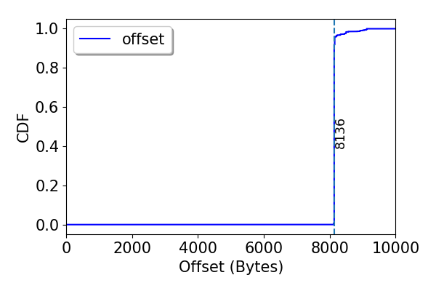
Partition spread
C1: record =>
dummy = array( 450B )
k = record.slice(0,10)
dummy = array ( 50B )
v = record.slice(10,100)
(x, y)
RDD x = LoadFromHDFS()
x1 = x.map(c1)
y = x2.sortBy(key)

Slide 17
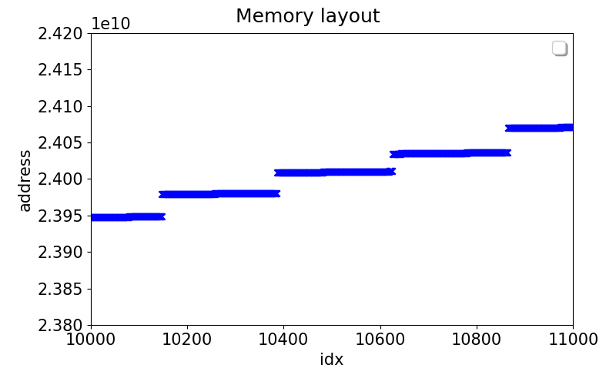
Partition spread: Layout

Slide 18
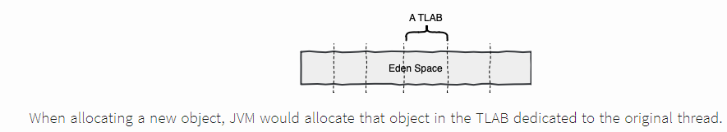
Partition spread: Layout
Thread local allocation Buffer
Can be changed using JVM flag: tried that.

Slide 19
Next

