Slide 1
Overview
RDMA experiments to answer the question:
What is the best-case CPU/Xput gains we can get by involving NIC in serialization?
Spark experiments => high dispersion in data layout
CPU needs to copy data into “bounce buffers”
Best-case: What if we can avoid copies? How much CPU can we save?

Slide 2
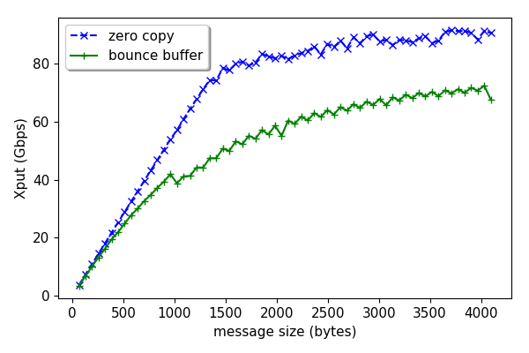
Copying overhead

Slide 3
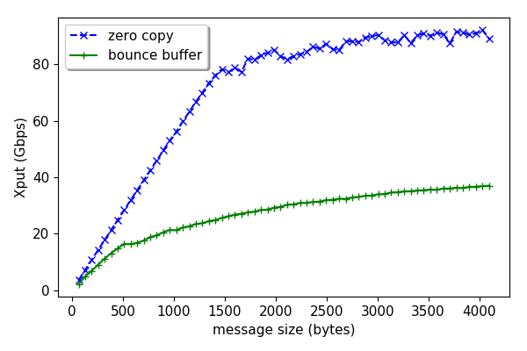
Copying overhead (more realistic)

