Slide 1
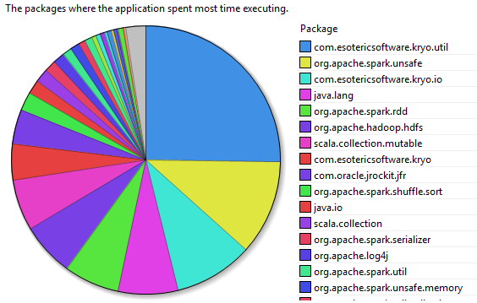
ACCELERATING SPARK
Serializing data
Spark is CPU-bound
Opportunities for relieving CPU
Assisting sorting
Serialiazation
CPU Breakdown for Shuffle

Slide 2
LITERATURE
Off-path accelerators – hardware acceleration
GPU, FPGA
On-path accelerators – data filtering
Switches
NICs can accommodate a bit of both worlds.

Slide 3
LITERATURE
Off-path accelerators – hardware acceleration
GPU, FPGA
On-path accelerators – data filtering
Switches
NICs can accommodate a bit of both worlds.

Slide 4
Off-path ACCELERATORS
Core library acceleration
Serialization
Sorting
Third-party lib acceleration
Integrating FPGAs/GPUs with Spark to enable accelerating workloads running on top of it
E.g., Linear regression, FFT

Slide 5
Off-path ACCELERATORS
Core library acceleration
Serialization
Sorting
Third-party lib acceleration
Integrating FPGAs/GPUs with Spark to enable accelerating workloads running on top of it
E.g., Linear regression, FFT

Slide 6
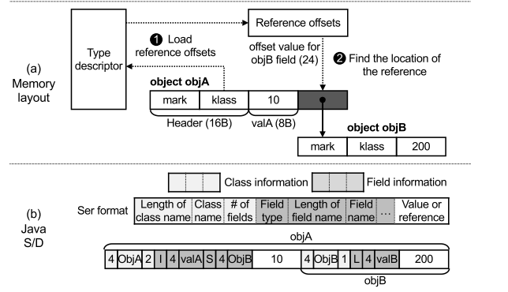
H/W BASED SERIALIZATION
Cereal: A Specialized Architecture for Object Serialization with Applications to Big Data Analytics, ISCA’ 20
Designing serialization technique to avail “Object-level” parallelism
Special hardware to exploit this

Slide 7
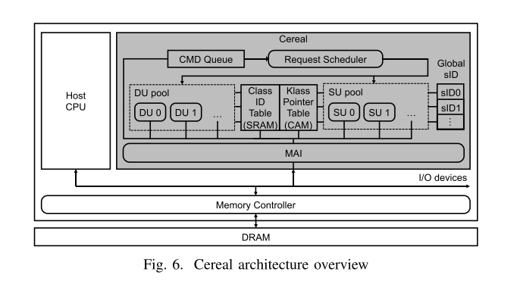
H/W BASED SERIALIZATION
Cereal: A Specialized Architecture for Object Serialization with Applications to Big Data Analytics, ISCA’ 20
Designing serialization technique to avail “Object-level” parallelism
Special hardware to exploit this
On-chip accelerator…
Direct access to DRAM
TLB
Cache coherent access

Slide 8
H/W BASED SERIALIZATION
Other works (based in SSD):
Morpheus: Creating Application Objects Efficiently for Heterogeneous Computing, ISCA’16 – from UCSD
HODS: Hardware Object Deserialization Inside SSD Storage, FCCM’18

Slide 9
The APPROACH FOR NICs
Explore off-path (PCIe) acceleration solutions (e.g., FPGA-based).
Morphing these to NICs.
Closer-to-network computation – like shuffle
Avoid two-way communication across PCIe
Other factors ?

