Slide 1
UPDAte
Learning more about JVM and DMA
Read a couple of related papers

Slide 2
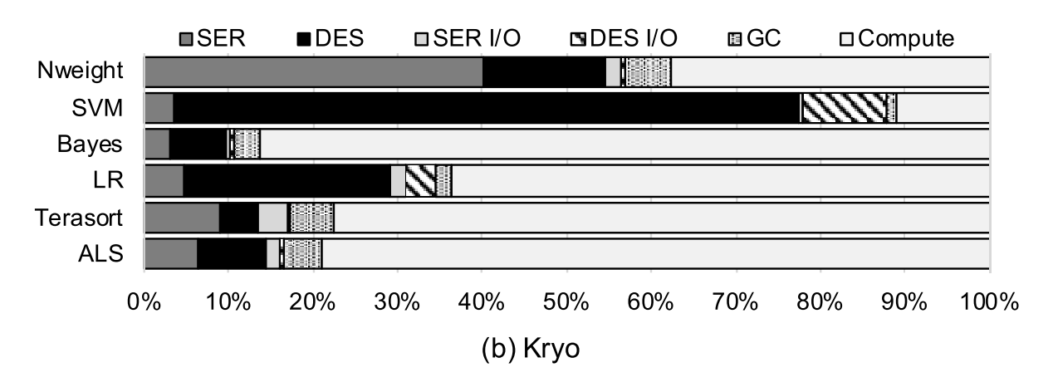
SER/DES in SPARK
CPU Breakdown

Slide 3
SER/DES WITH NIC
Direct object copy as much as possible
To avoid time spent in traditional serializers

Slide 4
Traditional Serializers
Written as Java libraries – no access to underlying object headers, etc.
Cannot copy an object as is – needs changes in JVM
Time is spent in:
Computation spent in converting objects from/to JVM-format
Memory copies in gathering/allocating objects
Memory copies when using sockets

Slide 5
SER/DES WITH NIC
Time is spent in:
Computation spent in converting objects from/to JVM-format
Memory copies in gathering/allocating objects
Memory copies when using sockets

Slide 6
SER/DES WITH NIC
Time is spent in:
Computation spent in converting objects from/to JVM-format
Memory copies in gathering/allocating objects
Memory copies when using sockets SparkRDMA

Slide 7
SER/DES WITH NIC
Time is spent in:
Computation spent in converting objects from/to JVM-format SKYWAY
Memory copies in gathering/allocating objects
Memory copies when using sockets SparkRDMA

Slide 8
SER/DES WITH NIC
Time is spent in:
Computation spent in converting objects from/to JVM-format SKYWAY
Memory copies in gathering/allocating objects
Memory copies when using sockets SparkRDMA

Slide 9
DMA
Devices see I/O Virtual Addresses
IOVAs to PA mapping in IOMMU
I/O Page tables and TLB entries maintained by the OS
dma_map and dma_unmap add these entries for a specified memory region (less than page size)
These are expensive in the datapath

Slide 10
DMA
To keep DMA performant –
Permanently mapped buffers – but a guaranteed memory copy
Hugepages – but not realistic
Amortize – keep data close and map/unmap only every once in a while
(Previous work?)

Slide 11
QUESTIONS
How much can we further improve performance by eliminating those last-mile memory copies?
Understanding JVM object layout, DMAing to managed heap, etc.
Emailed Skyway author for code.

Slide 12
MISC

Slide 13
SERDES WITH NIC: APPROACH?
Needs traversal to collect all pieces
Cannot do this from NIC – too much delay between references

Slide 14
SERDES WITH NIC: WITH NO CPU
Needs traversal to collect all pieces
Cannot do this from NIC – too much delay between references
All pieces in one go (Without CPU’s help)
Offsets determined in the NIC
Assuming all pieces are close
Not contiguous – so extra data copied at bandwidth cost
Cannot span multiple pages – IOVA different from VA
Needs huge pages - not realistic

Slide 15
SERDES WITH NIC: With CPU assistance
CPU traversal and Making a Scatter-Gather list
Collect all pages the object spans
Adjust references (in place) and send SG to NIC
Might end with lot of individual/small DMAs for each object
May be batch it for multiple records?
CPU Collecting all pieces into single piece
Still better than traditional serializers – But it’s just (Skyway + SparkRDMA)
Con: The with-in app copy is still there.

Slide 16
SERDES WITH NIC
Object can be in one piece – no need to break it up
But two things:
Update reference addresses in the new VA
Update few things in object headers
Who does it? CPU or NIC…
Batching for better throughput

Slide 17
NEXt
Lot of options/challenges
Setting up JVM and NIC with DMA
Play with reading/writing objects…
High-level question: What does it take to read/write data from/to the right place (final application-specified location) given current state of DMA and small pages in a performant way?

