Slide 1
Update
JVM architecture and code
Understanding DMA workflow
RDMA for Java networking

Slide 2
Avoiding Spark serialization
Transport objects directly without any CPU side copies
NIC needs free access to dynamic user space memory access in datapath
What are the challenges?
JVM-side implementation
DMA (map/unmap) performance
Syscall overhead

Slide 3
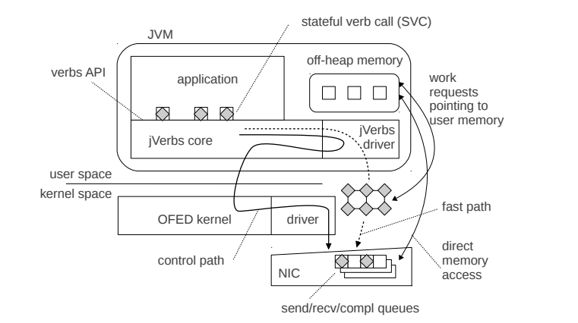
jVerbs: RDMA in JVM

