Slide 1
Update
Most papers on shared memory focus on HSA
  Designing in-house MMU and TLBs for accelerators
Low-level details on how drivers do DMA
  “Serious system instability is guaranteed”
  rIOMMU: a detailed instrumentation of IOMMU
jVerbs: Traced code to native RDMA
Skyway code: Haven’t looked at it yet

Slide 2
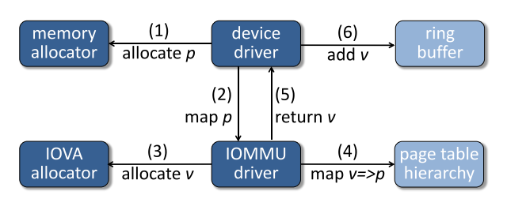
rIOMMU
Breaking down the cost of map and unmap operations.
DMA map

Slide 3
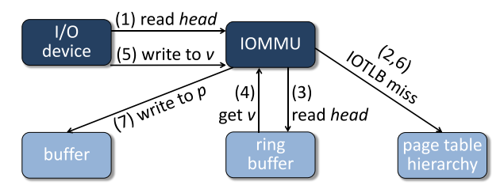
rIOMMU
Breaking down the cost of map and unmap operations.
DMA access

Slide 4
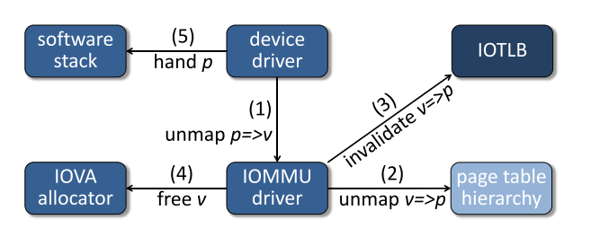
rIOMMU
Breaking down the cost of map and unmap operations.
DMA unmap

Slide 5
rIOMMU
Breaking down the cost of map and unmap operations.
DMA unmap

Slide 6
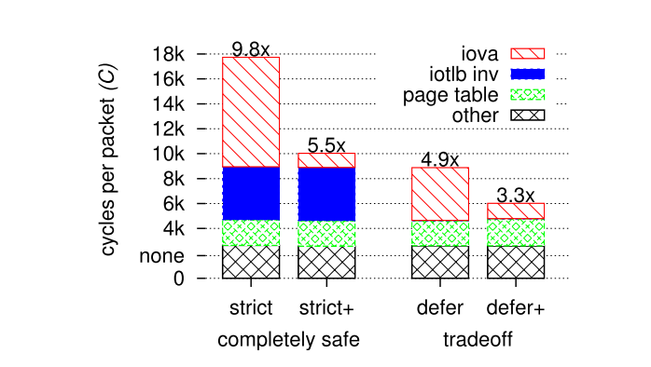
rIOMMU
Breaking down the cost of map and unmap operations.
Cost of mapping dwarfs the cost of translation
These prices are paid on every packet and that’s how it is in Linux => Another reason why DPDK performs so well!

Slide 7
rIOMMU
Breaking down the cost of map and unmap operations.
Cost of mapping dwarfs the cost of translation
These prices are paid on every packet and that’s how it is in Linux => Another reason why DPDK performs so well!

Slide 8
RDMA: Memory registration
Does it all happen as control path?
Does RDMA provide the flexibility of registering any memory?
  Tracing jVerbs for an answer
What’s the cost?
  Where’s the protection domain crossing?

Slide 9
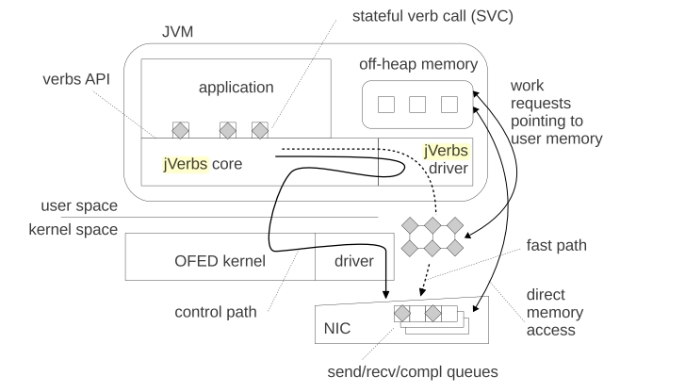
jVerbs
Wrapper around native RDMA calls
Uses off-heap because of direct buffers and access to virtual addresses
RDMA-Core libs

Slide 10
Next
Learn more about RDMA Memory Registration
5G talk

