Slide 1
Update
Workshop
Spark memory update

Slide 2
Workshop
Mostly NICs (Marvell, Mellanox, Xilinx promos)
Known papers (1-RMA, iPipe, AzureNIC)
StRoM – ETH Zurich

Slide 3
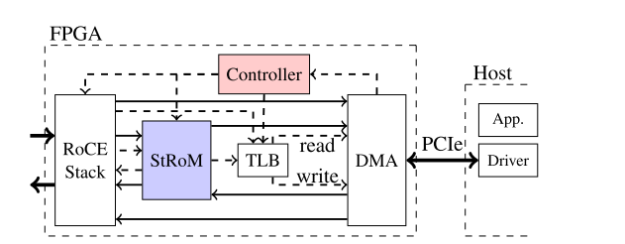
StRoM: Smart Remote Memory
RDMA avoids CPU only for one-sided verbs
But one-sided ops may incur multiple RTTs
StoRM: Proposes RPC RDMA verbs with remote CPU
StRoM puts the RPC on the remote NIC

Slide 4
Testbed
Spark-29
Spark-30
SPARK Executor
SPARK Executor
TeraSort
TeraSort
Network
HDFS + YARN
HDFS + YARN

Slide 5
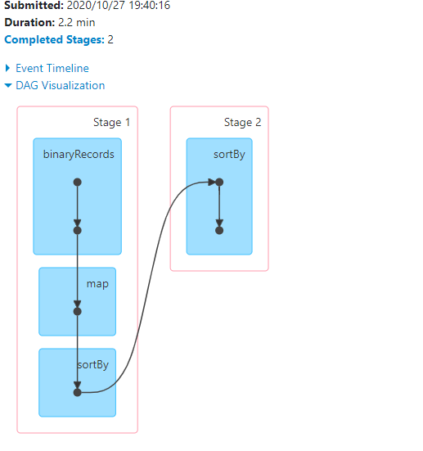
Spark shuffle
Snapshot

Slide 6
Metadata
1 Map job – single thread
1.3 million records
Each record: 166 B
Base
Key
Value

Slide 7
Questions
To understand:
Per-object spread
Per-partition spread

Slide 8
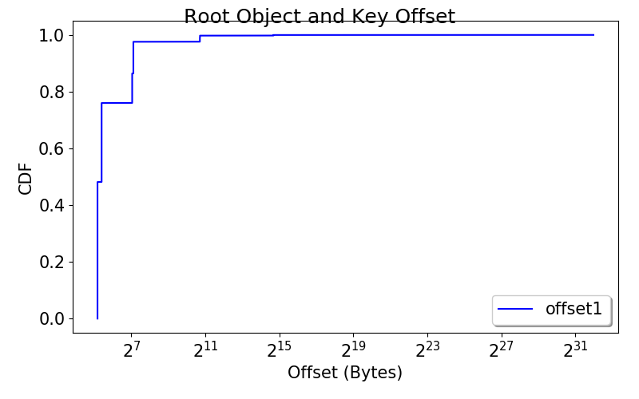
Object spread

Slide 9
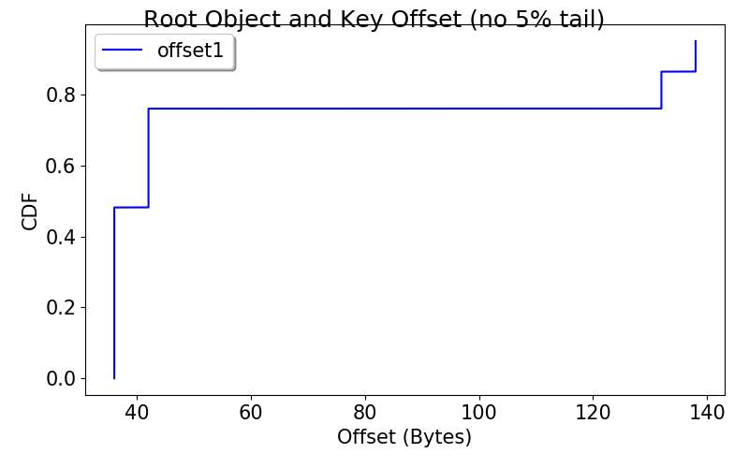
Object spread

Slide 10
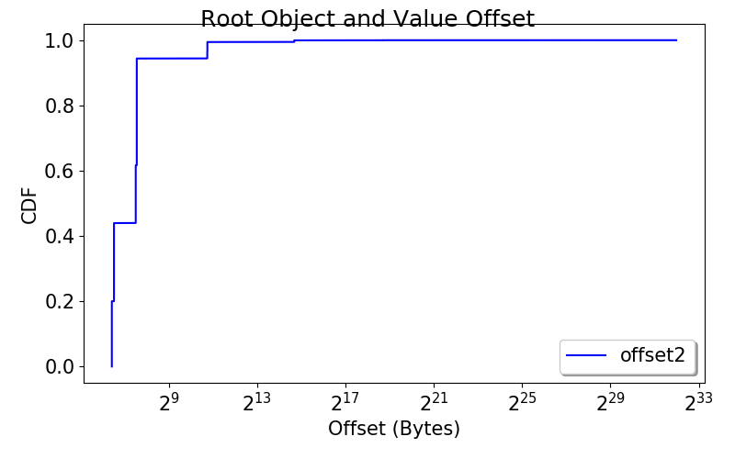
Object spread

Slide 11
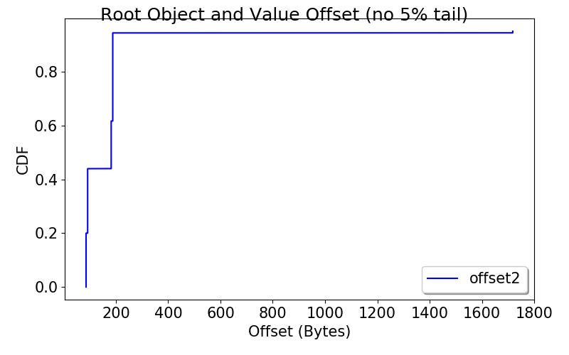
Object spread

Slide 12
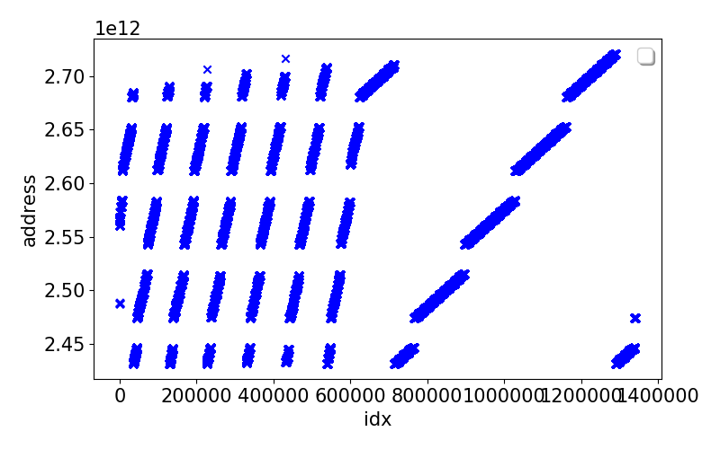
Partition spread
24341960736

Slide 13
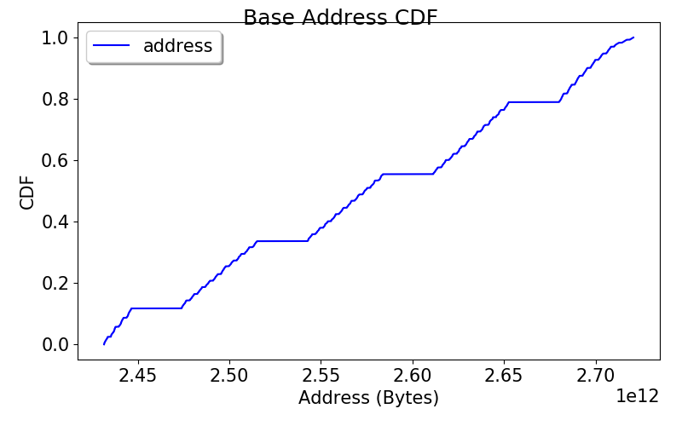
Partition spread

Slide 14
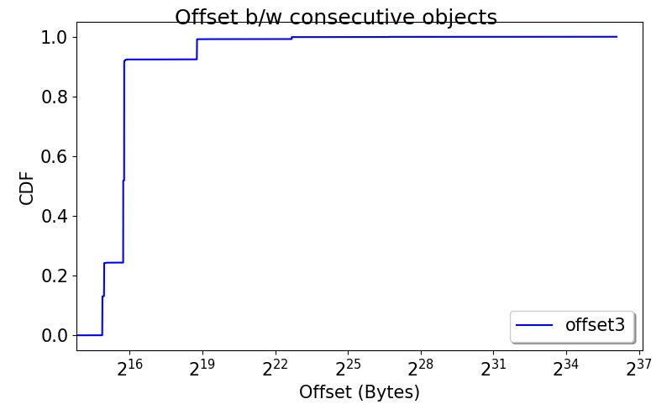
Partition spread

