Slide 1
Update
Understanding Spark’s memory allocation.
Bugfix; updated results.

Slide 2
Testbed
Spark-29
Spark-30
SPARK Executor
SPARK Executor
TeraSort
TeraSort
Network
HDFS + YARN
HDFS + YARN

Slide 3
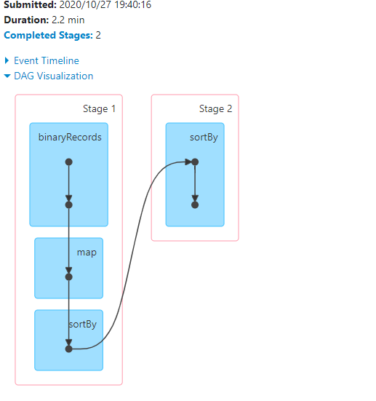
Spark shuffle
Snapshot

Slide 4
Data layout
1 GB

Slide 5
Data layout
1 GB
32 MB

Slide 6
Data layout
1 GB
32 MB

Slide 7
Data layout
1 GB
32 MB
100 B

Slide 8

Data layout
Input
Partition
100 B
Record
10 B Key
90 B Value
Java Object
Base Tuple
Key
Value

Slide 9
Questions
I’m interested in:
Record spread
Partition spread

Slide 10
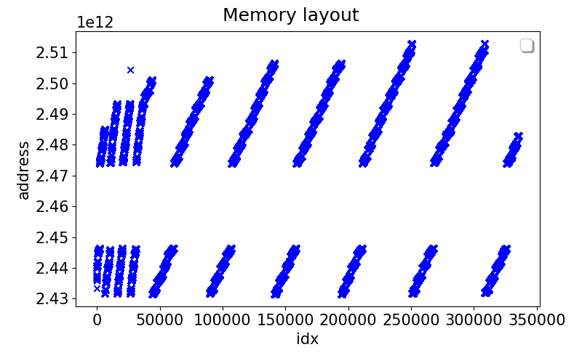
Bug
24341960736

Slide 11
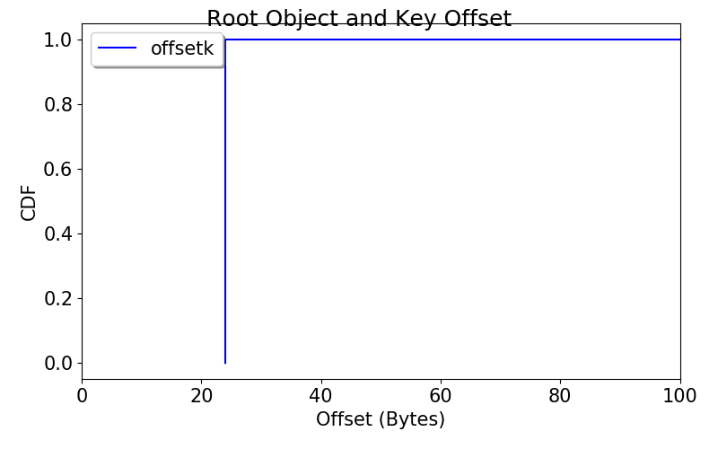
Record spread: Tuple Key Offset

Slide 12
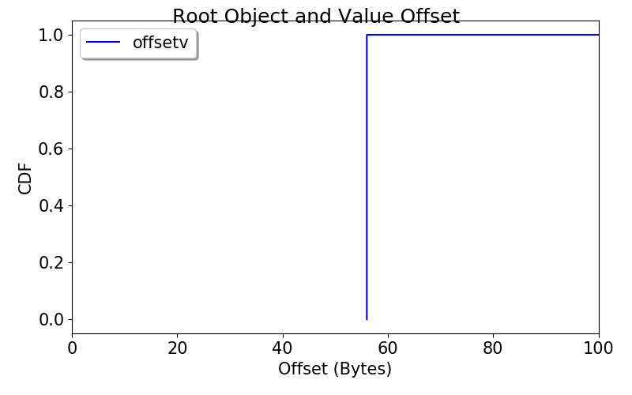
Record spread: Tuple Value Offset

Slide 13
Record spread
Data sticks together
Might want to try other workloads
With more complex records

Slide 14
Partition spread

Slide 15
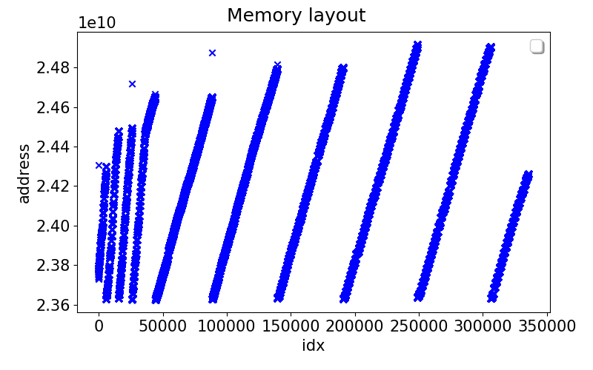
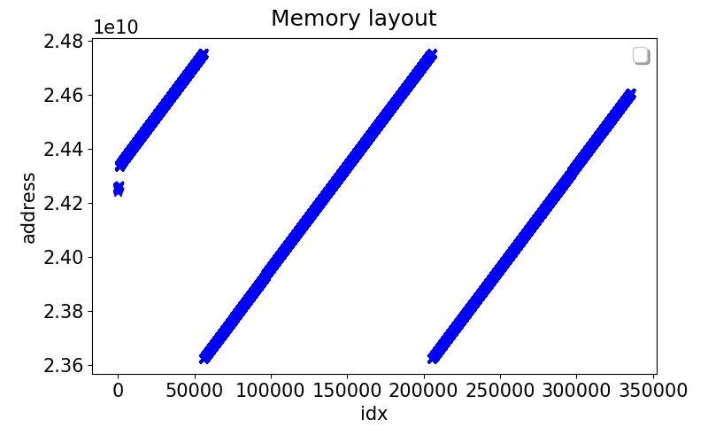
Partition spread: Layout
Multi-threaded
Single threaded

Slide 16
Partition spread: Layout
Multi-threaded
Single threaded
Slope ~ 26 KB
Slope ~ 8 KB

Slide 17
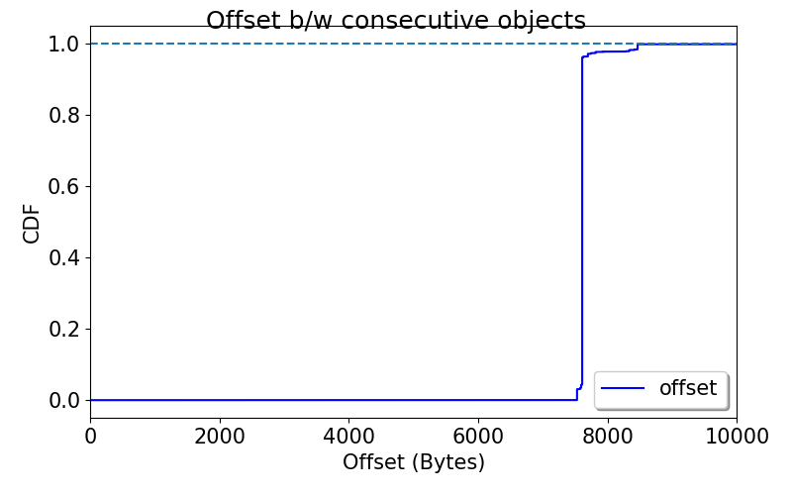
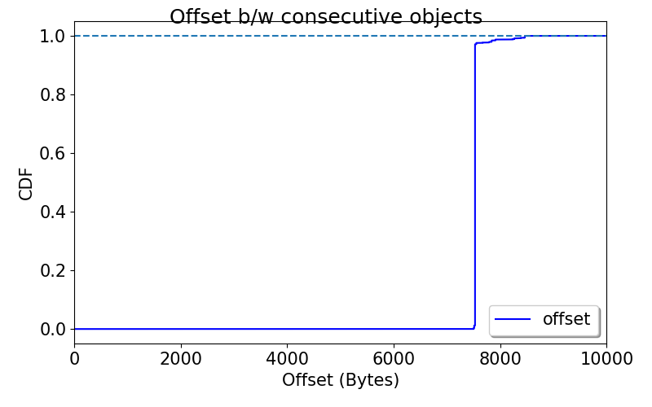
Partition spread: Stride
Multi-threaded
Single threaded
Mode ~ 8 KB
Mode ~ 8 KB

Slide 18
Partition spread: Layout

Slide 19
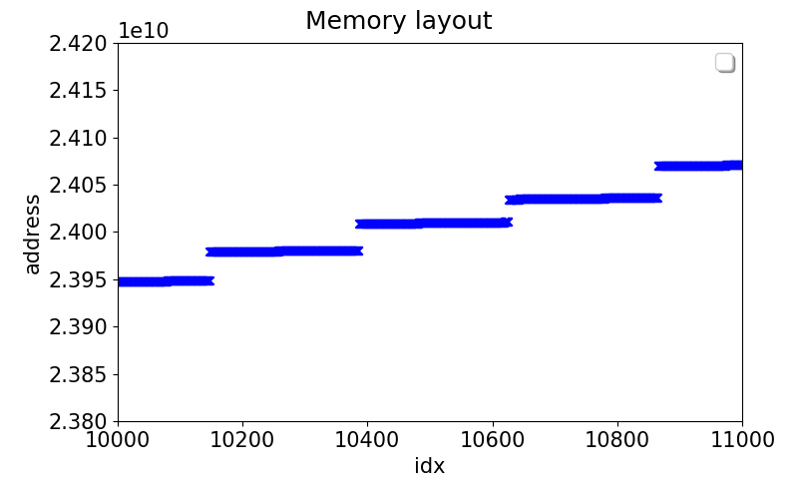
Partition spread: Layout

Slide 20
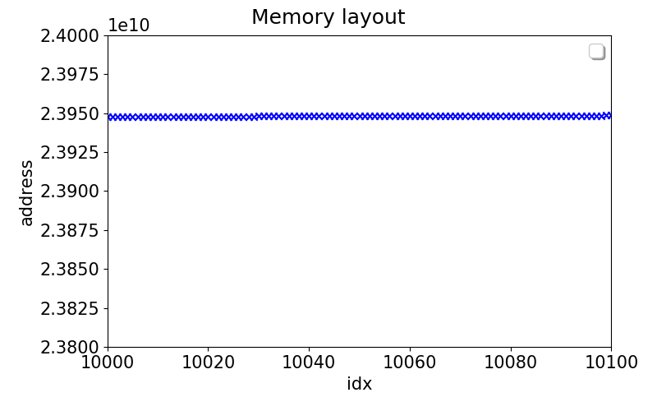
Partition spread: Layout

Slide 21
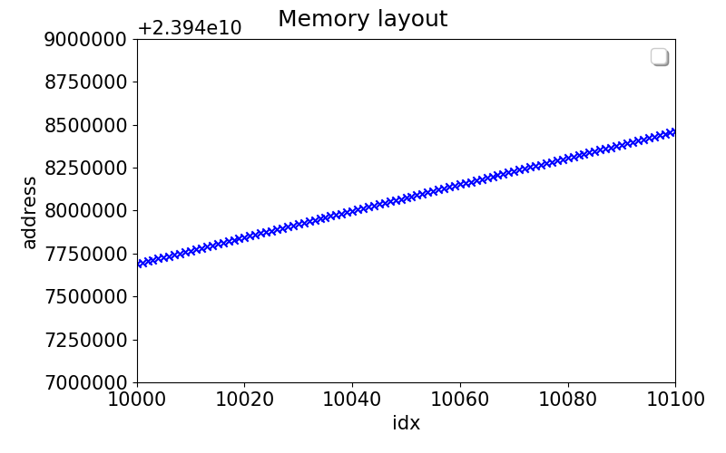
Partition spread: Layout
Slope ~ 8 KB

Slide 22
Partition spread: Stride
Multi-threaded
Single threaded

Slide 23
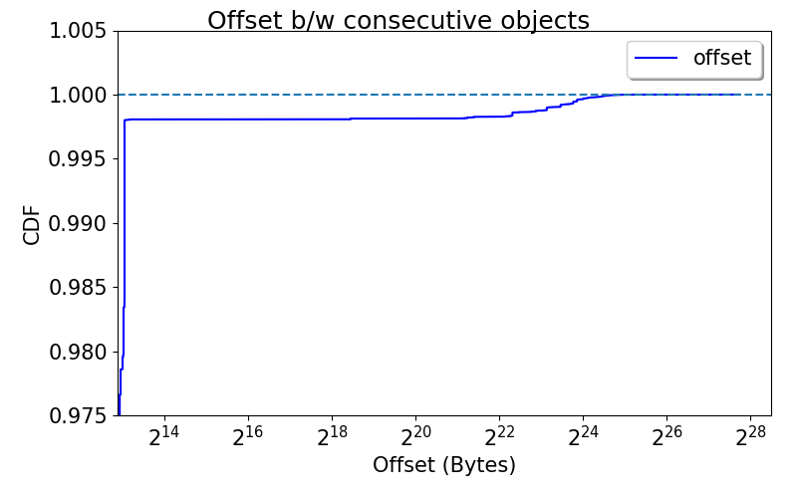
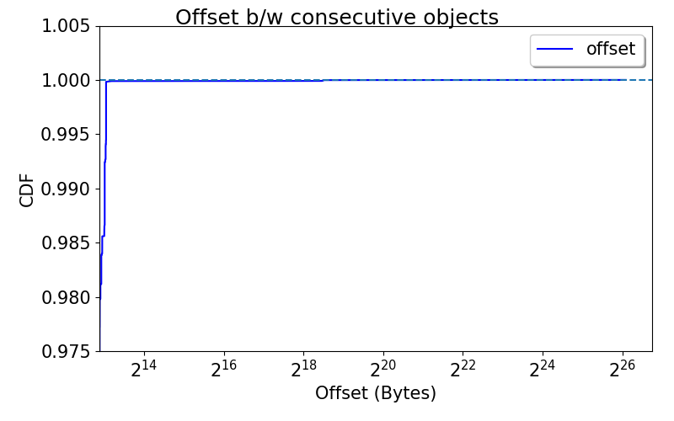
Partition spread: Stride (2.5% tail)
Multi-threaded
Single threaded

Slide 24
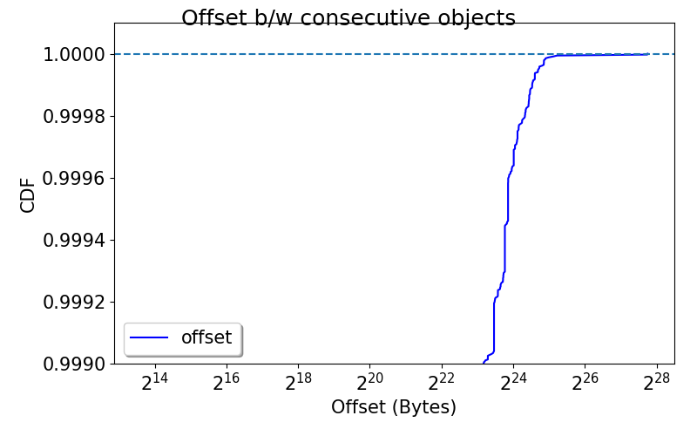
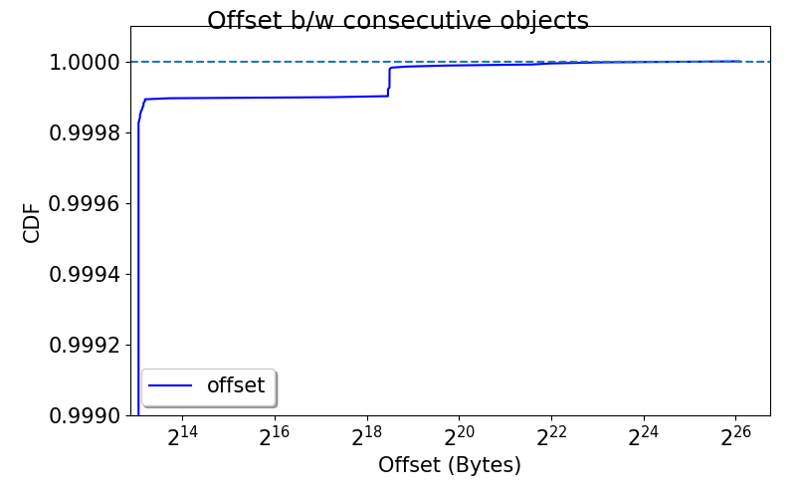
Partition spread: Stride (0.1% tail)
Multi-threaded
Single threaded

Slide 25
Partition spread: Layout
Multi-threaded
Single threaded

Slide 26
Question
Are the objects in next stripe replacing earlier stripes?

Slide 27
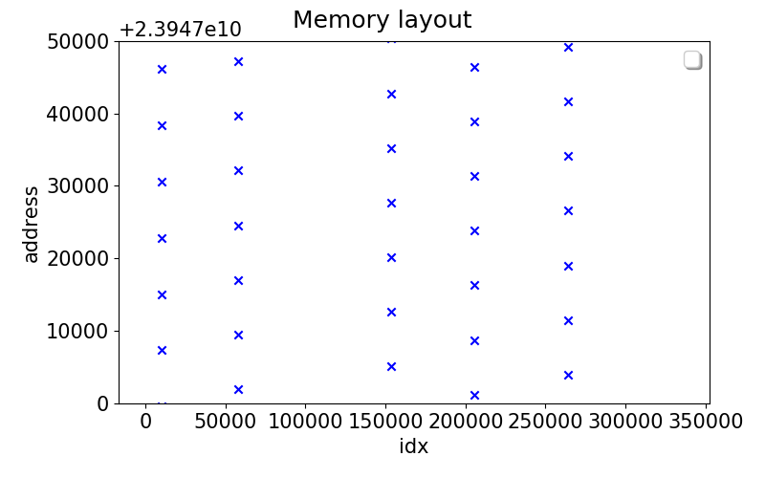
Question
No.

Slide 28
Partition spread: Questions
What determines the ~8k Bytes distance?
Not a thread interleaving thing
The algorithm itself?
What determines the ~1MB inter-batch distance?
Multiple threads receiving memory in chunks

Slide 29
Next
Looking into spark/java memory allocator

