Slide 1
Update
Spark’s tungsten and how it may affect us
Framing as a general problem and finding next challenges/todo
WWW paper rebuttal

Slide 2
Tungsten
Spark’s app-runtime co-design effort for SQL
In/off-heap memory management
Large number of small objects – GC and memory overhead
New data abstraction: DataRow
Custom operations: SQL ops are already defined
Default adoption for SQL, not sure about others.

Slide 3
Tungsten
How does it affect us?
Record spread – absent
Partition spread – still present. Need to confirm.
Minimal perf difference between in- and off-heap
There won’t be any serialization overhead
Other improvements would still apply

Slide 4
Devil’s advocate: Why spark is not a good idea
Too complex to plug in our custom solution
Con: Don’t see any obvious technical blocker
Con: Just being defeatist
Restricting data to memory; that too in a deserialized format
Pro: Spark is already memory-bound
Con: Spark does cache RDDs in memory, one extra RDD doesn’t make a diff.
Con: We can make our solution work with disk in the worst-case.
Con: Goal is not to improve spark in all ways, so we side-step this issue.
Tungsten
Pro: Without serialization improvements, our contributions will be limited.
Con: Our end-to-end solution still applies.

Slide 5
Further Thoughts
Keep the problem general
“(stateless)-acceleration-friendly interface for streaming workloads”
acceleration-friendly: keep entities separate and transparent
Streaming: can’t afford to make multiple trips over PCIe per data unit
For managed runtimes? – makes it more real.
E.g., ConnectedList<T> data type that you can call next()on. (Perhaps provide acceleration code on each T as an annotation.)
I can see this pluggable into Spark (with some effort)
Find other streaming platforms. Flink?

Slide 6
Next challenges
PL-side (to get data laid out the way we want)
How do we annotate data?
Is it reasonable to expect annotations for all objects?
Do we need static analysis?
Systems-side (optimal Host-NIC data transfer)
What does an efficient transfer look like, given a layout?
What kind of layout really helps?
Does layout matter? When does copying becoming a big deal?
Finding the/our balance

Slide 7
Next steps
PL-side (to get data laid out the way we want)
Find papers for language constructs for memory management
Find a PL person
Systems-side (optimal Host-NIC data transfer)
Try out some layouts and get some numbers
Finding the/our balance

Slide 8
Immediate todo
Profiling other spark workloads
Vetting Tungsten partition spread
Also, to look at record spread in other cases
Setting up for streaming setup over RDMA
C/C++
Emulate various data structures starting with our spark example
Talk to Stew?

Slide 10
Last Week’s Update
Spent time on spark code.
Spark memory management
Accounting for tasks
Balancing execution and storage, etc.
Making all memory “spillable”
Memory layout
Actual execution code paths
JVM memory management

Slide 11
Java Object layout: Questions
What affects layout of each record?
What determines the ~8k Bytes inter-record distance in each partition?
What causes batching during multi-threaded execution?

Slide 12
Spark
State: RDDs
Execution: RDD transformations
Narrow
Wide

Slide 13
Spark Example
RDD x = LoadFromHDFS()
x1 = x.map(c1)
x2 = x1.map(c2)
y = x2.sortBy(key)
y1 = y.map()
…

Slide 14
Spark Example
RDD x = LoadFromHDFS()
x1 = x.map(c1)
x2 = x1.map(c2)
y = x2.sortBy(key)
y1 = y.map()
…
Stage 1
Shuffle
Stage 2

Slide 15
Spark Example
RDD x = LoadFromHDFS()
x1 = x.map(c1)
x2 = x1.map(c2)
y = x2.sortBy(key)
y1 = y.map()
…
C = Load + c1 + c2
for each partition in y:
for each record:
r = C()
Shuffle write/shuffle read
…
Stage 1
Shuffle
Stage 2

Slide 16
Record spread (Key and Value offset)
C1: record =>
(record.slice(0,10), record.slice(10,100)
RDD x = LoadFromHDFS()
x1 = x.map(c1)
y = x2.sortBy(key)

Slide 17
Record spread (Key and Value offset)
C1: record =>
(record.slice(0,10), record.slice(10,100)
Object Layout
RDD x = LoadFromHDFS()
x1 = x.map(c1)
y = x2.sortBy(key)
Tuple
(24 B)
Key
(32 B)
Value
(112 B)

Slide 18
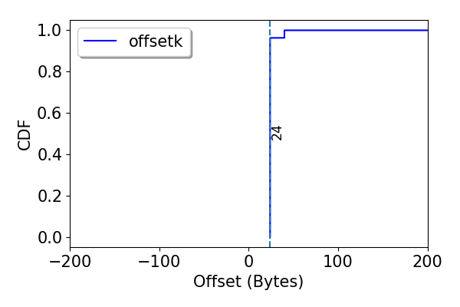
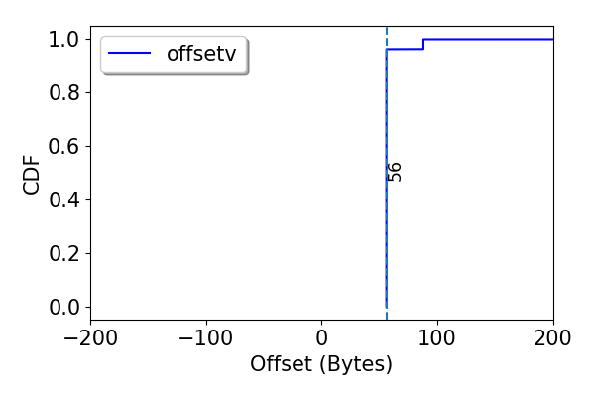
Record spread (Key and Value offset)
C1: record =>
(record.slice(0,10), record.slice(10,100)
Object Layout
RDD x = LoadFromHDFS()
x1 = x.map(c1)
y = x2.sortBy(key)
Tuple
(24 B)
Key
(32 B)
Value
(112 B)

Slide 19
Record spread (Key and Value offset)
C1: record =>
dummy = array( 450B )
k = record.slice(0,10)
dummy = array ( 50B )
v = record.slice(10,100)
(x, y)
RDD x = LoadFromHDFS()
x1 = x.map(c1)
y = x2.sortBy(key)

Slide 20
Record spread (Key and Value offset)
Object Layout
C1: record =>
dummy = array( 450B )
k = record.slice(0,10)
dummy = array ( 50B )
v = record.slice(10,100)
(x, y)
RDD x = LoadFromHDFS()
x1 = x.map(c1)
y = x2.sortBy(key)
Dummy
(450 B)
Key
(32 B)
Dummy
(50 B)
Value
(112 B)
Tuple
(24 B)

Slide 21
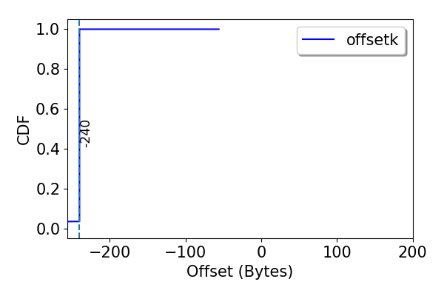
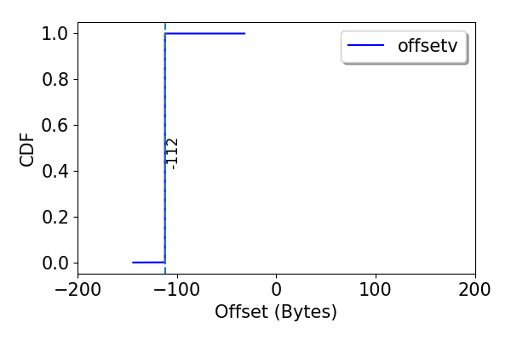
Record spread (Key and Value offset)
Object Layout
C1: record =>
dummy = array( 450B )
k = record.slice(0,10)
dummy = array ( 50B )
v = record.slice(10,100)
(x, y)
RDD x = LoadFromHDFS()
x1 = x.map(c1)
y = x2.sortBy(key)
Dummy
(450 B)
Key
(32 B)
Dummy
(50 B)
Value
(112 B)
Tuple
(24 B)

Slide 22
Record spread
Relates to how we implement closures
What happens when objects are referenced?
Look at other common spark workloads.

Slide 23
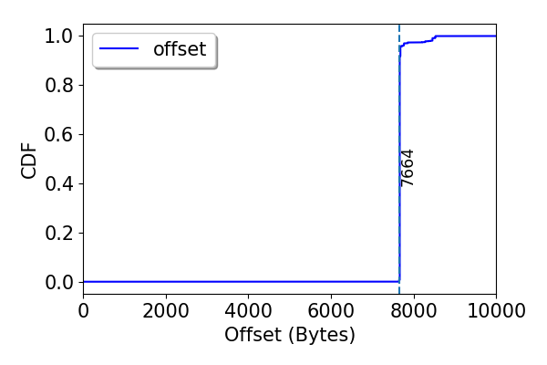
Partition spread

Slide 24
Spark Example
RDD x = LoadFromHDFS()
x1 = x.map(c1)
x2 = x1.map(c2)
y = x2.sortBy(key)
y1 = y.map()
…
C = Load + c1 + c2
for each partition in y:
for each record:
r = C()
Shuffle write/shuffle read
…
Stage 1
Shuffle
Stage 2

Slide 25
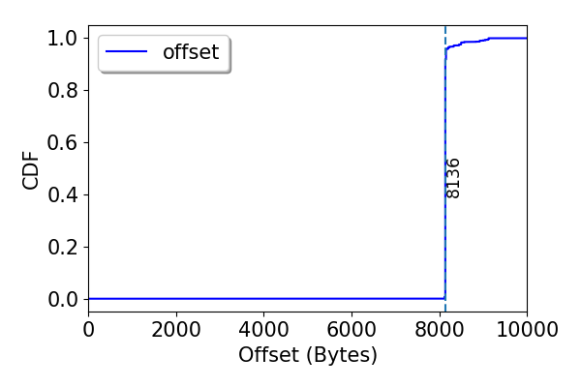
Partition spread
C1: record =>
dummy = array( 450B )
k = record.slice(0,10)
dummy = array ( 50B )
v = record.slice(10,100)
(x, y)
RDD x = LoadFromHDFS()
x1 = x.map(c1)
y = x2.sortBy(key)

Slide 26
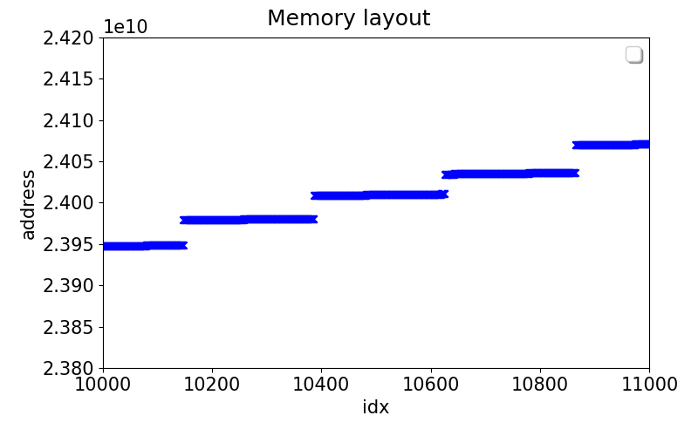
Partition spread: Layout

Slide 27
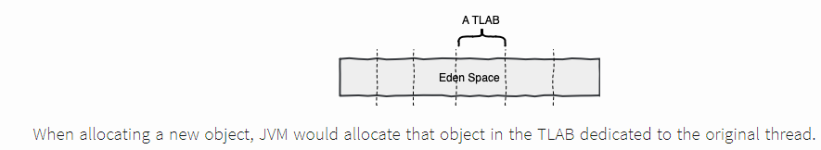
Partition spread: Layout
Thread local allocation Buffer
Can be changed using JVM flag: tried that.

Slide 28
Next

