Slide 1
Status
Research Exam
TDMA on CX-6

Slide 2
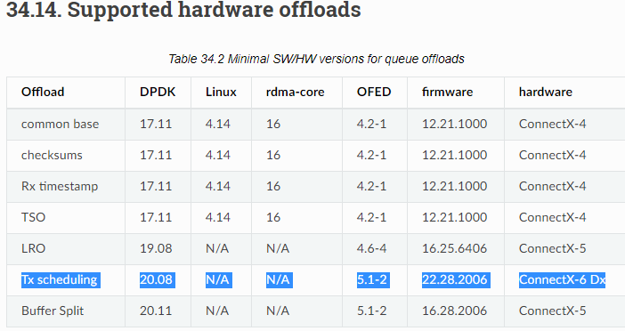
TDMA on CX-6
NICs all setup (thanks Alex F.)
Got PTP working
< 100ns drift
TX Scheduling feature
Allows sending packets at PTP timestamps
Enabled it in the firmware
Figuring out how to set timestamps…

Slide 3

TDMA on CX-6
Simple example:
TDMA with 2 queues
Sched

Slide 4
TDMA on CX-6
Scheduling in Software
Host-to-host PTP
Other inefficiencies?
DPDK
Sched
NIC

Slide 5
TDMA on CX-6
Scheduling in NIC
Proper TDMA scheduling in NIC would be ideal
Like Corundum
But CX-6 does not have that…
DPDK
NIC
Sched

Slide 6
TDMA on CX-6
Using TX scheduling feature…
Assuming:
round robin in the NIC
NIC blocks each queue on timestamp of the first packet
Q1: t, 3t, 5t, …
Q2: 2t, 4t, 6t, …
Thoughts?
DPDK
NIC
RR

