Slide 1
Status
Research Exam
Started writing
TDMA on CX-6
One-way latency numbers

Slide 2
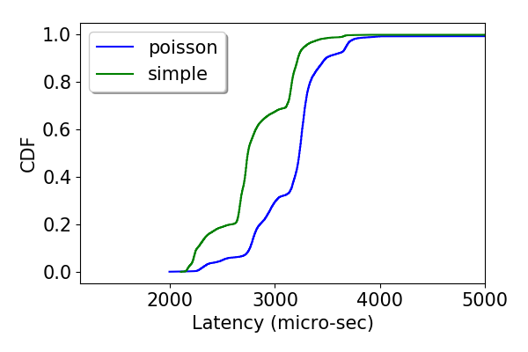
CX-6 Oneway latencies
Setup
Get (cached) NIC timestamp and add it to the packet (software)
Get h/w tstamp on the RX side
Showing the diff

Slide 3
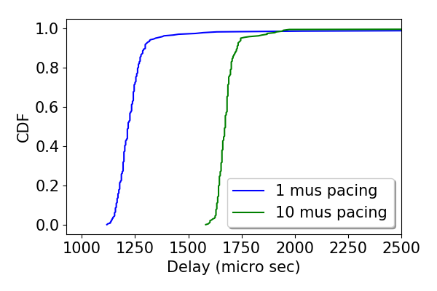
CX-6 Oneway latencies
Setup
Get (cached) NIC timestamp and add it to the packet (software)
Add incremental delta to schedule it in future (on the NIC)
Get h/w tstamp on the RX side
Showing the diff (minus delta)

Slide 4
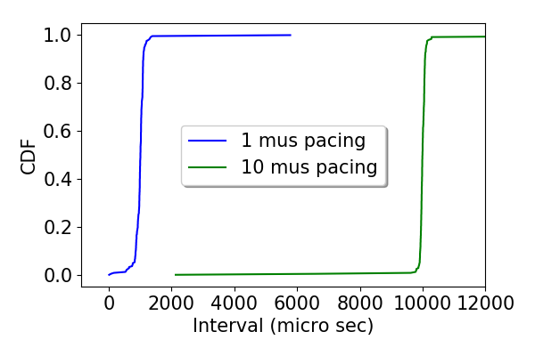
CX-6 Oneway latencies
Setup
Get (cached) NIC timestamp and add it to the packet (software)
Add incremental delta to schedule it in future (on the NIC)
Get h/w tstamp on the RX side
Showing the diff (minus delta)

