Slide 1



Free Performance Testing Evaluation Research Plan
Web Performance Optimization (WPO)

Slide 2
Objective of Project
Offer free performance evaluation/ inexpensive services to identify some problems with web sites for performance improvement so we can attract many clients.
Research and evaluate what free available tools out there which can provide some analysis and reports very quickly and help the client to improve performance and provide some reports which we can customize from their site.
Generate many leads and potential demand and close Performance Test projects deal with real performance testing using JMeter/LoadRunner.

Slide 3
What is WPO?
WPO means Web Performance Optimization.
It is more focused on client side.
It is all about how we can improve user experience.
Here in the HTML page we observe about - Rendering, Compression, Latency, Delivery and Timing.

Slide 4
Benefits of Web Performance Optimization
Web Performance Optimization is crucial for application success.
Web Performance Optimization is not done for Metrics, It’s about the user.
It helps to improve user experience and user conversion.
It helps in search rankings.

Slide 5

Tools Researched/Evaluated
WEBPAGETEST - https://www.webpagetest.org/
Pingdom- https://tools.pingdom.com/
GTmetrix- https://gtmetrix.com/
Chrome Dev Tools – Audits – powered by Lighthouse

Slide 6
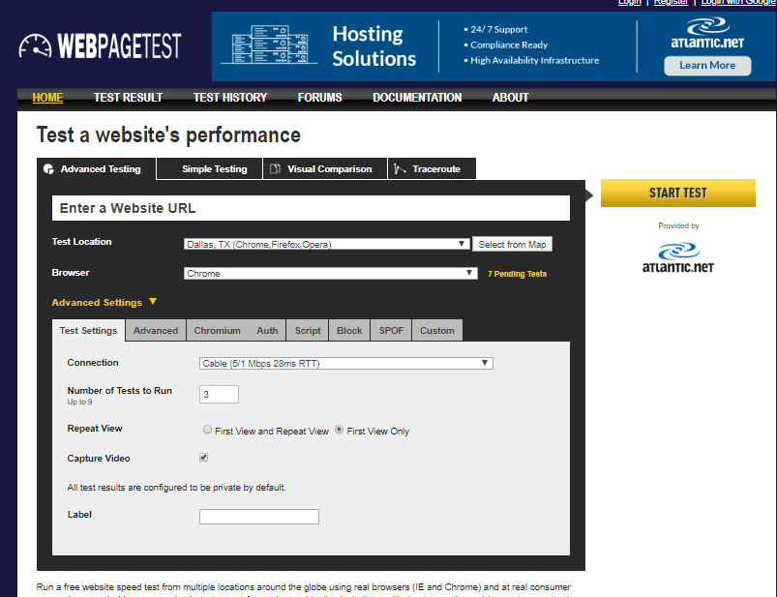
WEBPAGETEST https://www.webpagetest.org/

Slide 7
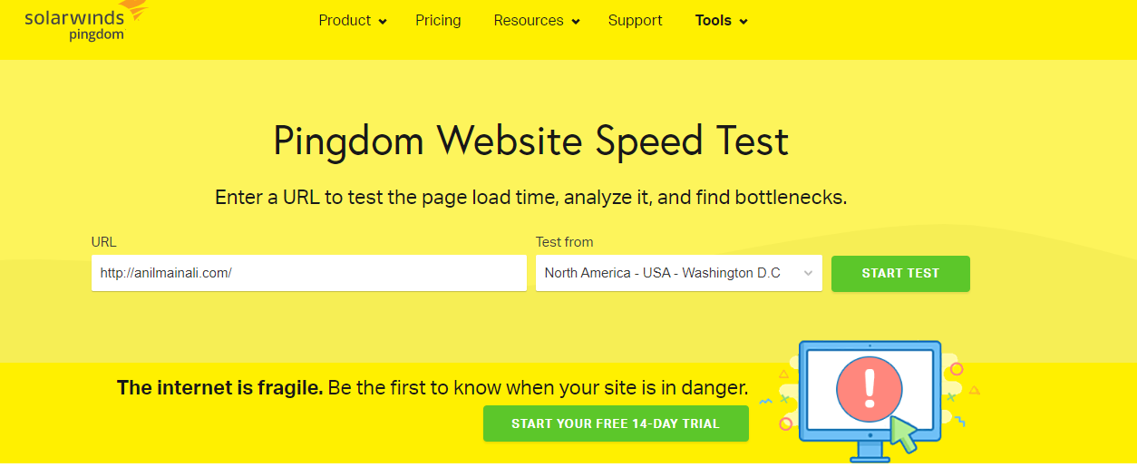
Pingdom https://tools.pingdom.com/

Slide 8
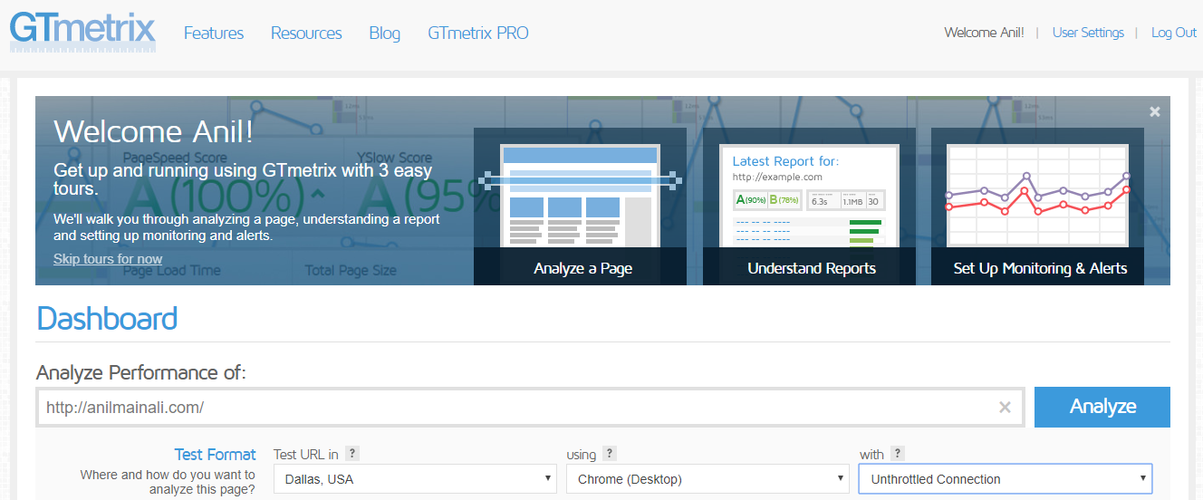
Gtmetrix https://gtmetrix.com/

Slide 9
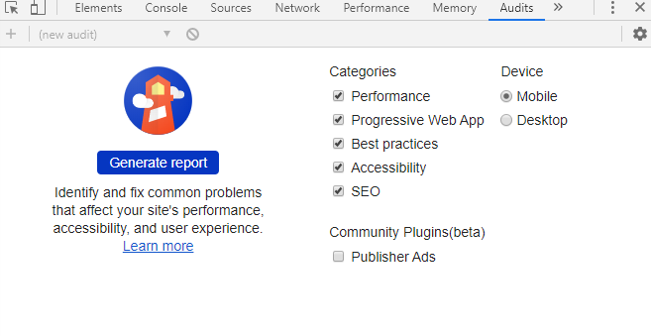
Chrome Dev Tools – Audits – powered by Lighthouse

Slide 10
Requirement Gathering
Client-side tests should happen for individual pages. We need individual pages URLs to be tested.
Where and how does the client want to analyze the page? Need the location of the server.
Which browser to test.
Some advanced settings information like HTTP Authentication information.
Connection Speed that client wants to use.
Information about if the client wants to test on mobile or desktop both.

Slide 11
Important Counters to Consider
Browser Centric Metrics
User Centric Metrics

Slide 12
Browser Centric Metrics
Time to First Byte
First Paint
Visually Complete
Page Load Time

Slide 13
User Centric Metrics
Speed Index
First Contentful Paint
First Meaningful Paint
Time to Interactive
Largest Contentful Paint
Custom Metrics

Slide 14
Some tips/ recommendations to speed up the website.
Use
Use a CDN for static content
Implement
Implement GZIP Compression
Switch
Switch your website to better host
Optimize
Optimize the size of images.
Number
Number of plugins should be minimized.
Use
Use caching and make static content expire late in future
Reduce
Reduce redirects
Implement
Implement HTTP/2(and HTTPS)
Minimize
Minimize the number of JavaScript and CSS files

Slide 15

Sample Reports
Some sample reports that are taken from different web optimization tool to show to the clients and help them to improve performance.

Slide 16
WEBPAGETEST Sample Reports

Slide 17
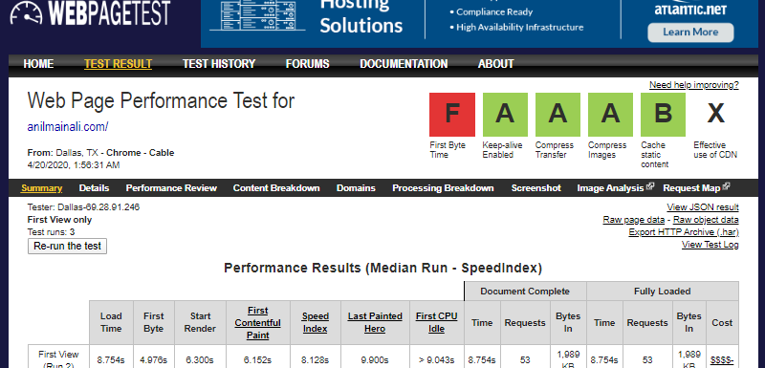

Slide 18
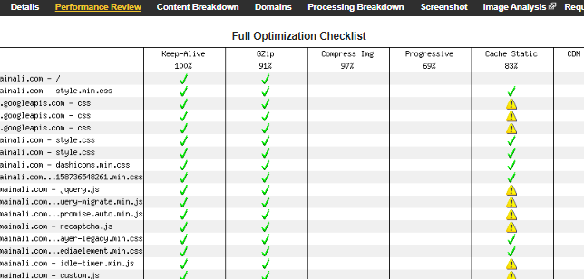

Slide 19
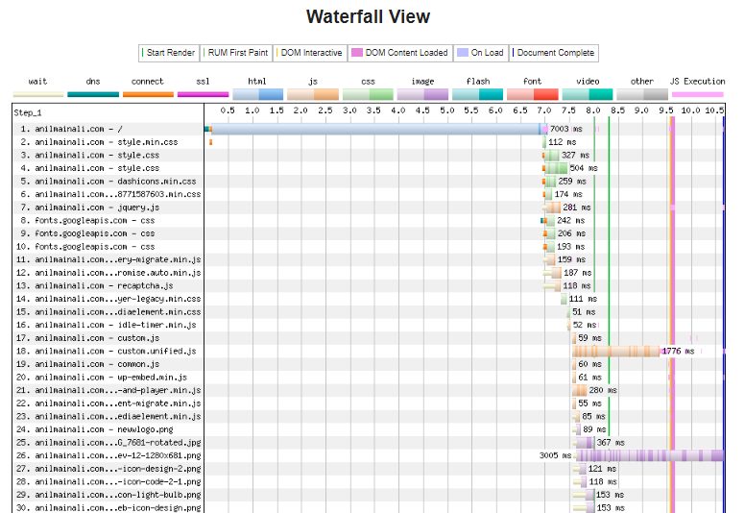

Slide 20
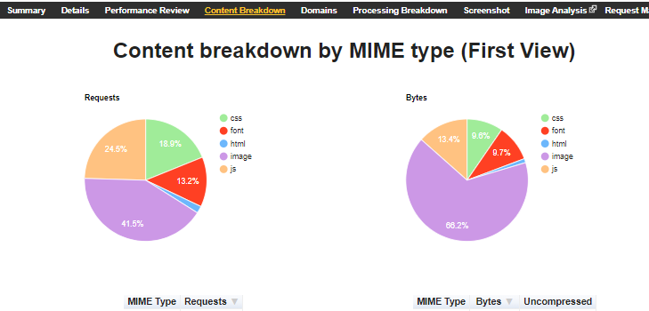

Slide 21
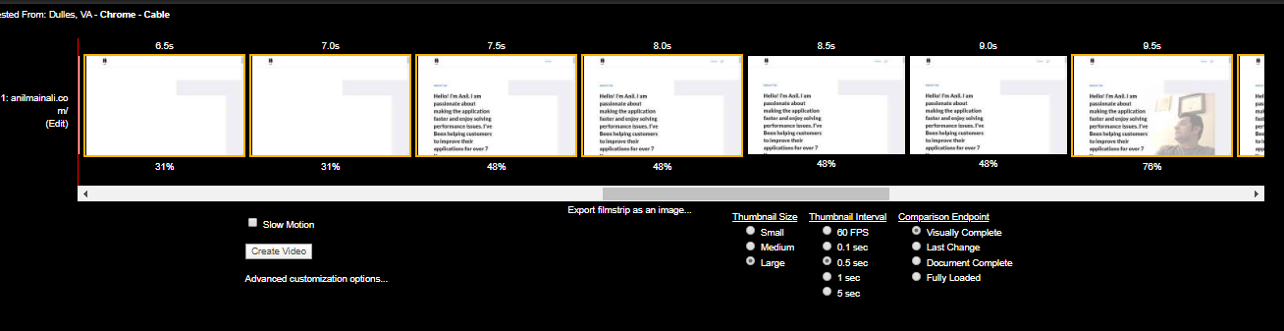
Filmstrip view

Slide 22

Video Feature

Slide 23
Pingdom Sample Reports

Slide 24
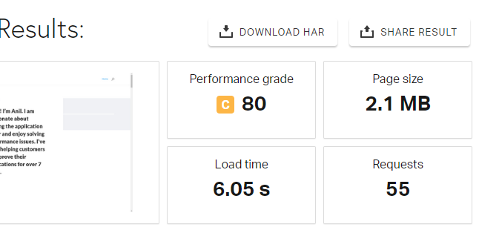

Slide 25
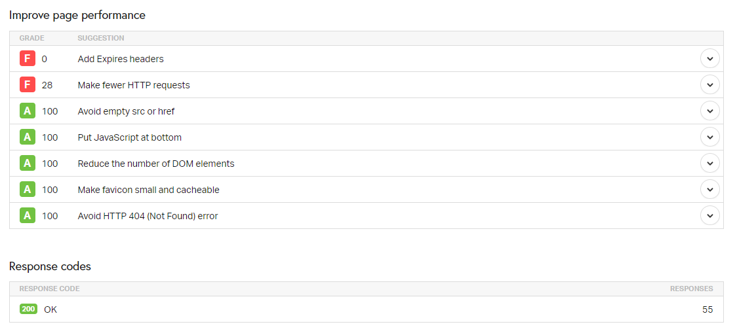

Slide 26
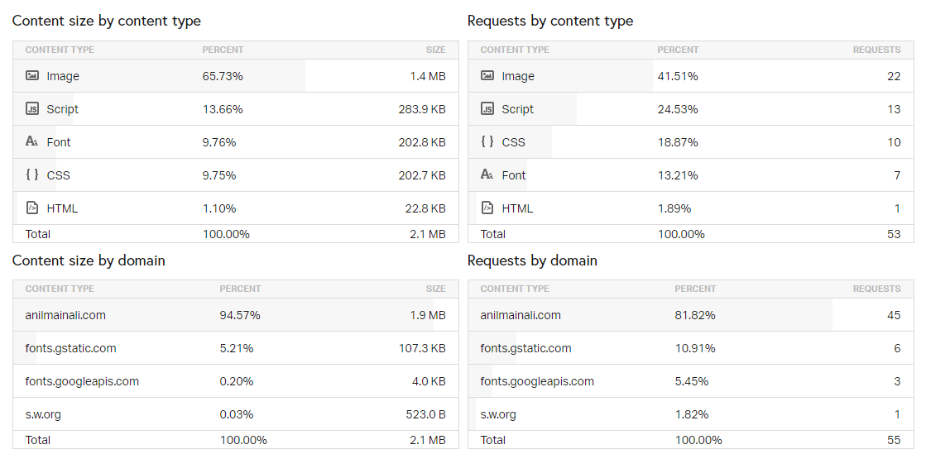

Slide 27
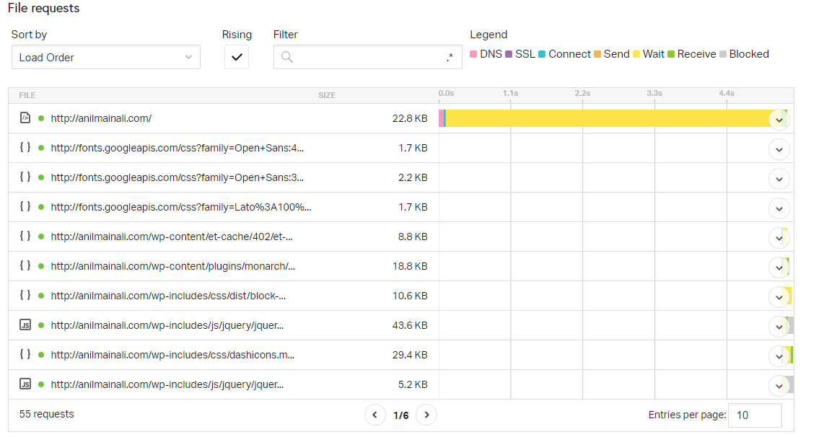

Slide 28
GTmetrix Sample Reports

Slide 29
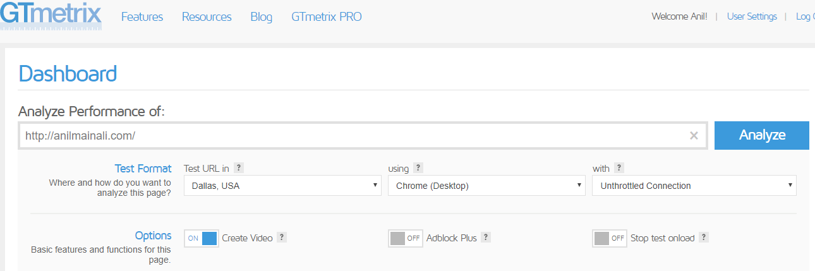

Slide 30
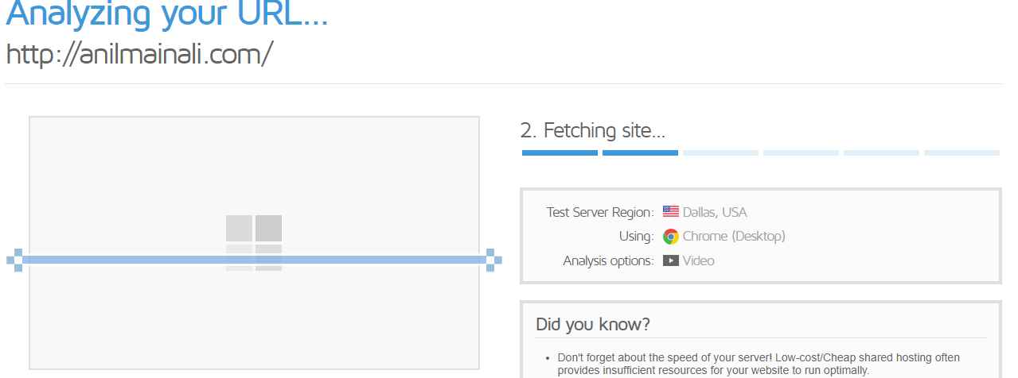

Slide 31
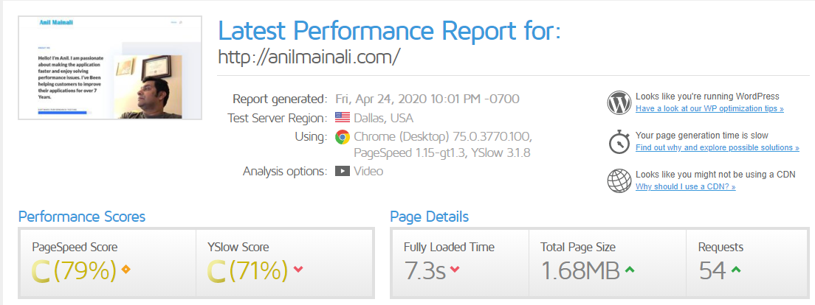

Slide 32
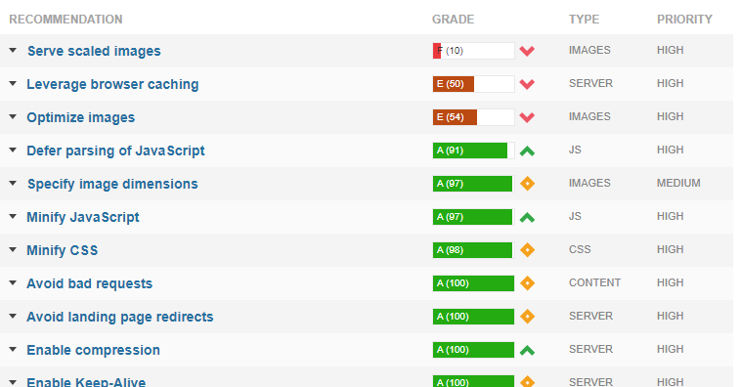

Slide 33
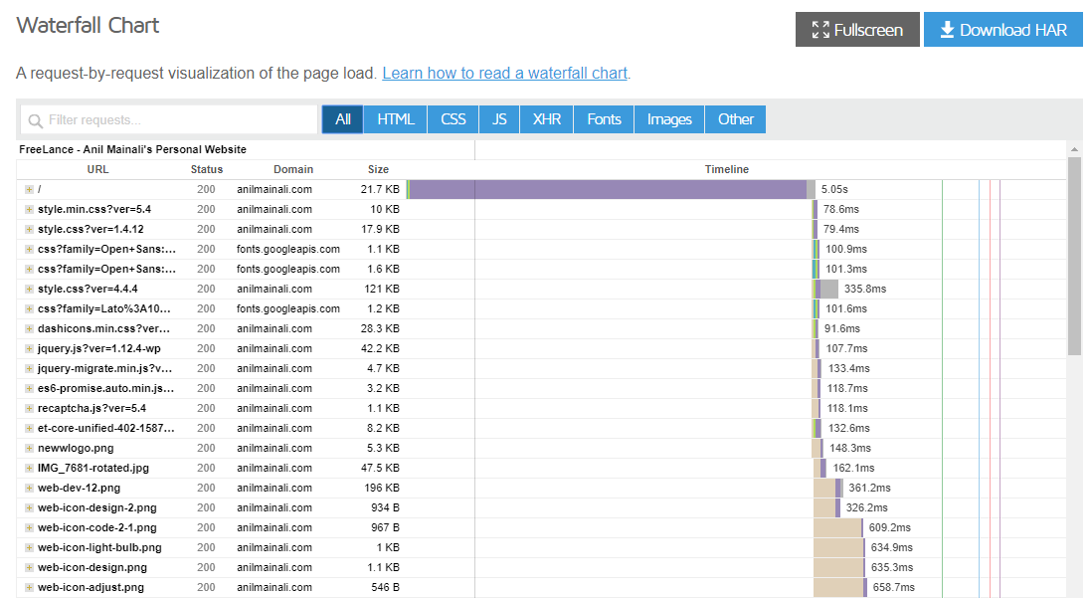

Slide 34
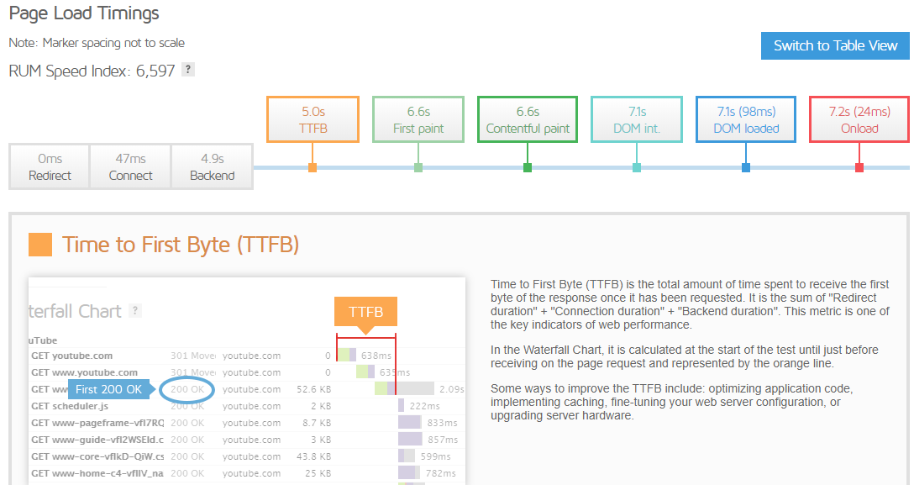

Slide 35
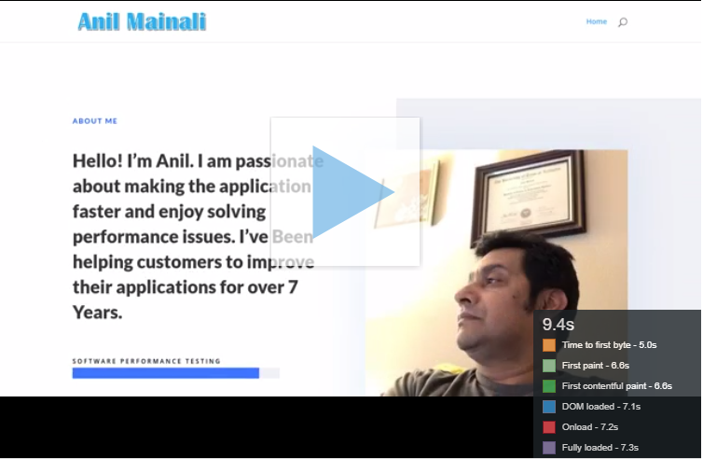
Video

Slide 36

Video Feature

Slide 37
Chrome Dev Tools Sample Reports

Slide 38
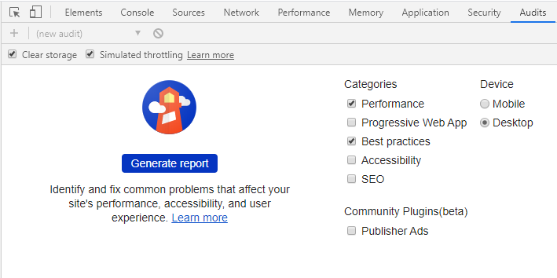

Slide 39
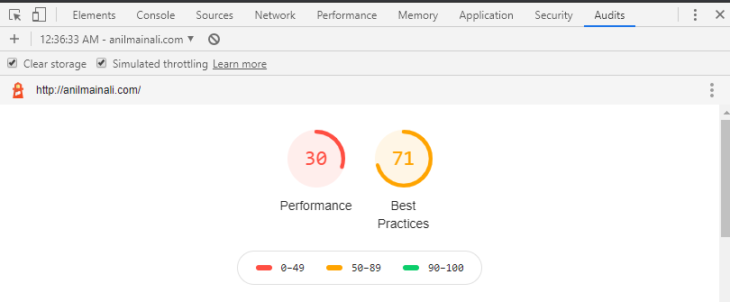

Slide 40
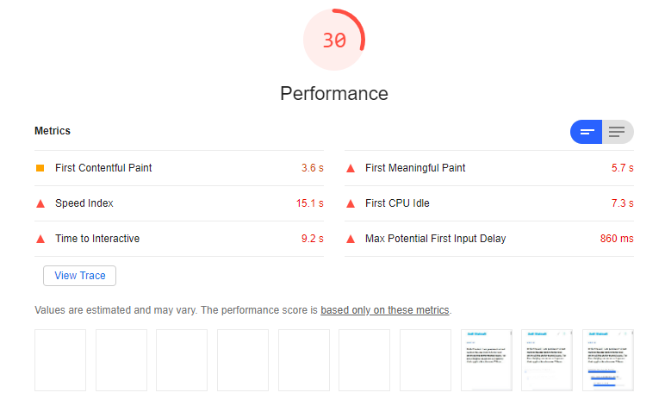

Slide 41
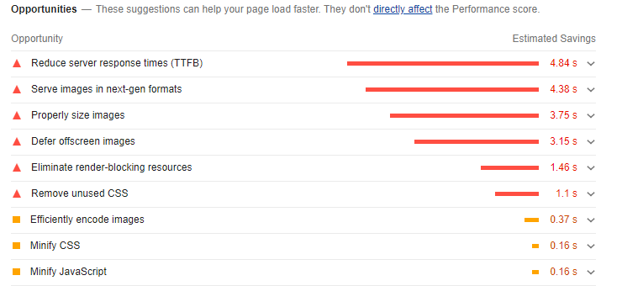

Slide 42
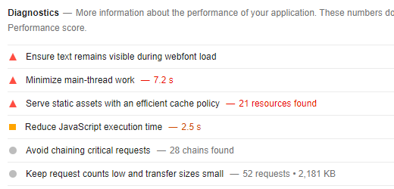

Slide 43
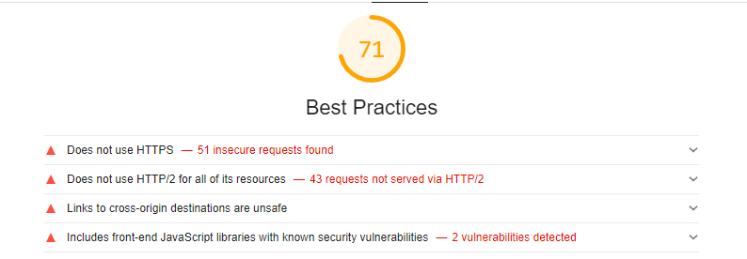

Slide 44

Solutions to our Main Objectives

Slide 45
How can we offer free performance evaluation/ inexpensive services to identify some problems with web sites for performance improvement so we can attract many clients?

Slide 46

We can achieve this by
Taking advantage of different free opensource web optimization tools like WebPageTest, Pingdom, GTmetrix, and Chrome Dev Tools.
Gathering requirements.
Running the single page test.
Observing the navigation complete round-trip timing from browser to server and server back to the browser.
Observing the critical browser and client-side metrics.
Analyzing the time it takes to digest the HTML information fully and shows the content to users on to the browser.
Analyzing and making sense of the default results of the test and making a recommendation to the clients.

Slide 47
Research and evaluate what free available tools out there which can provide some analysis and reports very quickly and help the client to improve performance and provide some reports which we can customize from their site.

Slide 48
Few free available tools which can provide some analysis and reports very quickly and help the client to improve performance and give some reports which we can customize from their site are:
WEBPAGESPEED
Pingdom
GTmetrix
Chrome Dev Tool

Slide 49
How can we generate many leads and potential demand and close Performance Test projects deal with real performance testing using JMeter? we generate many leads and potential demand and close Performance Test projects deal with real performance testing using JMeter/LoadRunner?

Slide 50

After performing the Web Page Optimization test and providing the feedback and recommendation to the client, we can suggest them to fix the issues and come back to us for end to end performance testing engagements.

Slide 51

Final Thoughts

Slide 52
Final Thoughts
To sum up, by doing client-side performance tests, we can provide lots of valuable insights and help clients to understand and improve the user experience.
However, only doing Client-Side performance testing is not enough. Along with the WPO test, we need to request a couple of scenarios and do scripting using JMeter/ LoadRunner and run a few tests with minimum users and provide the test results as well.
This approach will help the client to understand the application performance from both Client and Server Side. It will help us to close the Performance engagement deal with the client after a free evaluation process.

Slide 53

Thank You!

