Slide 1
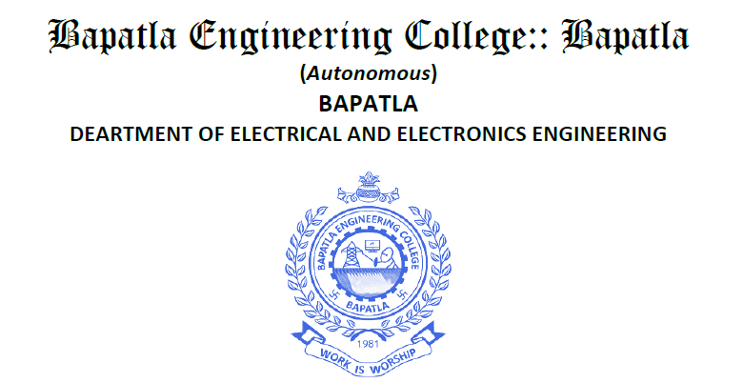
Presented By
Mr.G.ANILKUMAR,M.Tech,(PhD)
Asst Professor
BEC BAPATLA

Slide 2
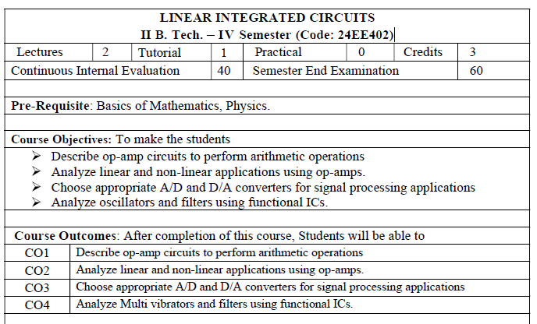
https://www.electronics-tutorials.ws/opamp/opamp
https://www.tutorialspoint.com/linear_integrated_circuits_applications

Slide 3
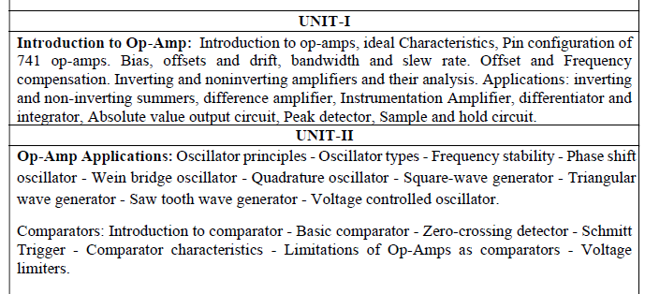

Slide 4
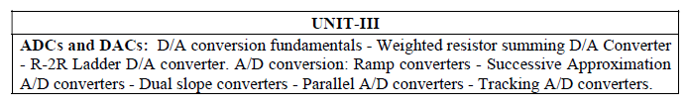
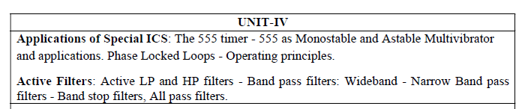
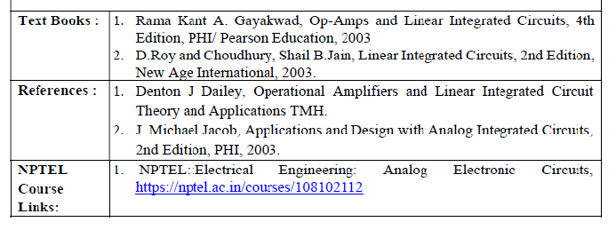

Slide 5

Why you study this subject

Slide 6
Jobs based on linear integrated circuits (LICs) are primarily in analog and mixed-signal circuit design, hardware engineering, and product validation within the semiconductor, telecommunications, and power management industries.

Slide 7


Slide 8
Key job roles include:
Analog/Mixed-Signal IC Design Engineer: Designing the internal circuitry of integrated circuits that handle analog signals, such as amplifiers, filters, and data converters (ADCs/DACs).
Hardware Design Engineer: Focusing on the design, development, and testing of printed circuit boards (PCBs) and electronic systems that incorporate LICs and other components.
Layout Engineer: Translating the schematic designs of analog and mixed-signal circuits into physical layouts for manufacturing on a silicon chip.
Application Engineer / Field Application Engineer (FAE): Providing technical support to customers, developing reference designs, and assisting with the integration of LICs into various products.

Slide 9
Product/Test Engineer: Developing test plans and procedures for evaluating the performance and reliability of LICs during manufacturing and characterization phases.
Signal Integrity/Power Integrity Engineer: Ensuring the quality of signals and power distribution within complex systems, which often heavily rely on the performance of linear components.
Power Electronics Engineer: Designing and analyzing power management circuits, voltage regulators, and converters that utilize linear ICs for efficient power delivery and control.

Slide 10
Industries and Companies
Professionals with expertise in linear integrated circuits are in demand across various sectors, including:
Semiconductor Foundries and Design Houses: Major employers include companies like Texas Instruments, Analog Devices, Qualcomm, MaxLinear, AMD, and Microchip Technology.
Consumer Electronics: Designing audio equipment, smartphones, and other devices.
Aerospace and Defense: Developing robust and reliable electronic systems for critical applications.
Automotive: Designing control units and power management systems for electric and smart vehicles.
Medical Equipment: Creating instrumentation and signal processing devices for healthcare technology.

Slide 11
Key Companies Hiring in India
Major international semiconductor companies have established significant design centers in India and are consistently hiring engineers with expertise in analog and linear circuits.
Texas Instruments: A very prominent recruiter for analog and mixed-signal design engineers in Bengaluru.
Analog Devices (ADI): Actively hires for staff and senior analog design roles in Bengaluru.
Qualcomm: Offers various roles in physical design, ASIC/RTL design, and analog layout engineering across Bengaluru and Hyderabad.
AMD: Recruits analog design engineers, particularly for high-speed memory/IO circuits, in Bengaluru.

Slide 12
NVIDIA: Hires for ASIC design and mask design roles with a focus on cutting-edge process nodes.
Synopsys: Frequently hires staff analog design engineers, with opportunities in Bengaluru and Hyderabad.
Intel (Altera): Has openings for analog layout design engineers.
MaxLinear: Actively recruits principal and staff analog/mixed-signal/RF IC design engineers in Bengaluru.
Renesas Electronics: Offers roles in analog and digital design engineering in Bengaluru and Hyderabad.
Other notable companies: Capgemini Engineering, Wipro, Tessolve, Ceremorphic, and SignalChip also have relevant job openings.

Slide 13
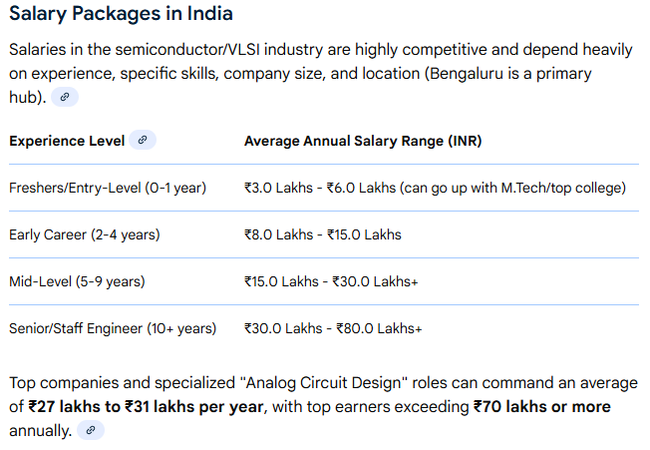

Slide 14
Linear Integrated Circuits (LICs) are analog ICs that process continuous signals, where output is proportional to input, unlike digital ICs' discrete states (high/low).
They perform functions like amplification, filtering, and voltage regulation, using components like op-amps and regulators in devices from audio systems to power supplies, offering high accuracy and reliability by integrating many components onto a single chip.

Slide 15
Key Characteristics
Analog Nature:
They work with continuously varying signals (voltage/current), having infinite possible states.
Linear Relationship:
Output is a direct, proportional function of the input signal, following Ohm's Law.
Applications:
Signal conditioning, audio amplification, power supply regulation, sensor interfaces, and instrumentation.
Examples:
Operational Amplifiers (Op-Amps like the 741), Voltage Regulators, Analog Multipliers.

Slide 16
How They Work (e.g., Op-Amp)
Integration: Combine many transistors, resistors, and capacitors onto one silicon chip.
Functions: Amplify small signals, compare voltages, or perform mathematical operations.
Benefits: Miniaturization, lower cost, improved reliability (fewer external connections), and better performance than discrete circuits.

Slide 17
Comparison with Digital Ics
Linear ICs:
Continuous signals, proportional outputs, analog processing (e.g., sound waves).
Digital ICs:
Discrete states (0s & 1s), Boolean logic, digital processing (e.g., computers).

Slide 18
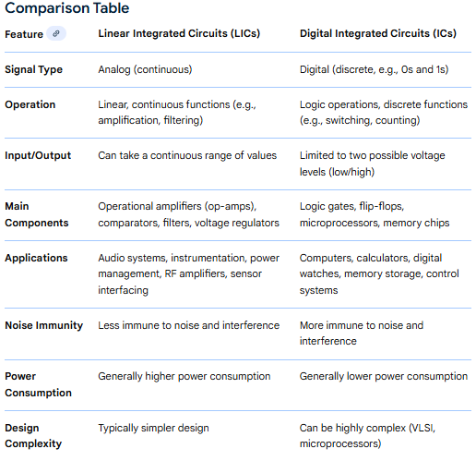

Slide 19
Advantages of Linear Integrated Circuits
Linear integrated circuits have several advantages and limitations. Some of the key advantages of linear ICs are highlighted in the following list −
Linear ICs have compact size.
Linear ICs are affordable for a wide range of applications.
Linear integrated circuits are highly reliable due to mature technology.
Linear integrated circuits provide consistent electrical performance.
Modern linear ICs consume very less amount of power.
Linear ICs reduce circuit design complexity in electronic circuits.
Linear ICs offer high gain.
Linear ICs are highly versatile.

Slide 20
Disadvantages of Linear Integrated Circuits
Some of the key disadvantages of linear ICs are highlighted in the following list −
Linear ICs can handle limited amount of power due to thermal constraints.
Linear ICs are more sensitive to noise and interference.
Linear ICs generate more heat and hence require additional cooling mechanism.
Most linear ICs have a fixed functionality and cannot be customized for different applications.
At very high frequencies, linear ICs show poor performance.
The performance of linear ICs varies with temperature.
Some linear ICs are inefficient in handling large voltage drops.
Linear IC designing becomes challenging for high-performance applications.

Slide 21
Applications of Linear ICs
Linear integrated circuits are widely used in a number of applications due to their ability to amplify, filter, and regulate analog signals with high accuracy and precision. Some of the common applications of linear integrated circuits are given here −
Linear ICs are used for amplification of audio signals and hence they are widely employed in devices like amplifiers, mixers, and equalizers.
Linear ICs are also used as a driver circuit for speakers and headphones, having high-fidelity.
Linear integrated circuits are used for amplifying and filtering signals received from sensors in a system, which is referred to as sensor signals conditioning.
Linear ICs are also used for converting analog signals into digital signals for processing using microprocessors or microcontrollers.
Linear ICs are employed in power supplies to produce a constant output voltage.
Battery chargers also make the use of linear ICs to regulate the voltages and currents.
Linear ICs are also found in DC-DC converter circuits used in various electronic systems.
Linear ICs are also integral parts of waveform and signal generators.

Slide 22
What You Will Learn in Linear ICs and Applications?
The following table lists all the topics with a basic description covered in this list on linear integrated circuits applications −
Basics of Integrated Circuits Applications − This chapter provides a brief overview of integrated circuits, their advantages, and types.
Basics of Operational Amplifier − In this chapter, you will learn about construction, characteristics, and different types of operational amplifiers (Op-Amps).
Op-Amp Applications − This chapter provides a detailed explanation on applications of operational amplifiers.
Arithmetic Circuits − This chapter discusses about two most common arithmetic circuits namely, adder and subtractor, and their working.
Differentiator & Integrator − In this section, you will explore the construction and working of differentiator and integrator.
Converters of Electrical Quantities − This chapter describes two most common electrical quantity converters namely, voltage to current converter and current to voltage converter.
Comparators − In this section, you will understand the construction and working of different types of comparators.

Slide 23
Log & Anti-Log Amplifiers − This chapter provides a description on construction and working of log and anti-log amplifiers.
Rectifiers − In this chapter, you will learn about rectifiers, their types and construction.
Clippers − This chapter gives an overview of op-amp based clipper circuits.
Clampers − This section describes op-amp based clamper circuits.
Active Filters − In this section, you will learn about different types of active filters used in electronic circuits.
Sinusoidal Oscillators − This chapter explains the construction and working of sinusoidal oscillators.
Waveform Generators − This chapter discusses about two important types of waveform generators, viz. square wave generator and triangular wave generator.
555 Timer − This chapter is meant for explaining the pin and functional diagrams of 555 time IC.
Phase-Locked Loop IC − In this section, you will find a detailed discussion on construction and working of phase-locked loop IC and its working.

Slide 24
Voltage Regulators − This chapter explains different types of voltage regulators used in electronic systems.
Data Converters − This chapter provides an overview of types of data converters and their specifications.
Digital-to-Analog Converters − This chapter is meant for explaining the working of different types of digital-to-analog converters.
Direct Type ADCs − In this chapter, you will find a detailed discussion on direct type analog-to-digital converter and its different types.
Indirect Type ADC − This chapter explains indirect type analog-to-digital converters.

Slide 25
An operational amplifier (op-amp) is a high-gain, direct-coupled voltage amplifier with differential inputs and a single-ended output. Originally developed for analog computers to perform mathematical operations, they are now a core building block in modern analog electronics, used for applications like amplification, filtering, and signal conditioning. Key characteristics include a very high input impedance and a very high gain, though the actual gain in a circuit is set by external feedback components.
What is an Ideal OP Amp?
An operational amplifier (OP Amp) is defined as a direct current coupled voltage amplifier that increases the input voltage passing through it. Ideally, an OP Amp should have high input resistance, low output resistance, and very high open loop gain. In an ideal OP Amp, the input resistance and open loop gain are infinite, while the output resistance is zero.

Slide 26
What an op-amp is
A high-gain amplifier: It significantly amplifies the difference between its two inputs.
Differential inputs: It has two inputs, a non-inverting input (+positive)
and an inverting input (−negative).
A signal applied to the non-inverting input appears in phase with the output.
A signal applied to the inverting input appears 180° out of phase with the output.
Single-ended output: It has a single output terminal that is a voltage.
Feedback-controlled gain: The high intrinsic gain is a starting point; the actual gain of the circuit is determined by external components, like resistors, that are connected to the op-amp through feedback.

Slide 27
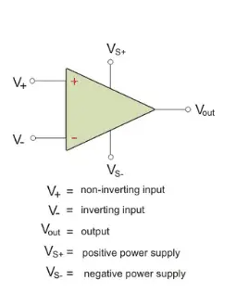
An ideal op-amp has infinite open-loop gain, infinite input impedance, zero output impedance, infinite bandwidth, zero input offset voltage, zero noise, and infinite common-mode rejection ratio, allowing it to perfectly amplify signals without loading the source, provide unlimited output power, operate across all frequencies, and produce zero output for zero input, making circuit analysis simple.

Slide 28
Here are the key ideal characteristics in detail:
Infinite Open-Loop Gain (𝐴𝑣)
Can produce any output voltage from a tiny input voltage difference, essentially requiring inputs to be identical (virtual short).
Infinite Input Impedance (𝑍𝑖𝑛)
: Draws zero current from the input source, preventing loading of the preceding stage.
Zero Output Impedance (𝑍𝑜𝑢𝑡)
Can deliver maximum power to any load without voltage drop, acting as a perfect voltage source.
Infinite Bandwidth: Amplifies signals from DC to infinite frequencies without attenuation or phase shift.

Slide 29
Zero Input Offset Voltage: Output is exactly zero when both input terminals are at the same potential (zero differential input).
Zero Noise: Does not add any unwanted noise to the amplified signal.
Infinite Common-Mode Rejection Ratio (CMRR): Perfectly rejects any signal common to both inputs, amplifying only the difference.
Infinite Slew Rate: Output voltage changes instantaneously with input changes.

Slide 30
Op-amp IC 741
A very popular IC version of op-amp is μA741. The manufacturer of pA741 is Fairchild Semiconductor.
Number of other manufacturers also produced 741 op-amp IC version namely MC1741 by Motorola, LM741 by National Semiconductor etc. For convenience, this widely used op-amp IC is called simply IC 741 op-amp dropping the prefixes.
Pin Diagram :
The IC 741 is 8 pin IC available in dual in line package (DIP). The pin diagram of IC 741 op-amp is shown in the Fig.1.

Slide 31
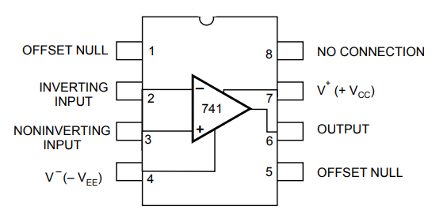
Fig:1 pin diagram of IC 741 op-amp
The pins 1 and 5 are offset null pins. These are used to nullify offset voltages and provide offset voltage compensation.

Slide 32
The pin 2 is inverting input while pin 3 is non inverting input terminal.
The output is to be taken from pin 6.
The pin 4 is for - V_{EE} supply while pin 7 is for + V_{CC} supply.
The pin 8 is the dummy pin and no connection are to be made to this pin externally.
Ideal Vs Practical Characteristics of 1C 741 Op-amp :
The Table 2.19.1 lists the ideal op-amp characteristics and the typical values of these characteristics for 741 IC.

Slide 33
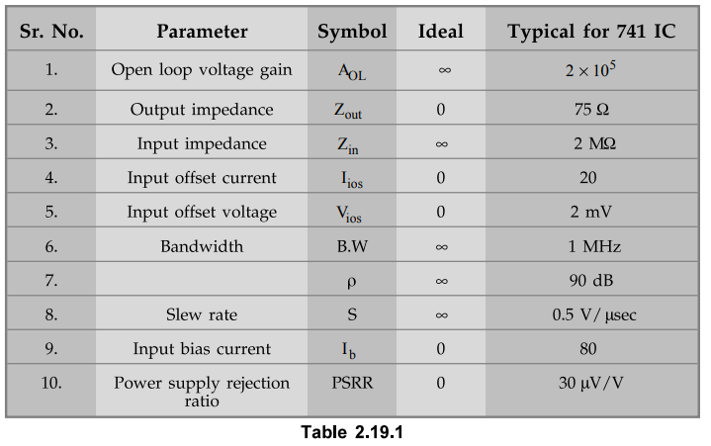

Slide 34
Features of IC 741 :
i) No frequency compensation required.
ii) Short circuit protection provided.
iii) Offset voltage null capability.
iv) Large common mode and differential voltage range.
v) No latch up.

Slide 35
What is Virtual Ground ?
As the name indicates it is virtual, not real ground. For some purposes we can consider it as equivalent to ground. In opamps the term virtual ground means that the voltage at that particular node is almost equal to ground voltage (0V). It is not physically connected to ground. This concept is very useful in analysis of opamp circuits and it will make a lot of calculations very simple.
Virtual Ground – Opamp
Lets see how the virtual ground concept is employed in inverting amplifier.

Slide 36
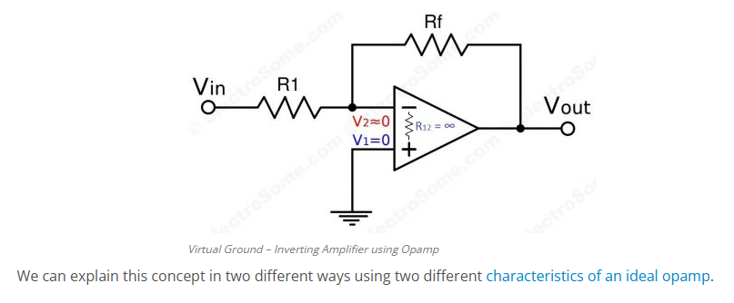
Using Infinite Voltage Gain
We already know that an ideal opamp will provide infinite voltage gain. For real opamps also the gain will be very high such that we can consider it as infinite for calculation purposes.

Slide 37
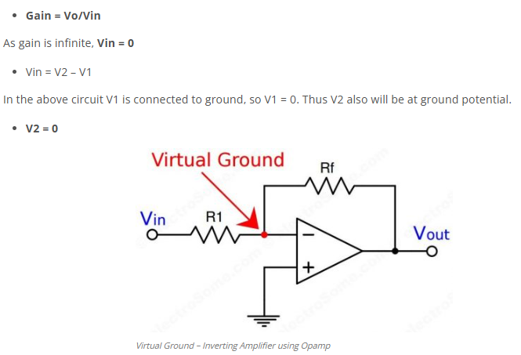

Slide 38
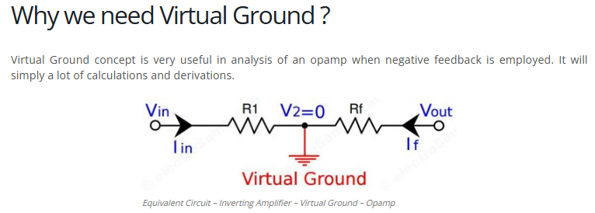

Slide 39
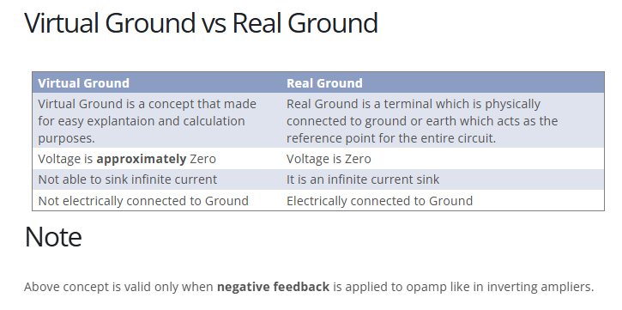

Slide 40
Thank you

