Slide 1

Bluestock Mutual Fund Analytics Capstone Project
Final Project Presentation
Prepared By: Anil Pachar

Slide 2

Problem Statement & Objectives
• Analyze mutual fund industry trends and fund performance
• Understand investor behavior and SIP patterns
• Build a complete ETL and analytics pipeline
• Develop advanced risk analytics
• Create an interactive Power BI dashboard
• Build a simple fund recommendation engine

Slide 3
Data Sources
• Fund Master Dataset
• NAV History Dataset
• Investor Transactions Dataset
• AUM Dataset
• SIP Inflows Dataset
• Category Inflow Dataset
• Portfolio Holdings Dataset
• Benchmark Indices Dataset

Slide 4
System Architecture
Raw CSV Files
↓
Data Cleaning (Python + Pandas)
↓
Feature Engineering
↓
SQLite Database
↓
EDA & Analytics
↓
Power BI Dashboard
↓
Insights & Recommendations

Slide 5
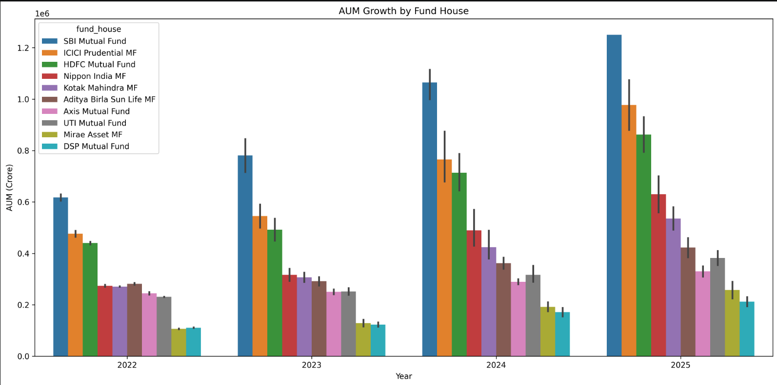
EDA Highlights – Industry Trends
• SBI Mutual Fund maintained highest AUM growth.
• Industry AUM increased consistently from 2022–2025.
• Major AMCs showed strong expansion.

Slide 6
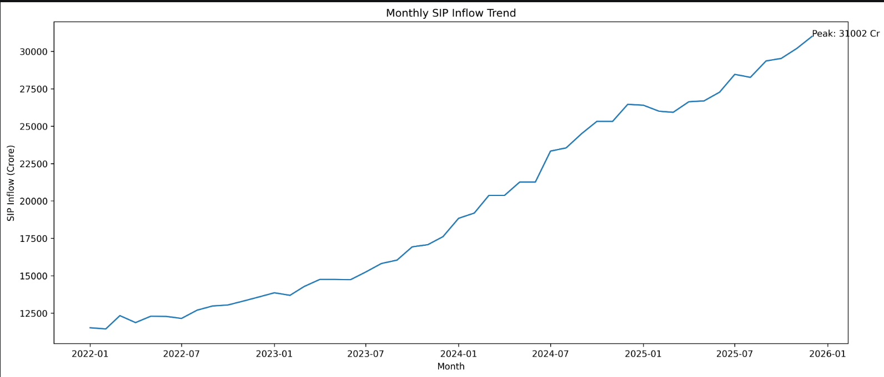
EDA Highlights – SIP Trends
• SIP inflows increased steadily.
• Peak SIP inflow crossed 31,000 Cr.
• Retail participation continues to rise.

Slide 7
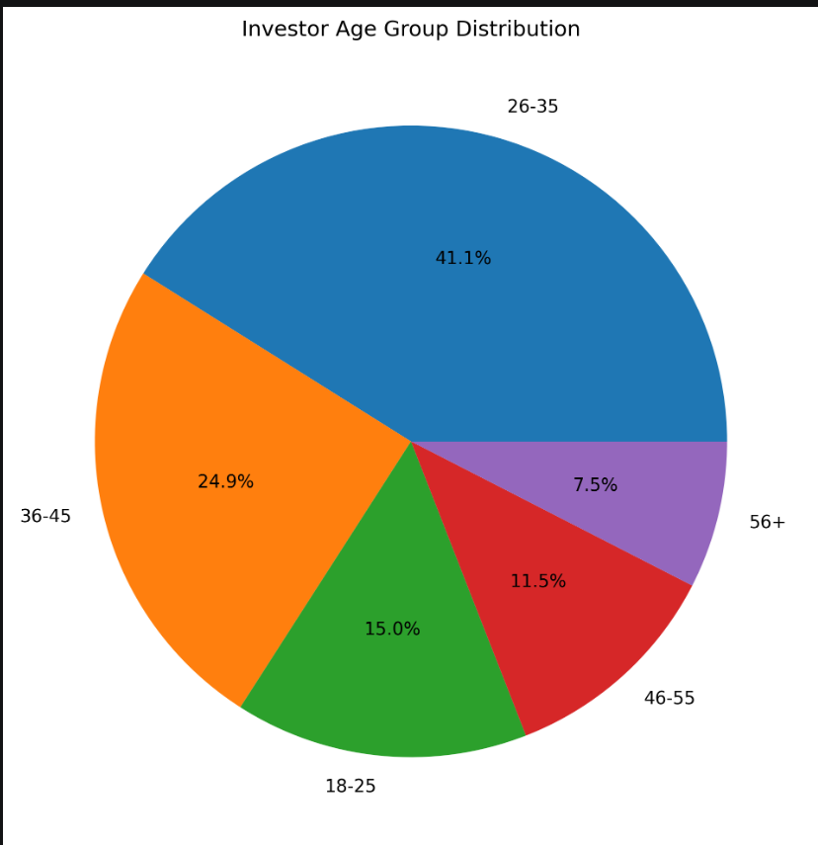
EDA Highlights – Investor Analysis
• 26–35 age group dominates investments.
• Young investors drive SIP growth.
• Strong participation across working professionals.

Slide 8
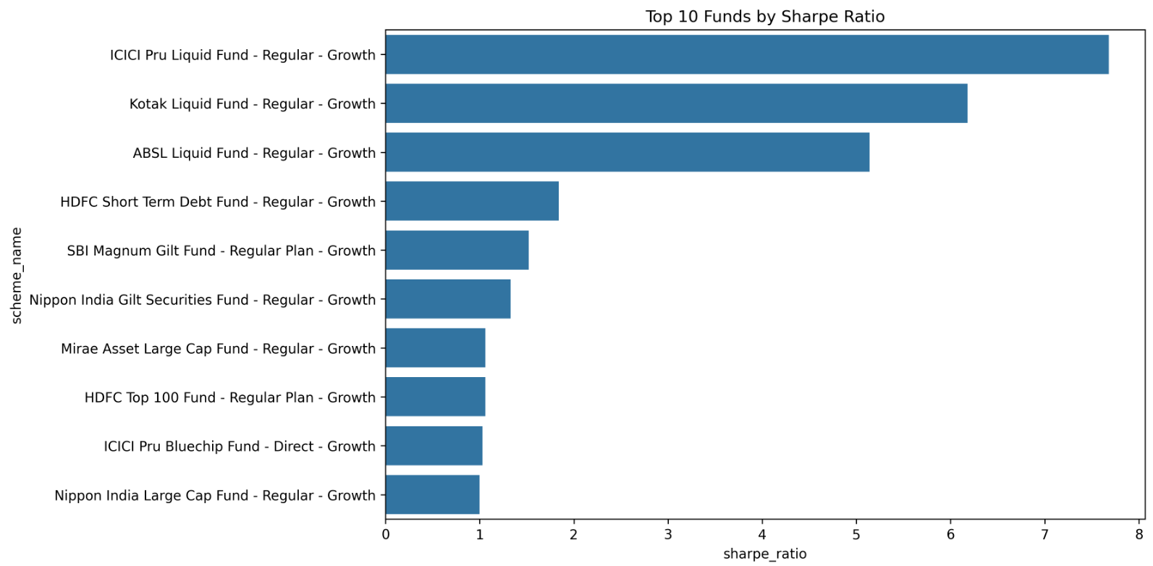
Fund Performance Metrics
• CAGR used for long-term growth measurement
• Sharpe Ratio evaluates risk-adjusted returns
• Sortino Ratio focuses on downside risk
• Alpha and Beta measure benchmark performance
• Maximum Drawdown captures downside exposure

Slide 9
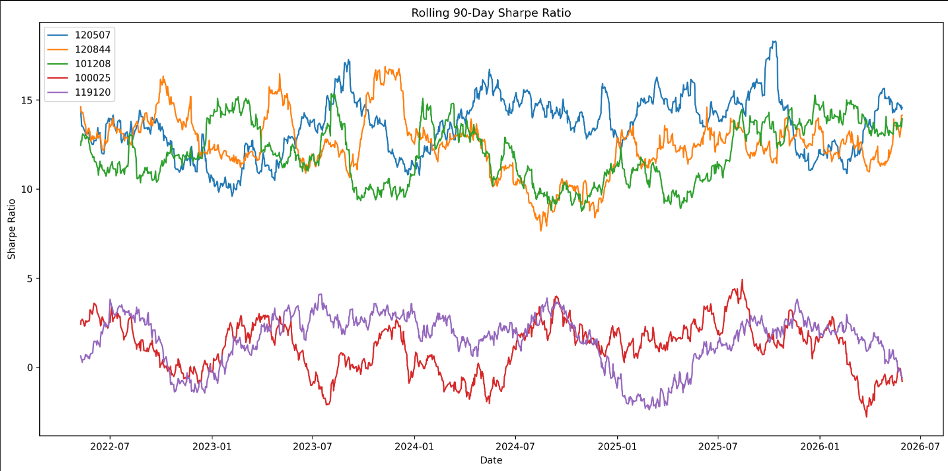
Advanced Risk Analytics
• Historical VaR (95%)
• Conditional VaR (CVaR)
• Rolling 90-Day Sharpe Ratio
• Investor Cohort Analysis
• SIP Continuity Analysis
• HHI Concentration Analysis

Slide 10
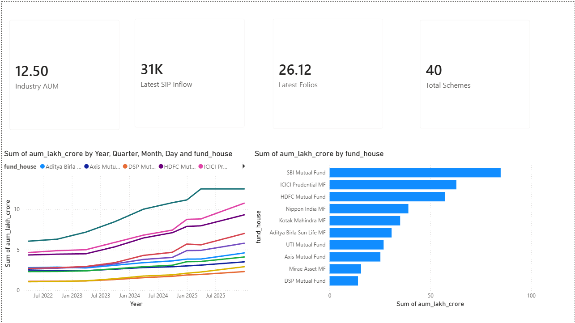
Power BI Dashboard – Industry Overview
• Industry AUM Overview
• SIP Inflow Monitoring
• Fund House Comparison
• Industry Growth Tracking

Slide 11
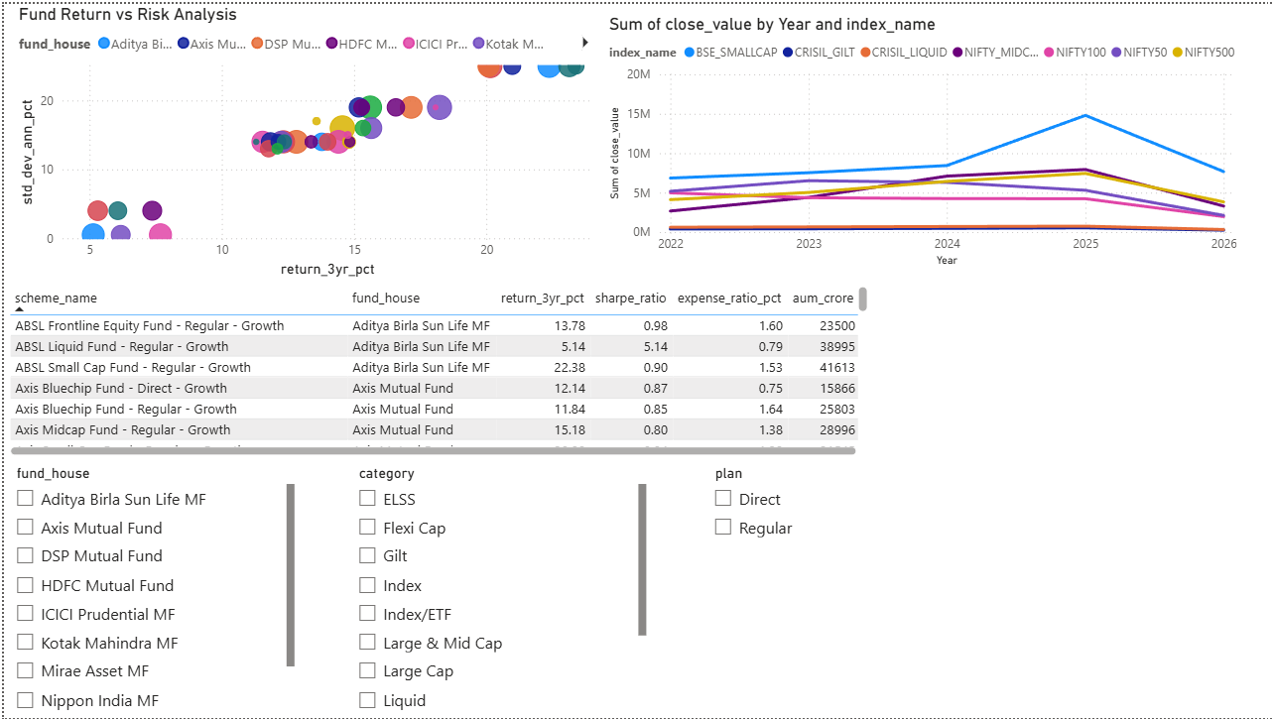
Power BI Dashboard – Fund Performance
• Risk vs Return Analysis
• Benchmark Comparison
• Fund Ranking Metrics
• Category-wise Performance

Slide 12
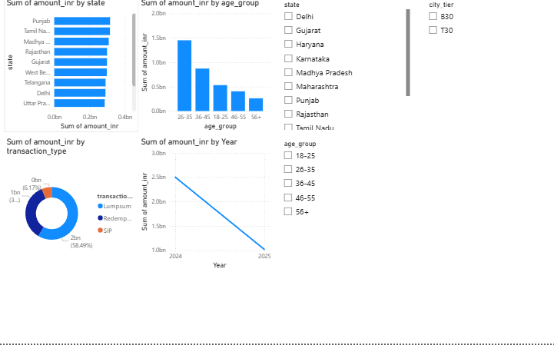
Power BI Dashboard – Investor Analytics
• State-wise Investment Analysis
• Age Group Distribution
• Transaction Type Analysis
• Investor Demographics

Slide 13
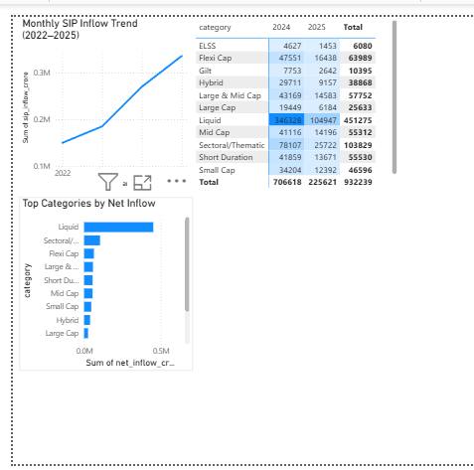
Power BI Dashboard – SIP & Market Trends
• SIP Inflow Trends
• Category Inflow Analysis
• Market Movement Tracking
• Growth Indicators

Slide 14
Thank You
Bluestock Mutual Fund Analytics Capstone Project
Questions & Discussion
Prepared By: Anil Pachar

