Slide 1
RFM model-based customer segmentation & customer churn prediction in Retail sector
Prepared by – Anil Patel (Roll No.55)
PGDM- RBA (2018-20)
Specialization – Operations
Mentored by – Dr. Subodh Deolekar

Slide 2
Introduction
Retail industry accounts for over 10 % of the country’s Gross Domestic Product (GDP) and around 8 % of the employment. India is the world’s fifth-largest global destination in the retail space.
Online retail sales are forecasted to grow at the rate of 31% year-on-year to reach US$ 32.70 billion in 2018. Revenue generated from online retail is projected to grow to US$ 60 billion by 2020.
Customer segmentation is the process of dividing the customer base into different groups based on various customer attributes, with a focus of understanding the customer base.
RFM is a data-driven customer segmentation technique that allows marketers to take tactical decisions. It empowers marketers to quickly identify and segment customers into homogeneous groups and target them with differentiated and personalized marketing strategies. This in turn improves customer engagement and retention.
In the dynamic market environment, churning could be the result of low-level customer satisfaction, aggressive competitive strategies, new products, regulations, etc. Churn models aim to identify early churn signals and recognize customers with an increased likelihood to leave voluntarily.
Several, popular in research community machine learning algorithms have been proposed in order to tackle the churning prediction problem out of which six of them used in this project are - Naive Bayes, Logistic Regression, Support Vector Machine, Decision Tree, Random Forest, Extreme Gradient Boosting.

Slide 3
Objectives
To apply k-means clustering on the online retail store data for RFM based-customer segmentation and analyze these customer groups.
To identify customers which are likely to churn and considering that variable as target variable, and build Customer churn prediction model which can be used in future to identify customers which are likely to churn based on their transactions history.
To compare different classification models and identify best one.
Problem statement
To identify and analyze different group of customers using online retail store data based on RFM values, to find out customers which are likely to churn and build customer churn prediction model which can be used in future to identify customers which are likely to churn based their transactions history.

Slide 4
Literature review
Daqing Chen, Sai Laing Sain, Kun Guo in (2012) presented case study to demonstrate how customer-centric business intelligence for online retailers can be created by forming distinct customer groups to help the business better understand its customer in terms of their profitability. Distinct groups were formed (i.e. customer segmentation) using the k -means clustering algorithm and decision tree induction, on the basis of the Recency, Frequency, and Monetary values.
Vafeiadis, K.I. Diamantaras, G. Sarigiannidis, K.Ch. Chatzisavvas in (2015) presented a comparative study on the machine learning methods applied to the challenging problem of customer churning prediction in the telecommunications industry. Different algorithms used were Naïve Bayes, Logistic Regression, Decision tree, Support Vector Machine, AdaBoost and found that best classifier was the SVM-POLY with AdaBoost with accuracy of almost 97%.
Annapurna, Deepshika, Shantam, Savita, Samarth and Yogesh in (2017) performed a comparative analysis of algorithms in predicting customer churn for a retail business. Different algorithms used for predicting churn were Random forest, Support vector machines and Extreme gradient boosting and found that Extreme gradient boosting performed better compared to other two.

Slide 5
Literature review
Sabbir, Shyla and Sadia in (2019)7 done comparative study among agglomerative, k-means and advanced version of k-means clustering algorithm which are carried out for RFM based market segmentation approach on online retail data set. They found that the advanced k-means reduces the total running time by 27.8% and 97.8% compared to standard k-means and agglomerative clustering, respectively and performs better than standard k-means in respect of clustering quality and speed.
Mohamad Abdul Kadir and Adrian Achyar in (2019)8 performed RFM based k-means clustering on customer purchase data of Bukku.id (E-commerce company) to identify customer behavior and divided the customer base into three clusters. Then each cluster was analyzed and suggested marketing strategies for each group of customers.
Firoz Hasan and Jueal Mila in (2019)9 proposed two recommendation rules on sparse data, the first one was based on association rules which helps in finding out the frequent pattern of items or products and another was based on k-means clustering method to categorize customers based on purchase behavior and demographic data.
Anitha and Malini in (2019)10 implemented RFM based customer segmentation using k-means clustering algorithm. Then clusters were evaluated using Silhouette Analysis for K-Means clustering algorithm with different number of clusters.

Slide 6
Research Methodology
Problem statement
Data pre-processing of training data
Exploratory Data Analysis
RFM analysis
RFM- based Customer segmentation model building using k-means clustering
Cluster analysis to identify customers which are likely to churn
Customer churn prediction model building with standardized RFM values as predictors and churn(yes/no) as target variable
Customer churn prediction model testing based on various performance parameters
Identifying best classification model

Slide 7
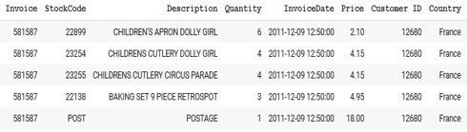
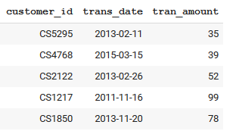
Data description
Training data: real transactional data set which contains all the transactions occurring between 01-Dec-2009 and 09-Dec-2012 for a UK-based registered non-store online retail.
Source - UCI-Machine Learning Repository
Initial size – 1067371 records and 8 attributes
Size after preprocessing – 741725 records and 8 attributes
Attributes - Invoice (unique transaction), StockCode (unique product code), Description (product name), Quantity (of each product per transaction), InvoiceDate (Invoice date & time), Price (product price per unit in sterling), CustomerID (unique customer), Country
Testing data: retail data transactions (occurring between 16-May-2011 and 16-Mar-2015) with no missing values
Source – Kaggle
Size – 125000 records and 3 attributes
Attributes - Customer Id (Nominal), transaction date (Numeric), transaction amount (Numeric).

Slide 8
Machine learning techniques
For customer segmentation : k-means clustering algorithm
For customer churn prediction (classification problem) :
Logistic Regression
Support Vector Machine
Random forest
Extreme Gradient Boosting
Decision tree
Naive Bayes
With cross-validation and
grid search
Limitation
For testing purpose, the retail dataset available on Kaggle is considered in this project. However one can take real transactional data of retail store to identify customer churn based on RFM values.

Slide 9
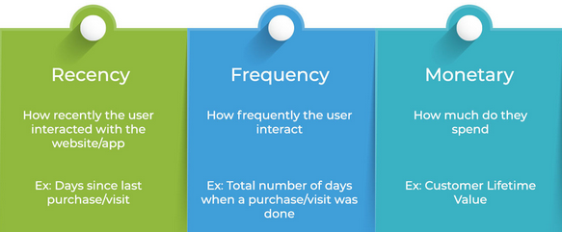
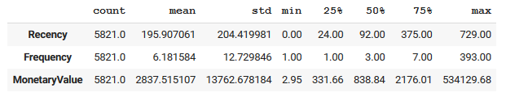
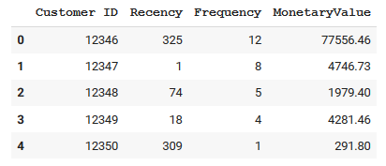
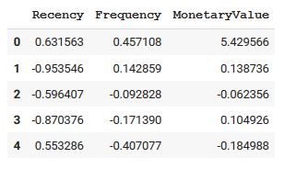
RFM analysis
RFM definition
Descriptive statistics of RFM values
RFM values calculated from training data
Standardized RFM values using StandardScaler

Slide 10

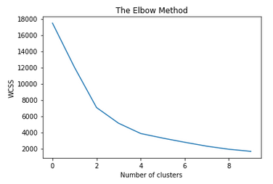
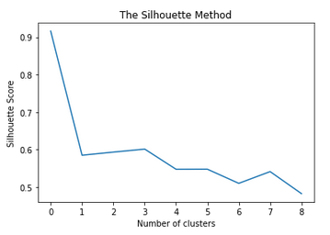
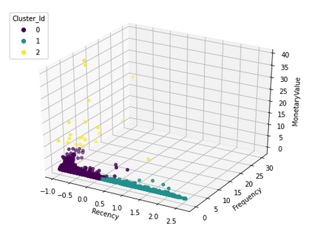
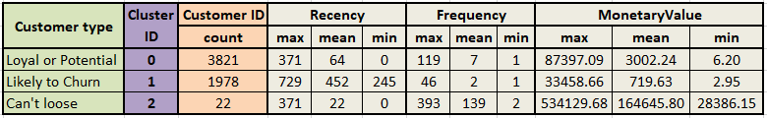
K-means clustering & analysis
3D scatter plot showing 3 clusters
Let’s now focus on building classification algorithm which would classify a particular customer as likely to churn or not churn in advance based on their past transaction history so that appropriate measures can be taken to retain those customers which are likely to churn.
This can be done by creating a target variable “Customer churn” of binomial nature in which 1978 customers are classified as “1” (likely to churn) and 3843 customers as “0” (not likely to churn) and Recency, Frequency and Monetary values as predictors.

Slide 11
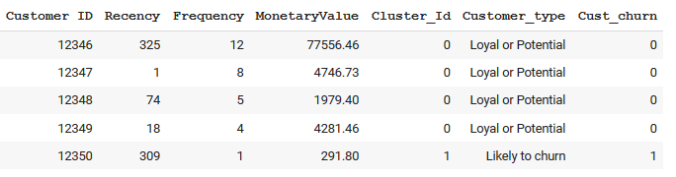
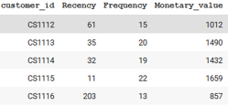

Customer churn model building
Snapshot of training data (5821 records X 7 attributes)
Classification Model | Accuracy
Logistic Regression | 99.93%
Support Vector Classification | 99.91%
Random forest | 99.81%
Extreme Gradient Boosting | 99.79%
Decision tree | 99.72%
Naive Bayes | 90.32%
Predictors
Target variable
Snapshot of RFM values calculated from testing data (6889 records X 4 attributes)
Criteria assumed for likely to churn customers: Recency (R) in days – from 111 to 857, Frequency (F) – from 4 to 18 and
Monetary(M) values – from 149 to 1505
After applying this criteria, 6889 customers are divided in two categories : 1195 customers in Likely to churn and 5694 customers – not likely to churn.

Slide 12
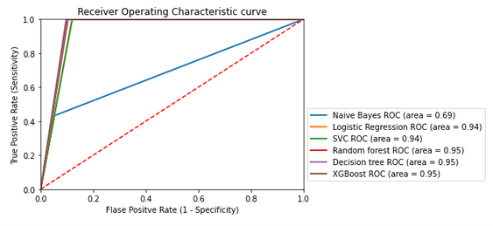
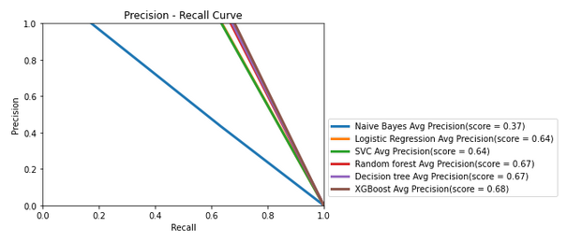
Summary of results on test data:
Classification Model | Precision | Recall | F1-score | Overall Accuracy | Area under ROC curve | Area under Precision recall curve
Extreme Gradient Boosting | 68.3% | 100% | 81.2% | 91.9% | 95% | 68%
Decision tree | 67.5% | 100% | 80.6% | 91.6% | 95% | 67%
Random forest | 66.9% | 100% | 80.2% | 91.4% | 95% | 67%
Logistic Regression | 63.8% | 100% | 77.8% | 90.2% | 94% | 64%
Support Vector classification | 63.6% | 100% | 77.7% | 90.1% | 94% | 64%
Naive Bayes | 63.5% | 43.3% | 51.5% | 85.8% | 69% | 37%
As we can observe, Extreme Gradient Boosting classification model performed best among all on testing data on all performance parameters.
Also Decision tree classification model performed better and as far as visualization and easiness to understand are concerned, Decision tree is preferred compared to Extreme Gradient Boosting.

Slide 13

Conclusion
In this project, the RFM model is implemented for online retail data set to analyze customer segmentation. Also, clusters are evaluated using Elbow method and Silhouette method for K-Means clustering algorithm with different number of clusters. Based on that customer base is divided into three groups- Can’t loose, Loyal or potential and Likely to churn.
This work also has shed some light on the performance of popular machine learning techniques for the churning prediction problem. The classification models are first trained on online retail dataset using k-Fold cross-validation and grid search to get the stable accuracy and then tested on different dataset having more number of records than training dataset and found that Extreme Gradient Boosting classification model performed best compared to other models on testing data on all performance parameters, thereby supporting the advantage of the application of boosting technique in classification problem.

