Slide 1

Network Standards
Chapter 2
Raymond Panko’s
Business Data Networks and Telecommunications, 7th edition
May only be used by adopters of the book
Notes:
[When you come to Figures 2-2, 2-3, 2-8, 2-15, and 2-16, it would be helpful to hand out a full-size copy.]
Chapter 1 discussed most of the core concepts in networking.
There is one core concept that is so large that it needs its own chapter. This is standards.
In many ways, learning networking is about learning how specific standards work because standards drive everything else.
This is a difficult chapter because many concepts in this chapter are abstract and easy to confuse with one another.
Studying this chapter will take a lot of work, but the work will be worth it because if you do not understand the concepts in this chapter, you will have problems throughout the course.

Slide 2
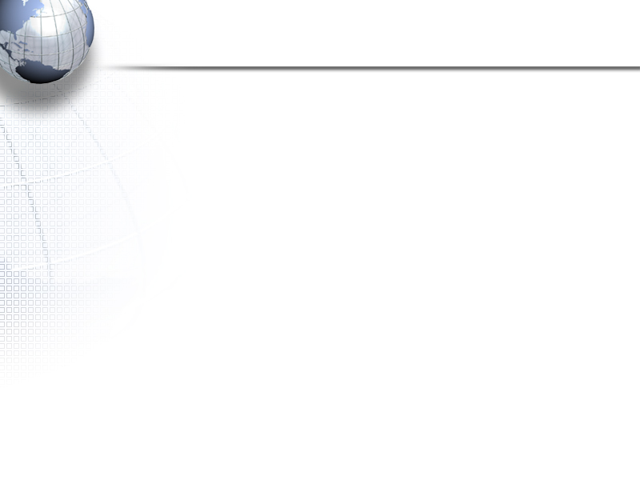
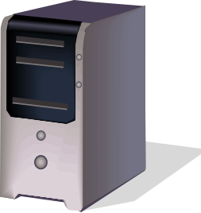

2-1: Network Standards
Network Standards
  Also known as protocols
  Network standards govern the exchange of messages between hardware or software processes on different host computers, including message order, semantics, syntax, reliability, and connection orientation
  Computers are not intelligent, so standards must be very rigid
Message
2-<number>
Notes:
<Read the slide.>

Slide 3
1.
Message Standards (Protocols)
Notes:
We will look first at the standards that govern messages.
Such standards are called protocols. In fact, many standards have “protocol” in their names.
We will use the terms “standards” and “protocols” interchangeably in this book.

Slide 4
2-1: Network Standards
Network Standards Govern
  Message order
    Turn taking, order of messages in a complex transaction, who must initiate communication, etc.
  Message semantics (meaning)
    HTTP request message: “Please give me this file”
    HTTP response message: Here is the file. (Or, I could not comply for the following reason)
  Message Syntax (organization)
    Like human grammar, but more rigid
    Header, data field, and trailer (Figure 2-2)
Notes:
<Read the slide.>

Slide 5
2-2: General Message Organization
General Message Syntax (Organization)
  General Message Organization (Figure 2-4)
  Primary parts of messages
    Data Field (content to be delivered)
    Header (everything before the data field)
    Trailer (everything after the data field)
  The header and trailer act like a delivery envelope for the data field
Trailer
Data Field
Header
Notes:
Moving from the specific syntax of HTTP messages to the syntax of messages in general, we see that in general a message can have three parts.
The most important part is the data field, which contains the content to be delivered.
This is like the letter in an envelope.
The data field is usually by far the longest part of the message.
The header is everything that comes before the data field, and the trailer is everything that comes after the data field.
The header and trailer act like a delivery envelope for the data field.

Slide 6
2-2: General Message Organization
General Message Syntax (Organization)
  Header and trailer are further divided into fields
Trailer
Data Field
Header
Other
Header
Field
Message with
all three parts
Destination
Address
Field is
Used by Switches and Routers
Like the Address on an Envelope
Notes:
Now that we have seen the three basic parts, we will look more closely at the header and trailer.
This figure shows that the header is divided into smaller sections called fields.
The most important header field is the destination address field.
This is like the address on a postal letter.
Switches and routers read this field to decide how to forward an incoming message back out.
Trailers can also be divided into fields.

Slide 7
2-2: General Message Organization
Data Field
Header
Other
Header
Field
Destination
Address
Field
Message without
a trailer
Usually only data link
layer messages have trailers
Notes:
Not all messages have all three parts.
For example, trailers are only found at something called the data link layer, which we will see later in this chapter.
Most messages DO NOT have trailers!
When trailers are found, they are found in data link layer messages (frames.)

Slide 8
2-2: General Message Organization
Header
Other
Header
Field
Destination
Address
Field
Message with
only a header
e.g.
TCP supervisory messages are pure headers
(there is no data field content to deliver)
Notes:
Some messages only have a header.
This is true of supervisory messages in TCP—a standard we will see later in this chapter.
There is no data field in TCP because there is no content to be delivered other than the supervisory information in the header.

Slide 9
2.
Reliability
Error Detection and Correction
Notes:
Some message standards are reliable, which means that they resend a message if an error occurs during delivery.
Others are not reliable.
<You might ask the class which is better—a reliable protocol or an unreliable protocol.
Most will vote for reliability.
Then tell them that most protocols are unreliable, not reliable.>
<Ask them to guess why most protocols are unreliable.
The answer is that reliable protocols place a heavier processing burden on the network and on the computers implementing them and this makes reliable protocols expensive.>

Slide 10

2-3: Reliable Transmission Control Protocol (TCP) Session
2
The Transmission Control Protocol (TCP) is an important standard in Internet transmission
TCP
  Receiver acknowledges each correctly-received TCP segment
  If an acknowledgments is not received by the sender, the sender retransmits the TCP message (called a TCP segment)
  This gives reliability: error detection and error correction
Notes:
To see how reliability can work, we will look at a protocol called the Transmission Control Protocol, better known as TCP.
TCP messages are called TCP segments.
In TCP, the receiver acknowledges every correct message it receives.
This is like a person nodding their head during a conversation to show that he or she is listening.
If the original sender does not receive an acknowledgement within a reasonable amount of time, it resends the message.
<Quick question: Ask the class which side detects the errors—the original sender or the receiver. Answer: it is the original sender, who realizes that an acknowledgement has not arrived.>

Slide 11

2-3: Reliable TCP Session
1
Client PC
TCP Process
Webserver
TCP Process
4. Data = HTTP Request
Carry
HTTP
Req &
Resp
(4)
5. ACK (4)
6. Data = HTTP Response
TCP Segment (Message) 4
Carries an HTTP Request
Segment 5 Acknowledges It
There Is No Need to Resend
7. ACK (6)
Request-Response
Cycle for Data Transfer
Notes:
Here is an example of a TCP segment that arrives correctly.
<Read the box in the lower-right part of the screen.>

Slide 12
2-3: Reliable TCP Session
3
Client PC
TCP Process
Webserver
TCP Process
8. Data = HTTP Request (Error)
Carry
HTTP
Req &
Resp
(4)
No receipt, so
so no ACK
9. Data = Retransmits HTTP Request because
No ACK was received
10. ACK (9)
Error Handling
Notes:
Here is an example of a TCP segment that does NOT arrive correctly.
<Read the box in the lower-right part of the screen.>

Slide 13
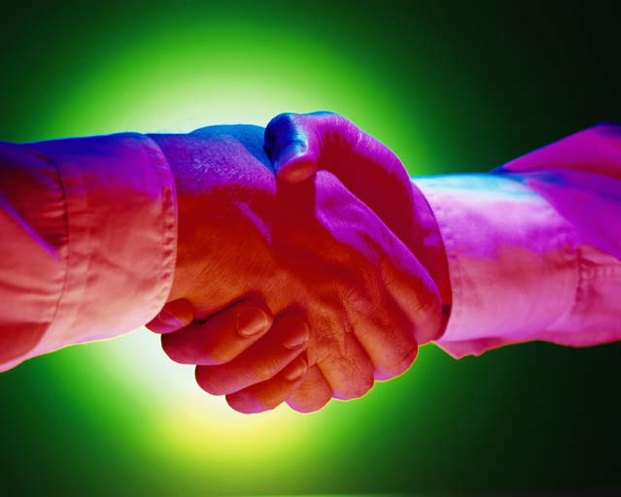
3.
Connection-Oriented and
Connectionless Protocols
Notes:
In addition to being either reliable or unreliable, protocols are either connection-oriented or connectionless.

Slide 14
2-4: Connection-Oriented and Connectionless Protocols
In TCP
Client PC
TCP Process
Webserver
TCP Process
Connection-Opening Messages
Messages During the Connection
Time
Connection-Closing Messages
Connection-oriented protocols have formal openings
and closings, like human telephone calls
Notes:
In addition to being reliable, TCP is connection-oriented.
There are formal openings and closings to TCP sessions. We will see these in detail in Chapter 8.

Slide 15

2-4: Connection-Oriented and Connectionless Protocols
4
Connection-Oriented Protocol
Connectionless Protocol
A
B
A
B
Open Connection
Message
(No Sequence Number)
Message with Sequence Number A1
Connectionless protocols, like
HTTP simply send messages
without prior connection
openings and without
subsequent connection closings
Connection-oriented protocols
give each message a
unique sequence number
Message with Sequence Number B1
Message with Sequence Number A2
Close Connection
Notes:
Connection-oriented protocols require the communicating partners to have formal openings and closings. Both sides must agree to open the communication, and, generally speaking, both sides must agree to close the communication.
Telephone conversations are like this. At the beginning of the call, there is at least a tacit negotiation that this is a good time to talk. At the end, simply hanging up is rude.
With formal connections, the two parties can keep track of all messages in the communication.
Messages have sequence numbers, so if messages arrive out of order, they can be put into order.
Also, acknowledgements can refer to specific messages, so there is no need to stop and wait for an acknowledgement before sending the next message.

Slide 16
2-5: Advantages and Disadvantages of Connection-Oriented Protocols
Advantages
  Connection-oriented protocols give each message a sequence number
    Thanks to sequence numbers, the parties can tell when a message is lost (There will be a gap in the sequence numbers)
    Error messages, such as ACKs, can refer to specific messages according to the sequence numbers of these messages
  Long messages can be fragmented into many smaller messages that can fit inside of packets
    The fragments will be given sequence numbers so that they can be assembled at the other end
    Fragmentation followed by reassembly is an important concept in networking
Notes:
<Read the slide.>

Slide 17
2-5: Advantages and Disadvantages of Connection-Oriented Protocols
Advantages
  Messages can refer to earlier messages by sequence number
    Important in database-based transaction processes where several messages must be exchanged to make a purchase, record a transaction, or do some other common business task
Disadvantages
  Connection-oriented protocols place a heavy load on networks and on computers connected to the Internet
Notes:
<Read the slide.>

Slide 18
4.
The Hybrid TCP/IP-OSI
Standards Architecture
Notes:
We are switching topics again, this time to look at something called a standards architecture.

Slide 19
Standards Architecture
A Standards Architecture Is a Broad Plan for Creating Standards
  Break the problem of effective communication into smaller pieces for ease of development
  Develop standards for the individual pieces
  Just as a building architect creating a general plan for a house before designing the individual rooms in detail
  The dominant architecture today is the hybrid TCP/IP-OSI standards architecture shown in the next slide
Notes:
<Read the slide.>

Slide 20
Figure 2-8: Hybrid TCP/IP-OSI Architecture
General Purpose (Core Later) | Layer | Specific Layer Purpose
Application-application communication | Application (5) | Application-application interworking
Transmission of a packet across an internet | Transport (4) | Host-host communication
 | Internet (3) | Packet delivery across an internet
Transmission of a frame across a single network (LAN or WAN) | Data Link (2) | Frame delivery across a network
 | Physical (1) | Device-device connection
Notes:
<Almost no companies use the pure OSI or pure TCP/IP architectures in practice. We will see that they use is a hybrid of OSI at Layers 1 and 2 and TCP/IP or another standards architecture at Layers 3 and 4.>
Now let’s look at the most widely used standards architecture, the hybrid TCP/IP-OSI standards architecture. We will see later why it has this rather long name.
The architecture has three general purposes. <Read the first column.>
These general purposes are further subdivided into specific standards layers. <Go through the second and third columns.>

Slide 21
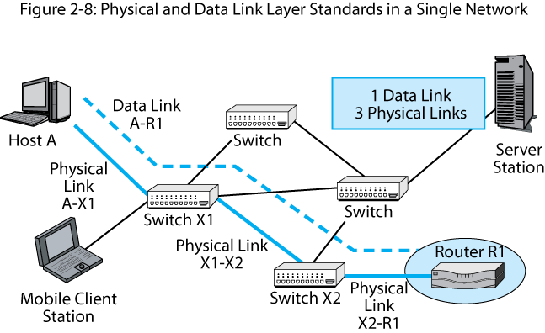
2-7: Physical and Data Link Layer Standards in a Switched Network
1
A data link is a frame’s path though a single switched network:
A-R1 (host-router)
A physical link is a connection between two devices:
A-X1 (host-switch), X1-X2 (switch-switch), X2-R1 (switch-router)
Notes:
<Trace the route a frame will take between Host A and Router R1, passing through the two switches.
<Then read the bottom text box.>
<Then read the upper text box.?

Slide 22
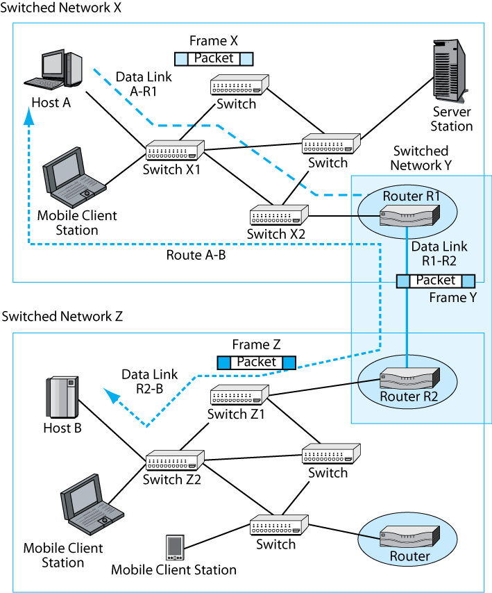
2-8: Internet and Data Link Layers in a Routed Network
1
A data link is a frame’s path through a single switched network. There are switched networks in the figure, so there are three data links
A route is a packet’s path all the way through the network. There always is a single route because there is only one packet
Notes:
<Read the slide.>

Slide 23

2-8: Internet and Data Link Layers in a Routed Network
3
A simplified view
Host A
Data Link A-R1
R1
Network X
3 Data Links: One per Network
Network Y
1 Route through the internet
Data
Link
R1-R2
Network Z
Route A-B
R2
Host B
Data Link R3-B
Notes:
This figure compares data links at the data link layer with routes at the internet layer.
A route is the packet’s path through the internet. There is only one route in an internet. <Point it out.>
A data link is the frame’s path through a single network. There are as many data links as there are single networks (3 in this case). <Point it out.>

Slide 24
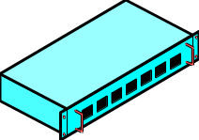
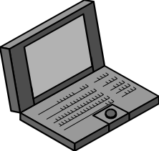
2-8: Internet and Data Link Layers in a Routed Network
Frame X
Packet
Data Link
A-R1
In Network X:
Two destination addresses:
Packet: Host B (destination host)
Frame: Router R1
Switch
Host A
Switch
Server
Station
Switch
X1
Mobile Client
Station
Switch
X2
Route
A-B
Router R1
Network X
Notes:
<Hand out a copy of Figure 2-10 so that students can see the entire figure.>
<Point out that this slide shows the top network, Network X.>
<Go through the box in the upper-right.>
<Note that the packet’s destination address is that of Host B, the destination host at the end of the route.>
<Note that the frame only goes as far as Router R1. Therefore, the frame’s destination address is that of Router R1.>

Slide 25
2-8: Internet and Data Link Layers in a Routed Network
To
Network X
Route
A-B
Router R1
Data Link
R1-R2
Frame Y
In Network Y:
Two destination addresses:
Packet: Host B (destination host)
Frame: Router R2
Packet
To
Network Z
Router R2
Network Y
Notes:
<Point out that this slide shows the middle network, Network Y.>
<Go through the box in the left middle of the screen.>
<Note that the packet’s destination address is still that of Host B, the destination host at the end of the route. This never changes.>
<Note that the frame carrying the packet only goes as far as Router R2. Therefore, the frame’s destination address is that of Router R2.>

Slide 26
2-8: Internet and Data Link Layers in a Routed Network
Frame Z
Data Link
R2-B
Packet
Host B
Switch
Z1
Router R2
In Network Z:
Two destination addresses:
Packet: Host B (destination host)
Frame: Host B
Switch
Z2
Mobile Client
Stations
Switch
X2
Router
Network Z
Notes:
<Point out that this slide shows the bottom network, Network Z.>
<Read the box in the left side of the screen.>
<Note that the packet’s destination address is still that of Host B, the destination host at the end of the route. Again, the packet’s address never changes.>
<Note that the frame goes all the way to the destination host. Therefore, the frame’s destination address is that of the destination host, Host B.>
<Point out that Host B has two addresses—an internet layer address and a data link layer address.>

Slide 27
Figure 2-10: Internet and Data Link Layers in an Internet
Internet and Transport Layers
  An internet is a group of networks connected by routers so that any application on any host on any network can communicate with any application on any other host on any other network
  Internet and transport layer standards govern communication across an internet composed of two or more single networks
Notes:
<Note that we have been looking at single networks, which are governed by the physical and data link layers.>
< We will now look at the next two layers, the internet and transport layers, which govern transmission through an internet.>
<Read the slide.>

Slide 28

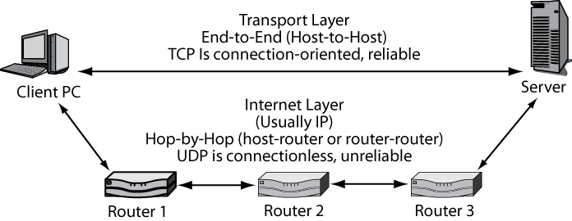
2-9: Internet and Transport Layers Standards
1
The transport layer adds functionality for the two hosts
to talk with each other to fix errors and do other things
The internet layer carries packets on the route
between the two hosts, across a series of routers.
There will be many hops across pairs of routers, so
internet layer protocols are kept very simple to reduce cost
Notes:
<Read the text boxes.>

Slide 29
2-10: Application Layer Standards
Application Layer Standards
  Govern how two applications work with each other, even if they are from different vendors
There are many application layer standards because there are many applications
  World Wide Web (HTTP)
  E-Mail (SMTP, POP, etc.)
  FTP (FTP)
  Database (ODBC)
  Etc.
  There are more application layer standards than any other type of standards
Notes:
<Read the slide.>

Slide 30
Standards Layers: Recap
Be able to repeat
this in your sleep!
Application (5)
Transport (4)
Internet (3)
Data Link (2)
Physical (1)
Notes:
<As a recap, go over the layers and their numbers.>
<Point out that layer numbering begins at the bottom layer.>

Slide 31
5.
Syntax Examples: Ethernet and IP
Notes:
We have been looking at the layers in the hybrid TCP/IP-OSI standards architecture.
Each layer above the physical layer has messages.
In this section, we will look at the syntaxes of some of these messages.

Slide 32
Octets
Field length may be measured in octets
An octet is a group of eight bits
In computer science, an octet is called a byte
Octet = 8 Bits
10010111
Notes:
Before we talk in detail about syntax, we need to introduce a new term, the “octet.”
An octet is a group of eight bits.
“Isn’t that a byte?” you ask? YES!
Computer people measure length in bytes, but networking people traditionally measure length in octets, so you need to get used to the terminology.
The term “octet” is at least logical. An octopus has eight arms. An octagon has eight sides.
<Question: Which month is October?
Answer: It is the 10th month, not the 8th.. The Romans screwed things up when they added July and August to honor Julius Caesar and Augustus Caesar, moving October from the 8th month to the 10th month.>

Slide 33
Figure 2-11: Ethernet Frame
Receiver uses Frame
check sequence
field to check for
transmission errors
If an error is detected,
the receiver merely
discards the frame
This is error detection
No retransmission,
so no error correction
Ethernet is
not reliable
Start
Preamble (7 octets)
Start of Frame Delimiter (1 octet)
Destination MAC Address (48 bits)
Source MAC Address (48 bits)
Length (2 octets)
LLC Subheader (7 octets)
Data
Field
Packet (usually IP Packet) (variable)
PAD (variable)
End
Frame check sequence (4 octets)
Notes:
<Point out the address fields and that the frame contains a packet in its data field.>
<Read text on the right.>

Slide 34
2-12: Internet Protocol (IP) Packet
Bit 0 |  |  | Bit 31
Version Number (4 bits) | Header Length (4 bits) | Diff-Serv (8 bits) | Total Length (16 bits)
Identification (16 bits) |  |  | Flags (3 bits) | Fragment Offset (13 bits)
Time to Live (8 bits) |  | Protocol (8 bits) | Header Checksum (16 bits)
Source IP Address (32 bits)
Destination IP Address (32 bits)
Options (if any) |  |  |  |  | Padding (to 32-bit boundary)
Data Field (dozens, hundreds, or thousands of bits) Often contains a TCP segment
The IP packet is a long string of bits
It is drawn 32 bits on a line
The first line is bits 0 through 31
(binary counting starts at zero)
The next line is bits 32 through 63
Notes:
<Read the text box.>

Slide 35
2-12: Internet Protocol (IP) Packet
The receiver uses the header
checksum field to check for errors
If an error is found, the receiver
discards the packet
As in Ethernet, there is no
retransmission, so IP is not reliable
Bit 0 |  |  | Bit 31
Version Number (4 bits) | Header Length (4 bits) | Diff-Serv (8 bits) | Total Length (16 bits)
Identification (16 bits) |  |  | Flags (3 bits) | Fragment Offset (13 bits)
Time to Live (8 bits) |  | Protocol (8 bits) | Header Checksum (16 bits)
Source IP Address (32 bits)
Destination IP Address (32 bits)
Options (if any) |  |  |  |  | Padding (to 32-bit boundary)
Data Field (dozens, hundreds, or thousands of bits) Often contains a TCP segment
Notes:
<Read the text box.>

Slide 36
2-12: Internet Protocol (IP) Packet
Bit 0 |  |  | Bit 31
Version Number (4 bits) | Header Length (4 bits) | Diff-Serv (8 bits) | Total Length (16 bits)
Identification (16 bits) |  |  | Flags (3 bits) | Fragment Offset (13 bits)
Time to Live (8 bits) |  | Protocol (8 bits) | Header Checksum (16 bits)
Source IP Address (32 bits)
Destination IP Address (32 bits)
Options (if any) |  |  |  |  | Padding (to 32-bit boundary)
Data Field (dozens, hundreds, or thousands of bits) Often contains a TCP segment
The source and destination
IP addresses are each 32 bits long
Notes:
<Read the text box.>

Slide 37
2-12: Internet Protocol (IP) Packet
Bit 0 |  |  | Bit 31
Version Number (4 bits) | Header Length (4 bits) | Diff-Serv (8 bits) | Total Length (16 bits)
Identification (16 bits) |  |  | Flags (3 bits) | Fragment Offset (13 bits)
Time to Live (8 bits) |  | Protocol (8 bits) | Header Checksum (16 bits)
Source IP Address (32 bits)
Destination IP Address (32 bits)
Options (if any) |  |  |  |  | Padding (to 32-bit boundary)
Data Field (dozens, hundreds, or thousands of bits) Often contains a TCP segment
The data field usually contains a
TCP segment or UDP datagram
Notes:
<Read the text box.>

Slide 38
6.
Reliability Options at the Transport Layer
TCP versus UDP
Notes:
We have been looking at the layers in the hybrid TCP/IP-OSI standards architecture.
Each layer above the physical layer has messages.
In this section, we will look at the syntaxes of some of these messages.

Slide 39
2-13: Why Not Make All Layers Reliable?
Reliability Is Expensive
  When errors are rare (in hops between routers and switches), the cost is not justified
  Switches and routers would be much more expensive if they did hop-by-hop error correction
  There are many switch and router hops, so doing error correction between hops would be very expensive
  Error correction at the transport layer corrects errors made at lower layers, making correction at lower layer unnecessary as well as expensive
Notes:
<Read the slide.>

Slide 40

2-13: Why Not Make All Layers Reliable?
2
Why Does Doing Error Correction at the
Transport Layer Make Sense?
First,
  There are only two transport processes: one on the source host, one on the destination host
  So error correction has to be done only once, keeping cost low
Second,
  The transport process is just below the application layer
  So doing error correction at the transport layer frees the application layer from doing error correction
Notes:
<Read the slide.>
<Students have a really hard time with this.>

Slide 41
2-14: TCP and UDP at the Transport Layer
Not all applications need reliability
  Voice over IP cannot wait for lost or damaged packets to be transmitted
  Network management protocols need to place as low a burden on the network as possible
  Both types of applications use the simpler User Datagram Protocol (UDP) instead of TCP
Notes:
Now we are switching topics again. Earlier we talked about the Transmission Control Protocol (TCP) at the transport layer.
There is a second transport layer protocol. This is the User Datagram Protocol (UDP).
<Read the figure.>

Slide 42
2-14: TCP and UDP at the Transport Layer
Comparison | TCP | UDP
Layer | Transport* | Transport*
Connection-orientation? | Connection-oriented | Connectionless
Reliable? | Reliable | Unreliable
Burden on the two hosts | High | Low
Traffic burden on the network | High | Low
*Note: TCP and UDP are the only transport-layer protocols
Notes:
<Read the table from top to bottom.>

Slide 43
7.
Vertical Communication Between Layer Processes on the Same Host
Notes:
We have talked about standards at various layers.
On hosts, switches, and routers, there is a hardware or software process that implements each layer.
We will look at how the processes at different layers interact on a single computer, switch, or router.

Slide 44
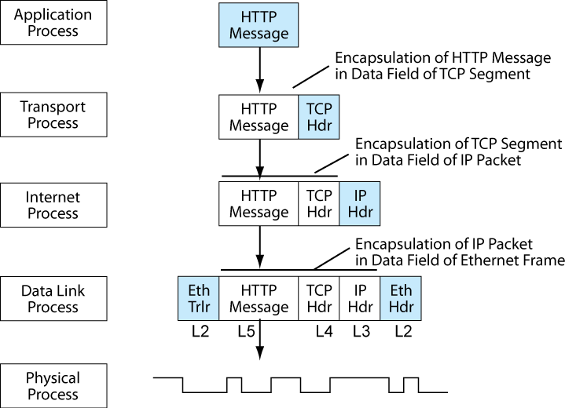
2-15: Layered Communication on the Source Host
Each layer requires
a process (hardware)
or software) on the host
In this section, we will
see how these layer
processes work together
on the source and
destination hosts, beginning
with the source host
Notes:
<Read the text box.>

Slide 45


2-15: Layered Communication on the Source Host
2
The process begins when a browser creates an
HTTP request message
Application
Process
HTTP
Message
Passes Message
Down to Transport Process
Transport
Process
HTTP
Message
TCP
Hdr
Encapsulation of HTTP Message
in Data Field of TCP Segment
Notes:
Let’s see what happens when a browser creates an HTTP request message.
The application process is the browser on the client PC. It creates the HTTP request message.
The application process then passes the application layer message—the HTTP request message—down to the next-lower-layer process, the transport layer process.
HTTP requires TCP at the transport layer.
The transport process encapsulates the application layer message in the data field of a TCP message. The transport process does this by adding a TCP header to the HTTP request message.

Slide 46
2-15: Layered Communication on the Source Host
When a layer process (N) creates a message, it passes it down to the next-lower-layer process (N-1) immediately
The receiving process (N-1) will encapsulate the Layer N message, that is, place it in the data field of its own (N-1) message
Notes:
Let’s look at the vertical communication process more abstractly.
<Read the slide.>
<Ask: In the previous slide, what was layer N? Answer: The application layer.>
<Ask: In the previous slide, what was layer N-1? Answer: The transport layer.>

Slide 47
2-15: Layered Communication on the Source Host
2
Transport
Process
HTTP
Message
TCP
Hdr
Internet
Process
HTTP
Message
TCP
Hdr
IP
Hdr
Encapsulation of TCP Segment
in Data Field of IP Packet
Notes:
Now let’s look at what the transport layer process does with the TCP message.
The transport layer is now Layer N. It passes the message down to Layer N-1 – the internet layer process.
The internet layer process encapsulates the TCP message in the data field of an IP packet by adding an IP header.
We now have an IP packet consisting of the HTTP message, a TCP header, and an IP header.

Slide 48
2-15: Layered Communication on the Source Host
2
Internet
Process
HTTP
Message
TCP
Hdr
IP
Hdr
Data Link
Process
Eth
Trlr
HTTP
Message
TCP
Hdr
IP
Hdr
Eth
Hdr
Encapsulation of IP Packet
in Data Field of Ethernet Frame
Notes:
Now we will look at what the internet layer process does.
The internet layer is now Layer N.
The internet process passes the IP packet down to the N-1 layer, the data link layer.
The data link layer encapsulates the IP packet in a frame. In this case, the frame is an Ethernet frame, so the layer process adds both an Ethernet header and an Ethernet trailer.

Slide 49
2-15: Layered Communication on the Source Host
Data Link
Process
Eth
Trlr
HTTP
Message
TCP
Hdr
IP
Hdr
Eth
Hdr
Physical
Process
Physical Layer converts the bits of the frame into signals.
There is no encapsulation at the physical layer
Notes:
Things are a very different below the data link layer.
The data link layer, now Layer N, still passes the message down to the next-lower layer, the physical layer.
However, the physical layer does not do encapsulation. It merely converts the bits of the frame into electrical or radio signals and sends the signal on to the next device.

Slide 50
2-15: Layered Communication on the Source Host
Recap
Notes:
<Walk through the recap, with everything shown on one screen.>

Slide 51
2-15: Layered Communication on the Source Host
4
The following is the final frame for
an HTTP message on an Ethernet LAN
Eth
Trlr
HTTP
Message
TCP
Hdr
IP
Hdr
Eth
Hdr
L2
L5
L4
L3
L2
Notice the Pattern: From Right to Left: L2, L3, L4, L5, maybe L2
Start with the highest-layer message (in this case, 5)
Add headers for each lower layer (L4, L3, and L2, in this case)
Don’t forget the possible trailing L2 trailer
Notes:
<This slide recaps how the final frame is built from the top down.>
<Go through the build to see the parts of the frame appear.>
<Then read the text at the bottom of the slide.>

Slide 52
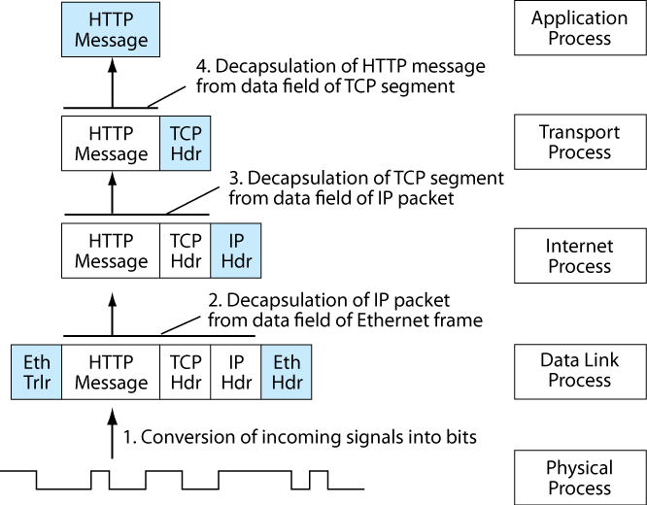
2-16: Decapsulation on the Destination Host
Notes:
So far, we have looked at interactions among layer processes on the source host.
Now we will look at what happens on the destination host.
The process is just the opposite. Each layer above the physical layer checks the message for errors and other information.
If the message is error free, the layer process DECAPSULATES the message from the data field and passes it on to the NEXT HIGHER layer.
<Go through what happens, beginning with the physical layer.>

Slide 53
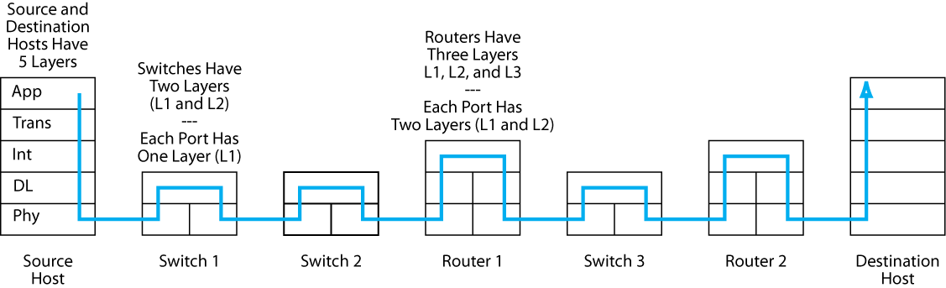
2-17: Layered End-to-End Communication
Encapsulation and decapsulation also occurs
on each switch and router along the way
In switches, the highest layer is the data link layer,
So switches are called Layer 2 devices
On routers, the highest layer is the internet layer,
So routers are called Layer 3 devices
Notes:
<Read the text box.>

Slide 54
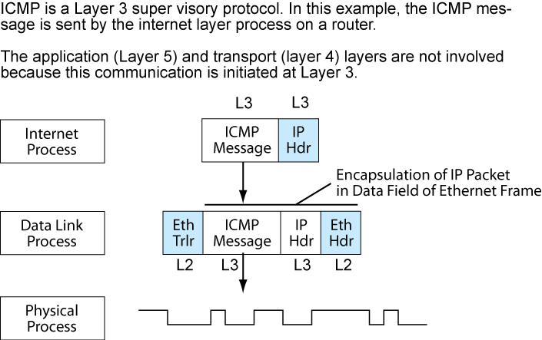
Figure 2-18: Layered Message Exchange Initiated at the Internet Layer
The application layer
process does not always
initiate communication
In ICMP, the internet layer
initiates the communication
and so is the highest layer
Notes:
In the previous example, the application layer initiated the communication.
Therefore, the highest layer process involved was the application layer.
But any layer can initiate communication.
For instance, if a router cannot deliver a message, it may send back and ICMP error message back to the sending host.
ICMP is a Layer 3 process, so the ICMP message will be the top-layer message.
The internet layer process, which created the ICMP message, adds an IP header.
It then passes the IP packet down to the data link layer.
The data link layer message encapsulates the IP packet and passes it down to the physical layer for delivery.
So only the internet and data link layers are involved. There are no transport and application layer components in the final frame.

Slide 55
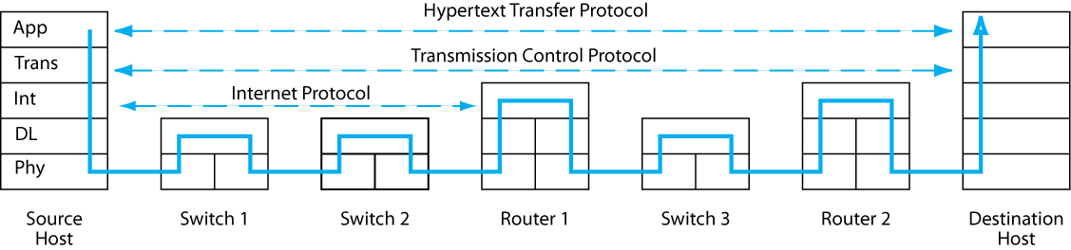
2-19: Combining Horizontal and Vertical Communication
Horizontal communication using protocols lets processes
talk to their peers on other hosts, switches, or routers
Vertical communication links processes on the same device
Horizontal and vertical communication
work together to provide message delivery
Notes:
<Read the text box.>

Slide 56
8.
OSI, TCP/IP, and Other Standards Architectures
Notes:
So far, we have been looking at the hybrid TCP/IP-OSI standards architecture.
We will see that this is a combination of two separate architectures, OSI and TCP/IP.
We will also see that there are other standards architectures.

Slide 57
2-20: The Hybrid TCP/IP-OSI Architecture
Broad Purpose | TCP/IP | OSI | Hybrid TCP/IP-OSI
Applications | Application | Application (Layer 7) | Application (Layer 5)
 |  | Presentation (Layer 6)
 |  | Session (Layer 5)
Internetworking | Transport | Transport (Layer 4) | TCP/IP Transport Layer (Layer 4)
 | Internet | Network (Layer 3) | TCP/IP Internet Layer (Layer 3)
Communication within a single switched LAN or WAN | Use OSI Standards Here | Data Link (Layer 2) | Data Link (OSI) Layer (Layer 2)
 |  | Physical (Layer 1) | Physical OSI Layer (Layer 1)
The TCP/IP-OSI Architecture draw its standards from two different
Standards architectures—TCP/IP and OSI
Notes:
<Read the text box at the bottom.>
<Then show which layers in the final architecture on the right come from TCP/IP and from OSI.>

Slide 58
2-20: The Hybrid TCP/IP-OSI Architecture
Dominance:
  The Hybrid TCP/IP-OSI Architecture governs the Internet and dominates internal corporate networks
  OSI standards dominate the physical and data link layers (which govern communication within individual networks) almost exclusively. OSI has 100% dominance at this layer
  TCP/IP dominates the internet and transport layer in internetworking and governs 80% to 90% percent of all corporate traffic above the data link layer
Notes:
<Read the text box.>

Slide 59
Figure 2-21: OSI and TCP/IP
 | OSI | TCP/IP
Standards Agency or Agencies | ISO (International Organization for Standardization) ITU-T (International Telecommunications Union–Telecommunications Standards Sector) | IETF (Internet Engineering Task Force)
Dominance | Nearly 100% at physical and data link layers | 80% to 90% at the internet and transport layers
Documents Are Called | Various | Mostly RFCs (requests for comments)
Notes:
<Read through the table.>

Slide 60
2-21: OSI and TCP/IP
Notes:
  Do not confuse OSI (the architecture) with ISO (the organization)
  The acronyms for ISO and ITU-T do not match their names, but these are the official names and acronyms
Notes:
<Read the slide.>

Slide 61
2-22: OSI Layers
Again, OSI Layers 1 and 2
Are almost universally used
Layer Number | OSI Name | Purpose | Use
1 | Physical | Physical connections between adjacent devices | Nearly 100% dominant
2 | Data Link | End-to-end transmission in a single switched network. Frame organization. Switch operation | Nearly 100% dominant
3 | Network | Generally equivalent to the TCP/IP internet layer. However, OSI network layer standards are not compatible with TCP/IP internet layer standards | Rarely used
4 | Transport | Generally equivalent to the TCP/IP transport layer. However, OSI transport layer standards are not compatible with TCP/IP transport layer standards | Rarely used
Although Layers 3 and 4 are architecturally
Similar in TCP/IP and OSI, individual standards from
the two architectures are not compatible at these layers
Notes:
<Read the text boxes.>

Slide 62
2-22: OSI Layers
Layer Number | OSI Name | Purpose | Use
5 | Session | Initiates and maintains a connection between application programs on different computers If a session is broken, only have to go back to the last rollback point Brilliant idea, but few applications need it and those that do have their own methods for managing sessions | Rarely used
6 | Presentation | Designed to handle data formatting differences, data compression, and data encryption In practice, a category for general file format standards used in multiple applications | Rarely used as a layer. However, many file format standards are assigned to this layer.
7 | Application | Governs remaining application-specific matters | Some OSI applications are used
Notes:
<Read the slide.>

Slide 63
2-23: Other Major Standards Architectures
IPX/SPX
  Used by older Novell NetWare file servers for file and print service
  Sometimes used in newer Novell NetWare file servers for consistency with older NetWare servers
SNA (Systems Network Architecture)
  Used by IBM mainframe computers
AppleTalk
  Used by Apple Macintosh desktops and notebooks to talk to Macintosh servers
Notes:
<Read the slide.>

Slide 64
2-24: Characteristics of Protocols Discussed in this Chapter
Layer | Protocol | Connection-Oriented or Connectionless? | Reliable or Unreliable?
5 (Application) | HTTP | Connectionless | Unreliable
4 (Transport) | TCP | Connection-oriented | Reliable
4 (Transport) | UDP | Connectionless | Unreliable
3 (Internet) | IP | Connectionless | Unreliable
2 (Data Link) | Ethernet | Connectionless | Unreliable
Notes:
This table recaps the protocols we have seen in this chapter.
<Read through the table.>

Slide 65
9.
Topics Covered
Notes:
<If you want to go through the topics covered, just read the following slides.>

Slide 66
Network Standards
The Core of Networking
Network Standards Govern
  Message timing (turn taking, etc.)
  Message syntax (structure of messages)
    Header, data field, trailer
    Header is subdivided into header fields
  Message semantics (meaning)
  Reliable or unreliable operation
    Requires both error detection and error correction
  Connection-oriented or connectionless operation
Notes:
<Read the slide.>

Slide 67
Architectures
Hybrid TCP/IP-OSI Architecture
  Layer 5: Application
  Layer 4: Transport
  Layer 3: Internet
  Layer 2: Data Link
  Layer 1: Physical
Connections
  Layer 1: Physical link between adjacent devices
  Layer 2: Data link through a single switched network
  Layer 3: route through a routed network (internet)
Notes:
<Read the slide.>

Slide 68
Architectures
Hybrid TCP/IP-OSI Architecture
  OSI is nearly 100% dominant at Layers 1 and 2
  TCP/IP is 70% to 80% dominant at Layers 3 and 4
  Situation at Layer 5 is complex
Notes:
<Read the slide.>

Slide 69
Syntax Examples
Ethernet Frame
  48-bit MAC address fields
  Error detection and discarding; not reliable
  Carries a packet in its data field
Internet Protocol (IP) Packet
  32-bit IP address fields
  Error detection and discarding; not reliable
  Usually carries a TCP or UDP message in its data field
Notes:
<Read the slide.>

Slide 70
TCP and UDP
The Only Protocols at the Transport Layer
TCP is Reliable
  Reliability is expensive
  TCP fixes errors at all lower layers, giving the application process clean data
  Error correction only has to be done once, on the source and destination hosts
UDP is Unreliable
  Low burden on the network and hosts
  Useful if application cannot use reliability or prefers not to use it
Notes:
<Read the slide.>

Slide 71
Vertical Communication
Notes:
<Walk through the slide, top to bottom.>

Slide 72
Vertical and Horizontal Communication
Notes:
<Note the simultaneous existence of horizontal and vertical communication.>

Slide 73

All rights reserved. No part of this publication may be reproduced, stored in a retrieval system, or transmitted, in any form or by any means, electronic, mechanical, photocopying, recording, or otherwise, without the prior written permission of the publisher. Printed in the United States of America.
Copyright © 2009 Pearson Education, Inc.
Publishing as Prentice Hall

