Slide 1
X Education Case Study SUBMISSION
Anil
Anand
Hitesh
Harsh

Slide 2
Objective
X Education is able to generate a lot of leads at initial stage but the conversion rate is very low. So it spend a lot of energy and resources on those leads to convert in the paying customer and only approx. 30% are converted, which clearly indicates that process is not optimized. It need to design a strategy where it put efforts only on promising leads.

Slide 3
Problem solving methodology
Understanding the Variables
Making the data set usable by removing the Duplicates, nulls and by imputing some of the values.
Applying the Logistic regression
Analysing the Algorithm Results and Model Performance
Deploying the Model

Slide 4
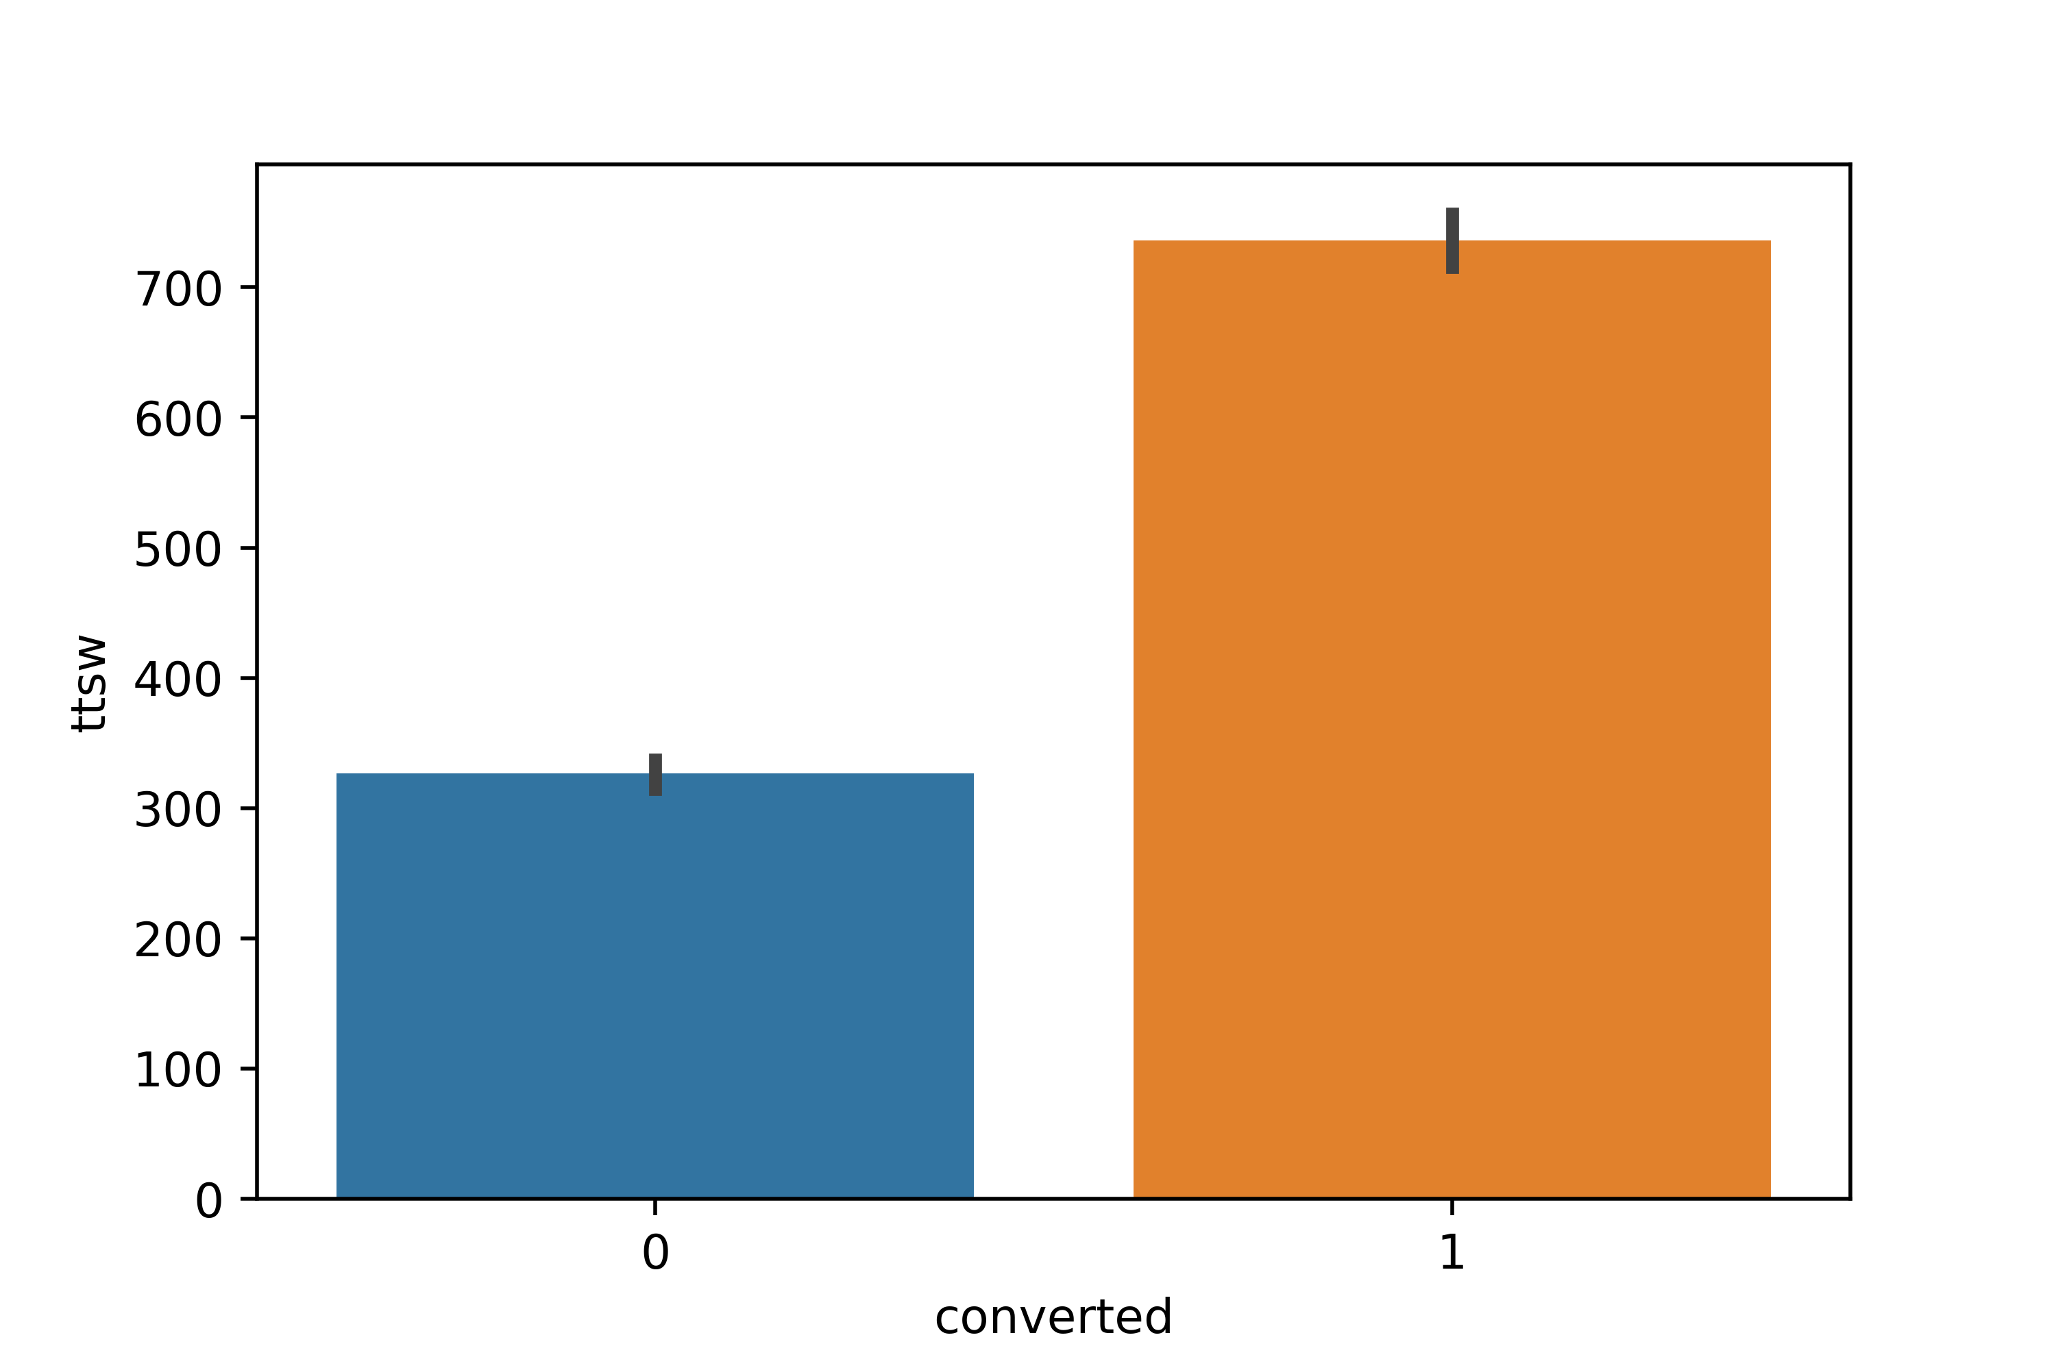
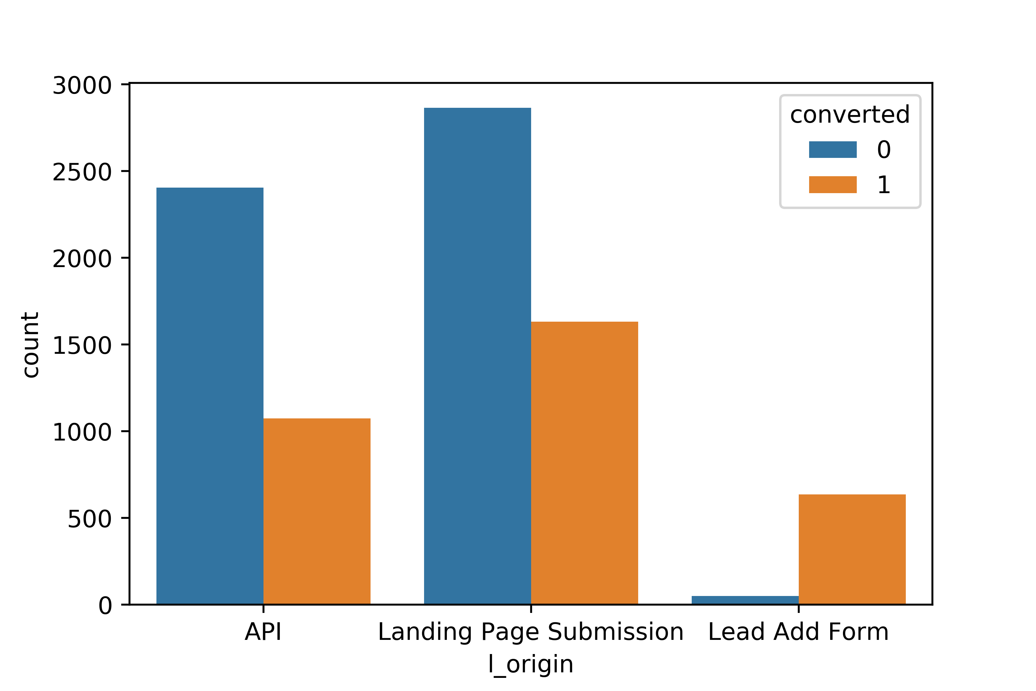
EDA
Those who spend more time on the web are more likely to get converted.
The leads which originate from the Lead_Add_Form are more likely to convert

Slide 5
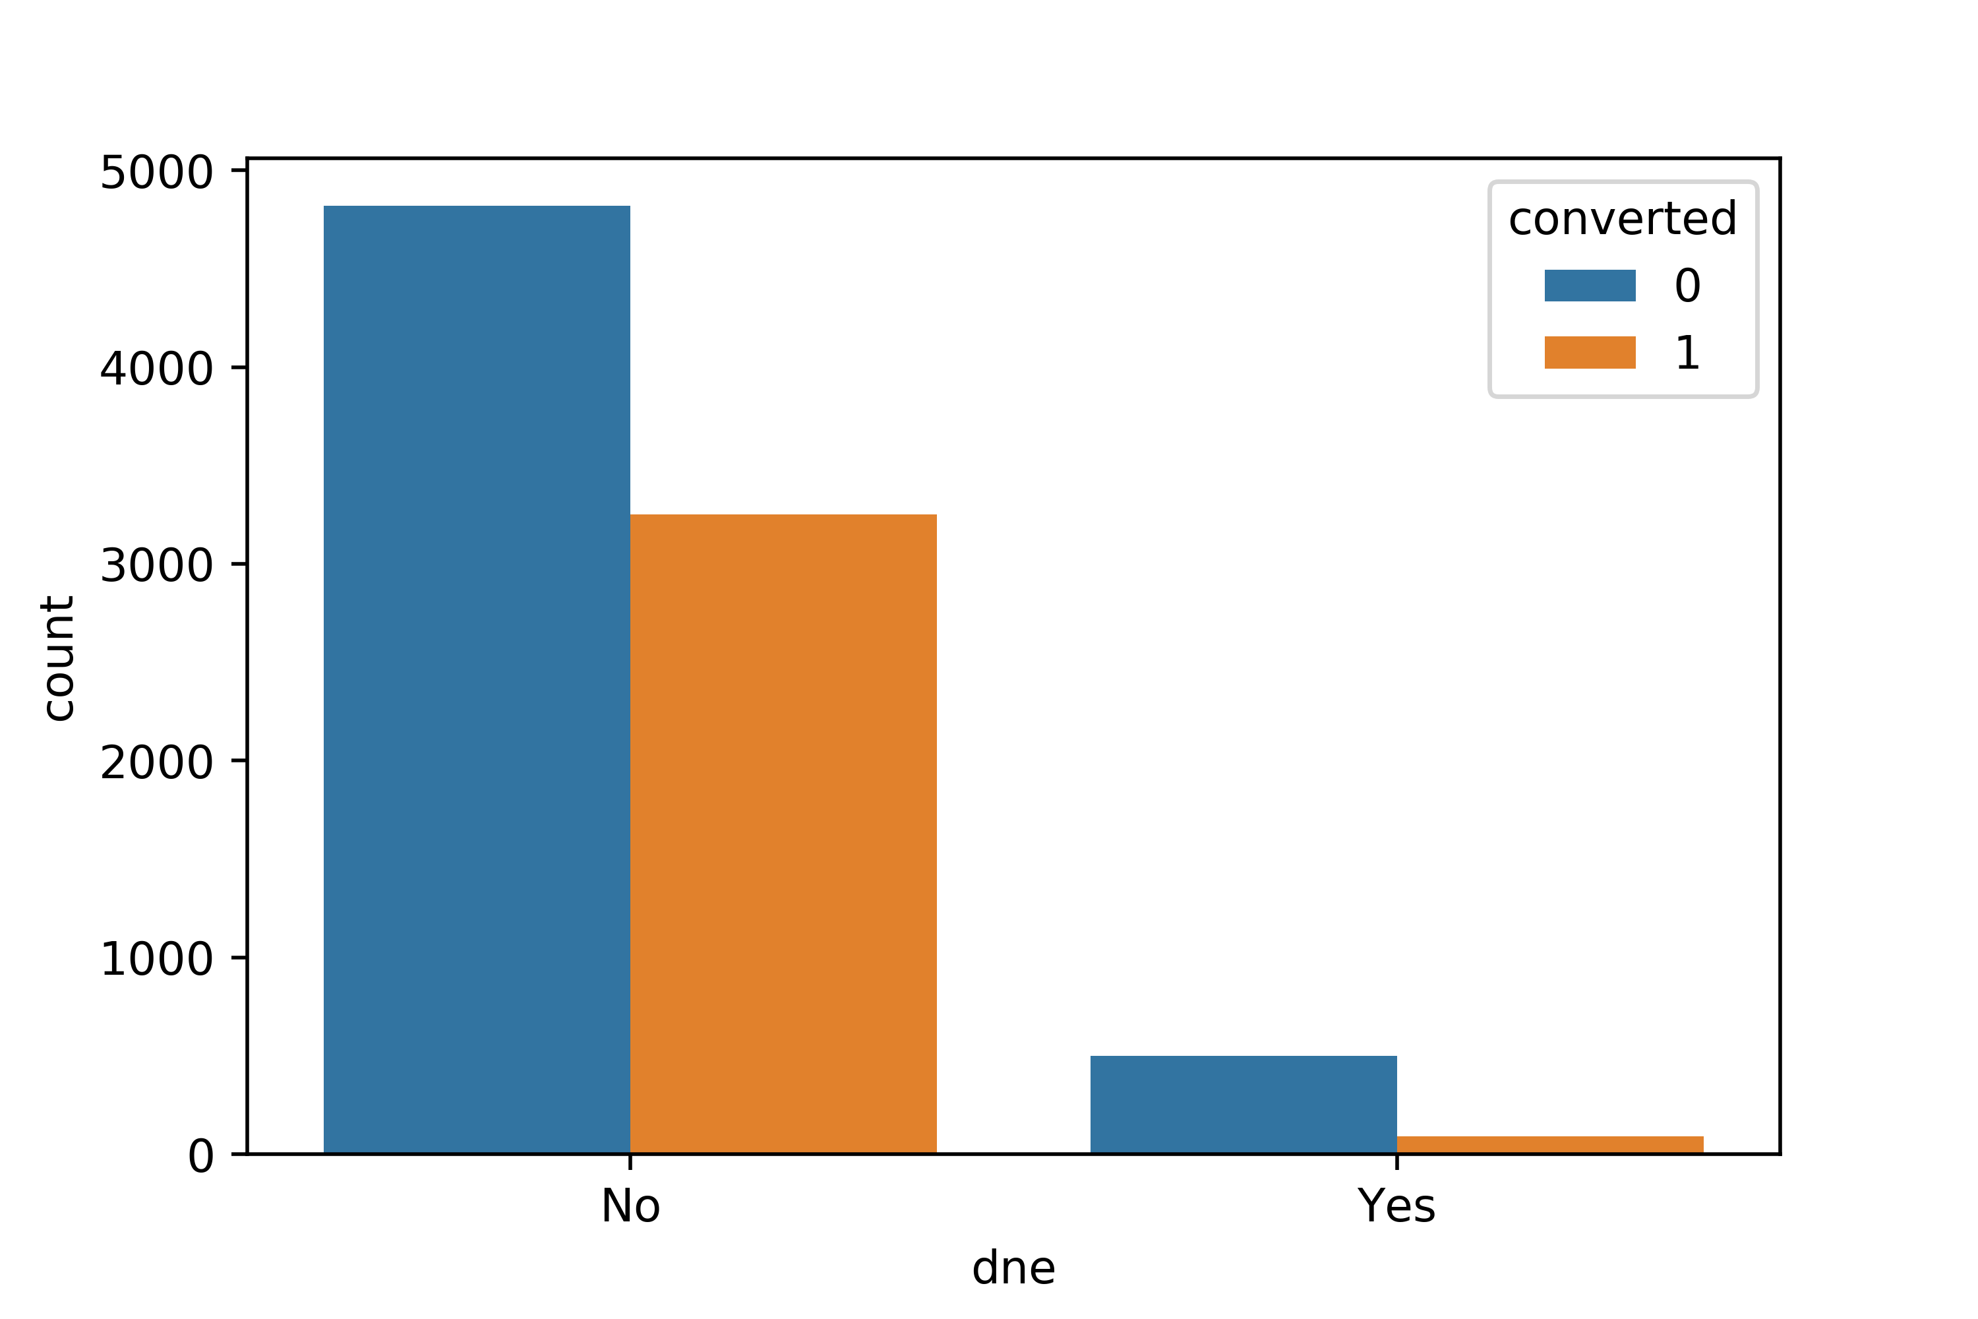
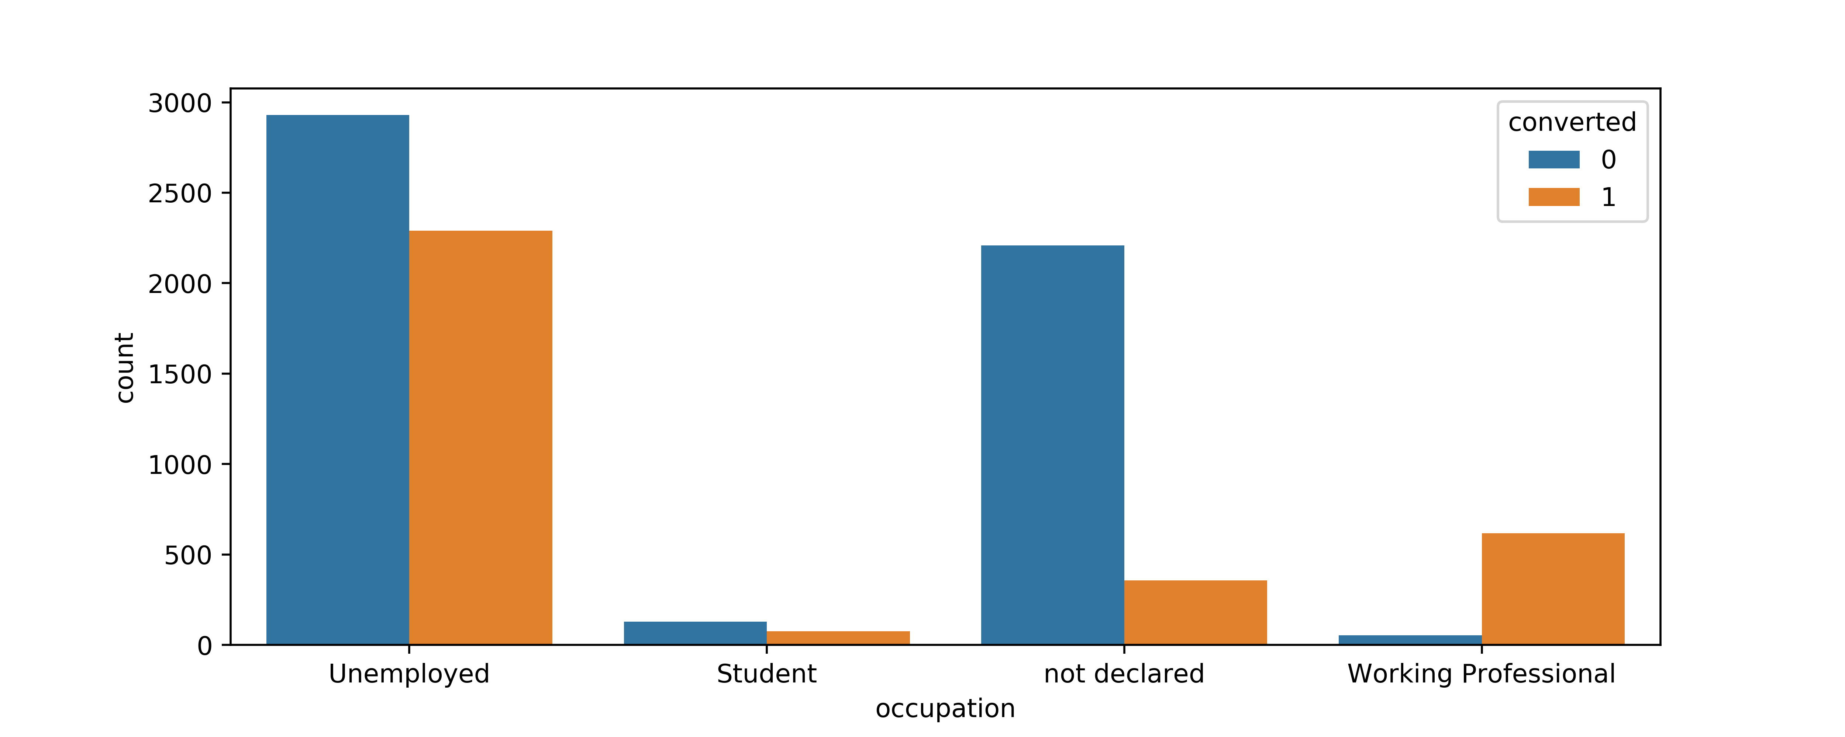
EDA
Those who opt to receive the email from X education are more likely to convert. The working professionals have the highest probability of getting converted.

Slide 6
Important Factors
Features | Coefficients
const | -1.8366
ttsw | 0.8052
orgn_API | -0.6609
src_Direct Traffic | -0.9587
src_Olark Chat | 0.6334
dne_Yes | -1.3247
hear_Multiple Sources | -0.9889
occ_Working Professional | 2.5905
what_Better Career Prospects | 1.2935
city_Mumbai | -0.2771
last_note_Email Opened | 0.5673
last_note_SMS Sent | 2.0099
Top 3 factors which affect the Lead Score Positively are “Total Time Spent on the web”, “Working Professionals”, and whose last notable activity is SMS Sent.
Top 3 factors which affect the Lead Score Negatively are opted for “Do not Email”, referred “multiple sources”, and source is “Direct Traffic”.

Slide 7
Analysis of Social Factors

Slide 8
Analysis of other Economic Factors
Cluster 3 countries have the lowest income per person and Cluster 5 countries have the highest income per person.

Slide 9
Conclusion

