Slide 1
Comcast Predictive Analytics
Weekly Status Report – Week 06
09 February 2018
Notes:
1

Slide 2
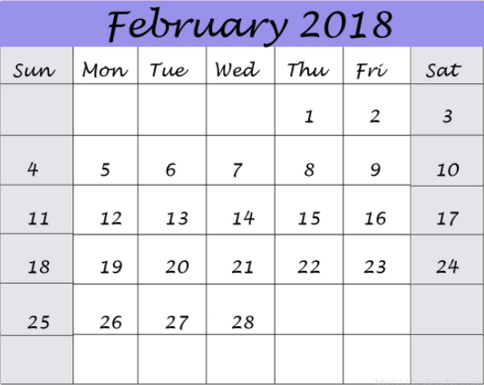
Weekly Status Report
Current Week
Action Items
Phase III
S3 data pushing into AWS EMR Master node – dry run
VMs Migration – II ( Open stack VMs to AWS )
Data Analysis – Redshift ( ~ S3 )
CIR Predictions Pipeline setup on AWS EC2 ( Redshift ) – Stand by Setup
Rewriting the ETL Codes for Redshift and S3 as the sources
ML Experiments – Unscheduled Reboot Predictions & Key call drivers for CIR
Other Important Activities
EMR Cluster validation and UI check for data distribution by running examples.
All the required packages installation on AWS EC2 Instances for Predictions Pipeline.
Week 15 (Current)
Week 16 (Next)
Redshift - CIR Predictions pipeline on AWS EC2 with results ( Tableau site to be accessible for results ) – Track 1
S3 – CIR Predictions pipeline : ETL Code logics implementations and end to end testing/validation – Track 2 ( Main)
ML Experiments – Unscheduled Reboot Predictions & Key call drivers CIR & using Redshift.
CIR Operationalization – Track 1 & Track 2 ( All ports , ETL Code logics, EMR Cluster hdfs config setup completion )
Next Week
Notes:
2

Slide 3
Contents
Phase III – ETL and ML Module Sub tasks 4
ETL Module – Sub tasks 5
Data Analysis 6
Unscheduled Reboot – Prediction Model 7
Key call drivers – CIR 8 - 9
Pending Tickets 10
Backup – Phase III: Key Tasks and Approaches to follow 12 – 21
Backup – Node Health Information 22

Slide 4




Sub Tasks – Phase III
ETL Module
Migration
Open stack to AWS
CIR Prediction model ( PROD)
Setup & Predictions ( EC2 )
Data Pull from S3 to EMR Master Node
New ETL Logics implementation (EMR)
for ML feed
Migration plan – II
Tagged AWS VMs - Dev , Prod
Implementation Plan Completed.
Open stack VMs production pipeline setup and Prediction results on EC2 Standalone VMs.
Direct access & Ports.
RDKB filtered Telemetry data to be extracted/pulled from S3 ( 15.5 M all data ) and stored on EMR Master node for processing.
CIR data streaming into EMR Master node.
DFs creation ( bootup,non-bootup & keep alive )
Timeslot DF
Mean DF
Sum DF
ML Module
CIR Prediction Operationalization
(EMR)
Key Call drivers
CIR
Key Call drivers
Unscheduled Reboot
Unscheduled Reboot Prediction Model
Root cause markers for other self heal opportunities
Make use of keep alive information
% of CIR MACs/ Unscheduled Reboot MACs covered by each key marker.
Ex : Wifi not connecting , box not sending Telemetry data to server ( struck state )
To be started
To be started
In progress
Blocked
To be used

Slide 5
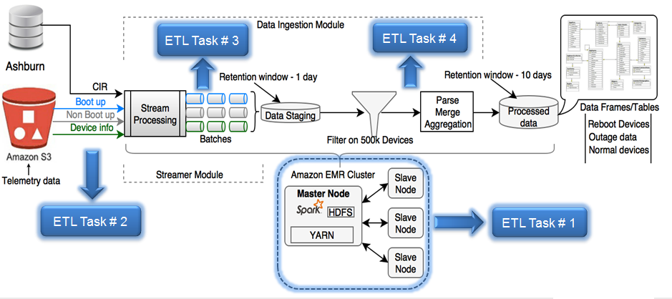
Phase III Subtasks Status - ETL Module
AWS EMR ( Cluster ) & EC2 instances – Direct access, Tableau port & CIR Ashburn data access are pending.
Planned ETL tasks for Phase – III and Progress.
3. Track -1 ( Backup/Standby Plan )
Redshift – Prediction Results
CIR Predictions Operationalization
VMs Migration from Open stack to AWS EC2 Completed.
Data growth analysis.
4. Track – 2 ( Main Plan)
S3 – Data source
Started DF generations development.
Telemetry data pull from S3 to EMR Master node – dry run completed ( EC2 ).
CIR streaming to Master node ticket is pending ( ETA – Feb end )
Redirecting CIR data from Open stack VMs to Master node and EC2.
All tasks are on-going
ETL Code logics Implementation
Dry run completed
Hdfs Config Capacity to be changed

Slide 6
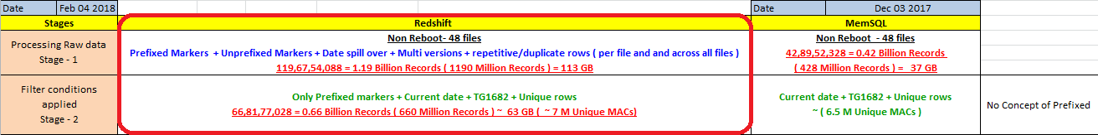
Data Analysis – Redshift ( ~ S3 )
Observations
Additional markers data compared to MemSQL for a MAC ( On an avg ).
Date spill over across all the files along with same row occurrence on a single file as well as 48 files ( Non- Reboot ).
Considerations
Filtering conditions – Only Prefixed markers + Current date + Unique rows + TG1682 at stage 1.
EC2 to EMR – CIR Prediction Pipeline will be migrated to EMR Cluster from EC2, post successful end to end validation and prediction results.

Slide 7
Unscheduled Reboot – Prediction Model (status – ongoing)
High level categorization of Machine Learning approaches to be used
Learning based on marker count - on-going
learning based on sequence of events (Ex : RNN)- To be started
Improvements to be made to Experiment 1 (on going):
Training Phase :
(To make sure “pure” reboot and non-reboot samples are supplied to the model)
To remove CIR MACs from both reboot and non-reboot samples.
To remove 3-hour windows with self-heal from both reboot and non-reboot samples.
To remove 3-hour windows overlapping with maintenance window from both reboot and non-reboot samples.
Testing Phase:
(to reduce false positives)
To remove 3 hour windows overlapping with maintenance window from prediction
Provide statistics of CIR MACs occurring in False Positives
Status of on-going Experiment
High level approach:- Learning based on marker count (3-hour window, marker count sum)
Experiment 1:
To Setup the pipeline on local system – completed
To Setup the pipeline on open stack VM- completed
To train the model on open stack VM using large amount of training data – on going
Cont…

Slide 8
Key markers for CIR (status- ongoing)
Approach used in existing CIR Prediction Model
Subtask 1 – To identify useful features
All Markers
Ex: ~ 300
Markers Importance Estimation by ML Model
Useful Markers
( ~ 25 )
Useful markers
ML Model for CIR Prediction
Marker contribution for each prediction
% Contribution of each key marker across MACs
(to be implemented )
Sample format - % Contribution of each key marker in each CIR MAC
Sample format - % Contribution of each key marker across CIR MACs
MAC ID | Markers exceeding count threshold | No of Markers exceeding count threshold | % Contribution from each marker
MAC 1 | WIFI_REBOOT, 2G_DISABLED | 2 | 50%
MAC 2 | HW_REBOOT, MOCAUP, SYNCLOST | 3 | 33%
……..
Marker | % Contribution across MACs
WIFI_REBOOT | 30%
MOCAUP | 20%
…….. | ……..
Cont…

Slide 9
Key markers for CIR (status- ongoing)
Alternative Approach ( status- ongoing)
Subtask 1 – Feature selection using EDA
All Markers
Ex: ~ 300
EDA (ongoing)
Useful markers,
Optimum window
To consider
(Ex : 3 hours)
Useful markers from EDA ( ~ 50 )
Shortlist true key markers
With the help of Apriori
Algorithm (~10)
Key marker
identification
for each call
(not prediction)
% Contribution of each key marker across MACs
Code completed and tested on local system
Sample format - % Contribution of each key marker in each CIR MAC
Sample format - % Contribution of each key marker across CIR MACs
MAC ID | Markers exceeding count threshold | No of Markers exceeding count threshold | % Contribution from each marker
MAC 1 | WIFI_REBOOT, 2G_DISABLED | 2 | 50%
MAC 2 | HW_REBOOT, MOCAUP, SYNCLOST | 3 | 33%
……..
Marker | % Contribution across MACs
WIFI_REBOOT | 30%
MOCAUP | 20%
…….. | ……..
Cont…

Slide 10
Pending Tickets
Enable port access for Site to Site(Tata) VPN for allocated AWS VM's -
https://ccp.sys.comcast.net/browse/INFRA-19844
To enable access to Ashburn data center to pull CIR data -
https://www.teamccp.com/jira/browse/FWREQ-2859
(Redirecting the CIR data from Open stack VM to AWS EMR Master node ) ~ EDA End of Feb
EMR Cluster validation - enabling ports on Cluster to access Spark UI -
https://ccp.sys.comcast.net/browse/RDKSVREQ-12764

Slide 11
Backup Slides

Slide 12
PHASE 3 – KEY TASKS AND APPROACHES TO FOLLOW

Slide 13
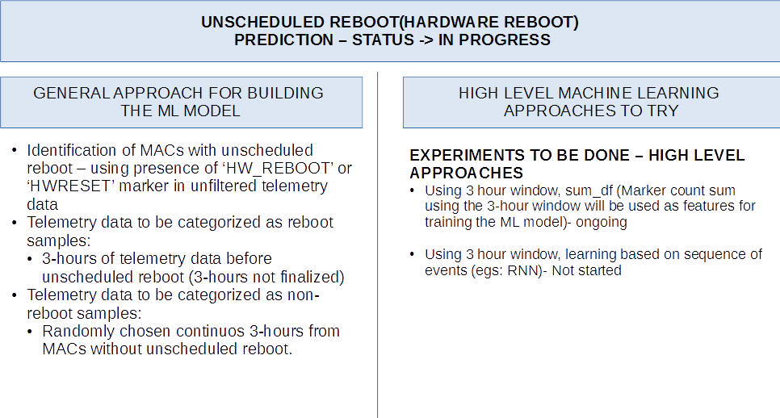

Slide 14
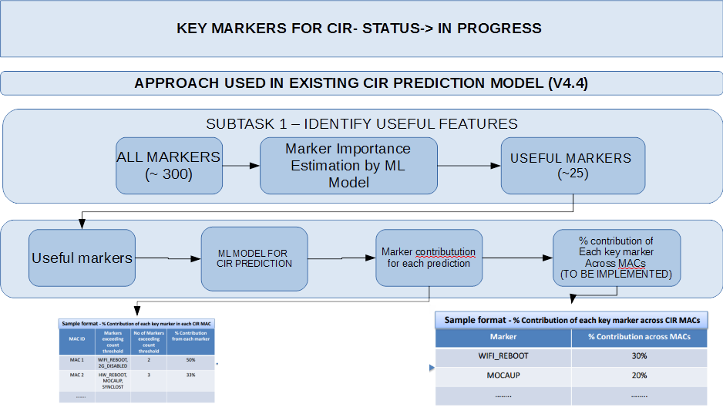

Slide 15
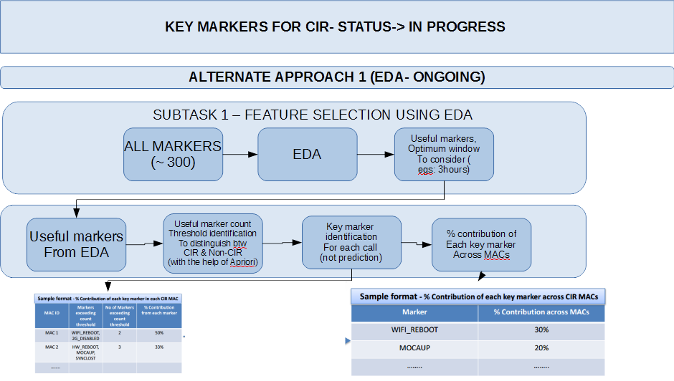

Slide 16
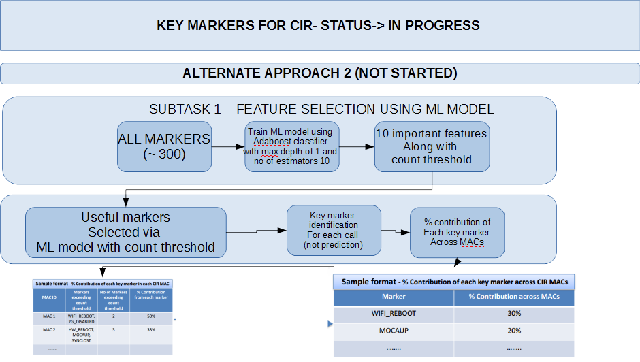

Slide 17
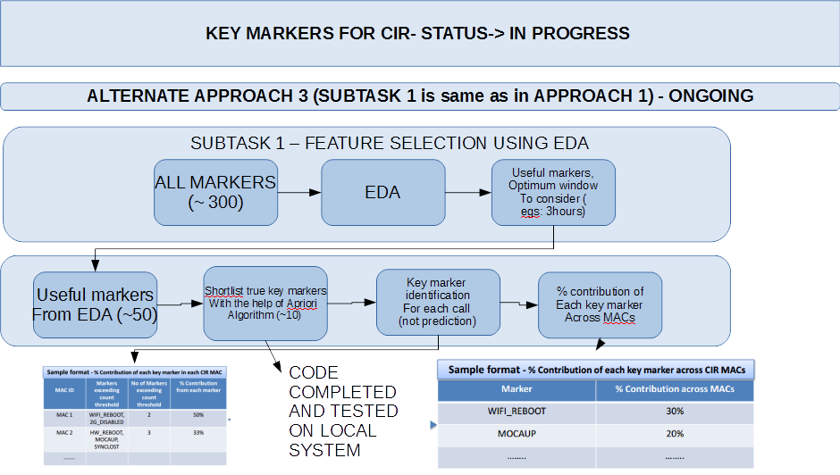

Slide 18
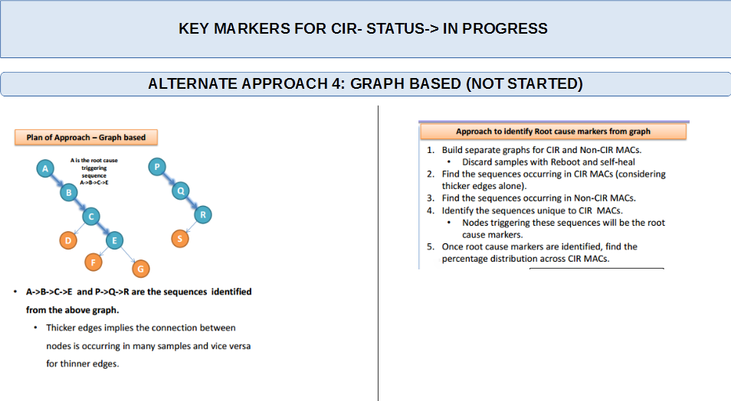

Slide 19
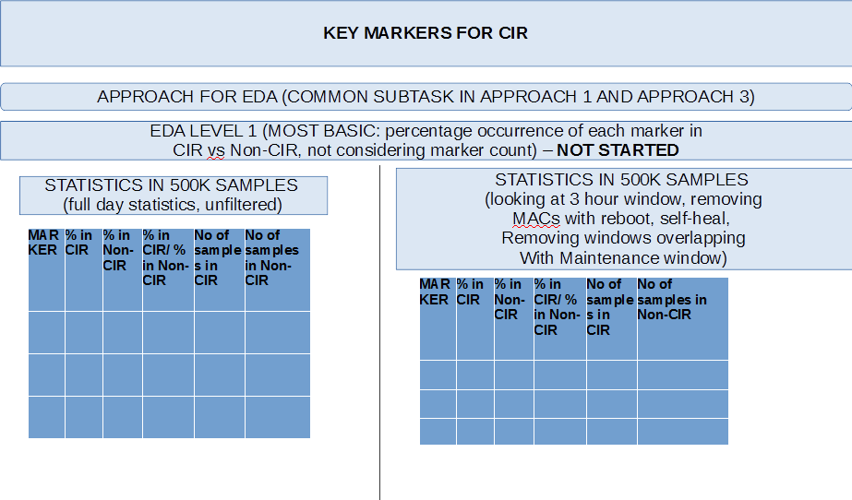

Slide 20
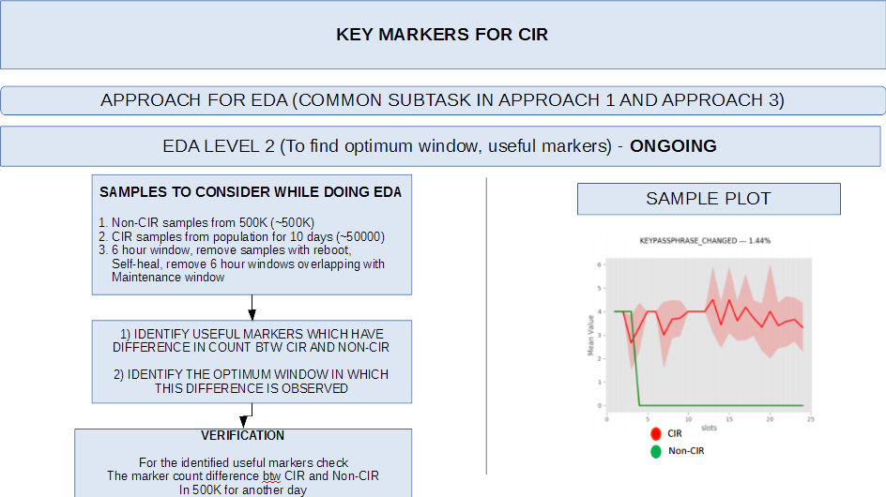

Slide 21
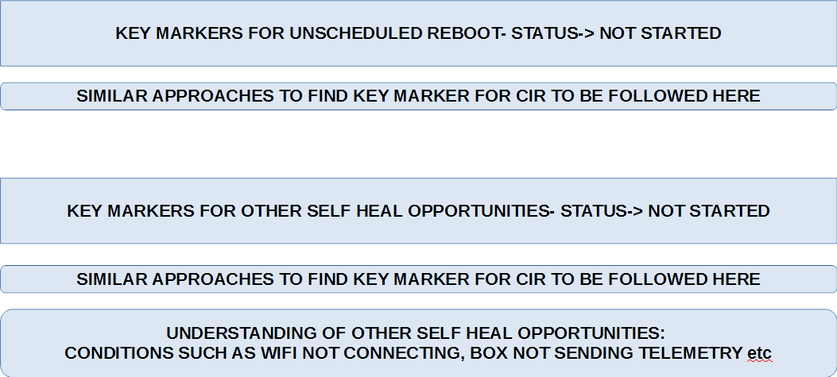

Slide 22
Utilization of Node health Information
Making use of node-health information
Node health information will be used to check if calls or unscheduled Reboots are caused by poor node health rather than any notable error pattern in Telemetry data.

Slide 23
Thank You
ITPB Road Whitefield Bangalore 560048 India | Tel +91 80 2297 9123 | Fax +91 80 2841 1474
info@tataelxsi.com
www.tataelxsi.com
Notes:
23

