Slide 1
AI(Artificial Intelligency)
What is Artificial Intelligence?
According to the father of Artificial Intelligence, John McCarthy, it is “The science and engineering of making intelligent machines, especially intelligent computer programs”.
Artificial Intelligence is a way of making a computer, a computer-controlled robot, or a software think intelligently, in the similar manner the intelligent humans think.
AI is accomplished by studying how human brain thinks, and how humans learn, decide, and work while trying to solve a problem, and then using the outcomes of this study as a basis of developing intelligent software and systems.

Slide 2
Philosophy of AI
While exploiting the power of the computer systems, the curiosity of human, lead him to wonder, “Can a machine think and behave like humans do?”
Thus, the development of AI started with the intention of creating similar intelligence in machines that we find and regard high in humans.

Slide 3
Goals of AI
To Create Expert Systems − The systems which exhibit intelligent behavior, learn, demonstrate, explain, and advice its users.
To Implement Human Intelligence in Machines − Creating systems that understand, think, learn, and behave like humans.

Slide 4
What Contributes to AI?
Artificial intelligence is a science and technology based on disciplines such as Computer Science, Biology, Psychology, Linguistics, Mathematics, and Engineering. A major thrust of AI is in the development of computer functions associated with human intelligence, such as reasoning, learning, and problem solving.
Out of the following areas, one or multiple areas can contribute to build an intelligent system.

Slide 5
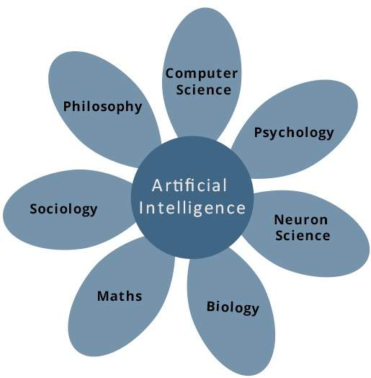

Slide 6
Programming Without and With AI
Programming Without AI Programming With AI
A computer program without AI can answer the specific questions it is meant to solve.
A computer program with AI can answer the generic questions it is meant to solve.
Modification in the program leads to change in its structure.
AI programs can absorb new modifications by putting highly independent pieces of information together. Hence you can modify even a minute piece of information of program without affecting its structure.
Modification is not quick and easy. It may lead to affecting the program adversely.
Quick and Easy program modification.

Slide 7
What is AI Technique?
In the real world, the knowledge has some unwelcomed properties −
Its volume is huge, next to unimaginable.
It is not well-organized or well-formatted.
It keeps changing constantly.
AI Technique is a manner to organize and use the knowledge efficiently in such a way that −
It should be perceivable by the people who provide it.
It should be easily modifiable to correct errors.
It should be useful in many situations though it is incomplete or inaccurate.
AI techniques elevate the speed of execution of the complex program it is equipped with.

Slide 8
Applications of AI
AI has been dominant in various fields such as −
Gaming − AI plays crucial role in strategic games such as chess, poker, tic-tac-toe, etc., where machine can think of large number of possible positions based on heuristic knowledge.
Natural Language Processing − It is possible to interact with the computer that understands natural language spoken by humans.
Expert Systems − There are some applications which integrate machine, software, and special information to impart reasoning and advising. They provide explanation and advice to the users.
Vision Systems − These systems understand, interpret, and comprehend visual input on the computer. For example,
A spying aeroplane takes photographs, which are used to figure out spatial information or map of the areas.
Doctors use clinical expert system to diagnose the patient.
Police use computer software that can recognize the face of criminal with the stored portrait made by forensic artist.
Speech Recognition − Some intelligent systems are capable of hearing and comprehending the language in terms of sentences and their meanings while a human talks to it. It can handle different accents, slang words, noise in the background, change in human’s noise due to cold, etc.
Handwriting Recognition − The handwriting recognition software reads the text written on paper by a pen or on screen by a stylus. It can recognize the shapes of the letters and convert it into editable text.
Intelligent Robots − Robots are able to perform the tasks given by a human. They have sensors to detect physical data from the real world such as light, heat, temperature, movement, sound, bump, and pressure. They have efficient processors, multiple sensors and huge memory, to exhibit intelligence. In addition, they are capable of learning from their mistakes and they can adapt to the new environment.

Slide 9
History of AI
Here is the history of AI during 20th century −
YearMilestone / Innovation1923Karel Čapek play named “Rossum's Universal Robots” (RUR) opens in London, first use of the word "robot" in English.
1943Foundations for neural networks laid.
1945Isaac Asimov, a Columbia University alumni, coined the term Robotics.
1950Alan Turing introduced Turing Test for evaluation of intelligence and published Computing Machinery and Intelligence. Claude Shannon published Detailed Analysis of Chess Playing as a search.
1956John McCarthy coined the term Artificial Intelligence. Demonstration of the first running AI program at Carnegie Mellon University.
1958John McCarthy invents LISP programming language for AI.

Slide 10
1964 | Danny Bobrow's dissertation at MIT showed that computers can understand natural language well enough to solve algebra word problems correctly.
1965 | Joseph Weizenbaum at MIT built ELIZA, an interactive problem that carries on a dialogue in English.
1969 | Scientists at Stanford Research Institute Developed Shakey, a robot, equipped with locomotion, perception, and problem solving.
1973 | The Assembly Robotics group at Edinburgh University built Freddy, the Famous Scottish Robot, capable of using vision to locate and assemble models.
1979 | The first computer-controlled autonomous vehicle, Stanford Cart, was built.
1985 | Harold Cohen created and demonstrated the drawing program, Aaron.

Slide 11
Major advances in all areas of AI −
Significant demonstrations in machine learning
Case-based reasoning
Multi-agent planning
Scheduling
Data mining, Web Crawler
natural language understanding and translation
Vision, Virtual Reality
Games
1997The Deep Blue Chess Program beats the then world chess champion, Garry Kasparov.
2000Interactive robot pets become commercially available. MIT displays Kismet, a robot with a face that expresses emotions. The robot Nomad explores remote regions of Antarctica and locates meteorites.

Slide 12
What is Intelligence?
Intelligence Description Example
Linguistic intelligence ….The ability to speak, recognize, and use mechanisms of phonology (speech sounds), syntax (grammar), and semantics (meaning). Narrators, Orators
Musical intelligence…..The ability to create, communicate with, and understand meanings made of sound, understanding of pitch, rhythm……
Musicians, Singers, Composers

Slide 13
Logical-mathematical intelligence….
The ability of use and understand relationships in the absence of action or objects. Understanding complex and abstract ideas…
Mathematicians, Scientists
Spatial intelligenceThe ability to perceive visual or spatial information, change it, and re-create visual images without reference to the objects, construct 3D images, and to move and rotate them.Map readers, Astronauts, Physicists

Slide 14
Bodily-Kinesthetic intelligence
The ability to use complete or part of the body to solve problems or fashion products, control over fine and coarse motor skills, and manipulate the objects.
Players, Dancers
Intra-personal intelligence
The ability to distinguish among one’s own feelings, intentions, and motivations.
Gautam Buddhha

Slide 15
Interpersonal intelligence
The ability to recognize and make distinctions among other people’s feelings, beliefs, and intentions.
Mass Communicators, Interviewers

Slide 16
What is Intelligence Composed of?
You can say a machine or a system is artificially intelligent when it is equipped with at least one and at most all intelligences in it.
The intelligence is intangible. It is composed of −
Reasoning
Learning
Problem Solving
Perception
Linguistic Intelligence

Slide 17
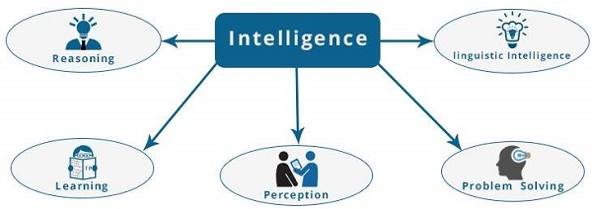
Let us go through all the components briefly −
Reasoning − It is the set of processes that enables us to provide basis for judgement, making decisions, and prediction. There are broadly two types −

Slide 18
Inductive Reasoning | Deductive Reasoning
It conducts specific observations to makes broad general statements. | It starts with a general statement and examines the possibilities to reach a specific, logical conclusion.
Even if all of the premises are true in a statement, inductive reasoning allows for the conclusion to be false. | If something is true of a class of things in general, it is also true for all members of that class.
Example − "Nita is a teacher. Nita is studious. Therefore, All teachers are studious." | Example − "All women of age above 60 years are grandmothers. Shalini is 65 years. Therefore, Shalini is a grandmother."

Slide 19
Learning − It is the activity of gaining knowledge or skill by studying, practising, being taught, or experiencing something. Learning enhances the awareness of the subjects of the study.
The ability of learning is possessed by humans, some animals, and AI-enabled systems. Learning is categorized as −
Auditory Learning − It is learning by listening and hearing. For example, students listening to recorded audio lectures.
Episodic Learning − To learn by remembering sequences of events that one has witnessed or experienced. This is linear and orderly.
Motor Learning − It is learning by precise movement of muscles. For example, picking objects, Writing, etc.
Observational Learning − To learn by watching and imitating others. For example, child tries to learn by mimicking her parent.
Perceptual Learning − It is learning to recognize stimuli that one has seen before. For example, identifying and classifying objects and situations.
Relational Learning − It involves learning to differentiate among various stimuli on the basis of relational properties, rather than absolute properties. For Example, Adding ‘little less’ salt at the time of cooking potatoes that came up salty last time, when cooked with adding say a tablespoon of salt.
Spatial Learning − It is learning through visual stimuli such as images, colors, maps, etc. For Example, A person can create roadmap in mind before actually following the road.
Stimulus-Response Learning − It is learning to perform a particular behavior when a certain stimulus is present. For example, a dog raises its ear on hearing doorbell.

Slide 20
Problem Solving − It is the process in which one perceives and tries to arrive at a desired solution from a present situation by taking some path, which is blocked by known or unknown hurdles.
Problem solving also includes decision making, which is the process of selecting the best suitable alternative out of multiple alternatives to reach the desired goal are available.
Perception − It is the process of acquiring, interpreting, selecting, and organizing sensory information.
Perception presumes sensing. In humans, perception is aided by sensory organs. In the domain of AI, perception mechanism puts the data acquired by the sensors together in a meaningful manner.
Linguistic Intelligence − It is one’s ability to use, comprehend, speak, and write the verbal and written language. It is important in interpersonal communication.

Slide 21
Difference between Human and Machine Intelligence
Humans perceive by patterns whereas the machines perceive by set of rules and data.
Humans store and recall information by patterns, machines do it by searching algorithms. For example, the number 40404040 is easy to remember, store, and recall as its pattern is simple.
Humans can figure out the complete object even if some part of it is missing or distorted; whereas the machines cannot do it correctly.

