Slide 1
Content
Population : -
E-commerce growth :-
Pre-farm introduction:-
Services to Farmer :-
How our group manage it:-
DFD(Data Flow Diagram of website):-
Use case Diagram:-
Sequence Diagram:-
Class Diagram:-
Component Diagram:-
Activity Diagram:-

Slide 2
State Diagram:-
Deployment Diagram:-

Slide 3
Population
Total population of India is 133.92 crore in 2017.
89 crore are living in rural area.
Among these 10 crore (approx.) are farmers.
And 6-7 crore (approx.) uses Internet or have knowledge of Internet.

Slide 4
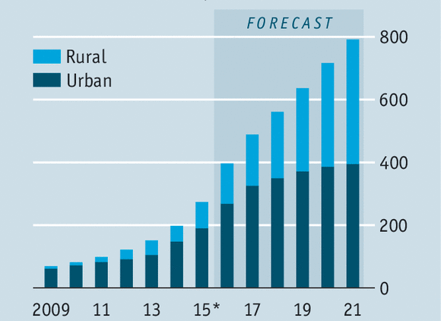
Internet Users(2009-2021)

Slide 5
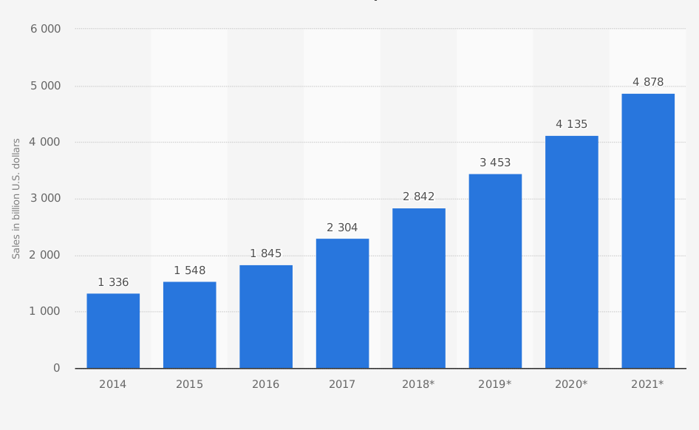
E-Commerce Growth(2014-2021)

Slide 6
Farmer uses Internet
A Boston Consulting Group study say that by 2020, about 315 millions Indians living in rural areas will be connected to internet.
Among them 118.7 millions are farmer.
There were an estimate 269 millions urban internet users in Dec 2016, while rural India, there were 163.
If a person using Internet then usually they have mobile or computer And they are able to buy any product online.

Slide 7
PREFARM
Prefarm connecting all the farmers in E-commerce
world .
Built a platform for all that person which depend on agriculture sector.
A agricultural platform for availability of all type of plants protective chemicals.

Slide 8
Services to farmers
Online crop protective chemicals.
Seminars by better producers.
Adviser (Who have a good knowledge of agriculture) among two or three village after couple of time each adviser shifted to each villages for individual carrying of field.
NPK, Urea, Pottash, Sulphate fertilizer are available.
Loan/KCC every year during difficult situation.
Employment .
Delivering or buying of dung/dungstock (inorganic fertilizer).
Employee for irrigation or harvesting or for any other farming based work.
Online availability of pump, cable, wire, pipe, casta, iron pipe, torch etc.
Page - 1

Slide 9
Harvesting information (location of thresher, harvester).
Online availability of organic medicine .
Online buying of crop through judging sample of crops with different member.
Vegetable buying on daily basis.
Milk buying and packing it for city or distributed among cities nearby.
Dress /shoes long and short only for farmer.
Trauli, tracter , sediel, (old & new) available on rent and for sell.
Organic fertilizer from dung( home made).
Individual carrying of field if needed.

Slide 10
Online buying of Grass powder .
Online buying of Khali.
Animals (goat, buffalo, cow etc) can be sell or buy online from home.

Slide 11
Producers how?
Delivery initially from near shop and then from stock (stock buy from pharmaceutical company) and quality matters.
Same with cloths (if required ).
Medicine store in hall with different section like library.
Testing the medicines on plant then added to website.
Seminar and certification with gift kit during seminar to best producing farmers.
Adviser should be agricultural specialist.
→ 1 adviser between/among villages.
NPK, DAP, Potash buy from company/Agency directly before season.
KCC/Loan providing which needed account in bank so that EMI is deducted from account of farmer.

Slide 12
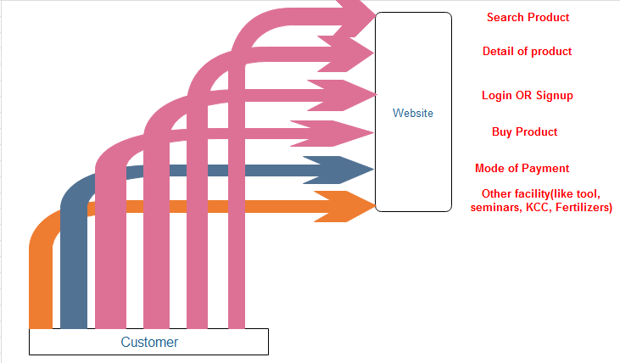
Data Flow Diagram (level 0)

Slide 13
Data Flow Diagram (level 1)

Slide 14
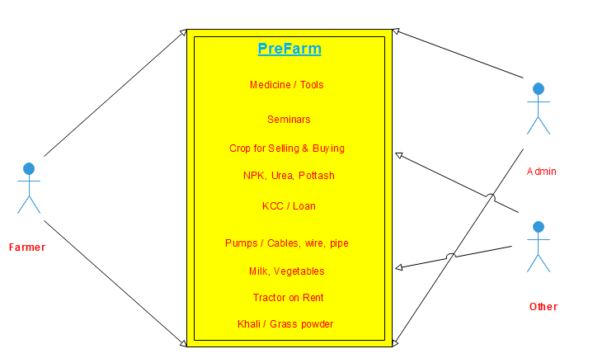
Use Case Diagram

Slide 15
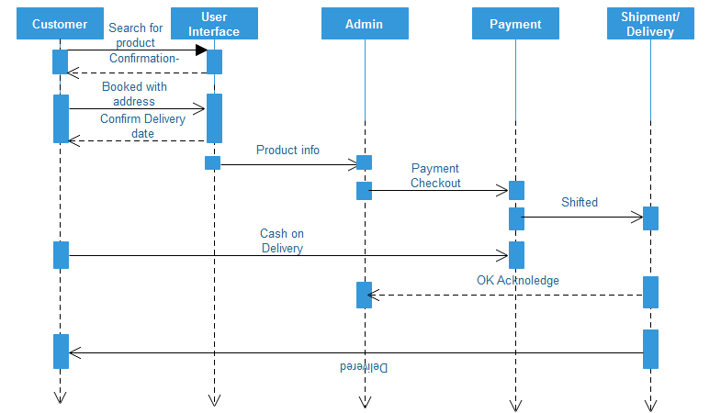
Sequence Diagram (Buying)

Slide 16
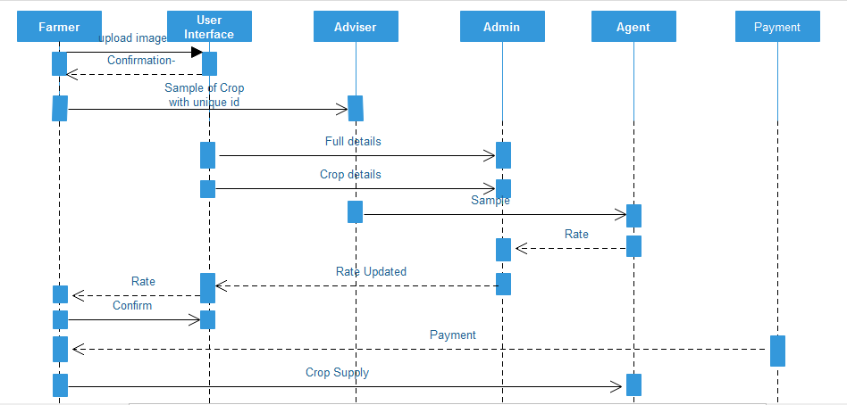
Sequence Diagram (selling crop)

Slide 17
Class Diagram

Slide 18
Component Diagram

Slide 19
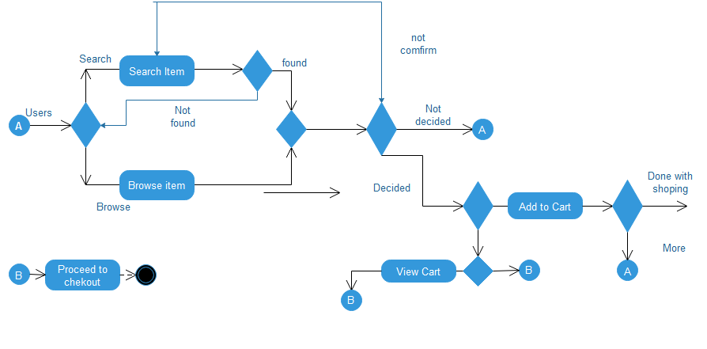
Activity Diagram

Slide 20
State Chart Diagram

Slide 21
Deployment Diagram

Slide 23
a good samaratian industrialist should come to a village, buy all the farms in the village, employ the same farmers with fixed salary , . As in USA if all small farms turn into a big farm , manufacturing ( here cultivating) cost reduces , machinery cost also reduces. As the industrialists have good vision and management, they can categories farmers or agri workers in different sections like preparing land , sowing, tilling, harvesting and can create departments to look after specific activities,. As the industrialists can work on wells or canals irrigation should not be a problem. They can also look after selling and storing more effectively. As other companies send their employees to other countries same these agro companies can also send young farmers to other countries to learn better techniques.

