Slide 1
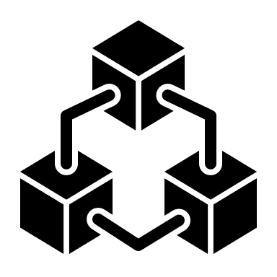
Continuous integration is the practice of automating the integration of code changes from multiple contributors into a single software project.
What is Continuous Integration?

Slide 2

Developers frequently merge code changes by placing it in a central repository where builds and tests then run.

Slide 3

WITHOUT CONTINUOUS INTEGRATION…
Without CI, developers must manually coordinate and communicate when they are contributing code to the end product.

Slide 4

How Continuous Integration works……..
SOFTWARE ENGINEERS WORK INDEPENDENTLY IN PARALLEL…

Slide 5
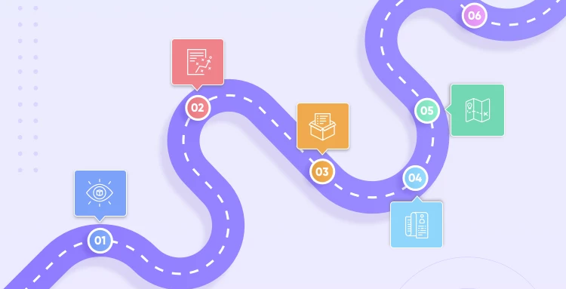
CI is used alongside an agile software development workflow. An organization will compile a list of tasks that comprise a product roadmap

Slide 6









The tasks are distributed amongst software engineering team members for delivery… Using Continuous Delivery working in parallel once one of these tasks are completed a developer will introduce that new work to the CI system to be integrated with the rest of the project.

Slide 7



TEAMS
CI enables organizations to scale in engineering team size, codebase size, and infrastructure.
JUST RIGHT….
JUST RIGHT….
TOO BIG…..

Slide 8





THROUGH TO RELEASE
DEVELOPERS OWN
CODE CHANGE
Continuous Integration allows each team member to own a new code change through to release

Slide 9



IMPROVE THE FEEDBACK LOOP
Product teams can test ideas and iterate product designs faster with an optimized CI platform. Changes can be rapidly pushed and measured for success. Bugs or other issues can be quickly addressed and repaired.

Slide 10

If your organization strives to reap the benefits of a DevOps approach or simply has a multiple-developer software team, Continuous Integration is important. It will help your engineering organization execute quicker and more effectively
API REFERENCES AND CITATIONS WEBSITES USED FOR THIS PROJECT:
https://www.atlassian.com/continuous-delivery/continuous-integration

