Slide 1
WEB 340 Node.js
Week 6 Data Persistence

Slide 2
Agenda
MongoDB.
Mongoose driver and connection string.
Mongoose.
Account registration.

Slide 3
MongoDB
Popular database that’s wiggled its way into the arms of many Node.js developers (Hahn, 2016).
In general, web applications store their data in one of two kinds of databases: relational or non-relational (Hahn, 2016).
Relational databases store data in table structures that resemble spreadsheets.
Tables are constructed with rows and columns.

Slide 4
MongoDB
Columns represent the field type (i.e., first name, last name or address).
Rows represent the raw data.
Non-relational databases are called NoSQL databases because they typically do not use traditional SQL (Structured Query Language) queries.

Slide 5
MongoDB
In general, most NoSQL databases are a lot like JavaScript because they are less ridged and more flexible.
Most applications have one database, like MongoDB and these databases are hosted on servers (Hahn, 2016). Servers can be located in a companies server farm or hosted by third-party cloud providers.
Examples of third-party cloud providers are: MongoDB Atlas, Digital Ocean, and AWS.
A MongoDB server can have many databases on it.

Slide 6
MongoDB
Best practices suggest, one database should be used per application.
Most organizations follow one of two strategies: many MongoDB instances for one server or one MongoDB instance per server.
MongoDB databases should be clustered across multiple servers.
To access a MongoDB database, the server sends requests to it through an API and database connection string.

Slide 7
MongoDB
Client libraries, referred to as database drivers, are the API’s developers use to manipulate data in a database.
MongoDB is structured by documents and collections.
Each collection is comprised of documents.
Documents represent the data structure and identify the fields in the object (i.e., first name, last name, address, etc.,).

Slide 8
MongoDB
Documents are similar to JSON in structure, but are actually called BSON data structures.
If it is valid JSON it’s valid BSON.
Think of MongoDB collections as an Excel workbook and documents as the Excel spreadsheets in the workbook.
Or, better yet, think of a MongoDB collection as a filing cabinet and the files in the cabinet as documents.

Slide 9
MongoDB
Web 340 introduces MongoDB to save data in the Pets-R-Us website.
This is not a database course; Web 335 is.
This course does not cover database features or advanced topics.
This course assumes you have limited to no experience with database technologies.

Slide 10
Connection string
To connect Node.js to your MongoDB database you will need to add a connection string to the index.js file and call the mongoose.connect() function.
Step 1: add a require statement for the mongoose library.
Step 2: create a connection string variable (copy the connection string from your MongoDB Atlas database).
Step 3: call the mongoose connect function.

Slide 11
Connection string
Sign in to MongoDB Atlas -> Open the “Overview tab.”
Select the “Connect” button.
Choose the “Connect your application” option.
Copy the string value under bullet point 2.
Make sure you read the comments under the string value. It explains what you need to replace in the connection string. Skipping past this part will cause errors in your project.
For the username and password, use the credentials you created following the MongoDB Atlas guide.

Slide 12
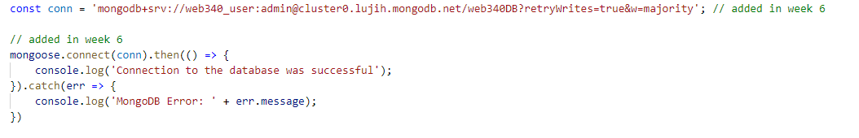
Connection string
Example:
Special note. Your application will generate errors if you did not follow the instructions under the pop-window when you copied the connection string from MongoDB Atlas.

Slide 13
Mongoose
Third-party NPM package.
Allows us to write plain JavaScript code to interact with a MongoDB database.
Great for non-database developers.
Easy to use.

Slide 14
Mongoose
Provides a straight-forward, schema-based solution to modelling your applications data and includes built-in type casting, validation, query building, business logic hooks and more, out of the box (Hahn, 2016).
Step 1: install mongoose.
Step 2: define a mongoose model.
Step 3: export the model.
Step 4: import the model using a require statement.

Slide 15

Mongoose
Every mongoose model needs a Schema, which is essentially the structure of the data you are creating (i.e., fields: first name, last name, address, etc.,).
Every mongoose model needs to be exported as a mongoose model.

Slide 16
Mongoose
Most used data types and constraints:
Data types: String, Number, Date.
Constraints: unique, required, default.
Default can be used as follows:
createdAt: {type: Date, default: Date.now }
Unique sets the property to only accept unique values.
Required sets the property to a required field.

Slide 17
Mongoose
Basic queries:
find.
findOne.
create.
findByIdAndDelete.
findByIdAndUpdate.

Slide 18
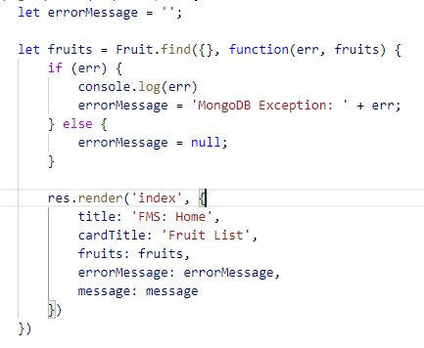
Mongoose
find:

Slide 19
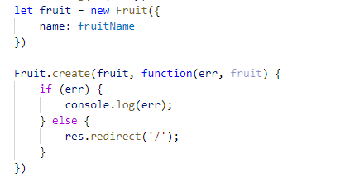
Mongoose
create:

Slide 20
Mongoose
find:
The find function returns a collection of documents.
Called off of the model you import (i.e., const Fruit = require(‘./models/fruit’);
Returns a callback function, which includes a MongoDB specific error object or the collection object.
Fruit.find({}, function(err, fruits) {})
The first argument is for filtering.
The second argument is the callback function.
The first argument in the callback function is the MongoDB error object.
The second argument in the callback function is the collection object.

Slide 21
Mongoose
create:
The create function returns the inserted document.
Called off of the model you import.
Returns a callback function, which includes a MongoDB specific error object or the collection object.
Requires a model to insert.
Fruit.create(newFruit, function(err, fruit) {})
The first argument is a new fruit object, second argument is the callback function.
The first argument in the callback function is the MongoDB error object.
The second argument in the callback function is the inserted fruit object.

Slide 22
Account registration npm packages
express-session: used to manage express sessions.
passport: used for authorization and authentication.
passport-local: used for authentication with standard usernames and password accounts.
passport-local-mongoose: used to simplify authentication and authorization.

Slide 23
Account registration
Added to the mongoose model:
Creates a username for the object by default.
Adds two additional fields to the collection: salt and hash.
Used to verify passwords.
Does not store plain text or encrypted passwords.

Slide 24
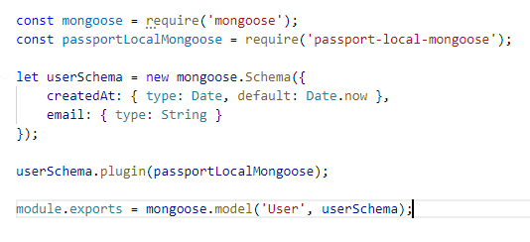
Account registration
Model:

Slide 25
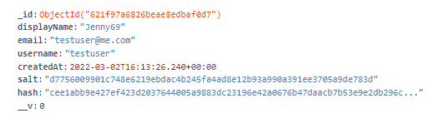
Account registration
Collection view:

Slide 26

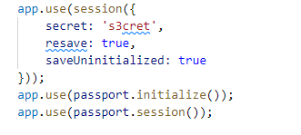
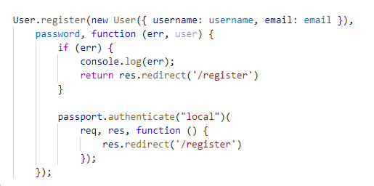

Account registration
Configuration code (added to the index.js file):

Slide 27
Account registration
The session object is needed for the express session library (i.e., const session = require(‘express-session’);)
To configure the session object call: app.use(session({}
To configure passport, you must call the initialize and session functions on the imported passport object (see the previous slide).
To map passport to the local storage object you must add a use statement for the LocalStrategy (i.e., const LocalStrategy = require(‘passport-local’);

Slide 28
Account registration
To serialize and deserialize the users password you must call the serializeUser and deserializeUser functions (see the previous slides).
Finally, to register a new user, you call a built-in register function from the npm passport-local-mongoose package (see the previous slides).
Calling passport.authenticate(‘local’) adds the users session to the browser and signs them into the website (see the previous slides).

