Slide 1
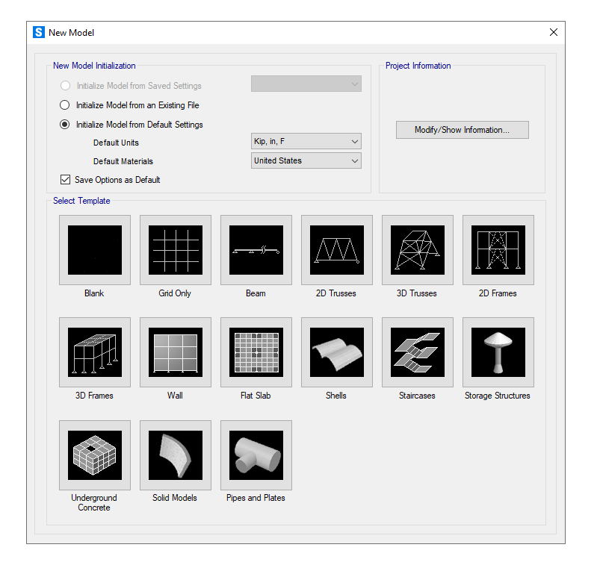
Click “New model”
Let’s start with two options:
Section design
Frame design

Slide 2
Frame Design
There are some steps to be optional by either right click or selection from top bar.
These are:
Edit Grid
Draw frame
Define material property
Define section property

Slide 3
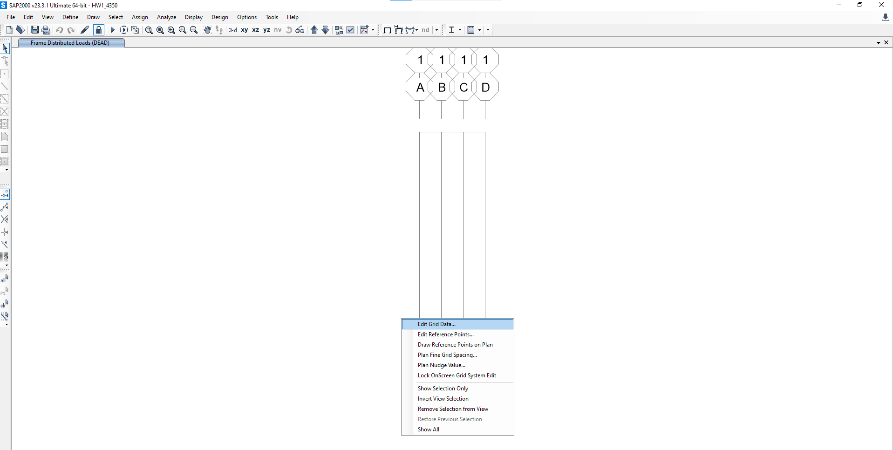
Right click to select “edit grid”

Slide 4
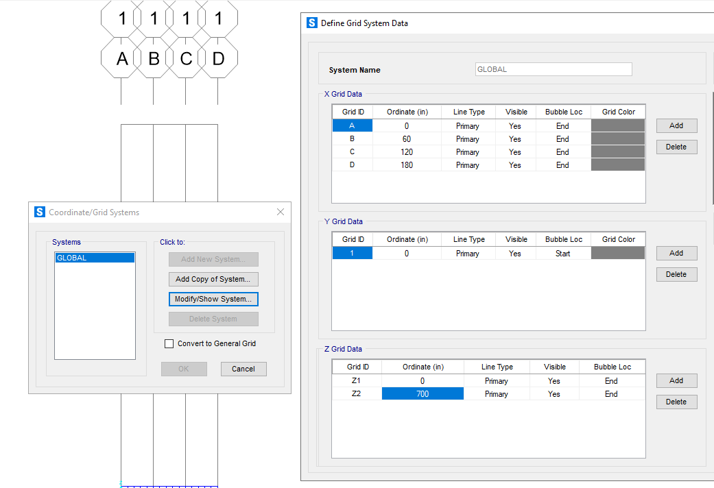
Input grids in three dimensions

Slide 5
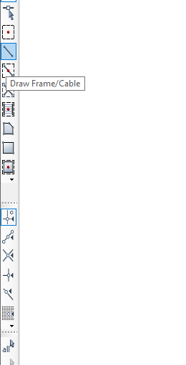
Select “Draw Frame/Cable”
Select “Draw frame/cable” to start drawing/modeling

Slide 6
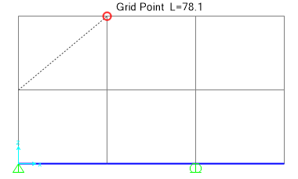
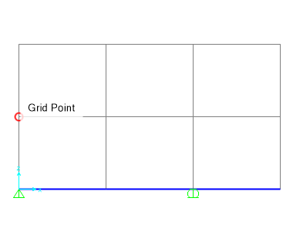
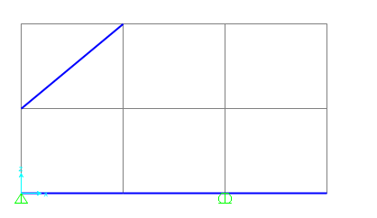
Draw you model
After selecting frame (see prev. page), you can draw your model from intersection of grids

Slide 7
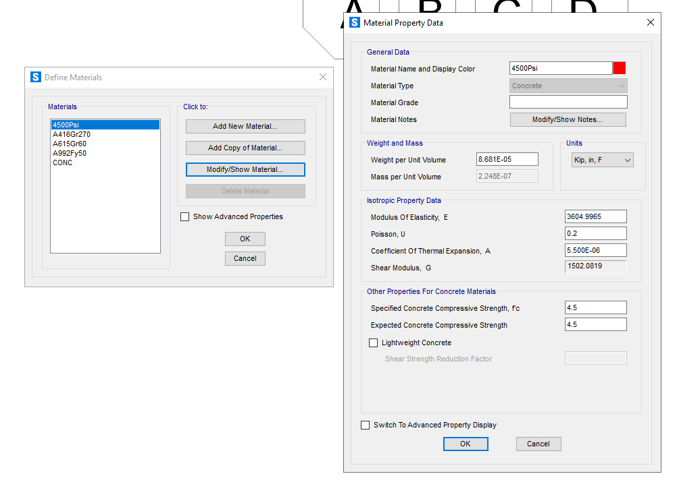
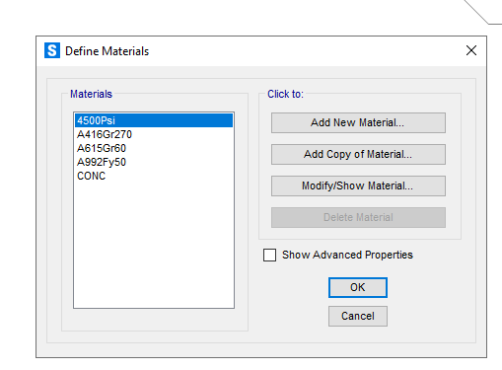
Define Material Property
ABS

Slide 8
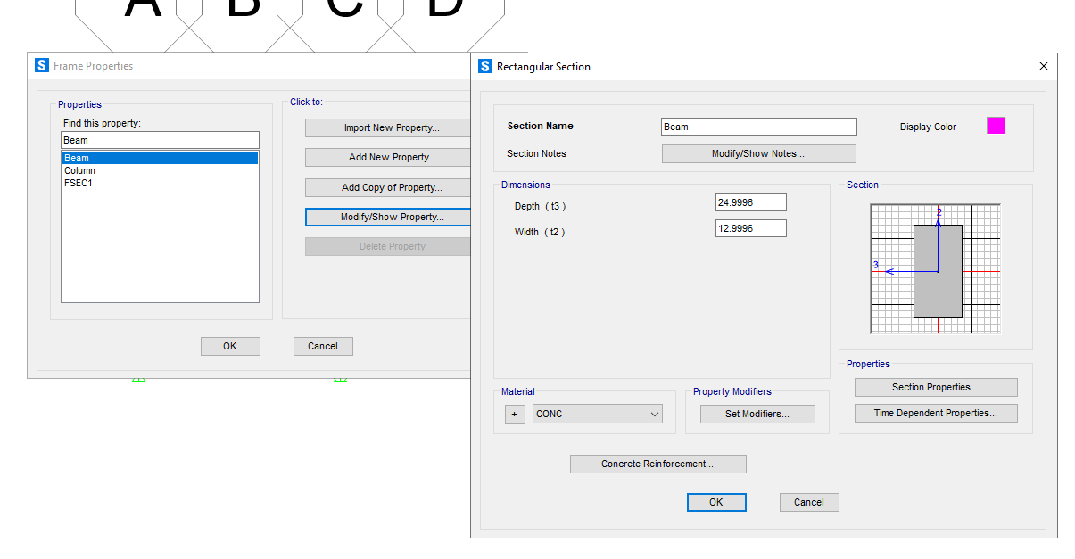
Define “Frame Section”

