Slide 1
Time Series in R
Unit 5 – Part-1

Slide 2
Introduction to Time Series Data
Time series data = observations collected sequentially over time at regular intervals.
Time series modeling is a method that uses data indexed by time (years, days, hours, minutes) to uncover hidden patterns and insights, enabling informed decision making.
Examples: daily temperature, monthly sales, hourly website hits.
Order matters; past values influence future values.
Helps understand patterns (trend, seasonality, cycles), forecast future values and detect anomalies.

Slide 3
Components of a Time Series
Trend: Long-term increase or decrease.
Seasonality: Regular, periodic fluctuations.
Cyclic Variation: Long-term up/down movements not fixed to a period.
Irregular/Noise: Unpredictable variation.

Slide 4
Examples of Time Series
Financial: stock prices, interest rates.
Business: monthly sales, customer footfall.
Environment: rainfall, temperature, pollution index.
Healthcare: patient admissions, disease incidence.

Slide 5
What is time series Data?
Time Series Data refers to values of a variable recorded over time, such as months, quarters, or years. Examples include stock prices changing every second or monthly unemployment rates.
There are two types:
1. Univariate: Uses a single variable to describe the data.
2. Multivariate: Uses multiple variables to describe the data.
Time Series Analysis examines patterns and trends in both univariate and multivariate data. R provides tools and commands to perform such analysis effectively.

Slide 6
Basic R Commands for Data Visualisation
R provides built-in functions to visualise time series quickly.
plot(): basic plotting function.
ts.plot(): specialised for time series; can overlay multiple series.
lines() & points(): add additional series or points to an existing plot.
legend(): add legends to differentiate series.
plot() – Creates a scatter plot or line plot of the given data.
hist() – Draws a histogram to show the frequency distribution of a dataset.
pie() – Generates a pie chart to represent parts of a whole.
boxplot() – Creates a box-and-whisker plot to display data distribution and outliers.
stripchart() – Produces a one-dimensional scatter plot for visualizing individual data points.
curve() – Plots a mathematical function or curve over a specified range.
abline() – Adds straight lines (horizontal, vertical, or regression) to an existing plot.
qqnorm() – Creates a normal Q-Q plot to check if data follows a normal distribution.

Slide 7
plot() Function in R
Purpose: Used to create different types of charts in R, widely used in time series visualization.
Customization: Graphical parameters like col (color), font, lwd (line width), lty (line type), cex (size of points/text) enhance visual appeal.
Basic Syntax: plot(x, y, type, main, sub, xlab, ylab, …)
Arguments:
x → X-axis coordinates (any R object)
y → Y-axis coordinates (optional)
type → Type of plot (lines, points, etc.)
main → Overall title
sub → Subtitle
xlab / ylab → Axis labels
… → Other optional parameters
plot() is versatile; combining it with other graphical parameters makes your plots more informative and visually appealing.

Slide 8
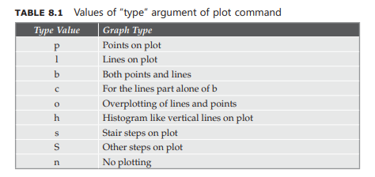

Slide 9
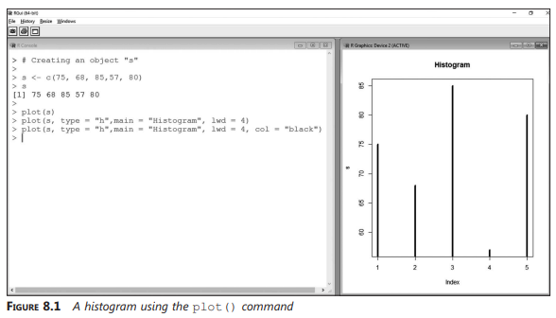

Slide 10
hist() Function in R
Purpose: Used to create a histogram, which represents a dataset using bars of different heights.
How it works: Divides the data into ranges (bins) and plots bars according to frequency in each range.
Basic Syntax:hist(x, …)
x → Vector of values for which the histogram is drawn
… → Other optional arguments for customization (color, labels, etc.)
Histograms help visualize the distribution of data and identify patterns like clustering or gaps.

Slide 11
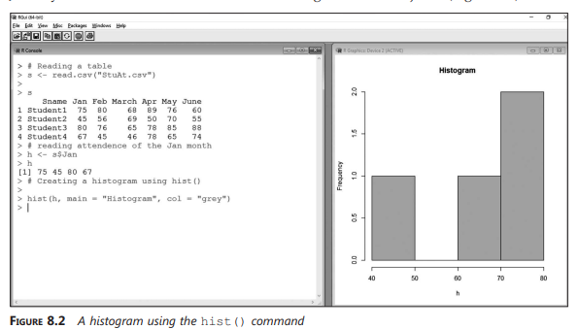

Slide 12
pie() Function in R
Purpose: Used to create a pie chart, which shows data as slices of a circle representing proportions.
Basic Syntax:
pie(x, labels = names(x), edges = 200, radius = 0.8, clockwise = FALSE, init.angle = if(clockwise) 90 else 0, density = NULL, angle = 45, col = NULL, border = NULL, lty = NULL, main = NULL, …)
x → Vector of numerical values
labels → Names of slices
col → Colors for slices
main → Title of the chart
clockwise → Direction of slices

Slide 13
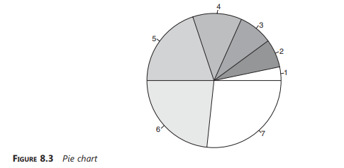
Example Steps:
1. Create data vector:B <- c(2, 4, 5, 7, 12, 14, 16)
2. Simple pie chart: pie(B)

Slide 14
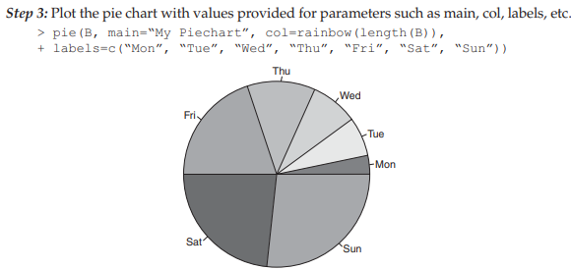

Slide 15
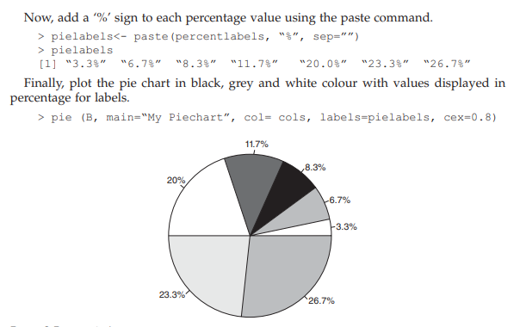
4. Black/Grey/White colors for printing:
cols<c("grey90","grey50","black","grey30","white","grey70","grey50")
5. Add percentages as labels:
percentlabels <- round(100*B/sum(B),1)
pielabels <- paste(percentlabels, "%", sep="")

Slide 16
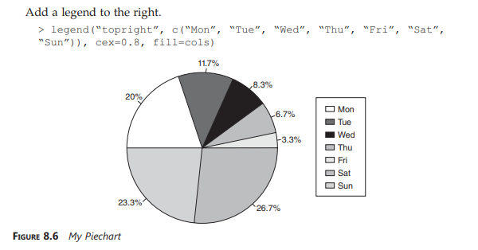

Slide 17
boxplot() Function in R
Also called: Box-and-whiskers plot, introduced by John Tukey (1977).
Purpose: Efficiently displays five key statistical measures:
Minimum (low value)
Lower quartile (25th percentile)
Median (50th percentile)
Upper quartile (75th percentile)
Maximum (high value)
Orientation: Can be drawn vertically or horizontally.
Usage: Often used alongside histograms for deeper data insights.
Advantages:
Shows data symmetry and skewness
Highlights outliers
Enables easy comparison of multiple datasets

Slide 18
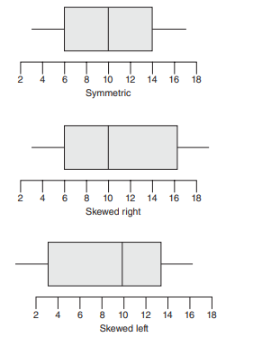
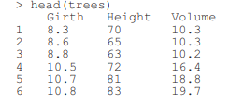
Steps to Create a Boxplot
Step 1: We will use the “trees” dataset. This data set provides measurements of the girth(diameter in inches), height and volume of timber in 31 felled black cherry trees. Use the head() function to view the top six rows from the data set.

Slide 19
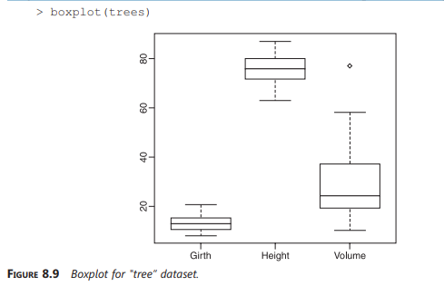
Step 2: Plot the boxplot using the boxplot() function. Boxplot is used to show the five magic numbers, viz., minimum, maximum, median, lower quartile and upper quartile.

Slide 20
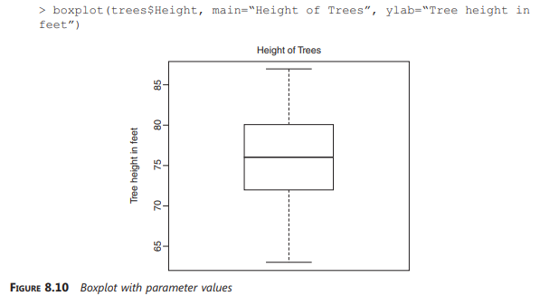
Step 3: Use parameters such as “main” to provide an overall title to the plot and “ylab” to provide label to the Y-axis, etc.

Slide 21
stripchart() Function in R
Purpose: Creates one-dimensional scatter plots (dot plots) to visualize data points along a single axis.
Best Use: Works well for small sample sizes as an alternative to boxplots.
Example Dataset: airquality dataset with 153 observations on variables: Ozone, Solar.R, Wind, Temp, Month, Day.
Basic Usage:
stripchart(airquality$Ozone, method="jitter", pch=19, col="blue", main="Ozone Levels in Airquality Dataset")
method="jitter" → spreads points to avoid overlap
pch → symbol/point type
col → color of points
main → title of the plot
Stripcharts allow you to see individual data points clearly, making them helpful for small datasets or detailed comparisons.

Slide 22
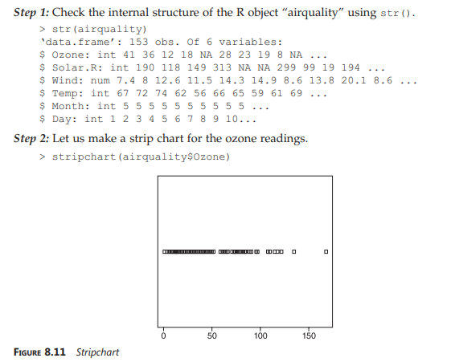
Example steps

Slide 23
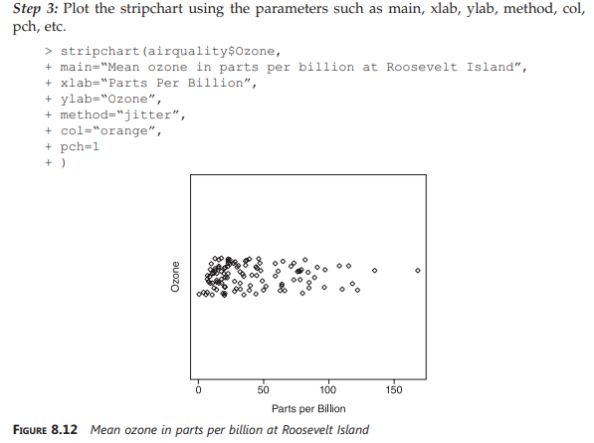

Slide 24
curve() Function in R
Purpose: Draws a curve of a function over a specified interval.
Usage: Can plot a mathematical expression or a vectorized function in x.
Basic Syntax: curve(expr, from = NULL, to = NULL, n = 101, add = FALSE, type = "l", xname = "x", xlab = xname, ylab = NULL, ...)
expr → Function or expression to plot
from, to → Range of x-values
n → Number of points used to draw the curve
add → Whether to add to an existing plot (TRUE/FALSE)
type → Type of plot line ("l" for line)
xlab / ylab → Axis labels
ex: curve(x^2, from=1, to=50, xlab="x", ylab="y")
curve() is ideal for visualizing functions and understanding their behavior over a range of values.

Slide 25
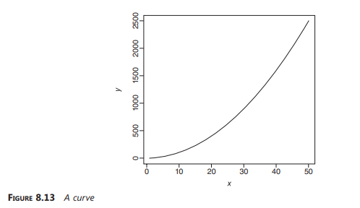

Slide 26
Basic R Commands for Data Manipulation
Purpose: Time series analysis often requires operations like:
Arithmetic mean
Standard deviation
Differences between observations
Probability distributions
Density estimation
R Commands: R provides various built-in functions to perform these operations efficiently and manipulate time series data.
Understanding these functions helps in summarizing, visualizing, and forecasting time-dependent data effectively.

Slide 27
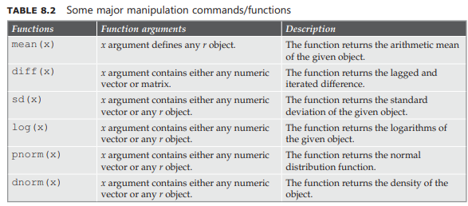

Slide 28
Example – Time Series Analysis in R
Creating Data: An object d is created to perform various time series operations.
Functions Used:
Functions like mean(), sd(), diff() help in basic statistical calculations.
pnorm() and qnorm() are used to analyze probability distributions of the data.
Purpose: These functions help in understanding distribution properties, trends, and variability in time series data.
Visualization: Figure 8.14 demonstrates how these functions work in practice.
Combining these commands allows you to summarize and model time series data efficiently in R.

Slide 29
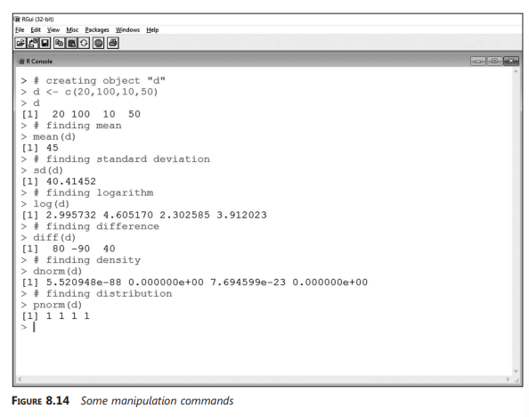

Slide 30
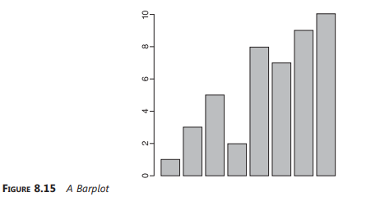
mean() Function
Objective: To determine the mean of a set of numbers. Plot the numbers in a bar plot and have a straight line run through the plot at the mean.
Step 1: Create a vector “numbers”.
> numbers <- c(1, 3, 5, 2, 8, 7, 9, 10)
Step 2: Compute the mean value of the set of numbers contained in the vector “numbers”.
> mean(numbers)
[1] 5.625
Outcome: The mean value for the
vector “numbers” is computed as 5.625.
Step 3: Plot a bar plot using the vector
“numbers”.
> barplot(numbers)

Slide 31
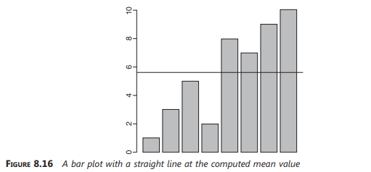
Step 4: Use the abline function to have a straight line (horizontal line) run through the bar plot at the mean value
> barplot(numbers)
> abline(h= mean(numbers))
Outcome: A straight line at the computed mean value (5.625) runs through the bar plot computed on the vector “numbers”.

Slide 32
median() Function
Objective: To determine the median of a set of numbers. Plot the numbers in a bar plot and have a straight line run through the plot at the median.
Step 1: Create a vector “numbers”.
> numbers <- c(1,3,5,2,8,7,9,10)
Step 2: Compute the median value of the set of numbers contained in the vector “numbers”.
> median(numbers)
[1] 6
Step 3: Plot a bar plot using the vector “numbers”. Use the abline function to have a straight line (horizontal line) run through the bar plot at the median.
> barplot(numbers)
> abline(h = median(numbers))

Slide 33
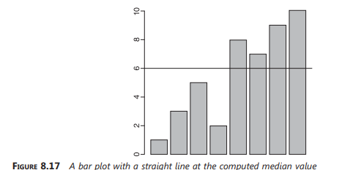
Outcome: A straight line at the computed median value (6.0) runs through the bar plot
computed on the vector “numbers”.

Slide 34
sd() Function
Objective: To determine the standard deviation. Plot the numbers in a bar plot and have a straight line run through the plot at the mean and another straight line run through the plot at mean + standard deviation.
Step 1: Create a vector “numbers”.
> numbers <-c(1,3,5,2,8,7,9,10)
Step 2: Compute the mean value of the set of numbers contained in the vector “numbers”.
> mean(numbers)
[1] 5.625
Step 3: Determine the standard deviation of the set of numbers held in the vector“numbers”.
> deviation <- sd(numbers)
> deviation
[1] 3.377975
Step 4: Plot a bar plot using the vector “numbers”.
> barplot(numbers)

Slide 35
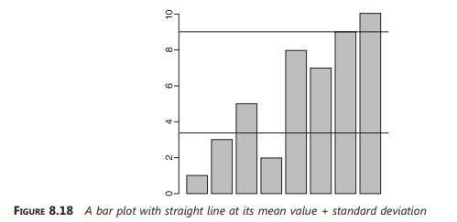
Step 5: Use the abline function to have a straight line (horizontal line) run through the
bar plot at the mean value (5.625) and another straight line run through the bar plot at
mean value + standard deviation (5.625 + 3.377975)
> barplot(numbers)
> abline(h=sd(numbers))
> abline(h=sd(numbers) + mean(numbers))

Slide 36
Mode Function in R
Objective: Find the mode (most frequently occurring value) of a dataset.
Note: R does not have a built-in function for mode, so we write a user-defined function.
User-Defined Mode Function:
Mode <- function(v) {
UniqValue <- unique(v)
UniqValue[which.max(tabulate(match(v, UniqValue)))]
}

Slide 37
Functions Used Inside Mode():
unique(v) → returns distinct values from vector v.
match(v, UniqValue) → finds positions of elements in v within UniqValue.
tabulate() → counts frequency of each value.
which.max() → identifies the most frequent value.
Example:
v <- c(2, 1, 2, 3, 1, 2, 3, 4, 1, 5, 5, 3, 2, 3)
unique(v)
# Output: 2 1 3 4 5
Mode(v)
# Output: 2 (most frequent value)
Outcome: The function correctly computes the mode of the dataset.
Understanding how to combine small functions (unique(), tabulate(), match()) is a good step toward writing custom functions in R.

Slide 38
match function
Takes a vector as the input and return the vector that has the positions of (first) matches of its first arguments in its second.
> v
[1] 2 1 2 3 1 2 3 4 1 5 5 3 2 3
> UniqValue <-unique(v)
> UniqValue
[1] 2 1 3 4 5
> match(v,UniqValue)
[1] 1 2 1 3 2 1 3 4 2 5 5 3 1 3

Slide 39
tabulate function
Takes an integer valued vector as the input and counts the number of times each integer occurs in it.
> tabulate(match(v,UniqValue))
1] 4 3 4 1 2
Going by our example, “2” occurs 4 times, “1” occurs 3 times, “3” occurs 4 times, “4”
occurs 1 time and “5” occurs 2 times.
Step 2: Create a vector “v”.
> v <- c(2,1,2,3,1,2,3,4,1,5,5,3,2,3)
Step 3: Call the function “Mode” and pass the vector “v” to it.
> Output <- Mode(v)
Step 4: Print the mode value of the vector “v”.
> print (Output)
[1] 2
Let us pass a character vector “charv” to the “Mode” function.
Step 1: Create a character vector “charv”.
> charv <- c(“o”, “it”, “the”, “it”, “it”)
Step 2: Call the function “Mode” and pass the character vector “charv” to it.
> Output <- Mode(charv)
Step 3: Print out the mode value of the vector “v”.
> print(Output)
[1] “it”

Slide 40
log() Function
The following are the variants of the log() function:
d log() computes the natural logarithms (Ln) for a number or vector
d log10() computes common logarithms (Lg)
d log2() computes binary logarithms (Log2)
d log(x,b) computes logarithms with base b.
> log (5)
[1] 1.609438
> log10(5)
[1] 0.69897
> log2(5)
[1]2.321928
>log(9,base=3)
[1] 2

Slide 41
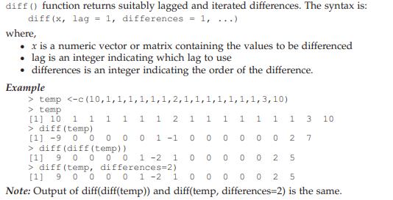
diff() Function

Slide 42
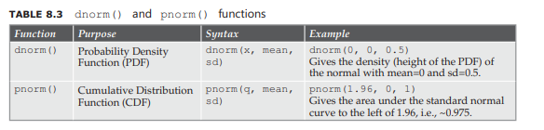
dnorm() and pnorm() Function

Slide 43
Similarity Search in Time Series Data
Time series data often contains repeating patterns or shapes.
Similarity search helps us compare two time series to find how closely they match.
Applications:
Stock price movement comparison
Weather pattern similarity across years
User activity trends on websites
Medical data (ECG, EEG pattern matching)
Types of Similarity:
1. Whole series similarity
Compare entire time series (e.g., sales of Product A vs Product B over 12 months).
2. Subsequence similarity
Find small patterns within a long time series (e.g., detecting “spikes” in electricity usage).

Slide 44
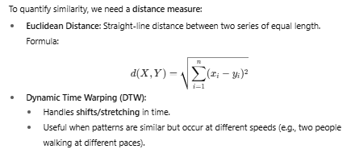
Distance Measures in Similarity Search

Slide 45
Similarity Search in R
Euclidean distance with dist()
x <- c(1, 2, 3, 4, 5)
y <- c(2, 3, 4, 5, 6)
dist(rbind(x, y), method="euclidean")
Dynamic Time Warping with dtw package
library(dtw)
x <- sin(1:100/10)
y <- cos(1:100/10)
alignment <- dtw(x, y)
plot(alignment, type="twoway")

Slide 46
Applications of Similarity Search
Finance: Finding stocks that move in similar patterns.
Retail: Identifying products with similar sales trends.
Healthcare: Matching patient heart rate/ECG patterns.
IoT & Sensor data: Detecting anomalies in machine activity.

Slide 47
Regression and Trend Analysis in Time Series Data
Trend = long-term increase or decrease in time series.
Regression = statistical method to model relationship between time (independent variable) and observed values (dependent variable).
Helps to identify underlying growth/decline in data

Slide 48
Types of Trends
1. Linear Trend: Straight-line growth/decline.
Example: Annual increase in population.
2. Exponential Trend: Growth/decay that accelerates over time.
Example: Viral spread of information.
3. Polynomial Trend: Curved pattern (quadratic, cubic).
Example: Business cycles with ups and downs.

Slide 49
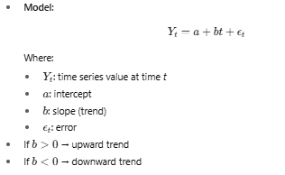
Regression for Trend Estimation

Slide 50
Linear Regression in R
time <- 1:10
sales <- c(20, 23, 25, 27, 30, 34, 36, 39, 41, 44)
model <- lm(sales ~ time)
summary(model)
plot(time, sales, main="Sales Trend", col="blue", pch=19)
abline(model, col="red", lwd=2)

Slide 51
Applications
Forecasting future demand/sales.
Identifying growth patterns in population, GDP, climate data.
Detecting decline in machine performance, website traffic, etc.

