Slide 1
UNIT-5 Time Series in R
Part-2

Slide 2
Reading Time Series Data in R
Why Reading Data is Important?
Before analyzing, we must import data into R in a format that R understands.
Normal numeric vectors are not enough – we need time-aware objects.
R provides special functions:
scan() → reads raw values from file/console.
ts() → converts values into a time series object (with start, end, frequency).
as.ts() / is.ts() → convert & check objects.

Slide 3
scan() Function
Reads raw numbers from a text file or console into R.
Useful for time series stored in plain text.
Syntax: scan(file)
file: name of the text file (e.g., "Attendance.txt").
Returns a numeric vector.
Example:
attend <- scan("Attendance.txt")
print(attend)
--If file has: 20 22 25 28 30,
→ Output in R: [1] 20 22 25 28 30

Slide 4
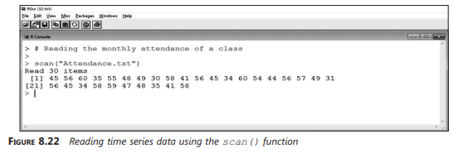
Reading time series data using the scan() function

Slide 5
ts() Function
Converts raw data (vector/matrix) into a time series object.
Adds time meaning (start date, frequency).
Syntax: ts(data, start, end, frequency)
data: vector/matrix of values.
start: time of first observation.
end: time of last observation (optional).
frequency: number of observations per time unit.
Common Frequencies:
1 = yearly data
4 = quarterly data
12 = monthly data

Slide 6
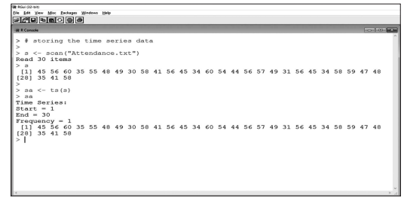
Storing time series data using the ts() function

Slide 7
Example:
t <- ts(attend, start=c(2011,1), frequency=12)
print(t)
--Here: start=c(2011,1) → Jan 2011.
frequency=12 → monthly data.

Slide 8
Converting and Checking
If you already have a numeric vector, you can still convert:
simple <- c(10, 20, 30, 40)
tseries <- as.ts(simple)
To check if an object is time series:
is.ts(tseries) # TRUE
is.ts(simple) # FALSE

Slide 9
Complete Example
# Step 1: Read numeric values from file
s <- scan("Attendance.txt")
# Step 2: Create monthly time series starting from Jan 2011
t <- ts(s, start=c(2011,1), frequency=12)
# Step 3: Print the time series
print(t)
scan() imports raw numbers.
ts() adds time dimension.
Now t is a time series object ready for plotting, decomposition, forecasting.

Slide 10
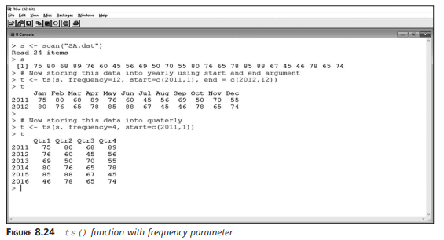

Slide 11
Why This Step Matters?
Raw numbers by themselves do not carry time information.
Time series object allows R to:
--Plot values against actual time.
--Perform decomposition (trend, seasonality).
-- Apply forecasting methods (e.g., ARIMA, Holt-Winters).
Without converting, analysis may be incorrect.

Slide 12
Plotting Time Series Data in R
After reading and storing data, the next task is to plot time series data.
Plotting represents data graphically → easy to understand.
R provides the function: plot.ts(x)---x = time series object
Example 1: Simple Time Series
# Attendance data stored in object t
plot.ts(t)
Object t contains time series data created using ts().
The plot shows random fluctuations in attendance data.

Slide 13
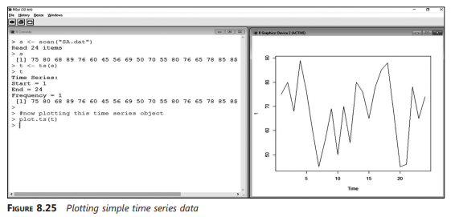
Plotting simple time series data

Slide 14
Example 2: Attendance Data (Multiple Students)
s <- scan("Attendance.txt")
t <- ts(s, start=c(2011,1), frequency=12)
plot.ts(t)
Object s = attendance data.
Converted to time series t.
The plot shows attendance data of students over six months.
key points:
plot.ts() is the best function for plotting time series.
Makes trend, seasonality, and fluctuations visible.
Forms the basis for decomposition & forecasting.

Slide 15
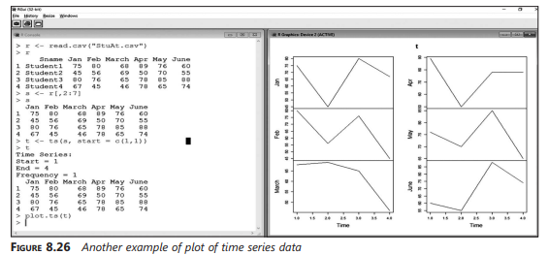
Another example of plot of time series data

Slide 16
Decomposing Time Series Data
Time series changes due to:
1. Seasonal factors (e.g., fruit prices in different seasons)
2. Cyclical movements (e.g., stock prices, business cycles)
3. Irregular events (e.g., political events, natural disasters)
Decomposition = breaking down time series into components for analysis.
Helps to understand hidden structures in data.

Slide 17

Components of Time Series
Trend (T): Long-term growth or decline in data
Seasonal (S): Repeating short-term pattern (daily, monthly, yearly)
Cyclical (C): Medium-to-long-term fluctuations (not fixed period)
Irregular/Random (I): Unpredictable variations (accidents, strikes)

Slide 18
Why Do We Decompose?
To separate influences on data
To identify seasonal and trend patterns clearly
To prepare data for forecasting methods (Exponential Smoothing, ARIMA, etc.)
To detect unusual events (outliers, shocks)

Slide 19

Decomposing Non-Seasonal Data
A non-seasonal series has:
1. Trend (T): Long-term upward/downward movement
2. Irregular/Random (I): Unpredictable variations
No seasonal or cyclical components.
Example: Monthly sales data without repeating seasonal patterns.
Decomposition method: Simple Moving Average (SMA)
Purpose: Smooth random fluctuations → highlight long-term trend

Slide 20
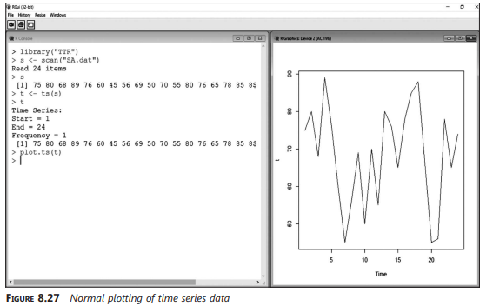
fig shows normal plot of time series data before smoothing.

Slide 21
R Function for Non-Seasonal Decomposition:
R provides SMA() function from package TTR
Syntax: SMA(x, n, …)
x: time series data (e.g., price, volume, attendance)
n: order of moving average
…: other options
Larger n → smoother curve → trend extracted more clearly

Slide 22
Example:
Data from “SA.dat” file → stored in object t
Step 1: Plot original series → random fluctuations
Step 2: Apply SMA with order = 4 → smooth data to estimate trend
Step 3: Plot smoothed data
R code:
library(TTR)
data <- scan("SA.dat") # Read data
t <- ts(data) # Create time series object
trend <- SMA(t, n=4) # Apply SMA
plot(t, main="Original vs Trend")
lines(trend, col="red") # Add trend line

Slide 23
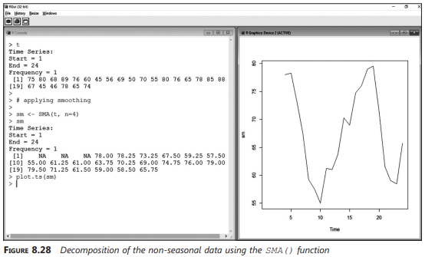
Fig shows smoothed series after SMA(4).

Slide 24
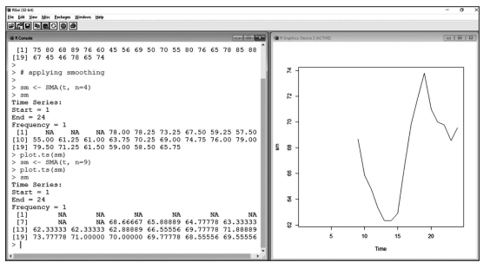
Higher Order Smoothing
Increasing the order (n) = smoother line
Helps in better estimation of trend by filtering out irregulars

Slide 25
Key Points:
Non-seasonal decomposition = Trend + Irregular only
SMA is used to separate trend from random noise
Order (n) controls level of smoothing
Useful before applying forecasting models

Slide 26

Decomposing Seasonal Data
A seasonal time series contains:
1. Trend (T) – long-term movement
2. Seasonal (S) – repeating short-term variations (e.g., monthly, quarterly)
3. Irregular (I) – random effects
Method: Calculate moving average to smooth trend & extract seasonal factor.

Slide 27
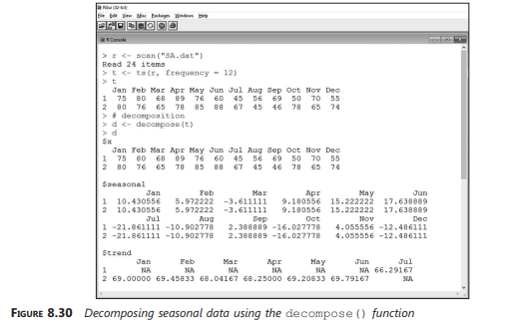
decomposition output (attendance data example)

Slide 28
Functions for Seasonal Decomposition:
decompose() function
Splits into seasonal, trend, irregular
Uses moving averages for smoothing
Syntax: decompose(x, type, …)
x → time series object
type → additive or multiplicative model

Slide 29
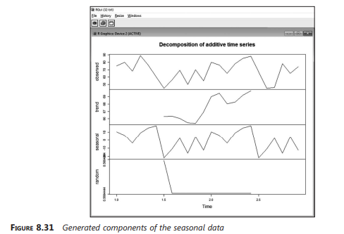
graphical plot of all components from decompose()

Slide 30
Example – Using decompose()
data <- scan("SA.dat") # Read attendance data
t <- ts(data) # Create time series object
# Apply decomposition
d <- decompose(t)
plot(d) # Plot seasonal, trend, irregular
Example shows peak in June (+17.63) and lowest in July (-21.86).
Indicates strong seasonal variation in attendance data.

Slide 31
STL (Seasonal-Trend Decomposition):
stl() function = Seasonal-Trend decomposition using LOESS regression
More flexible than decompose()
Syntax: stl(x, s.window, …)
x → time series object
s.window = “periodic” or odd number ≥ 7 (span for smoothing)

Slide 32
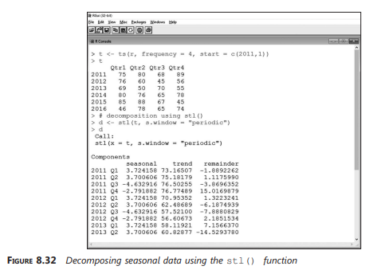
output of stl() function (list of components).

Slide 33
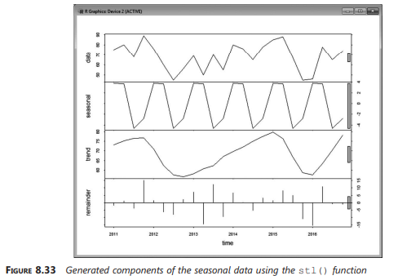
plot of STL components (trend, seasonal, remainder).

Slide 34
Key Points
Seasonal decomposition = Trend + Seasonal + Irregular
decompose() → simple, moving average based
stl() → advanced, regression-based (better accuracy)
Useful to detect and quantify seasonality before forecasting

Slide 35
Seasonal Adjustment
Seasonally Adjusted Time Series = Original data without seasonal component
Purpose:
1. Remove seasonal fluctuations → highlight trend + irregular
2. Easier to compare data across months/years
Method:
1. Estimate seasonal component
2. Subtract it from original time series

Slide 36
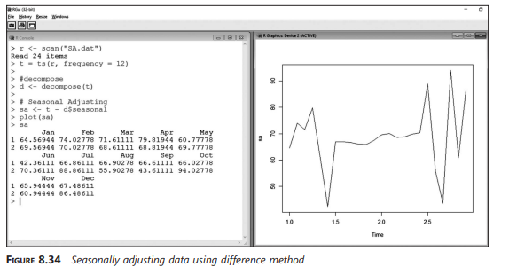
Example of seasonal adjustment using subtraction method (t – d$seasonal).

Slide 37
Methods of Seasonal Adjustment
1. Difference Method
Compute seasonal component using decompose()
Subtract from original series:
d <- decompose(t)
adjusted <- t - d$seasonal
plot(adjusted)
Produces seasonally adjusted series
2. Using seas() function (package seasonal)
Automates seasonal adjustment
Syntax:
library(seasonal)
seas(t)

Slide 38
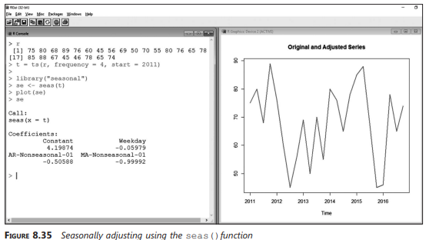
Seasonally adjusted series using seas().

Slide 39
Example:
Difference method: removes seasonal peaks/dips → shows smoother trend
seas(): directly generates seasonally adjusted data
data <- scan("SA.dat") # Attendance data
t <- ts(data)
# Method 1: Difference Method
d <- decompose(t)
adjusted <- t - d$seasonal
plot(adjusted, main="Seasonally Adjusted Series (Difference Method)")
# Method 2: Using seas()
library(seasonal)
sa <- seas(t)
plot(sa, main="Seasonally Adjusted using seas()")

Slide 40
Key Points
Seasonal adjustment removes recurring patterns
Helps reveal true trend in data
Two main approaches:
1. Manual difference method (t – d$seasonal)
2. Automated seas() function
Essential for business forecasting → avoids misleading seasonal effects

Slide 41
Regression Analysis
Regression Analysis: Identifies linear relationship between
1.Independent variables (predictors)
2. Dependent variable (response)
Used in time series to model influence of predictors on outcomes
In R, use the lm() function:
lm(formula, data, …)
formula → defines model (response ~ predictors)
data → dataset (vector, data frame, or list)

Slide 42
Example:
Create two vectors:
a → attendance data (independent variable)
r → result data (dependent variable)
Apply linear regression using lm():
a <- c(30, 35, 40, 45, 50)
r <- c(55, 60, 65, 70, 75)
model <- lm(r ~ a)
summary(model)
summary() returns coefficient values and significance tests

Slide 43
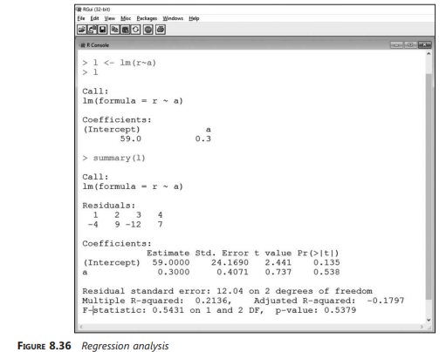
regression analysis output (coefficients table).

Slide 44
Output Explanation:
Intercept (constant) → baseline value of response
Slope (coefficient) → how much response changes per unit change in predictor
p-value → tests significance of predictor
R² (coefficient of determination) → how well model fits data

Slide 45
Key Points
Regression analysis helps quantify relationships in time series
lm() provides regression model with coefficients and diagnostics
Supports trend estimation and forecasting
Output used to:
1.Test predictor significance
2. Build predictive models

Slide 46
Forecasts Using Exponential Smoothing
Forecasting → predicts future values based on past observations.
Exponential Smoothing:
1. Assigns more weight to recent observations, less weight to older ones.
2. Filters out random noise → makes short-term forecasts.
In R: HoltWinters() function: HoltWinters(x, alpha=NULL, beta=NULL, gamma=NULL, …)
x → time series object
alpha → smoothing parameter for level
beta → smoothing parameter for trend
gamma → smoothing parameter for seasonality
Values range 0 to 1:
Near 0 → forecasts depend on less recent observations
Near 1 → forecasts depend more on recent observations

Slide 47

1 .Simple Exponential Smoothing
Estimates only the level of a time series at current point.
Best for data with no trend & no seasonality.
Uses parameter alpha (α).
Works well for short-term predictions.
α close to 1 → forecast depends on recent values.
α close to 0 → forecast depends on older averages.

Slide 48
R Example:
data <- scan("Attendance.txt")
a <- ts(data)
# Simple exponential smoothing
model <- HoltWinters(a, beta=FALSE, gamma=FALSE)
plot(model)
beta=FALSE, gamma=FALSE → disables trend & seasonality.
Forecast is smoother than original data.

Slide 49
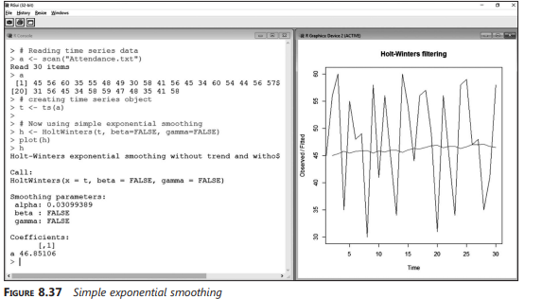
shows simple exponential smoothing forecast.

Slide 50
2 .Holt’s Exponential Smoothing
Extends simple method by adding trend component.
Best for data with trend but no seasonality.
Uses parameters:
1. alpha (α) → level 2. beta (β) → trend
Example:
data <- scan("Attendance.txt")
a <- ts(data)
# Holt’s method
model <- HoltWinters(a, gamma=FALSE)
plot(model)
gamma=FALSE → disables seasonality.
Output shows both level & slope.

Slide 51
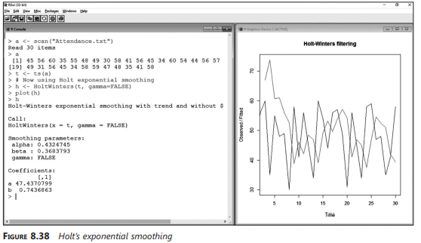
Holt’s exponential smoothing (original vs forecast).

Slide 52
Key Points
Captures trend changes in data.
α and β near 0 → forecast depends on older data.
α and β near 1 → forecast adapts quickly to recent changes.

Slide 53
3 Holt-Winters Exponential Smoothing
Extends Holt’s method by adding seasonality.
Best for data with trend + seasonality.
Uses parameters:
1. alpha (α) → level 2, beta (β) → trend 3. gamma (γ) → seasonality
Most powerful exponential smoothing method.
Suitable for real-world business data (sales, temperature, demand).
Provides trend + seasonal adjusted forecasts.

Slide 54
R Example:
R Code:
data <- scan("Attendance.txt")
a <- ts(data)
# Holt-Winters method
model <- HoltWinters(a)
plot(model)
All three parameters used.
Forecast shows trend and repeating seasonal patterns.

Slide 55
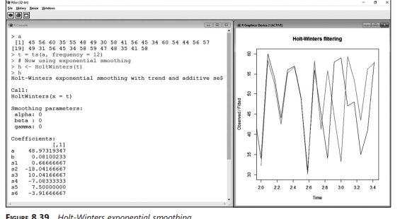
Holt-Winters exponential smoothing plot.

Slide 56
ARIMA Models
ARIMA = Autoregressive Integrated Moving Average
Used for time series forecasting when data shows patterns but also randomness.
Breaks into 3 parts:
1, AR (p): Autoregressive part
Current value depends on its own past values.
2. I (d): Integrated part
Differencing used to make series stationary.
3. MA (q): Moving Average part
Current value depends on past forecast errors.
Example: Predicting stock prices, sales, rainfall using past data.

Slide 57
General form: ARIMA(p, d, q)
Best for stationary time series (mean & variance constant over time).
Steps in ARIMA modeling:
1. Differencing a time series
2. Selecting candidate ARIMA model
3. Forecasting
4. Analysis of ACF & PACF
5. Diagnostic checking

Slide 58
What is Stationarity?
A stationary series has:
1. Constant mean (average does not change over time)
2. Constant variance (fluctuations are stable)
3. No seasonality (no repeating cycles)
Why needed?
ARIMA assumes stationary data for reliable forecasting.
If data is not stationary → apply differencing.

Slide 59

1. Differencing a Time Series
Differencing = subtracting consecutive values to remove trend/seasonality.
In R:
diff(x, differences=1) # 1st order difference
diff(x, differences=2) # 2nd order difference
Continue differencing until series looks stationary.

Slide 60
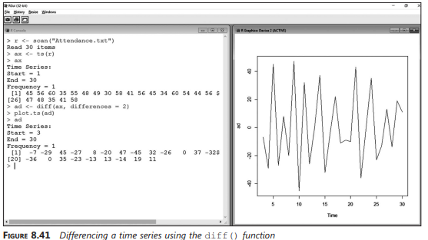
Shows stationary series after differencing order = 2.

Slide 61
2. Selecting Candidate ARIMA Model
After differencing, we must find best values for p and q.
Tools:
1. ACF (Autocorrelation Function):
Shows correlation of series with its past values.
Helps decide q (MA order).
2. PACF (Partial Autocorrelation Function):
Shows direct correlation with past values.
Helps decide p (AR order).
R Functions:
acf(series)
pacf(series)

Slide 62
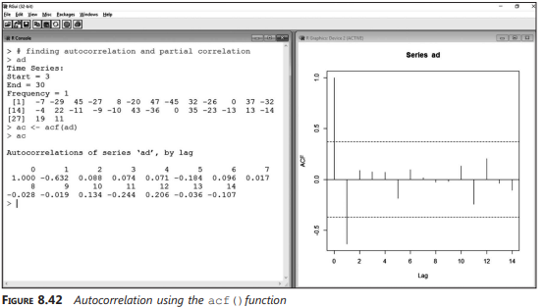
Figure--ACF plot

Slide 63
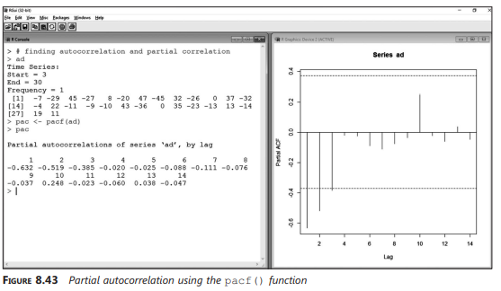
Figure--PACF plot

Slide 64
Example – Model Selection:
Suppose ACF shows 1 significant spike → suggests MA(1).
Suppose PACF shows 2 significant spikes → suggests AR(2).
If differencing order = 1 → ARIMA(2,1,1).
Alternatively, use:
library(forecast)
auto.arima(series)
automatically selects the best (p, d, q).

Slide 65
3. Forecasting with ARIMA
Once (p, d, q) chosen → fit ARIMA model.
In R:
model <- arima(series, order=c(p,d,q))
forecast(model)
Example: ARIMA(0,2,1) → fitted for attendance data.
Produces forecast values with confidence intervals.

Slide 66
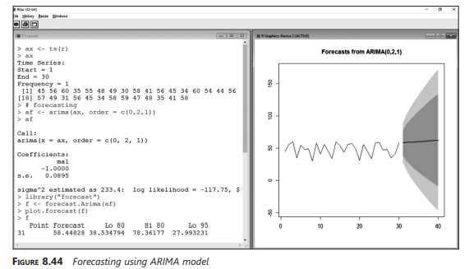
Forecast plot using ARIMA model.

Slide 67
4. Analyzing ACF & PACF (Simulation)
After fitting → simulate to check model assumptions.
Use arima.sim() in R:
sim <- arima.sim(model=list(ar=0.7, ma=0.3), n=100)
plot(sim)
Helps validate AR & MA terms used in the model.

Slide 68
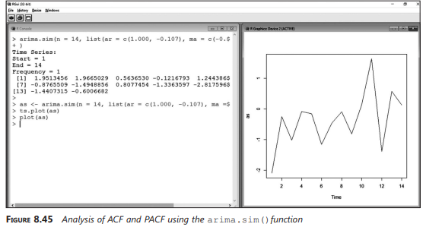
Simulation plot of ARIMA(p,d,q).

Slide 69
5. Diagnostic Checking
Goal → ensure model is a good fit.
Check residuals (errors).
In R:
tsdiag(model)
Outputs 3 diagnostic plots:
1. Standardized residuals → should look random
2. ACF of residuals → should show no significant spikes
3. Ljung-Box test → checks randomness

Slide 70
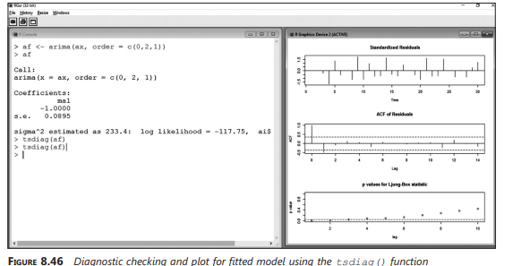
Diagnostic checking plots.

Slide 71
Key Points:
ARIMA(p,d,q) is powerful for forecasting non-seasonal, stationary series.
Steps to apply ARIMA:
Make series stationary (differencing).
Use ACF & PACF to choose p & q.
Fit ARIMA model.
Forecast future values.
Perform diagnostic checking.
---Useful in finance, economics, demand forecasting, climate studies.

