Slide 1
Logistic Regression
UNIT-4
Part-2

Slide 2
Introduction
Logistic Regression is part of Generalized Linear Models (GLMs).
Predicts probability of an event (values between 0 and 1).
Used when output is binary (Yes/No, True/False).
-Examples:
• Will a newborn be at medical risk?
• Will a flight be delayed?
• Is this email spam?

Slide 3
Why Not Linear Regression for Probabilities?
Linear Regression can output <0 or >1 (invalid for probabilities).
Logistic Regression solves this using log-odds transformation.
- Formula:
logit(p) = log(p / (1 - p))
Maps probability range (0–1) into (–∞, ∞).

Slide 4
Odds and Log-Odds
Odds = Probability of success ÷ Probability of failure.
Example: p=0.8 → odds = 0.8 / 0.2 = 4.
Log-odds (logit):
• Positive → event more likely.
• Negative → event less likely.
• Zero → equal chance (50%).

Slide 5
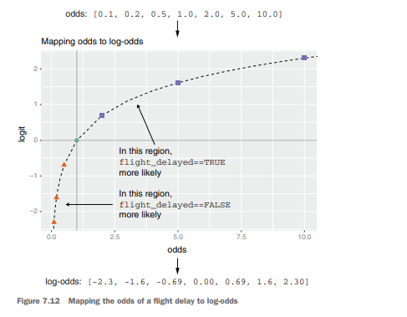
Figure 7.12: Shows mapping of probability → odds → log-odds.
Converts probabilities (bounded 0–1) into unbounded scale (–∞, ∞).

Slide 6
The Sigmoid Function
Converts log-odds back into probability.
Formula: s(x) = 1 / (1 + e^(-x)).
Properties:
• S-shaped curve.
• Always between 0 and 1.
• At x=0 → p=0.5.

Slide 7
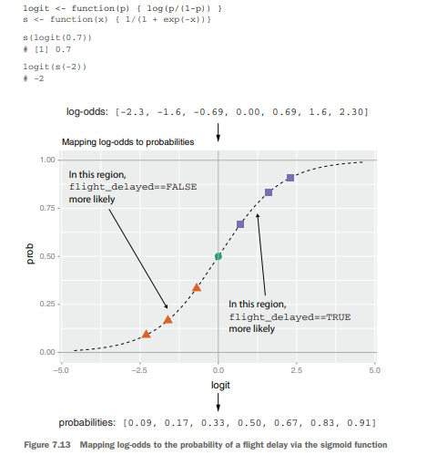
Figure 7.13: S-curve mapping log-odds → probability.
Ensures predictions are always valid probabilities.

Slide 8
Logistic Regression Model
Model equation:
logit(P(y=1)) = a + b1*x1 + b2*x2 + ... + bn*xn
Probability of success:
P(y=1) = sigmoid(a + b1*x1 + b2*x2 + ... +bn*xn)
- Interpretation:
• Each coefficient changes log-odds of outcome.
• Sigmoid converts it into probability.

Slide 9

Equation 7.2
A linear combination of inputs gets passed through sigmoid → probability.

Slide 10
Case Study – Natality Data
Dataset: CDC Natality Data (~26,000 births).
Task: Predict if baby is atRisk (Apgar score <7).
Predictor variables include:
• Mother’s weight (PWGT)
• Prenatal visits (UPREVIS)
• Smoker status (CIG_REC)
• Complications: breech, diabetes, hypertension
Split into training and test sets.

Slide 11
Listing 7.7 Loading the CDC data
load("NatalRiskData.rData")
train <- sdata[sdata$ORIGRANDGROUP <=5,]
test <- sdata[sdata$ORIGRANDGROUP > 5, ]
--Table 7.1 lists the columns of the dataset that you will use

Slide 12
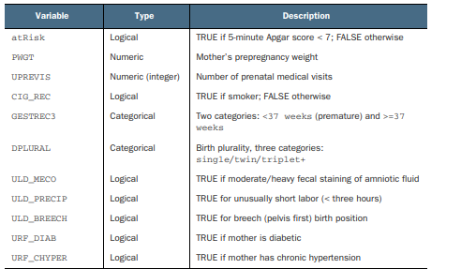
Table 7.1 Some variables in the natality dataset

Slide 13
Building Logistic Regression in R
Use glm() instead of lm().
Syntax:
model <- glm(formula, data=train, family=binomial(link='logit'))
Parameters:
• family=binomial → binary classification
• link='logit' → logistic regression
Example: glm(atRisk ~ PWGT + UPREVIS + CIG_REC + ..., data=train, family=binomial(link='logit'))

Slide 14
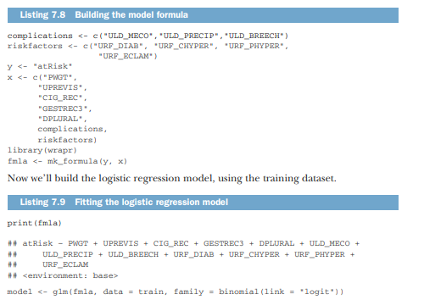
Listing 7.8 & 7.9 (formula + glm).
R builds a logistic regression model using glm() just like lm(), but with binomial family.

Slide 15
Making Predictions
Use predict() with trained model.
- Example:
train$pred <- predict(model, newdata=train, type='response')
test$pred <- predict(model, newdata=test, type='response')
- type='response' → probabilities (0–1).
- Without it → raw logit values.

Slide 16
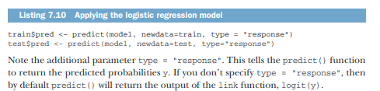
Listing 7.10 (predict).
Converts model output into probabilities.

Slide 17
Preserving Marginal Probabilities
Logistic Regression preserves probability distribution.
Logistic Regression keeps predicted probabilities consistent with observed proportions.
Example: If 5% of babies are “atRisk”, average predicted risk ≈ 5%.
Average predicted risk ≈ observed proportion of positive cases.
Works overall and within subgroups (e.g., premature babies).

Slide 18
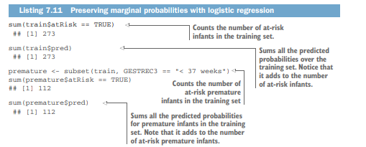
Listing 7.11 (probability check).
Shows predicted probabilities match actual event frequency.

Slide 19
Evaluating Predictions – Score Distribution
Good model: separates positive and negative cases.
Distribution plot:
- Negative cases → mostly low scores.
- Positive cases → mostly high scores.
Overlap region = uncertainty.

Slide 20
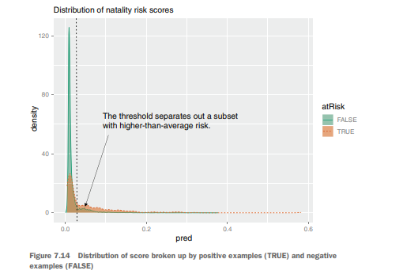
Figure 7.14 (Natality scores).
Shows how well the model distinguishes risky from safe babies.

Slide 21
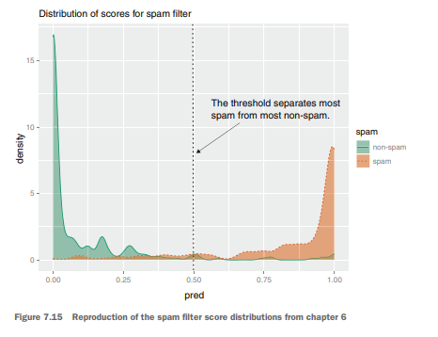
Figure 7.15 (Spam filter).
Spam example shows better separation between spam and non-spam.

Slide 22
Listing 7.12 (density plot code).
library(WVPlots)
DoubleDensityPlot(train, "pred", "atRisk",
title = "Distribution of natality risk scores")
---Plotting distribution of prediction score grouped by known outcome

Slide 23
Choosing Thresholds for Classification
Logistic regression predicts probabilities → need threshold to classify.
Example: threshold = 0.02 (2% risk)
Trade-offs:
• Higher threshold → higher precision, lower recall
• Lower threshold → higher recall, lower precision

Slide 24
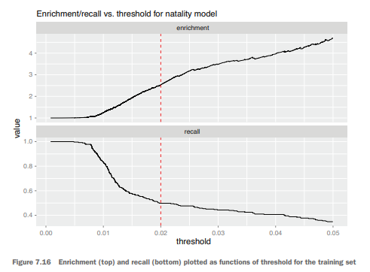
Figure 7.16 (Enrichment vs Recall curves).
Trade-off between precision and recall when adjusting threshold.

Slide 25
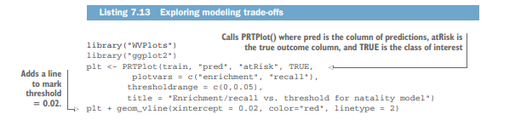
Listing 7.13 (PRTPlot code).

Slide 26
Confusion Matrix Evaluation
After threshold is fixed, build confusion matrix.
Example (threshold=0.02):
• Precision = 4.6%
• Recall = 55.5%
• Enrichment = 2.66 (better than random).

Slide 27
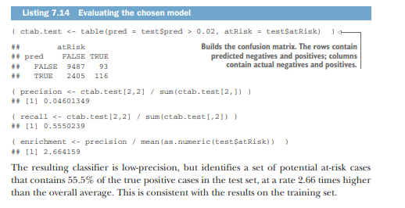
Listing 7.14 (confusion matrix + metrics).
Shows how threshold converts probabilities into Yes/No predictions and how well they perform.

Slide 28
Summary
Logistic Regression predicts probabilities for binary outcomes.
Uses logit transform + sigmoid function.
- In R:
• Build with glm() (binomial family)
• Predict with predict(..., type='response')
- Evaluate using:
• Probability distribution plots
• Threshold tuning (precision vs recall)
• Confusion matrix metrics

