Slide 1
Bluestock Mutual Fund Analytics Platform
Data Engineering • Analytics • Power BI Dashboard
Presented By: Anil Velma
Technologies:
Python, Pandas, SQLite, Power BI, NumPy, Matplotlib

Slide 2
Business Problem
Objective:
Analyze mutual fund industry data and build an end-to-end analytics platform.
Challenges:
• Large volume of fund data
• Data quality inconsistencies
• Need for risk-adjusted performance analysis
• Lack of centralized visual insights
Solution:
Develop a complete data pipeline, analytics engine, and interactive dashboard.

Slide 3
Project Architecture
Data Sources → Data Ingestion → Data Cleaning & Transformation → SQLite Database → EDA & Performance Analytics → Power BI Dashboard → Business Insights
• 8 datasets integrated
• 40+ mutual fund schemes analyzed

Slide 4
Data Engineering Pipeline
Key Activities:
• Imported raw mutual fund datasets
• Cleaned missing and inconsistent values
• Standardized date formats
• Built automated ETL pipeline
• Loaded processed data into SQLite
Deliverables:
✓ Cleaned CSVs
✓ SQLite database
✓ Automated ETL script

Slide 5
Exploratory Data Analysis
AUM Growth Chart
State Investment Distribution
Sector Allocation Chart
Key Findings:
• Industry AUM showed strong growth
• Investments concentrated in major states
• Equity categories dominate fund allocation

Slide 6
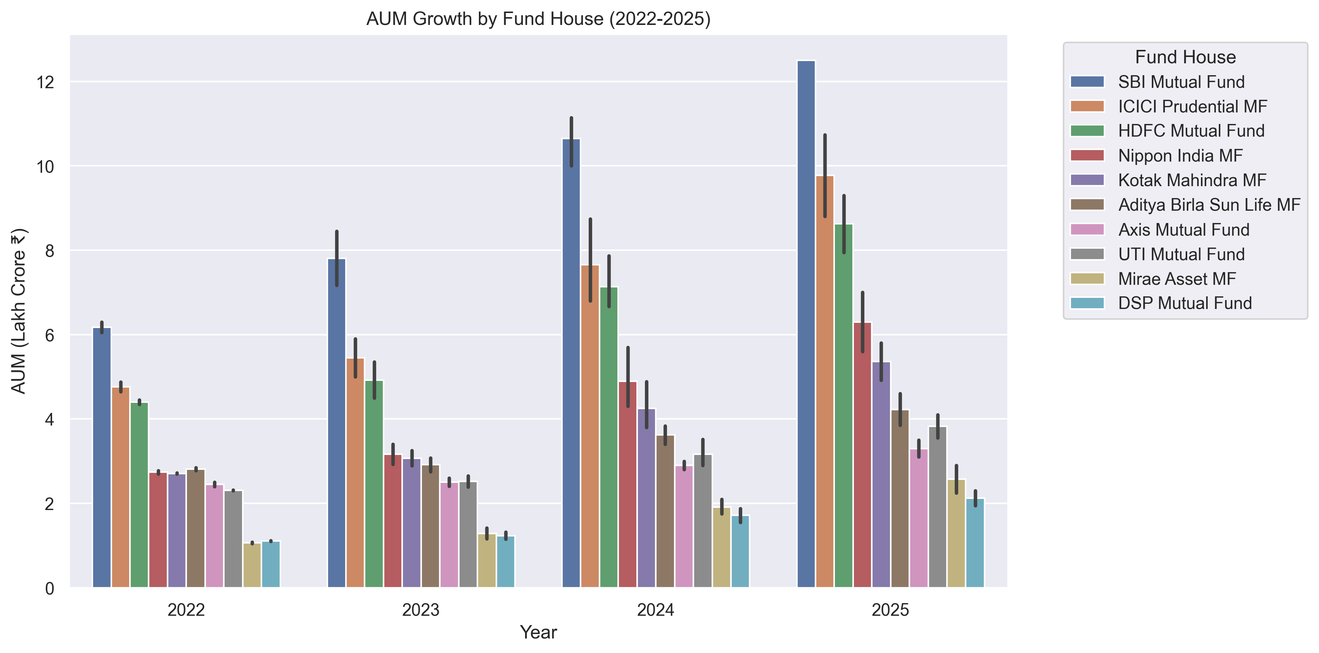
• AUM Growth Chart

Slide 7
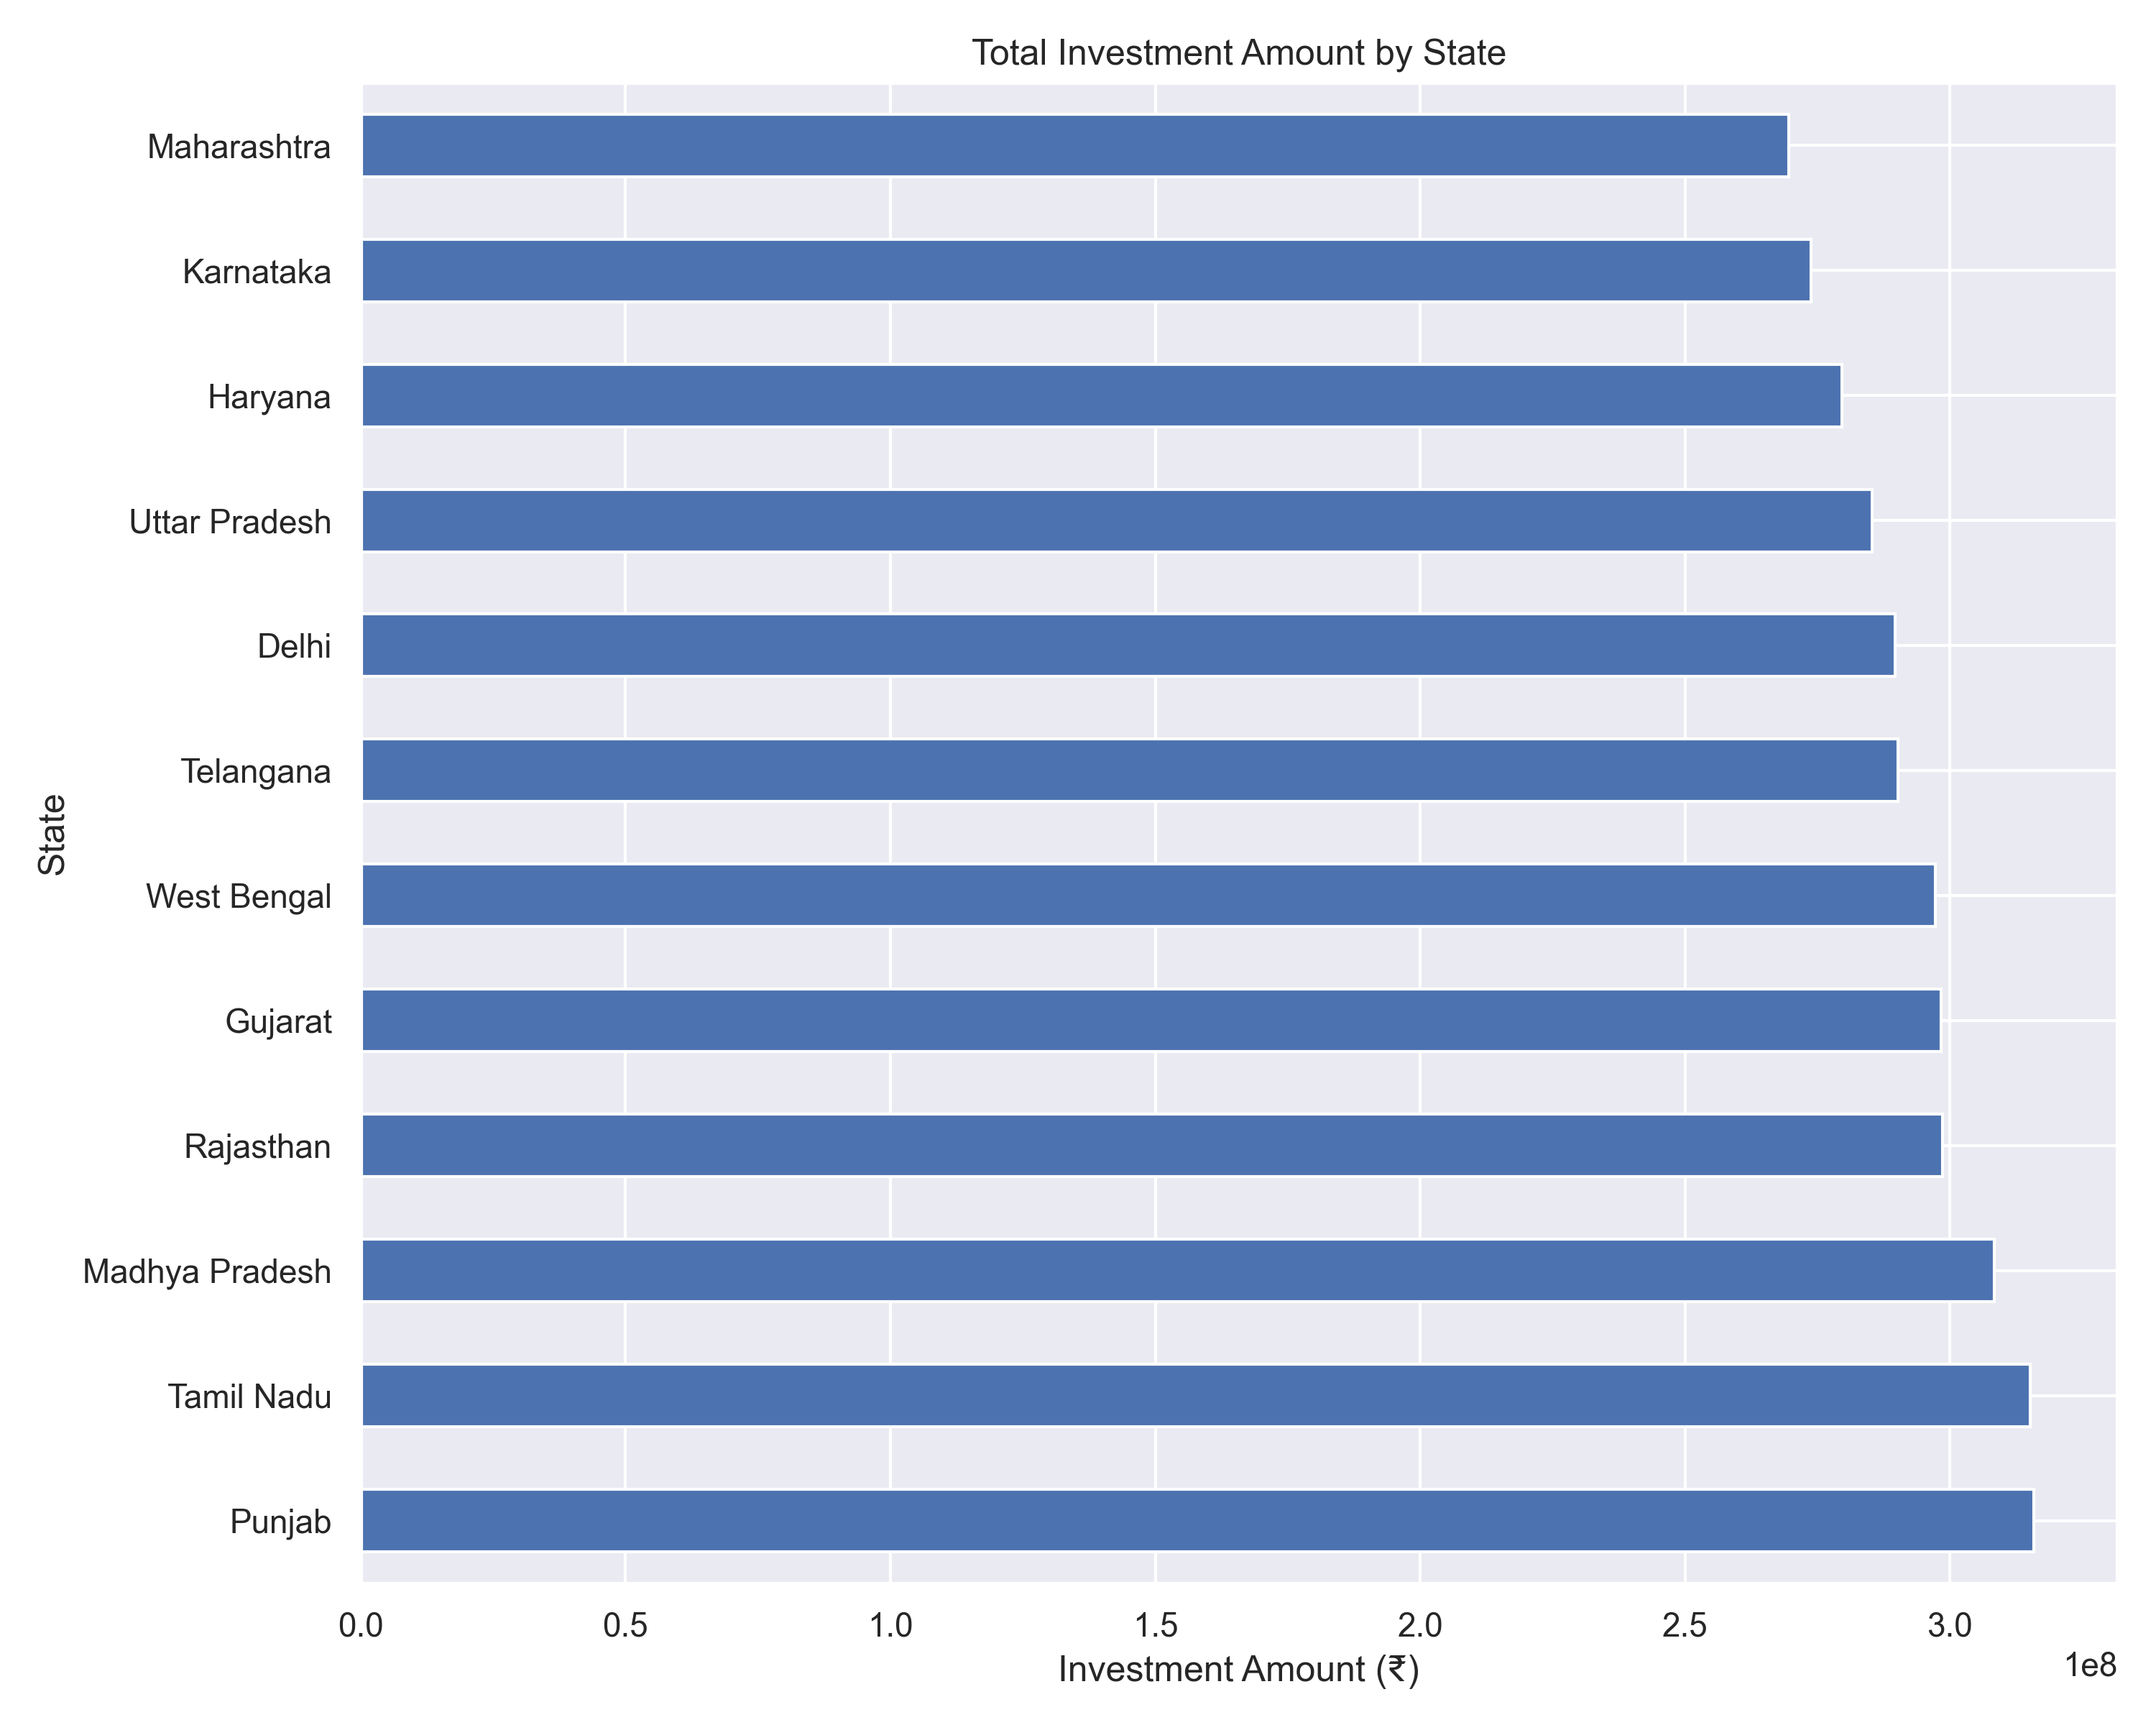
• State Investment Distribution

Slide 8
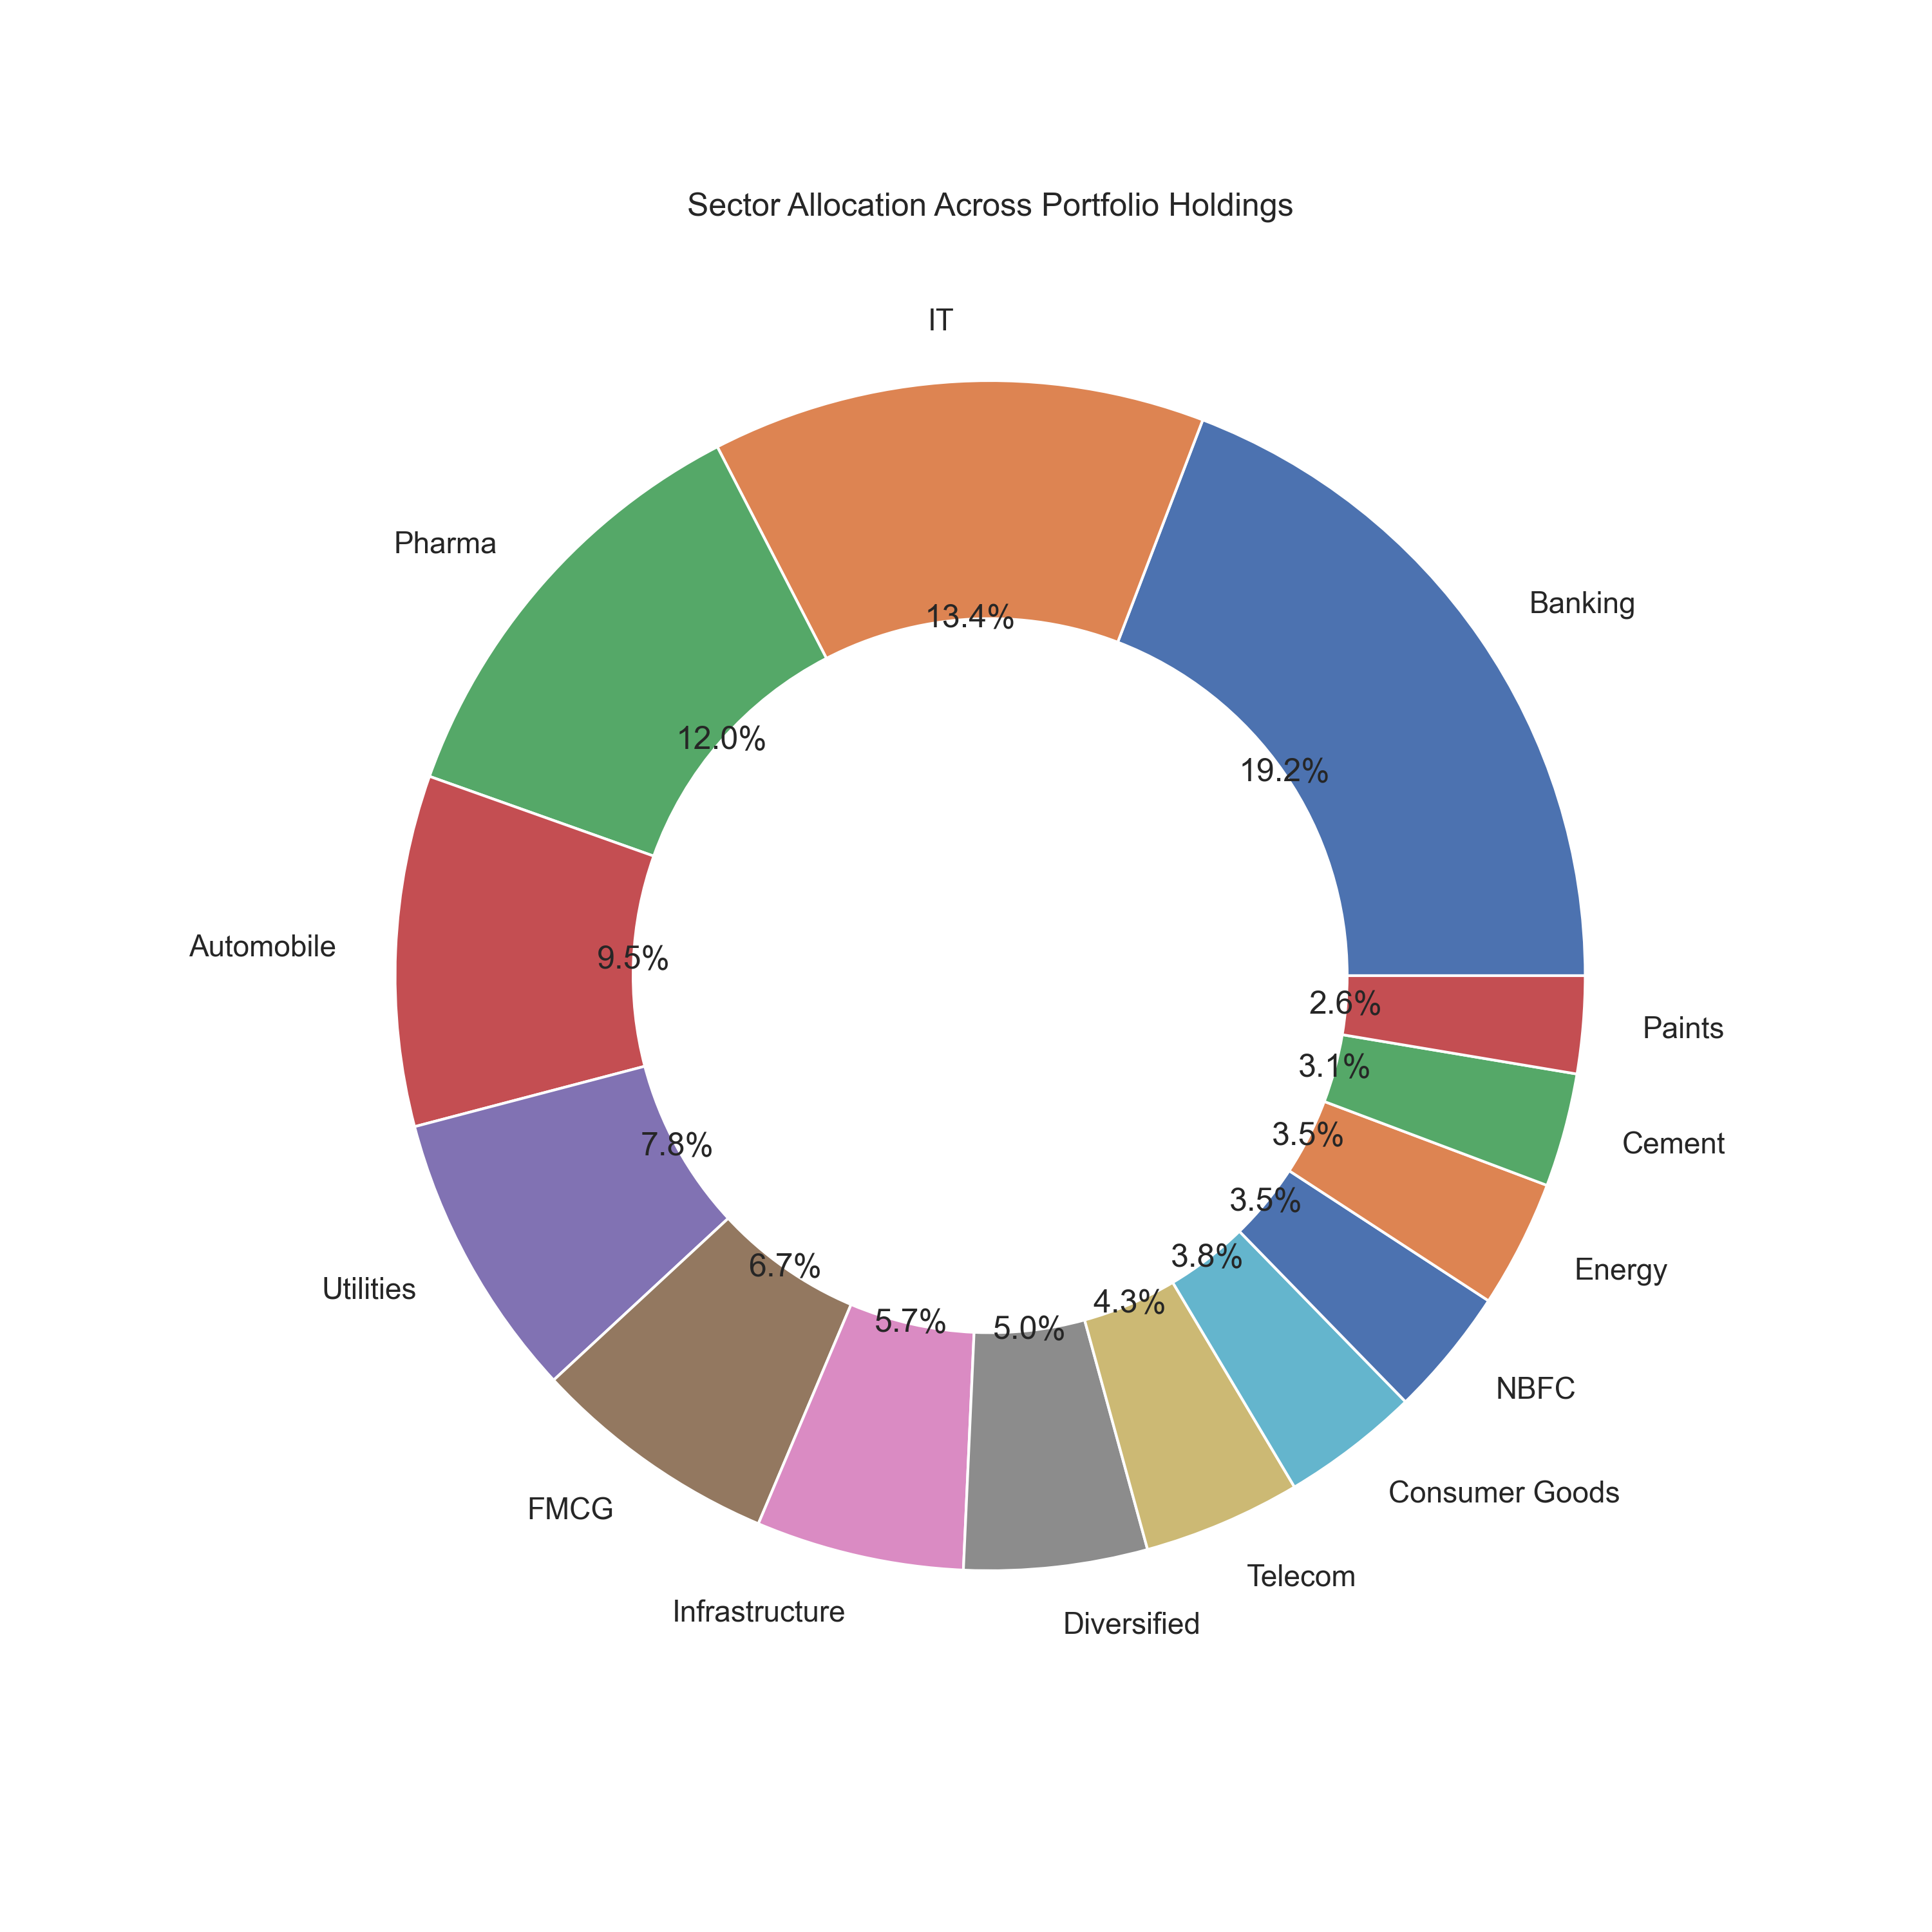
• Sector Allocation Chart

Slide 9
Performance Analytics
Metrics Computed:
• CAGR
• Sharpe Ratio
• Sortino Ratio
• Alpha
• Beta
• Maximum Drawdown
Insert:
• Top 10 CAGR
• Top 10 Sharpe Ratio
• Top 10 Alpha
Key Finding:
Risk-adjusted rankings provide better fund selection than return alone.

Slide 10
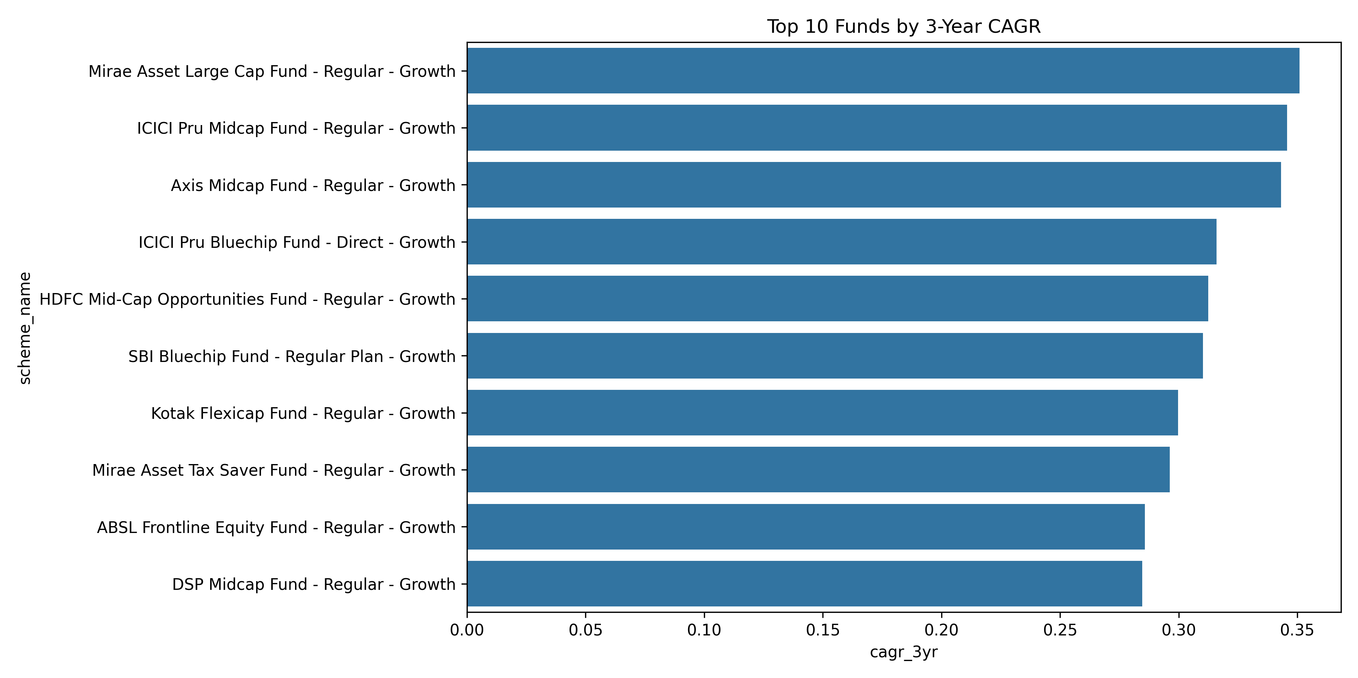
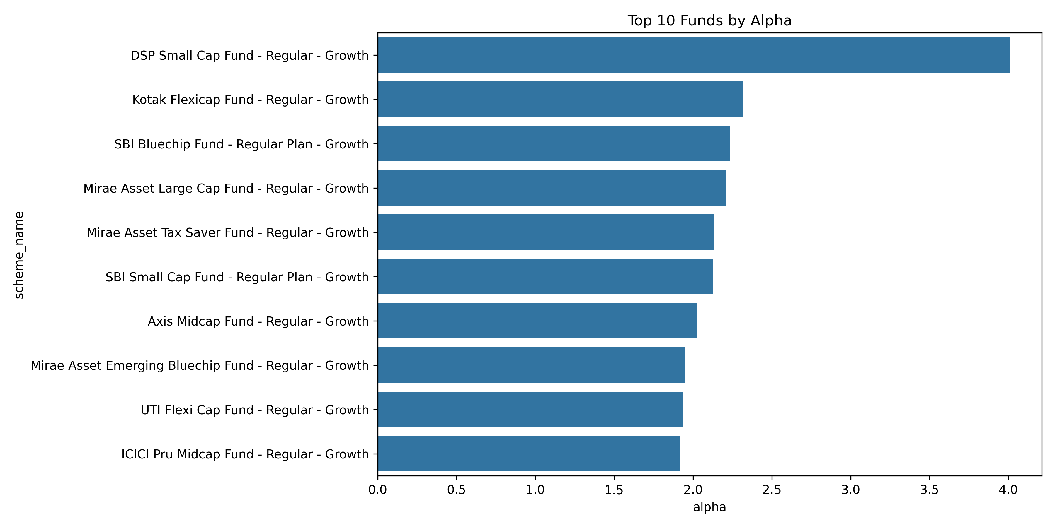
Top 10 CAGR
Top 10 Sharpe Ratio
Top 10 Alpha

Slide 11
Advanced Analytics
Risk Analytics:
• Rolling Sharpe Ratio
• Drawdown Analysis
• Volatility Assessment
Insert: Rolling Sharpe Chart
Insight:
Consistent funds maintain stronger risk-adjusted performance across market cycles.

Slide 12
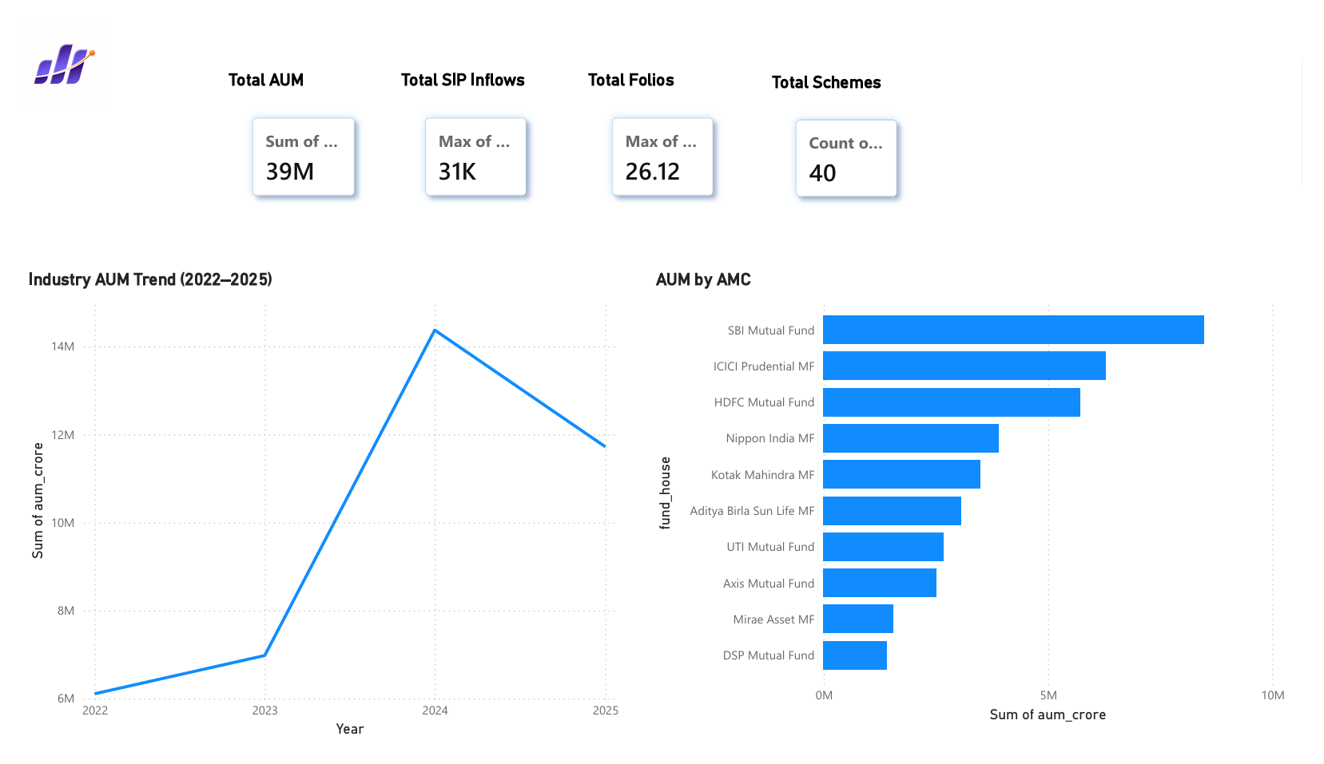
Dashboard Page 1 – Industry Overview
Features:
• Total AUM KPI
• SIP Inflow KPI
• Folio Count KPI
• Industry AUM Trend
• AMC Comparison
Business Value:
Provides a high-level industry health overview.

Slide 13
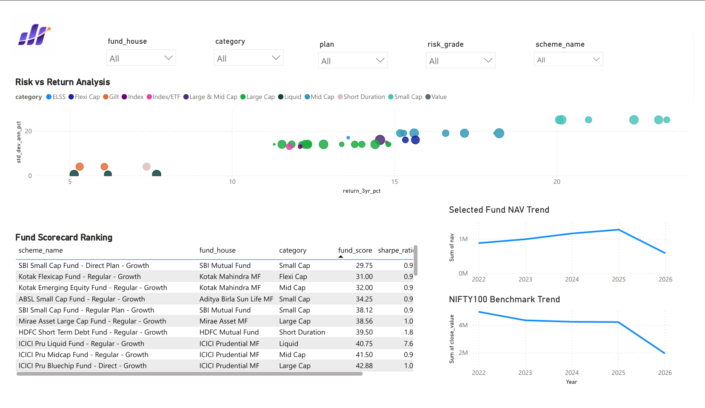
Dashboard Page 2 – Fund Performance
Features:
• Risk vs Return Scatter Plot
• Fund Scorecard Ranking
• NAV vs Benchmark
• Dynamic Slicers
Business Value:
Enables comparison of funds based on returns and risk.

Slide 14
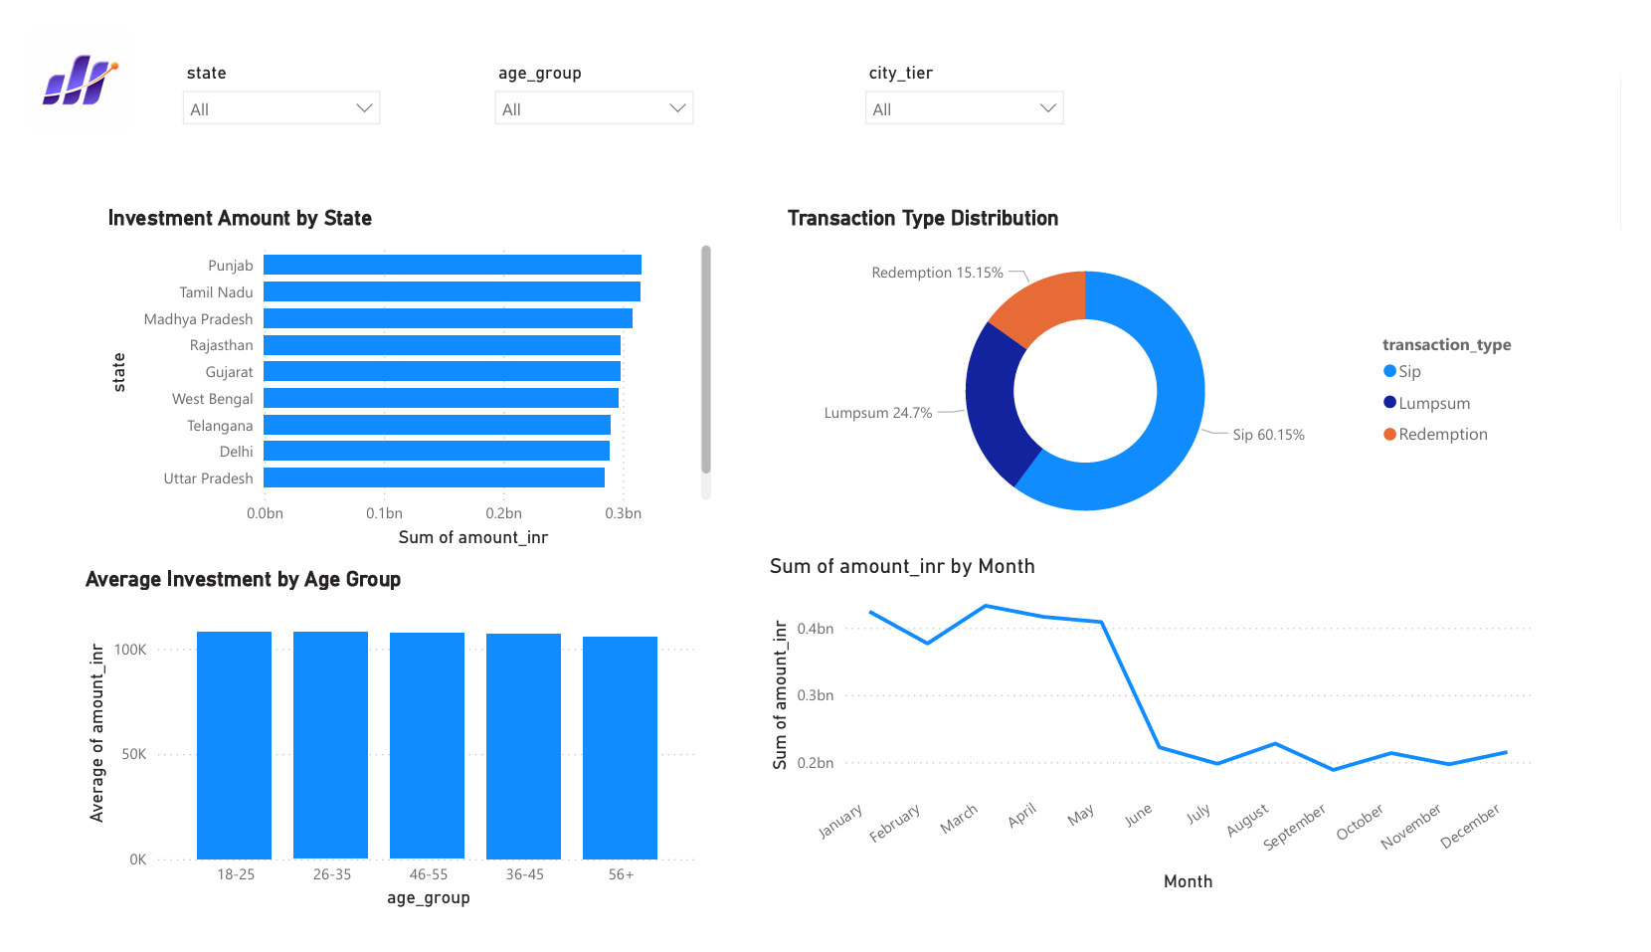
Dashboard 3 – Investor AnalyticsPage
Features:
• State-wise Investments
• Transaction Type Distribution
• Age Group Analysis
• Monthly Investment Trend
Business Value:
Understand investor behavior and demographics.

Slide 15
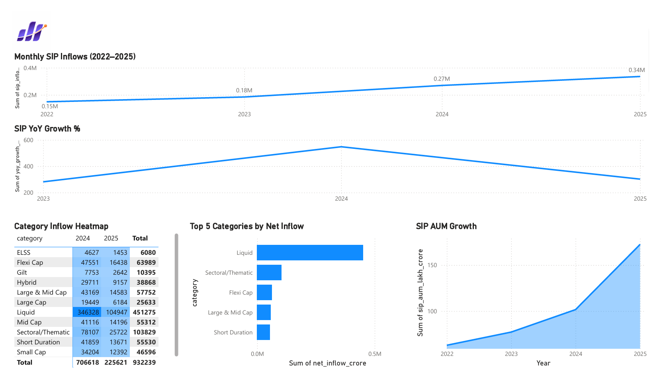
Dashboard Page 4 – SIP & Market Trends
Features:
• SIP Inflow Trend
• NIFTY50 Comparison
• Category Inflows
• Market Trend Analysis
Business Value:
Tracks investor sentiment and market participation.

Slide 16
Key Findings
• Mutual fund industry showed strong AUM growth.
• Equity-oriented funds generated superior returns.
• Sharpe Ratio identified funds with better risk-adjusted performance.
• SIP participation increased significantly.
• Dashboard enables real-time business insights.

Slide 17
Conclusion
Project Achievements:
✓ End-to-End ETL Pipeline
✓ SQLite Data Warehouse
✓ EDA & Performance Analytics
✓ Advanced Risk Metrics
✓ Interactive Power BI Dashboard
✓ Business Insight Generation
Future Enhancements:
• Live NAV Integration
• Streamlit Deployment
• Portfolio Optimization
• Automated Reporting
Thank You

