Slide 1
Azure Case Study
Swiggy Restaurants Dataset Analysis
Jan 9,2025
Vighneswar Anil
Developer – I Software Engineer

Slide 2

Objective
Create a comprehensive Data Pipeline with Azure Data Factory and Databricks to create a Dashboard for Swiggy Restaurants Dataset Analysis
Ingest data from source into a centralized repository.
Clean and transform the raw data into an analysis-ready format.
Enable efficient querying of the processed data to derive valuable insights.
Visualize the data through dashboards to help stakeholders understand key trends and patterns.

Slide 3

Data Sources
A JSON file containing comprehensive data on all restaurants listed on Swiggy in India from Kaggle database, sourced via HTTP and hosted on GitHub LFS.
Restaurant Information: Restaurant_ID, Name, Cuisine, City, Cost, Rating, and Address.
Menu Items: Nested array with attributes like Category, Item_Name, Price, Veg_or_Non_Veg.
Metadata: Lic_No, Link for restaurant details.
Rating Data: Includes Rating and Rating_Count.

Slide 4
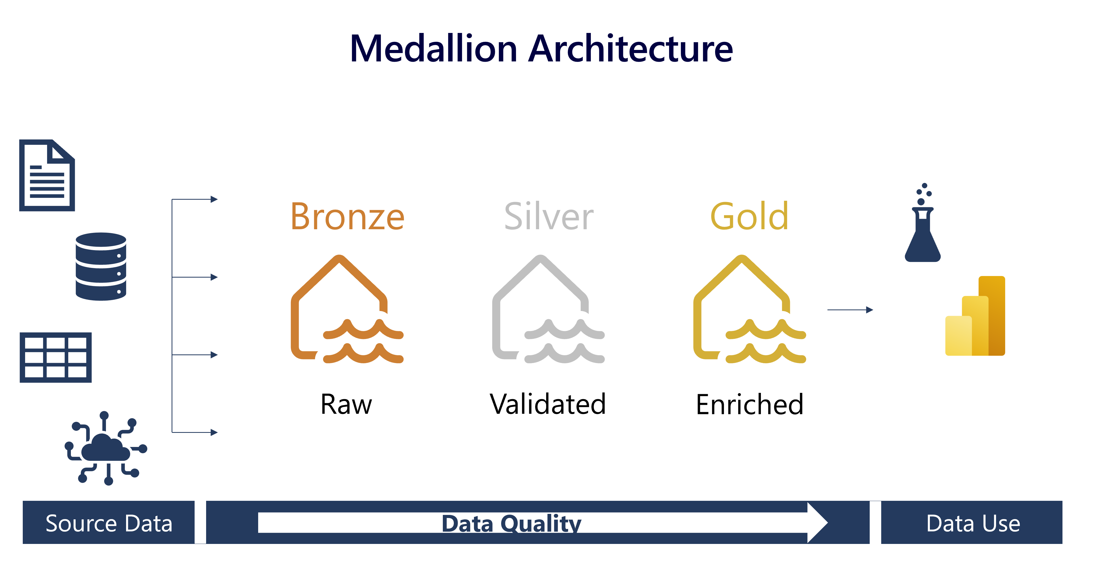
Approach
This project leverages the Medallion Architecture to structure data workflows across Bronze, Silver, and Gold layers for optimized data processing and analytics.

Slide 5
Approach
1.Data Ingestion
A copy data activity is used to copy raw data from the HTTP source (JSON format) to Azure Data Lake Storage Gen2 (ADLS2)
The data is stored in ADLS2, acting as the Bronze layer, which holds the unprocessed raw data before it is cleaned and transformed.
2. Data Transformation
Using Databricks notebooks cleans data by handling inconsistencies and missing values.
Filters the latest records from the Silver Layer and saves them into the Gold Layer for analysis and visualization.
3. Analysis & Reporting
Databricks SQL notebooks is used to perform SQL queries to derive insights.
Databricks create visualizations to present the data effectively using its notebook dashboard
4. Security and Logging
Using Azure Key Vault, encrypts sensitive information and handles credential management.
Pipeline run information is logged into SQL tables via ADF Copy Activity.

Slide 6
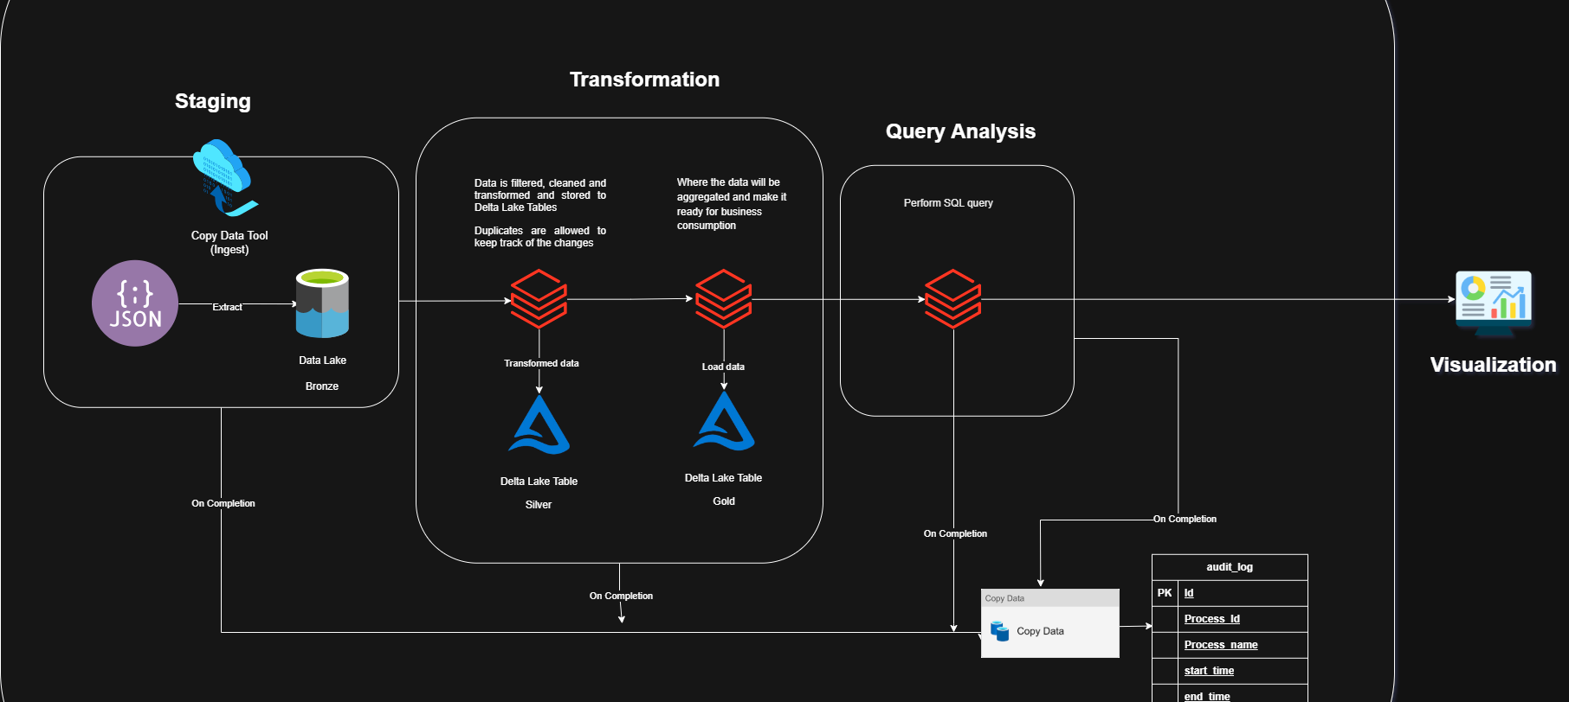
Architecture

Slide 7
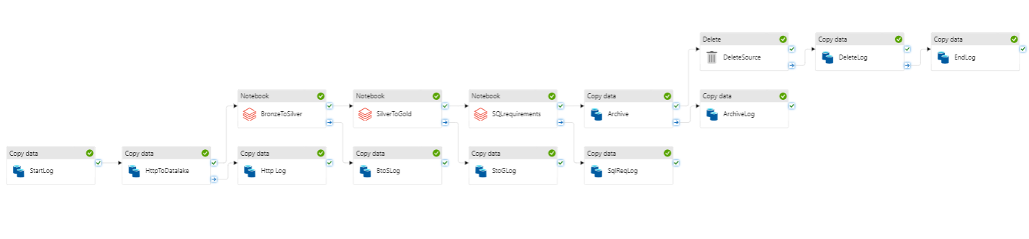
ADF Pipeline

Slide 8
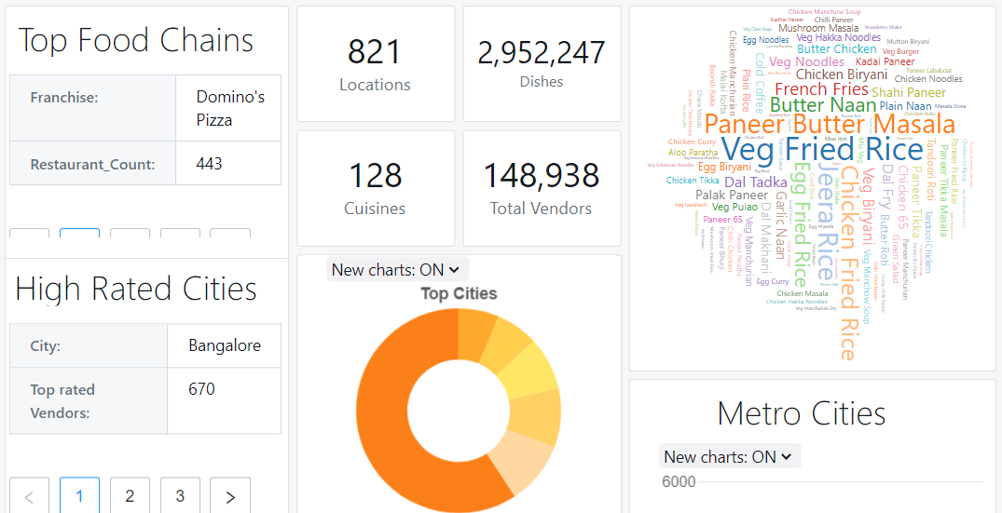
Visualization
Databricks notebook dashboard of the processed data.

Slide 9
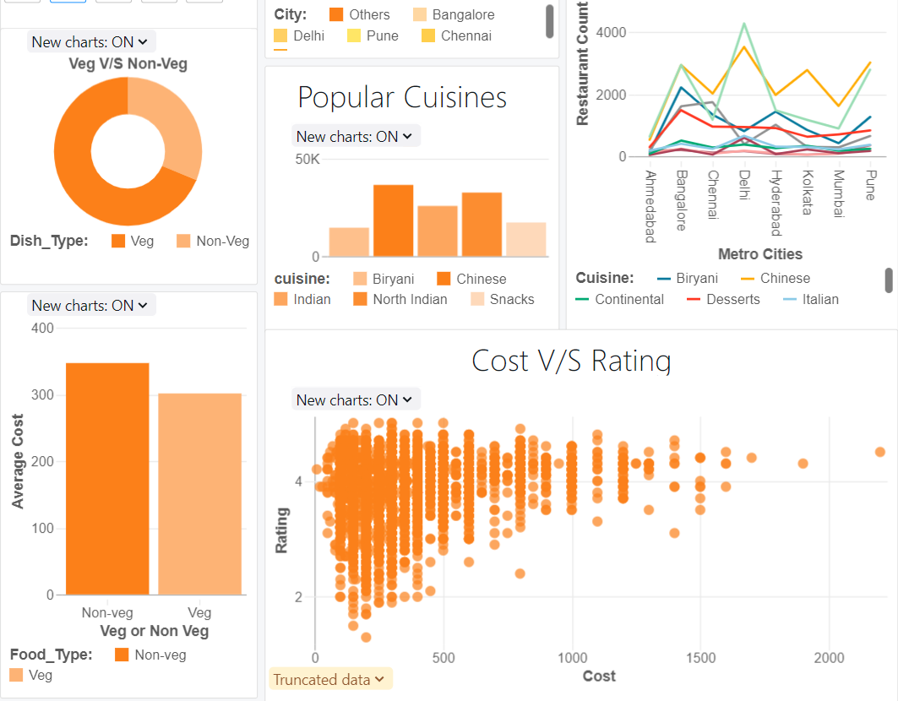
Visualization
Databricks notebook dashboard of the processed data.

Slide 10
Challenges
Data Logging
Implementing an effective method for logging pipeline activity data.
SQL script was run to log details directly into an SQL table using ADF copy data activity.
Fetching Data from Nested JSON
Deeply Nested JSON structure
Flattened the JSON using python script
Encryption and Credential Management
Encrypting sensitive information
Used Azure Key Vault for masking credentials and sensitive fields

Slide 11
Learnings
Used Azure key Vault with Databricks Notebook for secure management.
Gained hands-on experience in implementing the Medallion Architecture, and its various layers.
Gained experience in handling complex JSON data structures.
Familiarized with Azure Log Analytics Workspace for automated retrieval of pipeline data.

Slide 12
Insights
Used Azure key Vault with Databricks Notebook for secure management.
Gained hands-on experience in implementing the Medallion Architecture, and its various layers.
Gained experience in handling complex JSON data structures.
Familiarized with Azure Log Analytics Workspace for automated retrieval of pipeline data.

Slide 13
Vighneswar.Anil@ust.com

