Slide 1
BIRTH/DEATH REGISTRATION INTERGRATION WITH SERVICES
PIP104 University Project-II
Review-1
Batch Number:108
Roll Number | Student Name
20211CSE0083 | M.ANIL RAJ KUMAR
20211CSE0132 | V.DINESH VARDHAN
20211CSE0733 | Y.SAI PRAGNA
20211CSE0735 | K.SREYA
Under the Supervision of,
Dr./Mr./Ms./Prof. DR.JOTHISH C jothish.c@presidencyuniversity.in 9567063366
Assistant Professor.
School of Computer Science and Engineering.
Presidency University

Slide 2
Introduction
The integration of birth/death registration with various services can significantly improve the efficiency and accuracy of these processes. By connecting birth and death records to other relevant systems, it becomes possible to automate tasks, reduce paperwork, and provide better services to citizens.
Key areas for integration:
Healthcare:
Linking birth records to immunization schedules and health checkups.
Benefits of integration:
Improved efficiency: Automation of tasks reduces manual labor and speeds up processes.
Challenges and considerations:
Data privacy and security: Ensuring the protection of sensitive personal information is crucial.

Slide 3
Literature Review
The integration of birth and death registration with various services has become increasingly important in recent years. By connecting these records to other relevant systems, it is possible to automate tasks, reduce paperwork, and provide better services to citizens. This literature review explores the key areas of integration, benefits, challenges, and best practices.

Slide 4
Proposed Method
1. Data Standardization and Harmonization:
Develop a common data model: Establish a standardized data model for birth and death records, ensuring consistency across different systems and agencies.
Harmonize data elements: Standardize data elements such as names, dates, places of birth/death, and other relevant information.
2. System Integration and Interoperability:
Identify key systems: Determine the essential systems that need to be integrated, such as healthcare systems and government agencies.
3. User Interface and Experience Design:
Design intuitive interfaces: Create user-friendly interfaces for data entry, retrieval, and analysis. * Provide easy access: Ensure that users can easily access the integrated system and perform their tasks efficiently.
it is possible to successfully integrate birth/death registration with various services, improving efficiency, accuracy, and service delivery.

Slide 5
Objectives
The primary objectives of integrating birth and death registration with various services are to:
Improve Efficiency and Accuracy:
Reduce manual labor: Automate tasks to minimize the need for manual data entry and processing.
Speed up processes: Streamline workflows and reduce processing time for various services.
Reduce waiting times: Minimize the time it takes to obtain necessary documents and certificates.
Improve user experience: Create a more convenient and efficient experience for citizens.
Analyze population trends: Track demographic changes and population growth patterns.
Assess health outcomes: Study health trends and identify areas for improvement.Prevent Fraud and Improve Security:
Strengthen security: Implement measures to protect sensitive personal information.
By achieving these objectives, the integration of birth/death registration can significantly improve the quality of life for citizens and contribute to a more efficient and effective government.

Slide 6
Methodology
Needs Assessment:
Identify stakeholders
Gather Requriments
Assess existing systems
2.Data analysis and standardization:
Develop a data model
Implement data quality checks
3.Security and privacy measures:
Implement security measures
Ensure data privacy
Conduct regular security audits

Slide 7
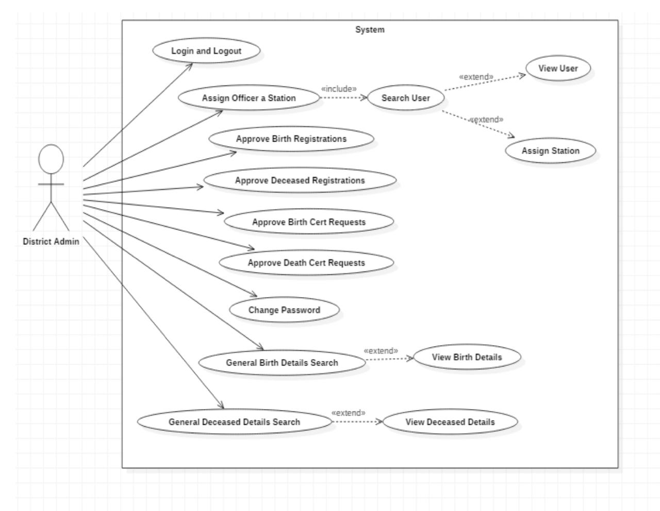
Architecture

Slide 8
Hardware/software components
Birth and death registration systems use a variety of hardware and software components, including: Microprocessors (PCs)PCs with modems can transmit data directly to a state's computer system. The PC software displays the record format and allows staff to enter dataSoftwareSoftware can extract registration data from a mainframe computer and perform editing functions. Digital platformsDigital platforms can ensure efficiency, accessibility, and accuracy in the registration process. DatabaseApproved birth and death records are stored in a database with a well-defined schema. Security measures, such as encryption and access restrictions, keep sensitive personal information safe.

Slide 9
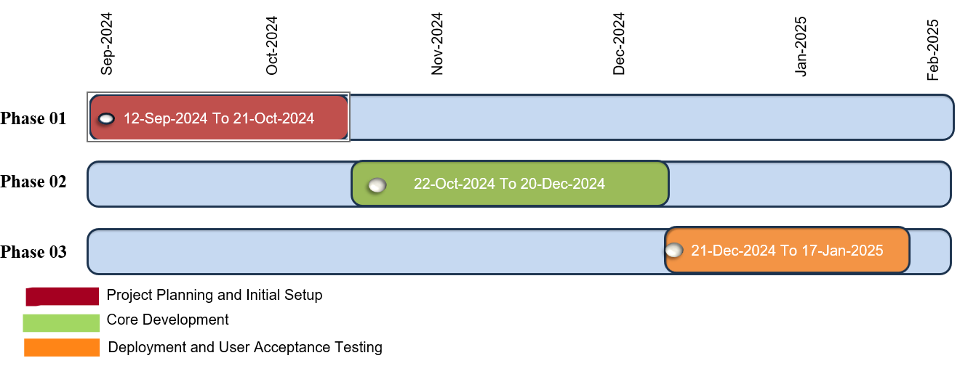
Timeline of Project

Slide 10
Expected Outcomes
The integration of birth/death registration with various services is expected to deliver the following outcomes:
Improved Efficiency and Accuracy:
Reduced manual labor: Automation of tasks will minimize the need for manual data entry and processing.
Better user experience: Citizens will have a more convenient and efficient experience when interacting with government agencies.
Health outcomes assessment: Health trends and disease patterns can be studied to identify areas for improvement.
Prevented Fraud and Improved Security:
Reduced identity theft: The risk of identity theft and fraudulent use of birth and death records will be minimized.
Overall, the integration of birth/death registration is expected to lead to a more efficient, accurate, and effective system for managing vital records, benefiting both citizens and government agencies.

Slide 14
Conclusion
The integration of birth/death registration with various services offers numerous benefits for both citizens and government agencies. By automating tasks, reducing errors, and improving data accuracy, it can significantly enhance the efficiency and effectiveness of public services.
Continuously monitor and evaluate the effectiveness of the integrated system. By addressing these challenges and implementing effective strategies, it is possible to realize the full potential of birth/death registration integration and create a more efficient, equitable, and responsive public service system.

Slide 15
Github Link
The Github link provided should have public access permission.
Github Link
https://github.com/anilvijiwada/Birth-Death-registration-intergration-with-services.git

Slide 16
References
mSIGA - mobile application for birth and death registration in hospitals and remote population areas
Birth/Death Online Registration Integration with Services
Authors-Shubham Gupta, Rishav Singh, Shubham Chaudhary, Ruban Ahmed, Mr. Vinesh Kumar
* eGo mdms :-> egov.mdms.host =https://dev.digit.org/eGov -*idGen :> *egov.idgen.host =https://dev.digit.org/* localization *service :-> *egov.localization.host =https://dev.digit.org/

Slide 17
Thank You

