Slide 1
EDA Project

Slide 2

Choose a dataset and perform exploratory data analysis to understand the patterns, trends, and relationships within the data.
Use visualizations like histograms, scatter plots, and box plots to represent the data.

Slide 3
Module 1 | Introduction
Module 2 | Dataset Overview
Module 3 | Data Cleaning
Module 4 | Analysis – Univariate, Bivariate and Multivariate
Module 5 | Data Visualization
Module 6 | Summary, Limitations and Challenges

Slide 4
Module 1. Introduction
Importance of EDA in the data science workflow.
Objectives of your EDA.

Slide 5
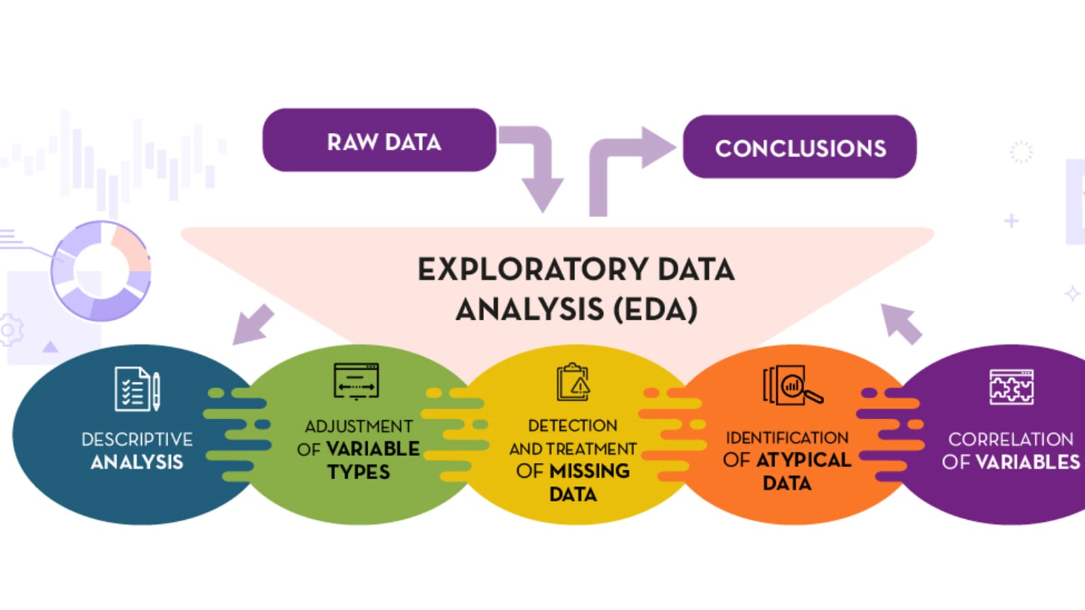

Slide 6
Module 2. Dataset Overview
Summary of the dataset you are working with.
- include information on the size, structure, and basic statistics (mean, median, standard deviation, etc.).

Slide 7
Module 3. Data Cleaning
Identification and handling missing values, duplicates, and outliers if any.
Address any data quality issues that may impact the analysis.

Slide 8
Module 4. Analysis
Univariate Analysis
Explore individual variables in the dataset.
Utilize histograms, box plots, and summary statistics to understand the distribution of each variable.
Identify any patterns or anomalies.

Slide 9
Module 4. Analysis
Bivariate Analysis
Explore relationships between pairs of variables.
Use scatter plots, correlation matrices, and other visualizations to identify patterns and dependencies.
Look for potential correlations or causations.

Slide 10
Module 4. Analysis
Multivariate Analysis
Extend the analysis to multiple variables.
Utilize techniques such as pair plots, heatmaps, and 3D plots to visualize relationships among multiple variables simultaneously.

Slide 11
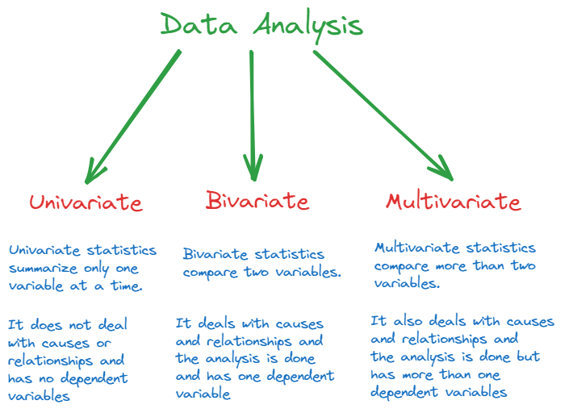

Slide 12
Module 5. Data Visualization
Use various visualization tools (Matplotlib, Seaborn, Plotly, etc.) to create compelling and informative graphs.
Ensure that visualizations are clear, labeled, and suitable for your target audience.

Slide 13
Module 6. Summary, Limitations and Challenges
Summarize key findings from the EDA.
Provide insights and actionable recommendations based on your analysis.
Discuss any limitations or challenges encountered during the EDA.
Restate key findings, and emphasize the importance of the EDA process.

Slide 14



