Slide 1
Cascading Style Sheets (CSS)
Presented By -
Anil Yadav

Slide 2
CSS CONTENTS
CSS INTRODUCTION WITH SYNTAX
HOW TO ADD CSS
CSS COLORS & BACKGROUND WITH COMMENTS
CSS BORDERS, MARGINS AND PADDINGS
CSS HEIGHT AND WIDTH
CSS OUTLINES
CSS TABLE
CSS SELECTORS

Slide 3
CSS INTRODUCTION
CSS stands for Cascading Style Sheets. CSS describes how HTML elements are to be displayed on screen, paper, or in other media.
Why Use CSS?
CSS is used to define styles for your web pages, including the design, layout and variations in display for different devices and screen sizes.
Syntax:-
h4 {color : red; font-size : 20px;}
Selector property values

Slide 4
HOW TO ADD CSS
Three Ways to Insert CSS
There are three ways of inserting a style sheet:
External CSS
Internal CSS
Inline CSS

Slide 5
i) External CSS
External styles are defined within the <link> element, inside the <head> section of an HTML page:
Exa :-
<head>
<link rel="stylesheet" href="mystyle.css">
</head>

Slide 6
ii) Internal CSS
An internal style sheet may be used if one single HTML page has a unique style.The internal style is defined inside the <style> element, inside the head section.
Exa :-
<head>
  <style>
  body {
  background-color: linen;
  }
  </style>
</head>

Slide 7
Iii) Inline CSS
An inline style may be used to apply a unique style for a single element.
To use inline styles, add the style attribute to the relevant element. The style attribute can contain any CSS property.
Exa :-
<html>
<body>
<h1 style="color:blue;text-align:center;">This is a heading</h1>
<p style="color:red;">This is a paragraph.</p>
</body>
</html>

Slide 8

CSS COLORS , BACKGROUNDS WITH COMMENTS
We can set the background color and Text color for HTML elements
<html>
<body>
<h1 style="background-color:Tomato;color:white;">
<!--comment here-->
Tomato</h1>
</body>
</html>
Output:-

Slide 9

CSS BORDERS, MARGINS & PADDINGS
The CSS border properties allow you to specify the style, width, and color of an element's border.
<html>
<head>
<style>
p.dotted {border-style: dotted;margin-left:20px;padding-top:5px;}
</style>
</head>
<body> Output:-
<p class="dotted">A dotted border.</p>
</body>
</html>

Slide 10

CSS HEIGHT AND WIDTH
The CSS height and width properties are used to set the height and width of an element.
Code:-
<html>
<head>
<style>
div {height: 50px;width: 50%;border: 1px solid blue;}
</style>
</head>
<body>
<div>Div height 50 pixels and width of 50%.</div>
</body>
</html>

Slide 11

CSS OUTLINES
An outline is a line drawn outside the element's border.
<html>
<head>
<style>
p {border: 2px solid black;outline: green solid 10px;margin: auto;padding: 20px;}
</style>
</head>
<body>
<p>green outline with a width of 10px.</p>
</body>
</html>

Slide 12

CSS TABLE
HTML tables allow web developers to arrange data into rows and columns.
Code:-
<html>
<head>
<style>table, th, td {border: 1px solid black;}</style>
</head>
<body>
<table>
<tr><th>Firstname</th><td>Anil</td> </tr>
</table>
</body>
</html>

Slide 13
CSS SELECTORS
Universal Selector
ID Selector
Class Selector
Tag name Selector
Descendant Selector
Child Selector
General Selector
Adjacent Sibling Selector

Slide 14
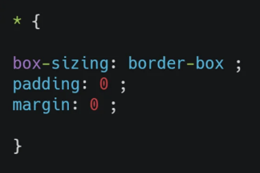
Universal Selector
The universal selector provided by CSS helps in choosing any elements within the HTML page.

Slide 15
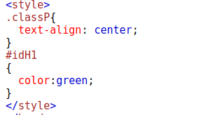
ID & CLASS SELECTOR
The id selector uses the id attribute of an HTML element to select a specific element.In css , we can select by hash (#) character.
The class selector selects HTML elements with a specific class attribute.In css , we can select by period (.) character.

Slide 16
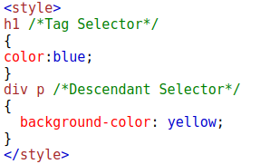
Tag Name & Descendant Selector
Tag Name selector selects HTML elements with a specific Tag name.
The descendant selector matches all elements that are descendants of a specified element.

Slide 17
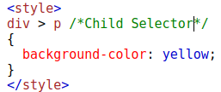
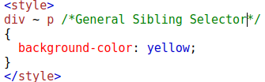
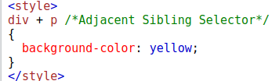
CHILD, GENERAL SIBLING & ADJACENT SELECTOR
The child selector selects all elements that are the children of a specified element.
The general sibling selector selects all elements that are next siblings of a specified element.
The adjacent sibling selector is used to select an element that is directly after another specific element.

Slide 18


