Slide 1
Power of R
Team CDMA

Slide 2
Demonstrated through three data analytics projects
Load Libraries
library(tidyverse) library(knitr) library(igraph) library(networkD3) library(visNetwork) library(tidytext) #install.packages("tidytext") library(wordcloud) #install.packages("wordcloud") library(ggtext) library(ggalt) library(ggthemes) library(ggpubr)

Slide 3
1.Sentiment Analysis through Word Cloud
Data Source: Indian Budget Portal
Load data
reshape the .txt data frame into one column
tidy_dat <- dat %>% pivot_longer(everything(), values_to = 'word', names_to = NULL)
Tokenize
tokens <- tidy_dat %>% unnest_tokens(word, word) %>% count(word, sort = TRUE)

Slide 4
Load default stop words
data("stop_words")
Remove stop words using dplyr::anti_join
tokens_clean <- tokens %>% anti_join(stop_words, by='word') %>% # remove numbers filter(!str_detect(word, "^[0-9]"))
Remove additional words seen in first round
uni_sw <- data.frame(word = c("cent", "pm", "crore", "lakh", "set", "level", "sir")) tokens_clean <- tokens_clean %>% anti_join(uni_sw, by = "word")

Slide 5
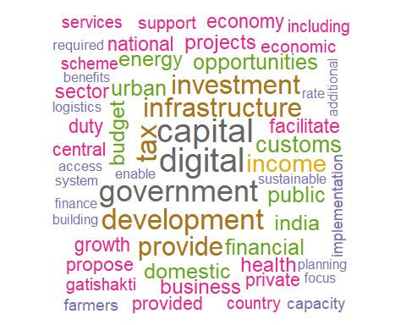
Plot

Slide 6
2.Customisation available in R visualisation
Customisation at micro level, e.g. adding icons, country flags, etc. in Axes of Plots generated.
Data Set used- 120 Years of Olympics Source: Kaggle

Slide 7
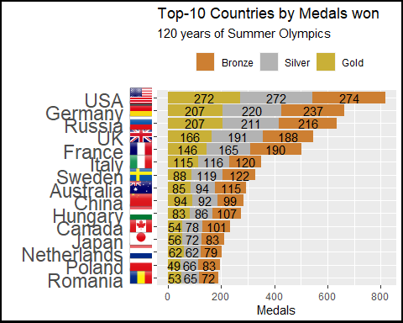
Output plot

Slide 8
3. Network Analysis and Visualisation
Data Set - Export Schemes data sample
A beneficiary is entitled to get only one Import/Export Code. However network analysis revealed that a single beneficiary was enrolled using different attributes such as mobile number, email, PAN, bank account number, etc. and obtained multiple IECs.
Data points analysed
Unique IE Code
Other Identification attributes, such as
Mobile number
E-mail
PAN Number

Slide 9
Code Explanation: Steps-
Load data.
Convert all attributes to tidy format, using tidyr::pivot_longer()
Convert it to graph object, using igraph library.
Add attributes(color and shape) for each node
Plot interactive plot using visNetwork library.

Slide 10
Preview the data
IE_code | telephone | email | PAN
8629664493 | 9870029885 | goldenstars0786@gmail.com | AABCT0050D
8849905875 | 9740516000 | grsisl@rediffmail.com | AABCT0050D
8186529510 | 9570698755 | bindalk19@gmail.com | AAEFK6698Q
8797183238 | 9670553990 | bh2cc@yahoo.co.in | AAFCR9606R
8118229673 | 9870029885 | lozicnet_delhi@goodboss.com | AAKPG2765Q
8186821161 | 9870029885 | scientific.syndicate@rediffmail.com | ACCPC3990P
8610077392 | 9709244730 | goelk19@gmail.com | AJGPR3543Q
8651507473 | 9740516885 | bh26007@yahoo.co.in | AJGPR3543Q
8794363860 | 9570698755 | abcdrsisl@rediffmail.com | AJOPT5146K
8559625141 | 9740516885 | grsisl@rediffmail.com | GANPS2679C

Slide 11
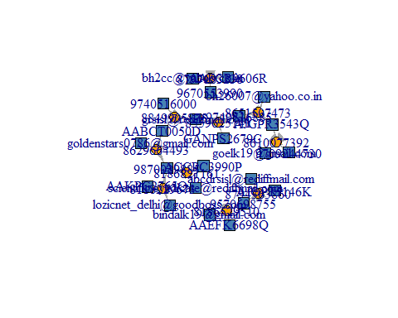
Performing network analysis

Slide 12
Group_id | IE_code | telephone | email | PAN
1 | 8629664493 | 9870029885 | goldenstars0786@gmail.com | AABCT0050D
1 | 8849905875 | 9740516000 | grsisl@rediffmail.com | AABCT0050D
2 | 8186529510 | 9570698755 | bindalk19@gmail.com | AAEFK6698Q
3 | 8797183238 | 9670553990 | bh2cc@yahoo.co.in | AAFCR9606R
1 | 8118229673 | 9870029885 | lozicnet_delhi@goodboss.com | AAKPG2765Q
1 | 8186821161 | 9870029885 | scientific.syndicate@rediffmail.com | ACCPC3990P
1 | 8610077392 | 9709244730 | goelk19@gmail.com | AJGPR3543Q
1 | 8651507473 | 9740516885 | bh26007@yahoo.co.in | AJGPR3543Q
2 | 8794363860 | 9570698755 | abcdrsisl@rediffmail.com | AJOPT5146K
1 | 8559625141 | 9740516885 | grsisl@rediffmail.com | GANPS2679C

Slide 13
Features of R used -
Level of customisation available
Better readable and concise code
Interactive visualisations
Tidy data concepts laid down by Hadley Wickham, widely used across many programming languages such as pandas in python, tableau, etc.
Functional programming aspects of dplyr::across - a powerful function to perform large number of analysis in one single line of code.
Network Analysis, Word Cloud, etc. otherwise not possible in many licensed softwares such as Tableau and Power BI, without knowledge of R/Python.

