Slide 1
BRSKI overview and issues
Very short BRSKI overview.
recap of incoming/outgoing discussion
audit token, nonce-full/nonce-less versions
online view, offline view
ownership voucher details: Kent

Slide 2
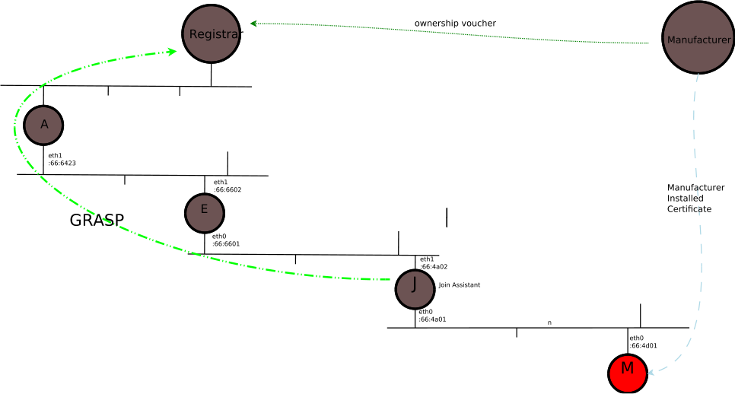
The cast
Manufacturer
Manufacturer Authorized Signing Authority (MASA)
Registar
Join Assistant/Proxy
New Node (pledge)
(ownership) voucher
LL fe80::123->fe80::proxy
ULA
fd12:345::1-> registrar
(circuit proxy, IPIP, NAT66)

Slide 3
Incoming (callhome) / Outgoing
Debate
I-D.ietf-netconf
-call-home
6tisch
Will use incoming,
With COMI+
System-keystore
proxy
Call Home
-outgoing TCP, followed by swap of client/server
Incoming
pledge
registrar
Syn
coap
Syn/ack
pledge
registrar
Syn
ClientHello
syn
Syn/ack
Syn/ack
Outgoing
ack
TLS ClientHello
SSH open
pledge
registrar
syn
Syn/ack
Tcp client
TLS server
ANIMA
Decided to stick
With outgoing via
proxy
Ack
TLS ClientHello

Slide 4
Audit tokens and ownership
Mix of contradictory requirements!
Audit Token
Weak to no link to owner
  May be bearer token!
  Likely contains link to owner’s public key.
  May link to some DN/CN of owner
Uses MASA to serve as registration, providing audit trail to subsequent “owners”
Ownership Voucher
Strong link to owner
MASA either produces the voucher (possibly “online”), or provides access to already created voucher.
MASA stores history of previous vouchers.
(controversial), may include Voucher Revocation List!

Slide 5
Audit vs Ownership Voucher
YANG description
module: ietf-voucher
+--rw voucher | Audit | Ownership
+--rw assertion | trust anchor for Registrar
+--rw trusted-ca-certificate | id of Registrar | id of Registrar
+--rw certificate-id
| +--rw cn-id? string
| +--rw dns-id? string
+--rw unique-id* | id of Pledge | id of Pledge
+--rw nonce | Real Time Clock proofing | Real Time Clock proofing
+--rw created-on | if RTC available on Pledge | if RTC available on Pledge
+--rw expires-on | if RTC available on Pledge | if RTC available on Pledge
+--rw revocation-location | under consideration | under consideration
+--rw additional-data | future proofing

Slide 6
Token Requirements
Online validation
  May include NEA-type assessment of current firmware of device (remote attestation) back to vendor.
  Strong connection to supply chain to provide proof of ownership.
Offline validation
  Need to collect all Tokens/Vouchers onto stable storage for use offline.
    National security concerns, disaster recovery, protection against vendor going out of business
  Uncooperative/immature supply chain
    Need to include voucher in bearer token form inside packaging as QR code
    Supporting re-sale of devices, transitive trust of ownership vouchers

