Slide 1
IETF95 Summary of summary slides of IETF94
Simplying assumption 1: 6tisch like has a PCE/JCE
draft-pritikin-bootstrapping-keyinfrastructures-00
→ draft-ietf-anima-bootstrapping-keyinfra-02
Term mapping
JCE → ANIMA Registrar
Joint Assistant → ANIMA “Proxy”
Simplying assumption 2: leverage 802.1AR work
Fundamental to anima-bootstrapping
Challenge 1: how does the network authenticate?
ANIMA bootstrap defines “ownership voucher”

Slide 2
Things left to Resolve
Goal of ANIMA bootstrap is to create Enrollment over Secure Transport (RFC7030)
ANIMA accomodates HTTPS or DTLS/CoAP + Blockwise. Hard sell to make DTLS Mandatory to Implement.
Goal of 6tisch bootstrap is to create secured CoAP/6top transport from JCE/PCE to new node
DTLS/CoAP only + 6top, blockwise may be controversial?
VS

Slide 3
Join Problem
How to let random uninitialized, “drop shipped”, potentially malicious nodes into your network without destroying the network.
802.1x/EAP/PANA has this “solved” for initialized nodes which know which network they want to join; need to be per-provisioned with certificates.
needs EAP-TLS to make this work, which then includes new layers of fragmentation. This code is used once.
PANA/1x authenticator function scales with number of nodes attempting to join, is subject to DoS attack, defending against may be too expensive for constrained nodes
1x function for ANIMA ACP bootstrap may interfere with 1x function being provided by routers/switches for end-hosts!
The goal is to provision new nodes with certificates, at which point “traditional” methods may be used to join network.

Slide 4
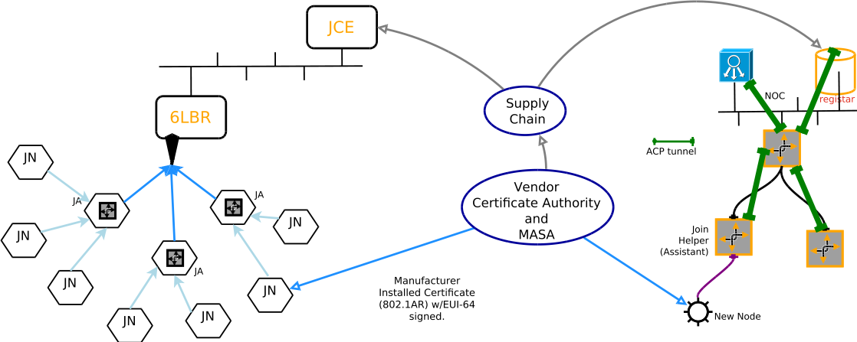
Network Diagram
Both 6tisch/LLN and ANIMA share Manufacturer Installed Certificates (“MIC”), and have a supply chain relationship with network operator via which Ownership Vouchers can be communicated.

Slide 5
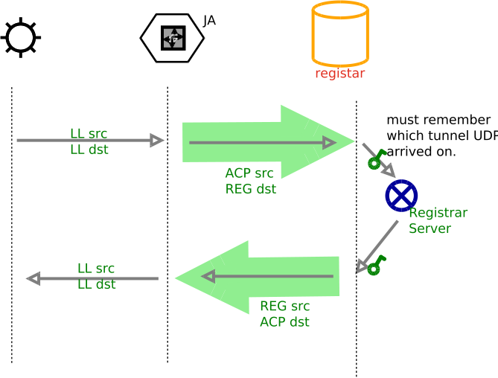
New Node /Registrar communications
New Node ↔ Proxy use Link Local addresses.
Communication is CoAP/DTLS over UDP
(or HTTPS/TCP)
Proxy ↔ Registrar communication is forwarded (D)TLS traffic; proxy is uninvolved in security.
Proxy is neither trusted, nor needs to be truthworthy
Green Encapsulation arrow can be implemented in different ways

Slide 6



Proxy/Join Assistant proxy methods
HTTPS
Via circuit proxy (process per connection), or HTTP proxy.
Via NAT66 of link-layer enrollment addresses to ACP ULA address
Stateless IPIP encapsulation of link-local traffic to registar
CoAP/DTLS
UDP circuit proxy
NAT66 of link-layer to ACP ULA address
Stateless IPIP encapsulation of link-local traffic to registrar
Essentially this is routing-dispatch IPIP encapsulation
Brian Carpenter
was visibly ill
Least amount of new
Code for constrained
Devices, highest
Resistance to DoS
Costs some bandwidth
See draft-richardson-anima-state-for-joinrouter-00: Considerations for stateful vs stateless join router in ANIMA bootstrap, for longer discussion

Slide 7
Funny Icons for other slides

