Slide 1
Status of Cluster C325
https://www.rfc-editor.org/cluster_info.php?cid=C325
draft-ietf-anima-grasp-15.txt
draft-ietf-anima-grasp-api-10.txt
draft-ietf-anima-autonomic-control-plane-30.txt
draft-ietf-anima-bootstrapping-keyinfra-45.txt
draft-ietf-anima-reference-model-10.txt
draft-ietf-anima-prefix-management-07.txt
IETF 110
ANIMA Working Group

Slide 2
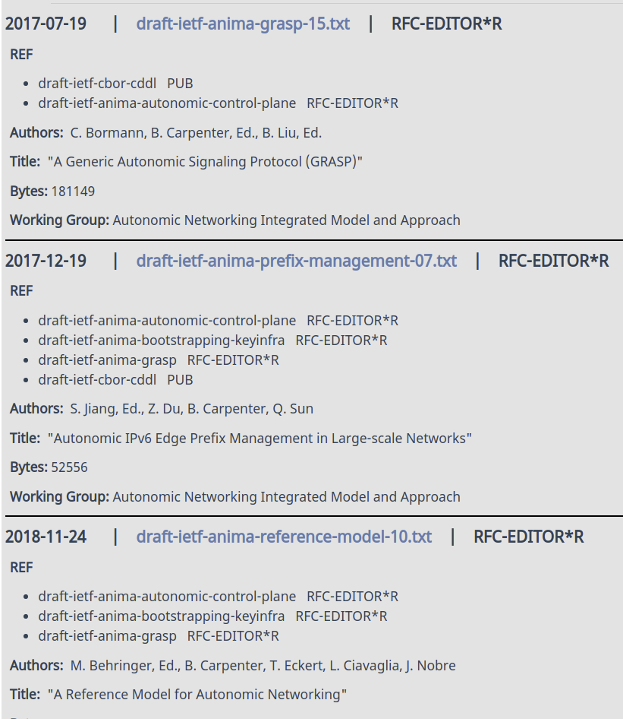
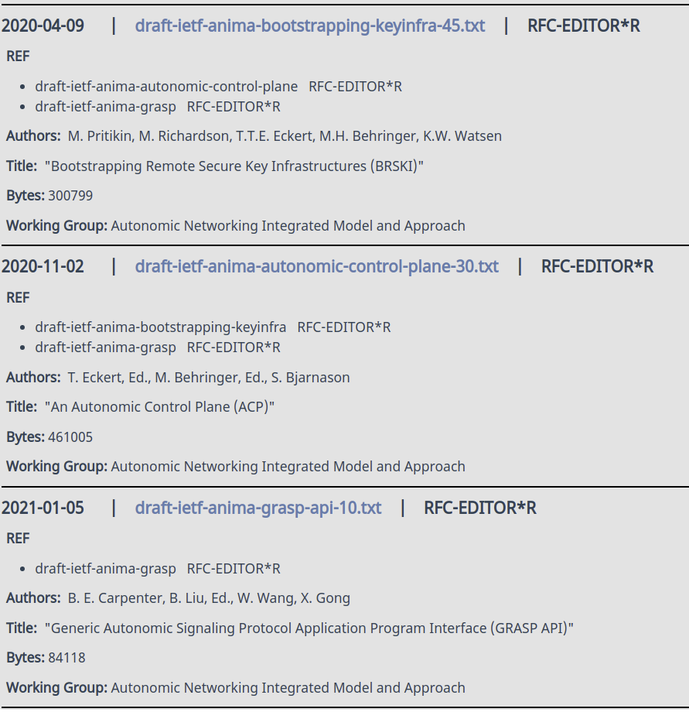
Status --- ALMOST

