Slide 1
draft-ietf-anima-bootstrapping-keyinfra
Versions 44 and 45
IETF 109 – not Bangkok
Slides from:
Michael Richardson
mcr+ietf@sandelman.ca

Slide 2
Rename of EST extensions -44
In August, shortly after IETF108, there was a discussion that started in the brski-async-enroll document.
  DOCUMENT was stuck in MISREF anyway...
Async-enroll would like to add some end-points, but they are CMP related and just don’t belong under /.well-known/est.
Okay, should we move all the BRSKI endpoints?
My input to the thread: https://mailarchive.ietf.org/arch/msg/anima/BYpLzpiES1EcXos3vmTy-nNwAvg/
This was IMPLEMENTATION AFFECTING. And implementors were consulted, and we agreed that it made sense.
  Was approved with an IETF LC on 2020-09-14.
  Also took a pass through IANA and .well-known reviewer Mark Nottingham.

Slide 3
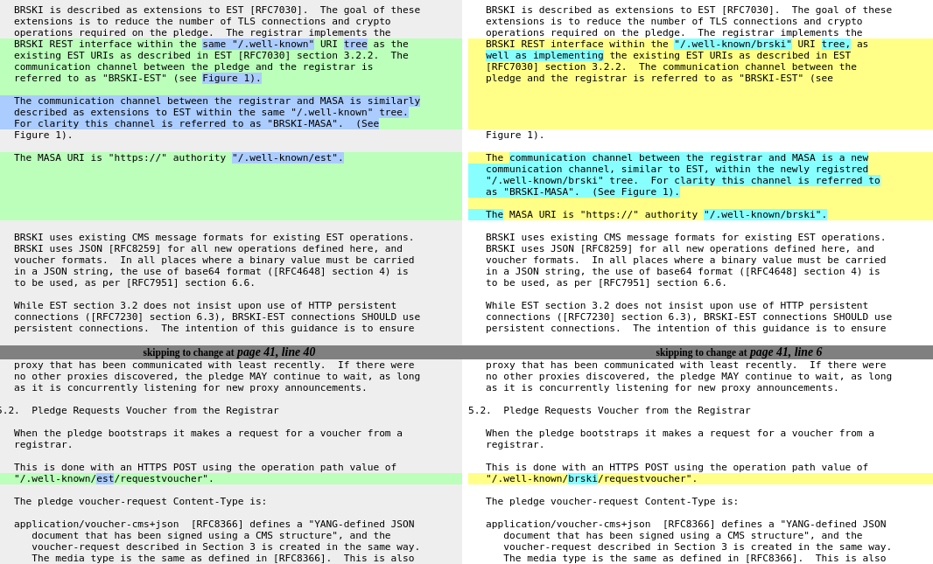
The change: a picture of a thousand words

Slide 4
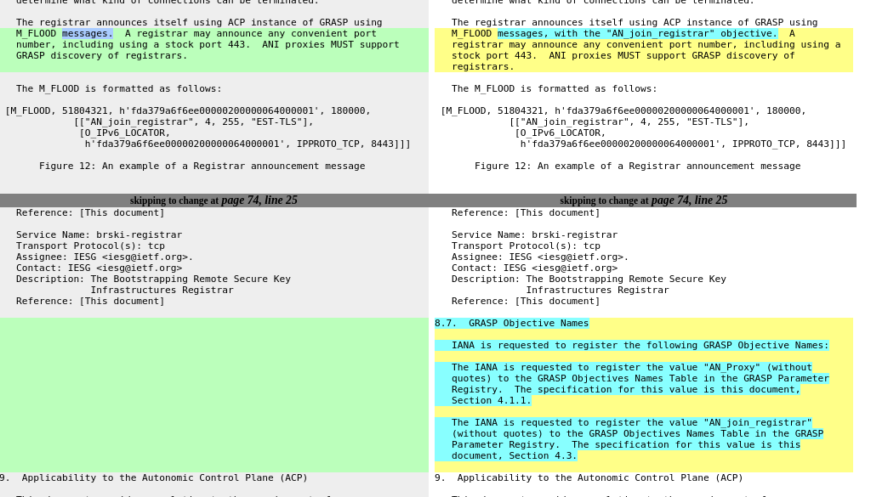
Added missing IANA action -45
In October, Toerless noticed that the BRSKI draft was missing an IANA action for the GRASP objectives: AN_Proxy and AN_join_registrar
A revision was created to fix the problem, and the AD approved it, and IANA was asked to review.

Slide 5
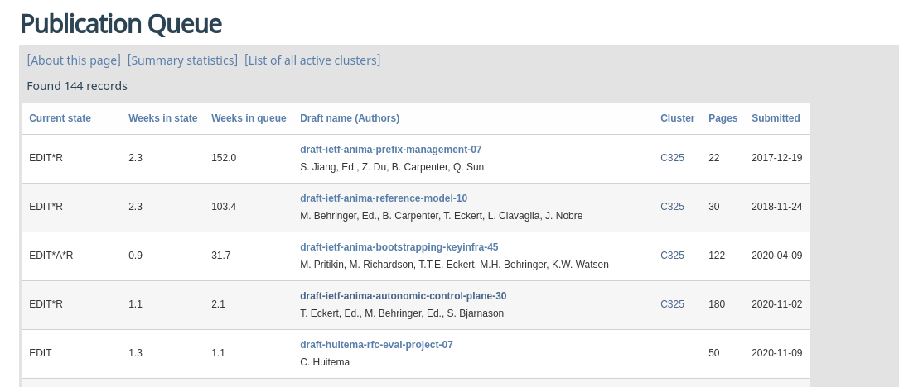
Current state of cluster C325
Looks like we are at the top of the Q!!!
No AUTH48 activity yet though

