Slide 1
BRSKI document status for IETF104, Prague. March 26, 2019
Authors:
Max Pritikin,
Michael Richardson
and
Kent Watsen

Slide 2
BRSKI document – passed WGLC
Received Three reviews:
  GenART review from Jari Arkko, see it here:
    https://www.ietf.org/mail-archive/web/anima/current/msg03866.html
    https://mailarchive.ietf.org/arch/msg/anima/iVg7MRMdBQBVFA5VFiksYFHchBU
  SecDir review from Christian Huitema, see it here:
    https://mailarchive.ietf.org/arch/msg/anima/XCS6JpwQSm3naOivwCYaO0AAsVs
  IoT Directorate review from Russ Housley
    https://mailarchive.ietf.org/arch/msg/anima/1N7AR8hqu2oIWuTFFd9OQOab8S
Posted version -18 and -19 with incremental improvements, summary of final activities posted to mailing list
  https://mailarchive.ietf.org/arch/msg/anima/Sjr2Yy1YNfUw3WVv1EqOa7Swef0

Slide 3
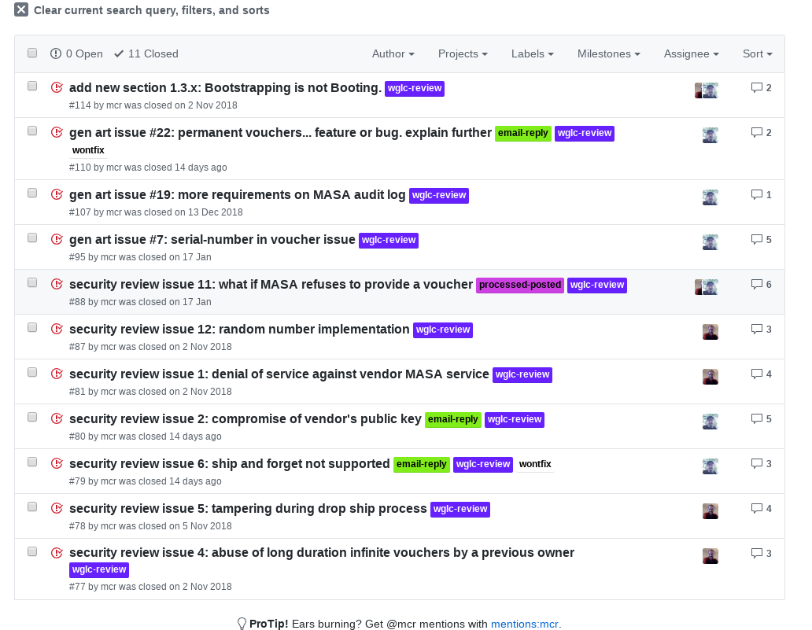
Github Issues on BRSKI
https://github.com/anima-wg/anima-bootstrap/issues?utf8=%E2%9C%93&q=is%3Aissue+
Many improvements to text, added a number of sections:
  new section 5.3: Registrar Authorization of Pledge
  new section 3.1: Nonceless Voucher Requests
  new section 8: Applicability to the Autonomic Control Plane (plus other details in the document)
  new section 9: Privacy Considerations:
Tried to narrow scope to ANI needs, lest ocean boiled.

Slide 4
Interop testing of BRSKI
BRSKI-19
Contains many
clarifications
Being adopted by Thread Group
  For details ask them.
DOTS wants to use it
In active Interoperability testing by FairHair Alliance
  Third in-person session occuring Monday and Today.
In use by CIRALabs SecureHomeGateway
MASA / Registrar implementations from:
  Siemens
  minerva.sandelman.ca
Client (pledge) implementations from :
  NXP, Silabs,
  Signify, Cisco
  Sandelman, Siemens (test client)
  ZHAW

Slide 5
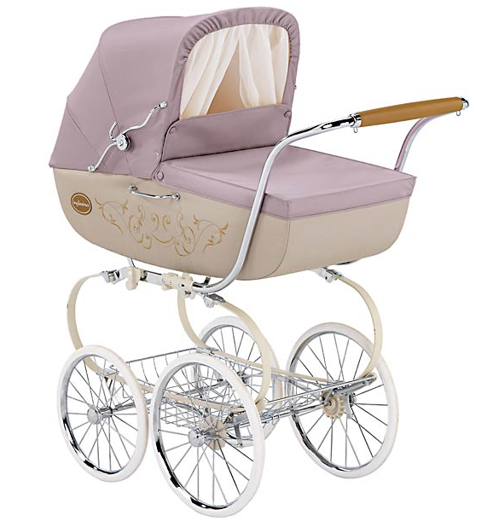
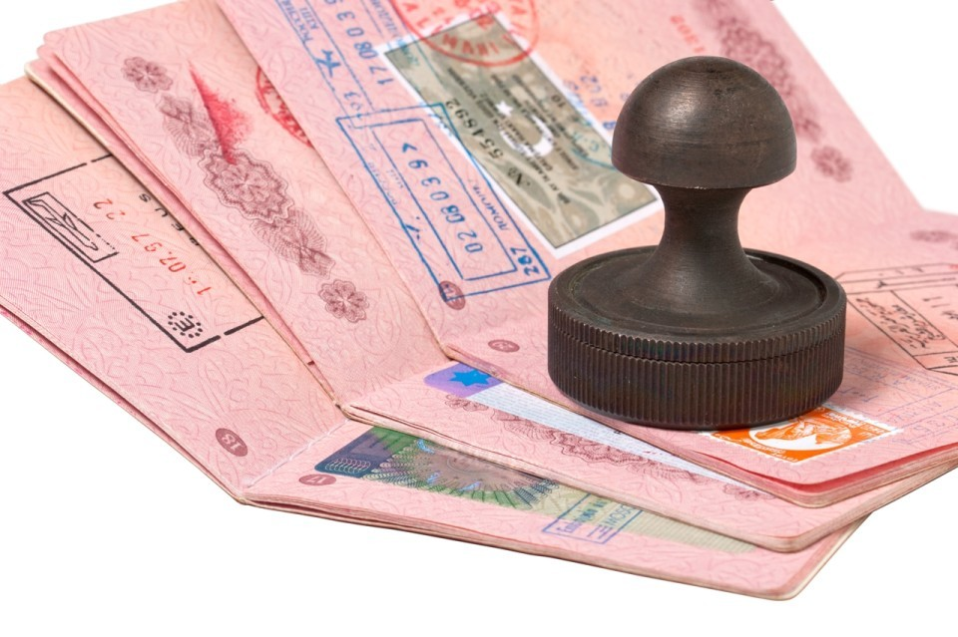

Some BRSKI iconology
Pledge
Join Registrar/Coordinator
  JRC
  Registrar
Stajano, F. and Ross Anderson,
"The resurrecting duckling: security issues for ad-hoc wireless networks", 1999,
https://www.cl.cam.ac.uk/~fms27/papers/1999-StajanoAnd-duckling.pdf
Wikipedia, "Wikipedia article: Imprinting", July 2015,
https://en.wikipedia.org/wiki/Imprinting_(psychology)
https://en.wikipedia.org/wiki/Animal_House
Manufacturer
Authorized
Signing
Authority
-> MASA.
VOUCHER
  RFC8366

Slide 6
Major Issue for WG
Should we completely remove unsigned pledge voucher request?
  Offline case has no voucher request from pledge, and in the online case it seems to offer only illusion of security, with no significant reduction in crypto for pledge.
  Was written as a compromise for limited devices, but constrained-voucher seems to be better fit.
Corollory, should constrained-voucher include unsigned voucher requests? Always? Never?

Slide 7
Document now with AD/IESG
Questions?
?

