Slide 1
IETF95 Summary of summary slides of IETF94
Simplying assumption 1: 6tisch like has a PCE/JCE
draft-pritikin-bootstrapping-keyinfrastructures-00
→ draft-ietf-anima-bootstrapping-keyinfra-02
Term mapping
JCE → ANIMA Registrar
Joint Assistant → ANIMA “Proxy”
Simplying assumption 2: leverage 802.1AR work
Fundamental to anima-bootstrapping
Challenge 1: how does the network authenticate?
ANIMA bootstrap defines “ownership voucher”
For 6tisch WG
And netconf
And ANIMA

Slide 2
Contrast ANIMA and 6tisch
Goal of ANIMA bootstrap is to create Enrollment over Secure Transport (RFC7030)
ANIMA accomodates HTTPS or DTLS/CoAP + Blockwise. Hard sell to make DTLS Mandatory to Implement.
Network is not constrained
  After bootstrap, may be multi-gigabit
While device is not constrained in aggregate, ANIMA ACP code may run on control plane/line-card CPU: some hardware offload available, but not universal.
Goal of 6tisch bootstrap is to create secured CoAP/6top transport from JCE/PCE to new node to transport YANG.
DTLS/CoAP only + 6top, blockwise may be controversial?
Network is constrained (not challenged)
Devices are very code and ram constrained.
Battery power is common (but not universal)
VS
ANIMA
6tisch

Slide 3
Contrast ANIMA and NETCONF
Goal of ANIMA bootstrap is to create Enrollment over Secure Transport (RFC7030)
ANIMA accomodates HTTPS or DTLS/CoAP + Blockwise. Hard sell to make DTLS Mandatory to Implement.
ANIMA replaces IDevID with LDevID ASAP.
ANIMA assumes link-local connectivity, device owner is link network operator
ANIMA tends to be for “infrastructure”
Goal of NETCONF is to provide signed bootstrap data (YANG) to device.
Variety of sources: HTTP, HTTPS, DNS, mDNS, DHCP, removable storage...
NETCONF uses IDevID directly
NETCONF assumes device owner likely is not link operator, or operator is unsophisticated (home user)
NETCONF more appliance, and high-volume access device focused, rather than core infrastructure.
VS
Wild generalization!
Wild generalization!
ANIMA
NETCONF

Slide 4
Contrast 6tisch and NETCONF!
Goal of 6tisch bootstrap is to create secured CoAP/6top transport from JCE/PCE to new node to transport YANG.
Devices and networks constrainted.
6tisch will replace IDevID with LDevID for use with 802.15.9 or other per-link KMP
No cheap broadcast/multicast, or service discovery
Device owner is network owner.
Goal of NETCONF is to provide signed bootstrap data (YANG) to device.
Variety of sources: HTTP, HTTPS, DNS, mDNS, DHCP, removable storage...
NETCONF uses IDevID directly
NETCONF assumes device owner likely is not link operator, or operator is unsophisticated (home user)
NETCONF more appliance, and high-volume access device focused
VS
ANIMA
NETCONF

Slide 5
Join Problem
How to let random uninitialized, “drop shipped”, potentially malicious nodes into your network without destroying the network.
802.1x/EAP/PANA has this “solved” for initialized nodes which know which network they want to join; need to be pre-provisioned with certificates.
  needs EAP-TLS to make this work, which then includes new layers of fragmentation. This code is used once.
  PANA/1x authenticator function scales with number of nodes attempting to join, is subject to DoS attack, defending against may be too expensive for constrained nodes
  1x function for ANIMA ACP bootstrap may interfere with 1x function being provided by routers/switches for end-hosts!
The goal is to provision new nodes with certificates, at which point “traditional” methods may be used to join network.

Slide 6
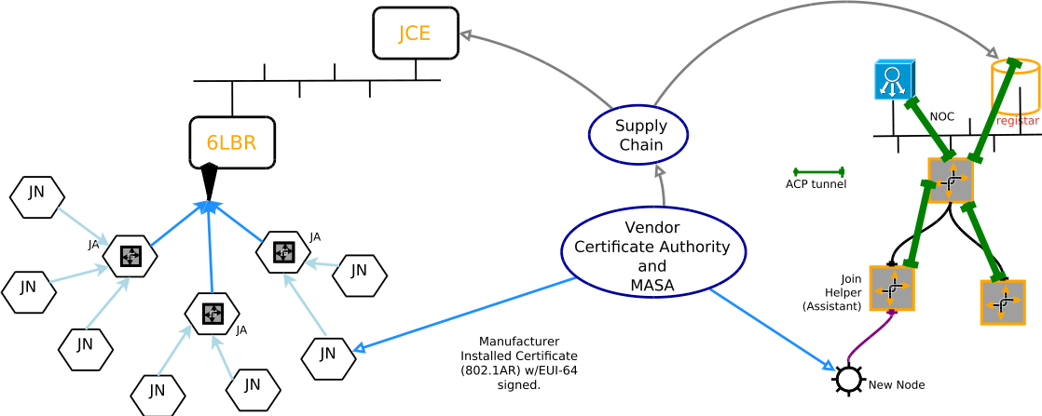
Network Diagram
ANIMA
6tisch
Both 6tisch/LLN, ANIMA and NETCONF share Manufacturer Installed Certificates (“MIC”) [IDevID], and have a supply chain relationship with network operator via which Ownership Vouchers can be communicated.

Slide 7
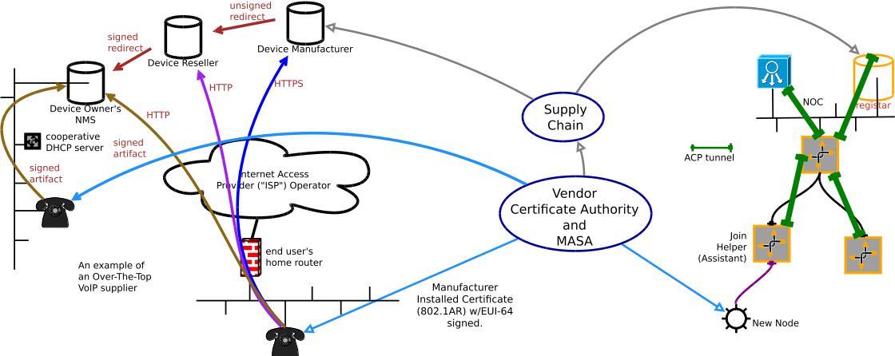
Network Diagram: NETCONF

Slide 8
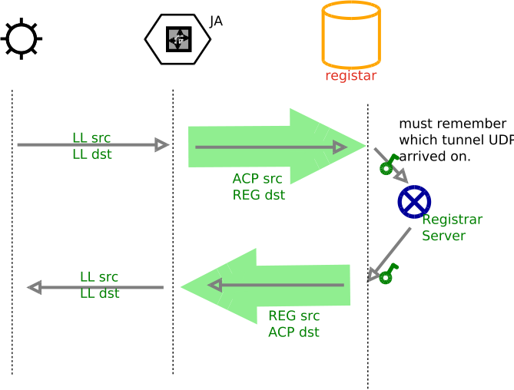
New Node /Registrar communications
New Node ↔ Proxy use Link Local addresses.
Communication is CoAP/DTLS over UDP
  (or HTTPS/TCP)
Proxy ↔ Registrar communication is forwarded (D)TLS traffic; proxy is uninvolved in security.
  Proxy is neither trusted, nor needs to be truthworthy
Green Encapsulation arrow can be implemented in different ways

Slide 9



Proxy/Join Assistant proxy methods
HTTPS
  Via circuit proxy (process per connection), or HTTP proxy.
  Via NAT66 of link-layer enrollment addresses to ACP ULA address
  Stateless IPIP encapsulation of link-local traffic to registar
CoAP/DTLS
UDP circuit proxy
NAT66 of link-layer to ACP ULA address
Stateless IPIP encapsulation of link-local traffic to registrar
  Essentially this is routing-dispatch IPIP encapsulation
Brian Carpenter
was visibly ill
Least amount of new
Code for constrained
Devices, highest
Resistance to DoS
Costs some bandwidth
See draft-richardson-anima-state-for-joinrouter-00: Considerations for stateful vs stateless join router in ANIMA bootstrap, for longer discussion

Slide 10
Funny Icons for other slides

