Slide 1
BRSKI document status for IETF103, Bangkok. Nov.5, 2018
Authors:
Max Pritikin,
Michael Richardson
and
Kent Watsen

Slide 2
BRSKI document – passed WGLC, two reviews
GenART review from Jari Arkko, see it here:
    https://www.ietf.org/mail-archive/web/anima/current/msg03866.html
    https://mailarchive.ietf.org/arch/msg/anima/iVg7MRMdBQBVFA5VFiksYFHchBU
SecDir review from Christian Huitema, see it here:
    https://mailarchive.ietf.org/arch/msg/anima/XCS6JpwQSm3naOivwCYaO0AAsVs
  Generated significantly long thread.

Slide 3
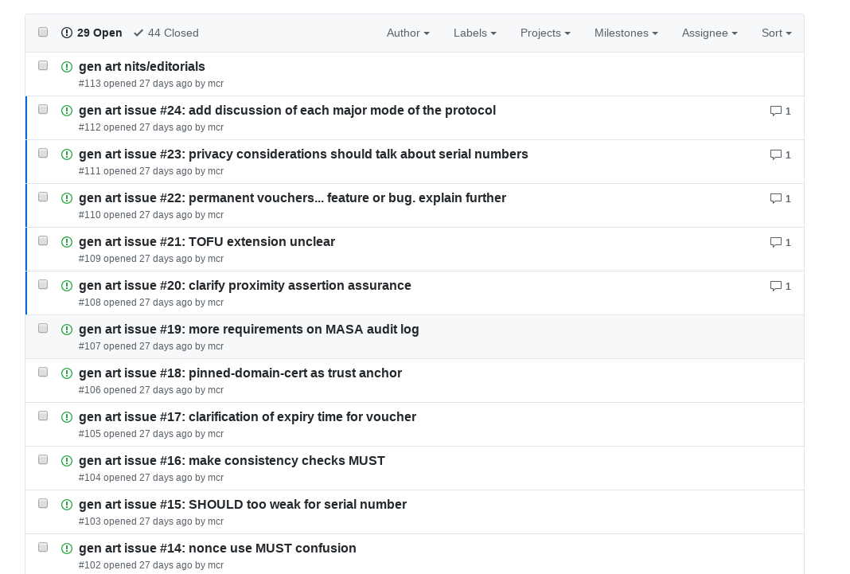
Github Issues on BRSKI
https://github.com/anima-wg/anima-bootstrap/issues
47 issues opened from these two reviews.
  29 issues not yet even assigned to Max or Michael
-17 document posted this morning with things worked out to date.
  Will take a few weeks!
  Many comments will result in additional text to narrow of scope.
    Many want ocean boiled.

Slide 4
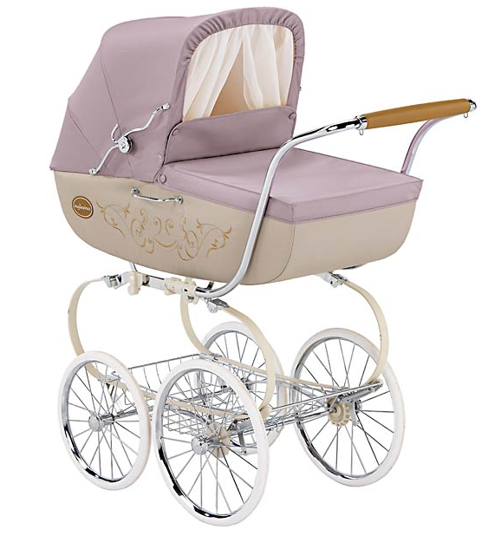
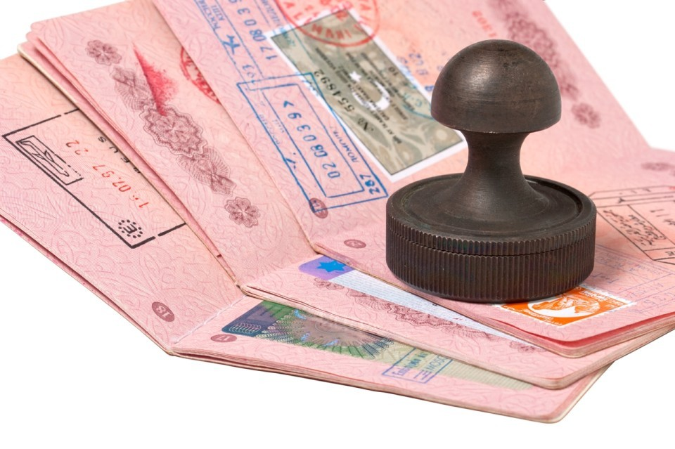

Some BRSKI iconology
Pledge
Join Registrar/Coordinator
  JRC
  Registrar
Stajano, F. and Ross Anderson,
"The resurrecting duckling: security issues for ad-hoc wireless networks", 1999,
https://www.cl.cam.ac.uk/~fms27/papers/1999-StajanoAnd-duckling.pdf
Wikipedia, "Wikipedia article: Imprinting", July 2015,
https://en.wikipedia.org/wiki/Imprinting_(psychology)
https://en.wikipedia.org/wiki/Animal_House
Manufacturer
Authorized
Signing
Authority
-> MASA.
VOUCHER
  RFC8366

Slide 5
Questions and Comments
?

