Slide 1
ANIMA
BRSKI
Bootstrapping Remote Secure Key Infrastructure
An option for
HOMENET
security
Michael Richardson
mcr+ietf@sandelman.ca
https://www.sandelman.ca/SSW/ietf/meeting/ietf101/ietf101_anima_brski_homenet

Slide 2
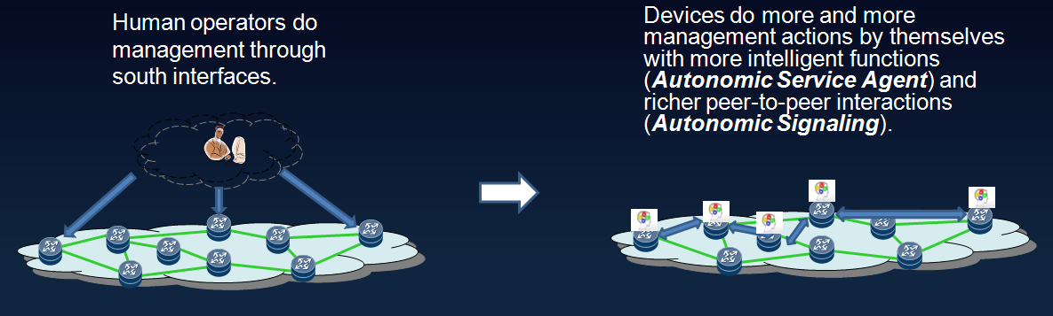
Anima’s approach towards autonomics
  Autonomic Networking Integrated Model Approach
  “Integrated Model Approach” indicates that Anima is not a “Clean Slate”; rather, it could be integrated into current networks (e.g. co-exist with NMS/SDN).
  According to current charter, Anima aims at developing some “re-useable components”, which means some common technologies that could be used among different scenarios.

Slide 3
Two Anima Groupsets: ANI & ASA
ANI (Autonomic Network Infrastructure)
  Three fundamental functions
1) Secure bootstrap (aka. BRSKI)
2) A secure and dedicated channel (VPN) for management/control (aka. ACP)
3) A generic signaling protocol (aka. GRASP)
  Could be used by most of the scenarios
  Started at the initial stage
ASA (Autonomic Service Agent)
  Specific functions regarding to various configurations/services
  Run on top of ANI
  Use GRASP for communication
    Need defining GRASP options (called “Objectives” in GRASP) for each kind of service

Slide 4
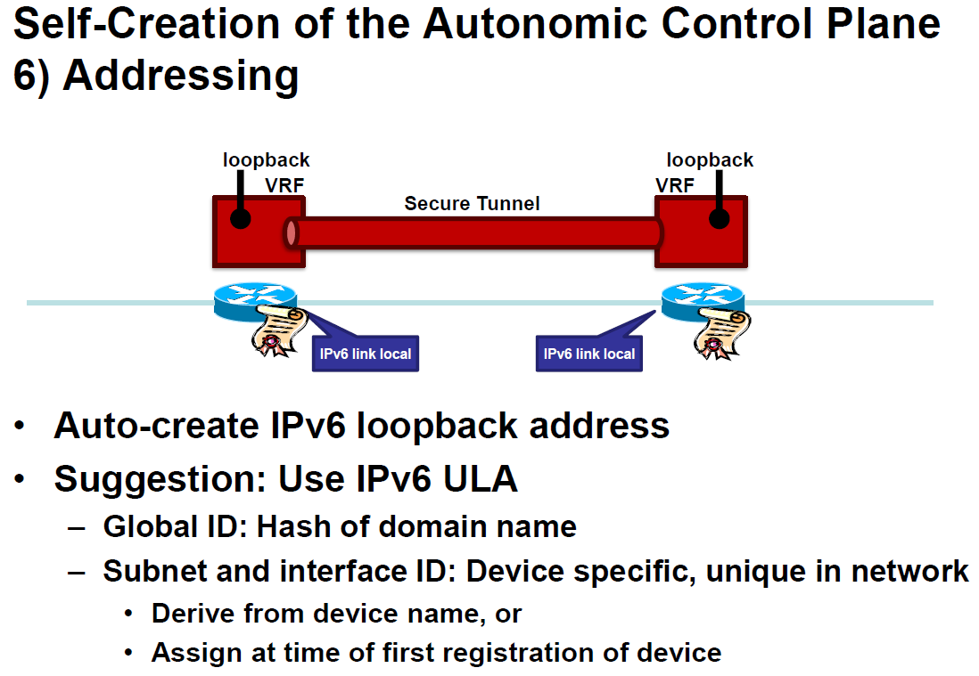
Copied from https://www.ietf.org/proceedings/92/slides/slides-92-anima-7.pdf

Slide 5
How to bootstrap trust?
Devices come out to the box with a trust anchor linking them to the manufacturer.
End user convinces manufacturer that device belongs to them, and manufacturer issues voucher: see draft-ietf-anima-voucher
Device now trusts end user
  How is end-user identified? (Issue for later slide)

Slide 6
Join (Enroll) Problem
How to securely let new devices into a network without destroying the network.
The goal is to provision new nodes with certificates, at which point “traditional” methods may be used to secure network (802.1x/EAP)
Nodes are uninitialized
They are “drop shipped” directly from the warehouse.

Slide 7
Why not use EAP?
  Why didn’t you use 802.1x/EAP/PANA?
    Hasn’t it “solved” this problem?
  Well… no.
    EAP is a mechanism to get a network key, or authenticate an existing node.
    BRSKI is about both *finding* the right network, and getting the credential that you’d need to do a 1x method.
  We also want to do this for the *routers* and *switches* that will be providing 1x services later on. The authenticator/authentication-server back-haul is usually radius, and requires at a minimum, a secret to be configured. It’s also often stateful. We felt that there were too many conflicts with existing 1x uses.

Slide 8
Enrollment at IETF
(many things in many places)
From draft-richardson-enrollment-roadmap-01
  Iot-dir suggested a wiki for now
    https://trac.ietf.org/trac/int/wiki/EnrollmentRoadmap
Insert
homenet
Enrollment
Story
Add
To
Diagram

Slide 9

Bootstrapping Remote Secure Key Infrastructures (BRSKI)
New Device getting Online
Every device that supports ANIMA Bootstrapping is pre-installed a device certificate, which is in the form of 802.1AR certificate.
Registrar
Registrar
Device Certificate
Pledge

Slide 10
Terminology – synchronized/negotiated between ANIMA, 6tisch, and NETCONF
PLEDGE: the new device
Join Proxy: the helper.
Join Registrar/Coordinator(JRC)
Sometimes s/Join/Enrollment/
  Because ROLL people use the world “Join” in a different context.
Registrar
Pledge
(stateless?)
Proxy
Registrar

Slide 11
Bootstrapping Remote Secure Key Infrastructures (BRSKI)
Connects to BRSKI Join Proxy
Every device that has already got online acts as a BRSKI Proxy by default.
  They broadcast the GRASP Flood messages periodically so that they can be found.
  (New device can remain sealthy)
The new device chooses one proxy which will relay the communication between the new device and the Registrar.
Registrar
Registrar
Chosen Proxy
Link-Local IPv6
Pledge

Slide 12
Bootstrapping Remote Secure Key Infrastructures (BRSKI)
Enrollment to the Registrar
Registrar authenticates device using IDevID certificate.
Pledge
  They use EST protocol for secure certificate exchange.(EST: Enrollment over Secure Transport, RFC7030)
Registrar
Chosen Proxy
Registrar
Chosen Proxy
(stateless?)
Proxy
Link-Local IPv6
Pledge
ACP
IP over IPsec
(over LL)
RPL (6550)
Device Certificate

Slide 13
Vouchers
module: ietf-voucher
yang-data:
voucher-artifact
+---- voucher
+---- created-on yang:date-and-time
+---- expires-on? yang:date-and-time
+---- assertion enumeration
+---- serial-number string
+---- idevid-issuer? binary
+---- pinned-domain-cert binary
+---- domain-cert-revocation-checks? boolean
+---- nonce? binary
+---- last-renewal-date? yang:date-and-time
{
"ietf-voucher:voucher": {
"created-on": "2016-10-07T19:31:42Z",
"assertion": "logged",
"serial-number": "JADA123456789",
"idevid-issuer": "base64encodedvalue==",
"pinned-domain-cert": "base64encodedvalue==",
"nonce": "base64encodedvalue=="
}
}
Signed with CMS
(CBOR+COSE soon)

Slide 14
Things Homenet does not need
ACP is overkill
  Just use BRSKI
    6tisch join/enrollment process will do that
Intent-based policy
  But ANIMA hasn’t got it anyway, and SUPA is dead,
    Intent is implicit in HOMENET anyway.
Maybe even PK*I* is unnecessary
  Just use the secure transport to exchange PSKs, or exchange RPK.
    BRSKI with vouchers to make secure transport.

Slide 15
Things HOMENET probably wants
Vouchers
Integration of BRSKI + MUD
  MUD might be the “killer” app that makes this worth it.
    Manufacturer Usage Description Specification
    https://datatracker.ietf.org/doc/draft-ietf-opsawg-mud/
Manufacturer involvement!
“push-button” extensions (see section 6) to BRSKI to operate with reduced security.

Slide 16
Challenges for HOMENET non-professionally managed network --- no infrastructure!
“unprofessional”? “amateur”? “un-managed”?
  Key is probably that infrastructure is very hard to fund.
So… who/what will run the Join Registrar (JRC)?
  Is there any PKI?
  If so, what happens when the PKI machine is replaced?
    Perhaps, quite abruptly.
    His/Her JRCs?
Interactions with “SmartHome”, etc. IoT things.
  Having BRSKI would be good, as it would provide an anchor in the home.
  Maybe IoT network will provide JRC?
What is the fallback when there is no JRC?
  Chicken and egg situation
Can the Join Registrar be cloud-located?
  Can it be outsourced?

Slide 17
Layer-8 and layer-9 issues
While often an IETF
tradition to claim this is
out of scope, too
many of our good
ideas die because
we did not figure
how the incentives
would work
Relates to entire HOMENET challenge: who is gonna pay for ongoing maintenance?
  Does the end-user want to be beholden to that entity?
Is there a fax-effect we are missing?
  Can providing HOMENET security enable other things?
If the home user
is in fact the “product”
for another entity,
we might want to
think hard about
privacy issues
sooner.

Slide 18
Some additional thoughts/hopeshttp://hubofallthings.org/
Aims to be a place to keep one’s personal data, self-owned.
Seems an obvious place for a JRC function!
Currently cloud-based, for pragmatic reasons.
  London based, some cross-over of people
Suffers from same layer-9 issues as HOMENET

Slide 19
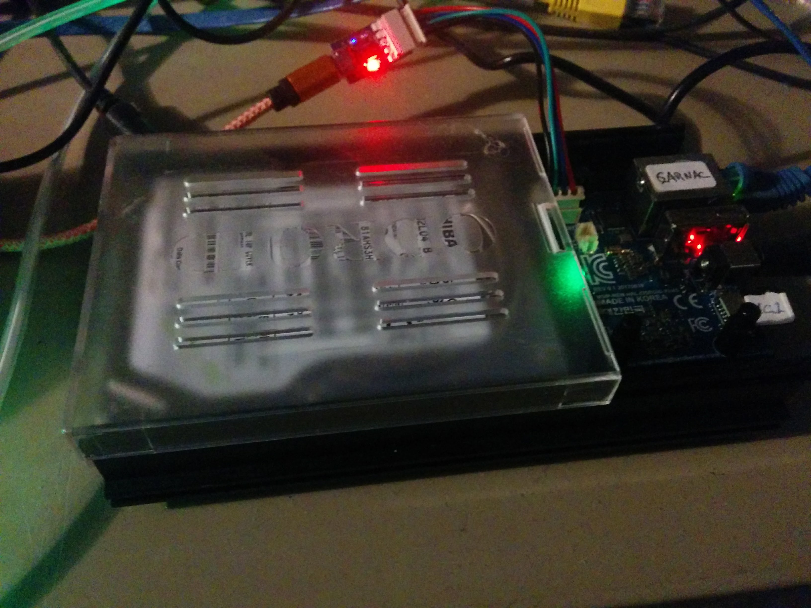
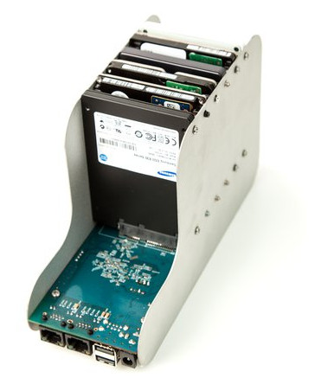
My experimental JRC/hubofallthings
OxDroid HC1 (2cm x 5cm), with old laptop HD.
  HD is superfluous, but is the “media” container.
Functionally identical, GnuBEE home NAS, but better packaging.
Good for hacking, but how to get one into every household?
  A regular homenet problem!
  Pushing string.

Slide 20
How to proceed - 1
Finish current work!
Help ANIMA and 6tisch review our current documents.
  Are there MUST NOTs that you think would have to change for Homenet?
  SHOULDs which HOMENET can not do, likely are less of a problem.
    Write a profile

Slide 21
How to proceed – 2 - profile
Write a profile of BRSKI for HOMENET.
  Do you want full BRSKI (HTTPS, JSON format vouchers + CMS signatures)
  Or constrained voucher (CoAP +{DTLS,EDHOC}, CBOR format vouchers, COSE signatures)
  May have to support both to enable the “home office” to use enterprise equipment, while still speaking to IoT.
  What kind of join proxy will you make MTI?
    BRSKI default is stateful, trivial to code (just a “port forward”), constrained default is stateless, a bit harder to code.
      Type of proxy used is between Proxy and JRC; Pledge does not change.

Slide 22
How to proceed – 3 – Legacy/fallback considerations
Figure out what a BRSKI-HOME device will do in a legacy home.
  Probably call home with NETCONF zero-touch!
  If it is too good, maybe that’s all that will ever occur.

Slide 23
Questions/Discussion
?
Michael Richardson
mcr+ietf@sandelman.ca
https://www.sandelman.ca/SSW/ietf/meeting/ietf101/ietf101_anima_brski_homenet

Slide 24
How to proceed – step 0 find cool acronym (an IETF tradition)
Find a way to expand the acronym
  Suggestion: “RADLER”
    a nice summer beer (BRSKI) with grapefruit juice
  Remote ADder for Lots of Exciting Routers

