Slide 1


First Trip
basement

Slide 2
First Trip
basement

Slide 3
First Trip
basement
QRcode
scan

Slide 4
First Trip
basement
SN: 1234
2021-04-16

Slide 5
First Trip
basement
Voucher
Request
SN: 1234
Assertion:
agent-proximity
SN: 1234
2021-04-16

Slide 6
First Trip
basement
CSR + JWT
enroll
Voucher
Request
SN: 1234
Assertion:
agent-proximity
SN: 1234
2021-04-16

Slide 7


MASA
Registrar
service
truck
basement

Slide 8
MASA
Registrar
service
truck
basement
Voucher
Request
SN: 1234
Assertion:
agent-proximity
SN: 1234
2021-04-16

Slide 9
MASA
Registrar
Voucher request
Voucher
Request
SN: 1234
Assertion:
agent-proximity
SN: 1234
2021-04-16
service
truck
basement

Slide 10
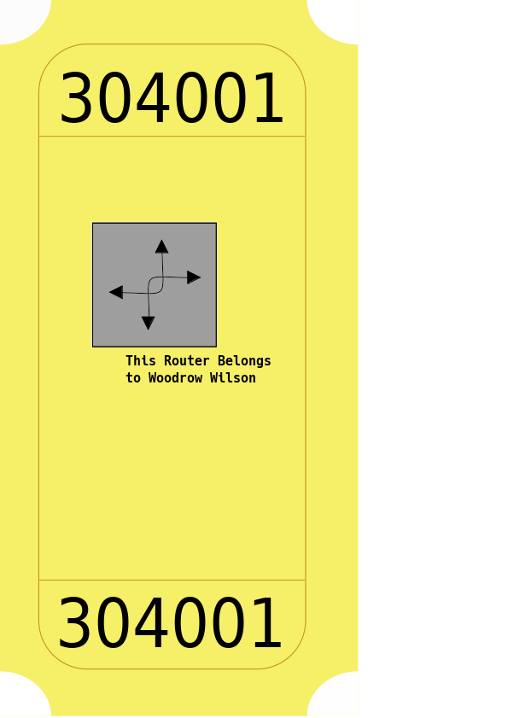
MASA
Registrar
service
truck
basement

Slide 11
MASA
Registrar
service
truck
basement

Slide 12
Second Trip

Slide 13
Second Trip

Slide 14
Second Trip
LDevID
Certificate

