Slide 1


First Trip
basement
CSR + JWT
enroll
QRcode
scan
SN: 1234
2021-04-16
Voucher
Request
SN: 1234
Assertion:
agent-proximity
SN: 1234
2021-04-16

Slide 2
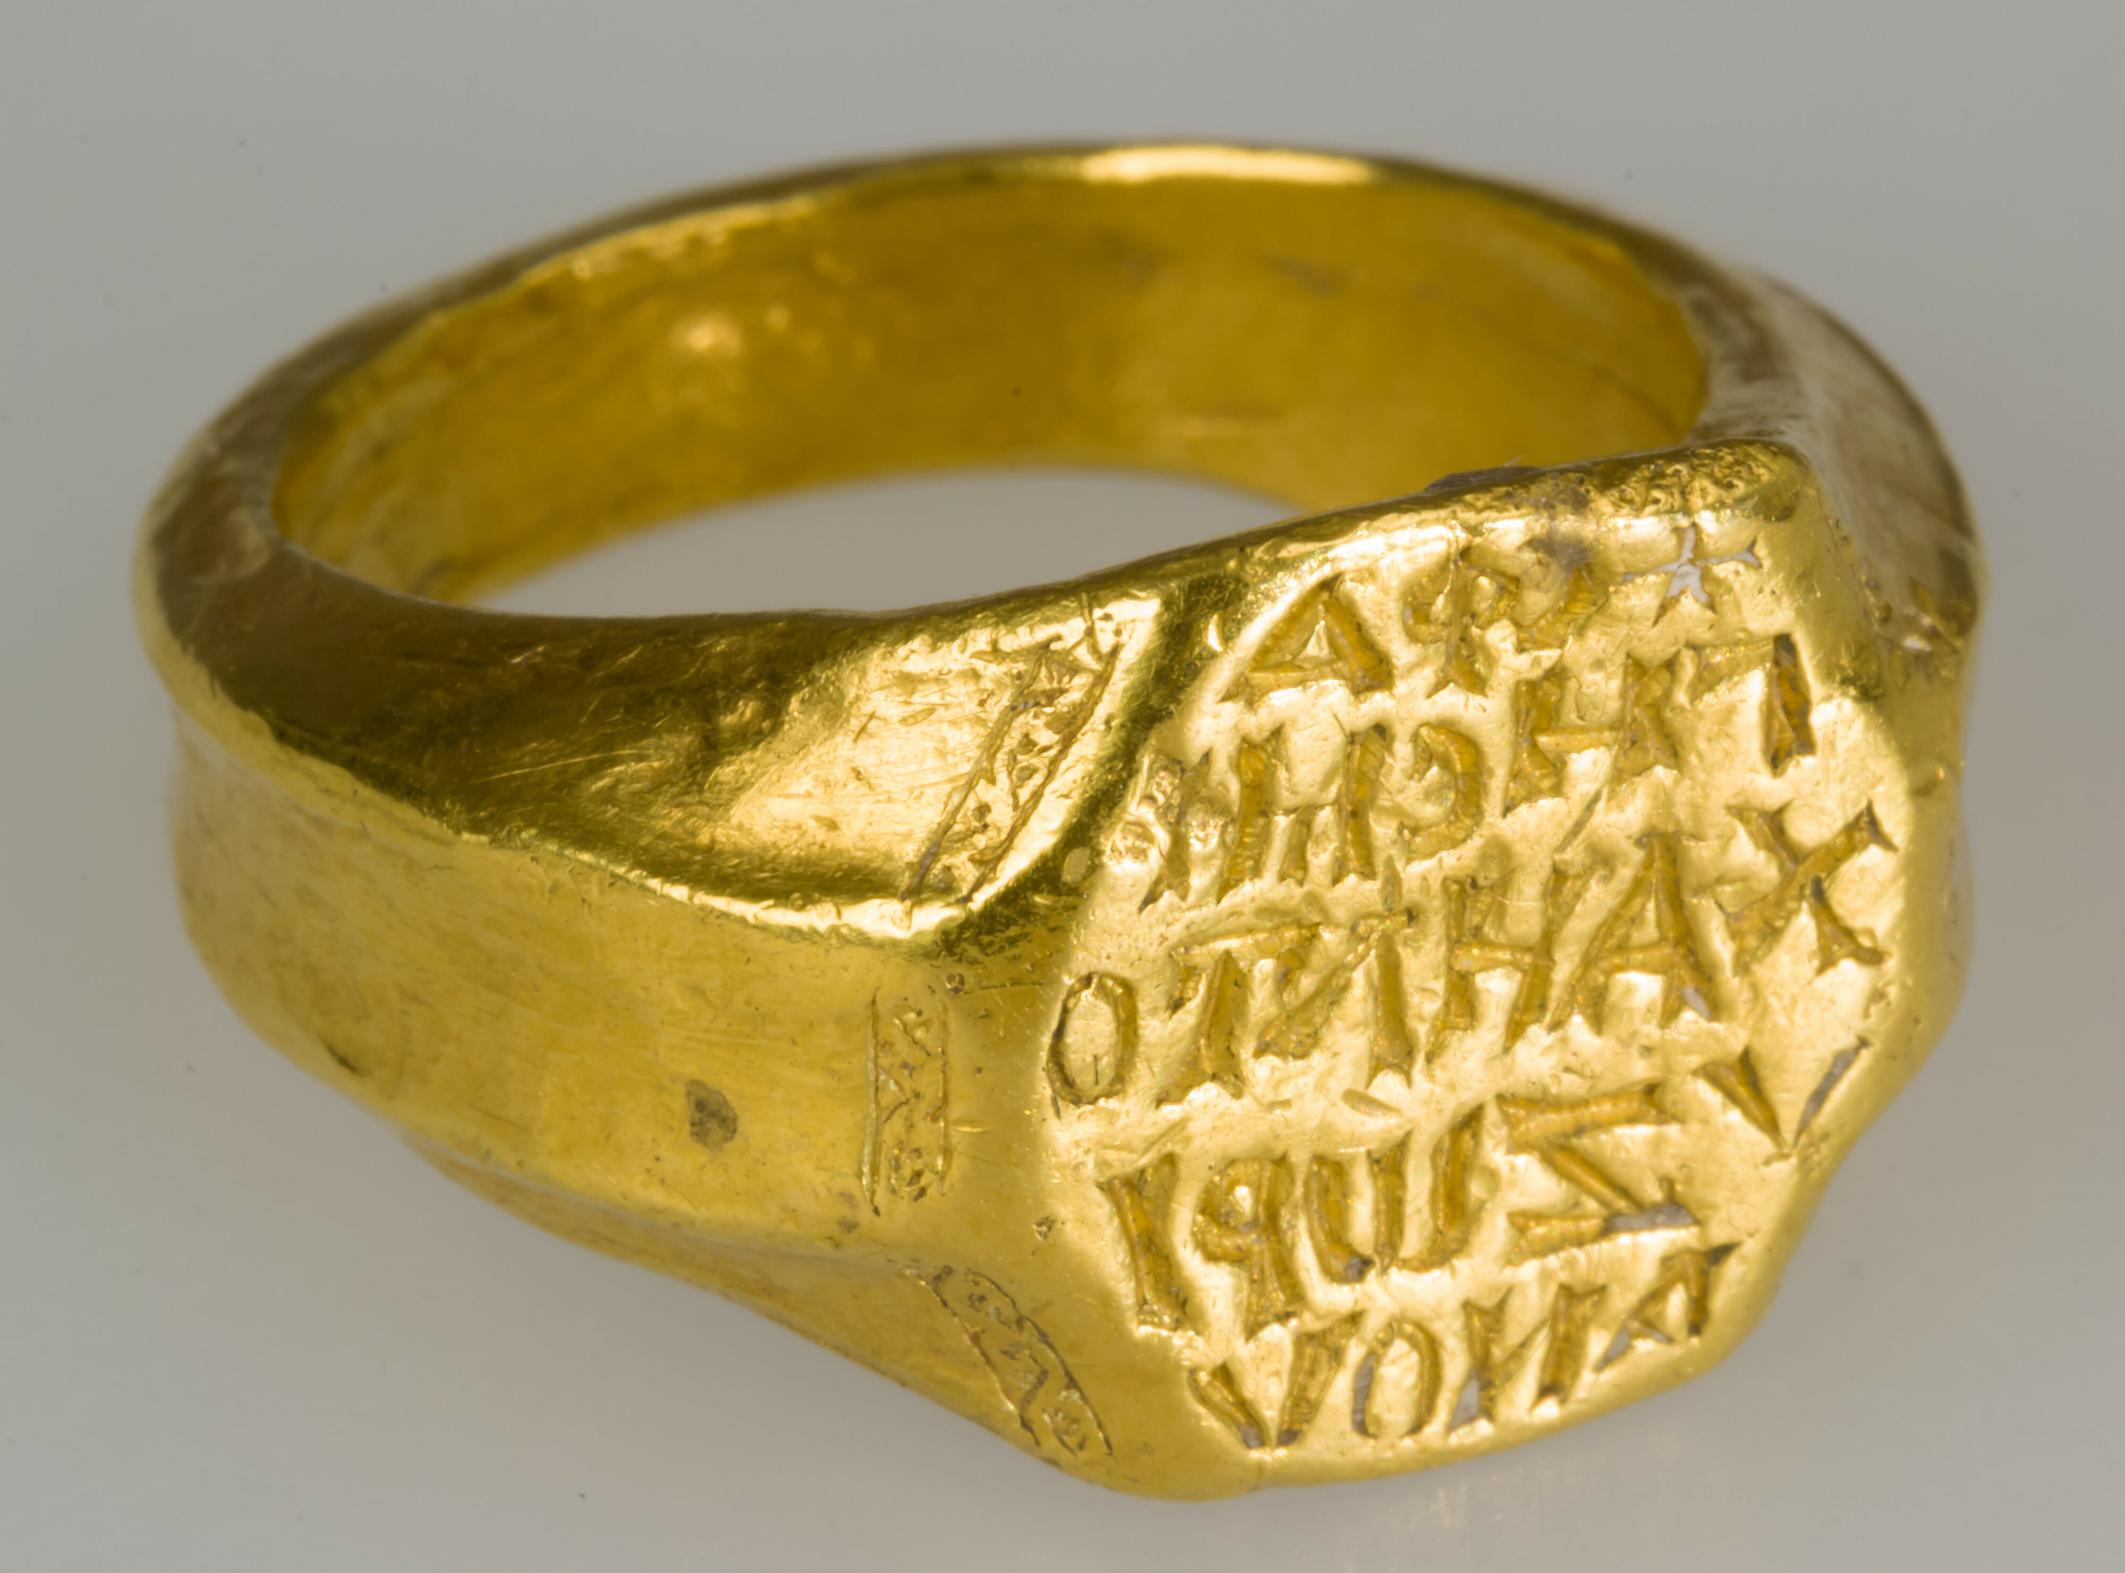

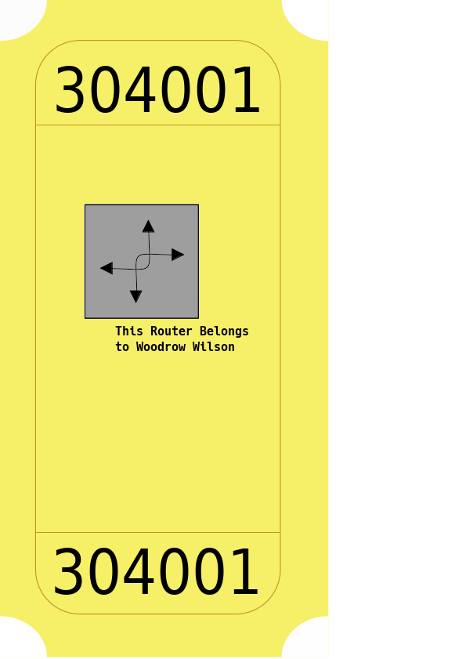
MASA
Registrar
Voucher request
Voucher
Request
SN: 1234
Assertion:
agent-proximity
SN: 1234
2021-04-16
service
truck
basement
Voucher
Request
SN: 1234
Assertion:
agent-proximity
SN: 1234
2021-04-16

Slide 3
Second Trip
LDevID
Certificate

