Slide 1
Update on BRSKI-AE – Support for asynchronous enrollment
draft-ietf-anima-brski-async-enroll-03
Steffen Fries, Hendrik Brockhaus, Elliot Lear, Thomas Werner
IETF 111 – ANIMA Working Group

Slide 2
Problem to solve
Limited or no connectivity between Pledge and Registrar.
Distinction between operational modes of the pledge
Pledge-initiator-mode (use case 1): Pledge acts as client and follows the BRSKI approach for the voucher exchange, but allows for alternative enrollment protocols
Pledge-responder-mode (use case 2): Pledge acts as server and communicates with registrar via a registrar-agent. Pledge is triggered (pushed) to generate and receive bootstrapping data. → main changes made this use case
Draft addresses these issues by defining the call flow and objects to be exchanged. To be independent of the transport security authenticated self-contained objects (signature-wrapped objects) for the certificate enrolment to bind proof of possession and poof of identity to the exchanged objects (similar to existing voucher exchanges with pledge)
7/21/2021
2

Slide 3
BRSKI-AE Status History of (main) changes from version 01 to version 02
Defined detailed call flow and exchanged objects for interactions in UC2 between pledge – registrar-agent – registrar and MASA. Object format aligns with draft JOSE signed voucher artifacts (Section 5.2.3).
Removed TLS-PSK approach between pledge and registrar-agent to allow transport security independent object exchange and also to avoid relying on PSK.
Included enhancements in voucher-request content and handling to allow registrar to verify agent-proximity to the pledge (enhancements in voucher-request and handling on registrar) in Section 5.2.3.
Defined enhancements in voucher-request YANG to allow for additional parameters to be transported (Section 6).
Terminology alignment (pledge-agent -> registrar-agent; PULL/PUSH -> pledge-initiator-mode and pledge-responder-mode).
7/21/2021
3

Slide 4
BRSKI-AE Status History of changes from version 02 to version 03
Discussion of open issues discovered in the currently applied YANG definitions:
YANG doctors were informed to have an early review on
the enhanced voucher-request from RFC 8995
the enhancement of the assertion enum of the voucher to include new value agent-proximity (section 5.2) → relates to RFC 8366bis discussion
No feedback received, yet
YANG module for CSR (for the enrollment request): draft currently reuses SZTP-CSR defined sub module: turns out to be not possible as the complete module must be used. → Proposal provided on mailing list to define csr types independent of the embedding protocol as part of SZTP-CSR is currently discussed
7/21/2021
4

Slide 5
BRSKI-AE Abstract view on use case 2 call flow
7/21/2021
5

Slide 6

First Trip
basement

Slide 7
First Trip
basement
Read device serial number
7/21/2021
7

Slide 8
First Trip
basement
Read device serial number
Alternatively: scan QR Code
7/21/2021
8

Slide 9
First Trip
basement
LDevID EE (Reg); agent-signed-data in JOSE
SN: 1234
2021-04-16
7/21/2021
9

Slide 10
First Trip
basement
voucher request in JOSE
Voucher
Request
SN: 1234
LDevID EE (Reg)
Assertion:
agent-proximity
SN: 1234
2021-04-16
7/21/2021
10

Slide 11
First Trip
basement
Enroll
Request
CSR
IDevID
enroll request CSR in JOSE
voucher request in JOSE
Voucher
Request
SN: 1234
LDevID EE (Reg)
Assertion:
agent-proximity
SN: 1234
2021-04-16
7/21/2021
11

Slide 12
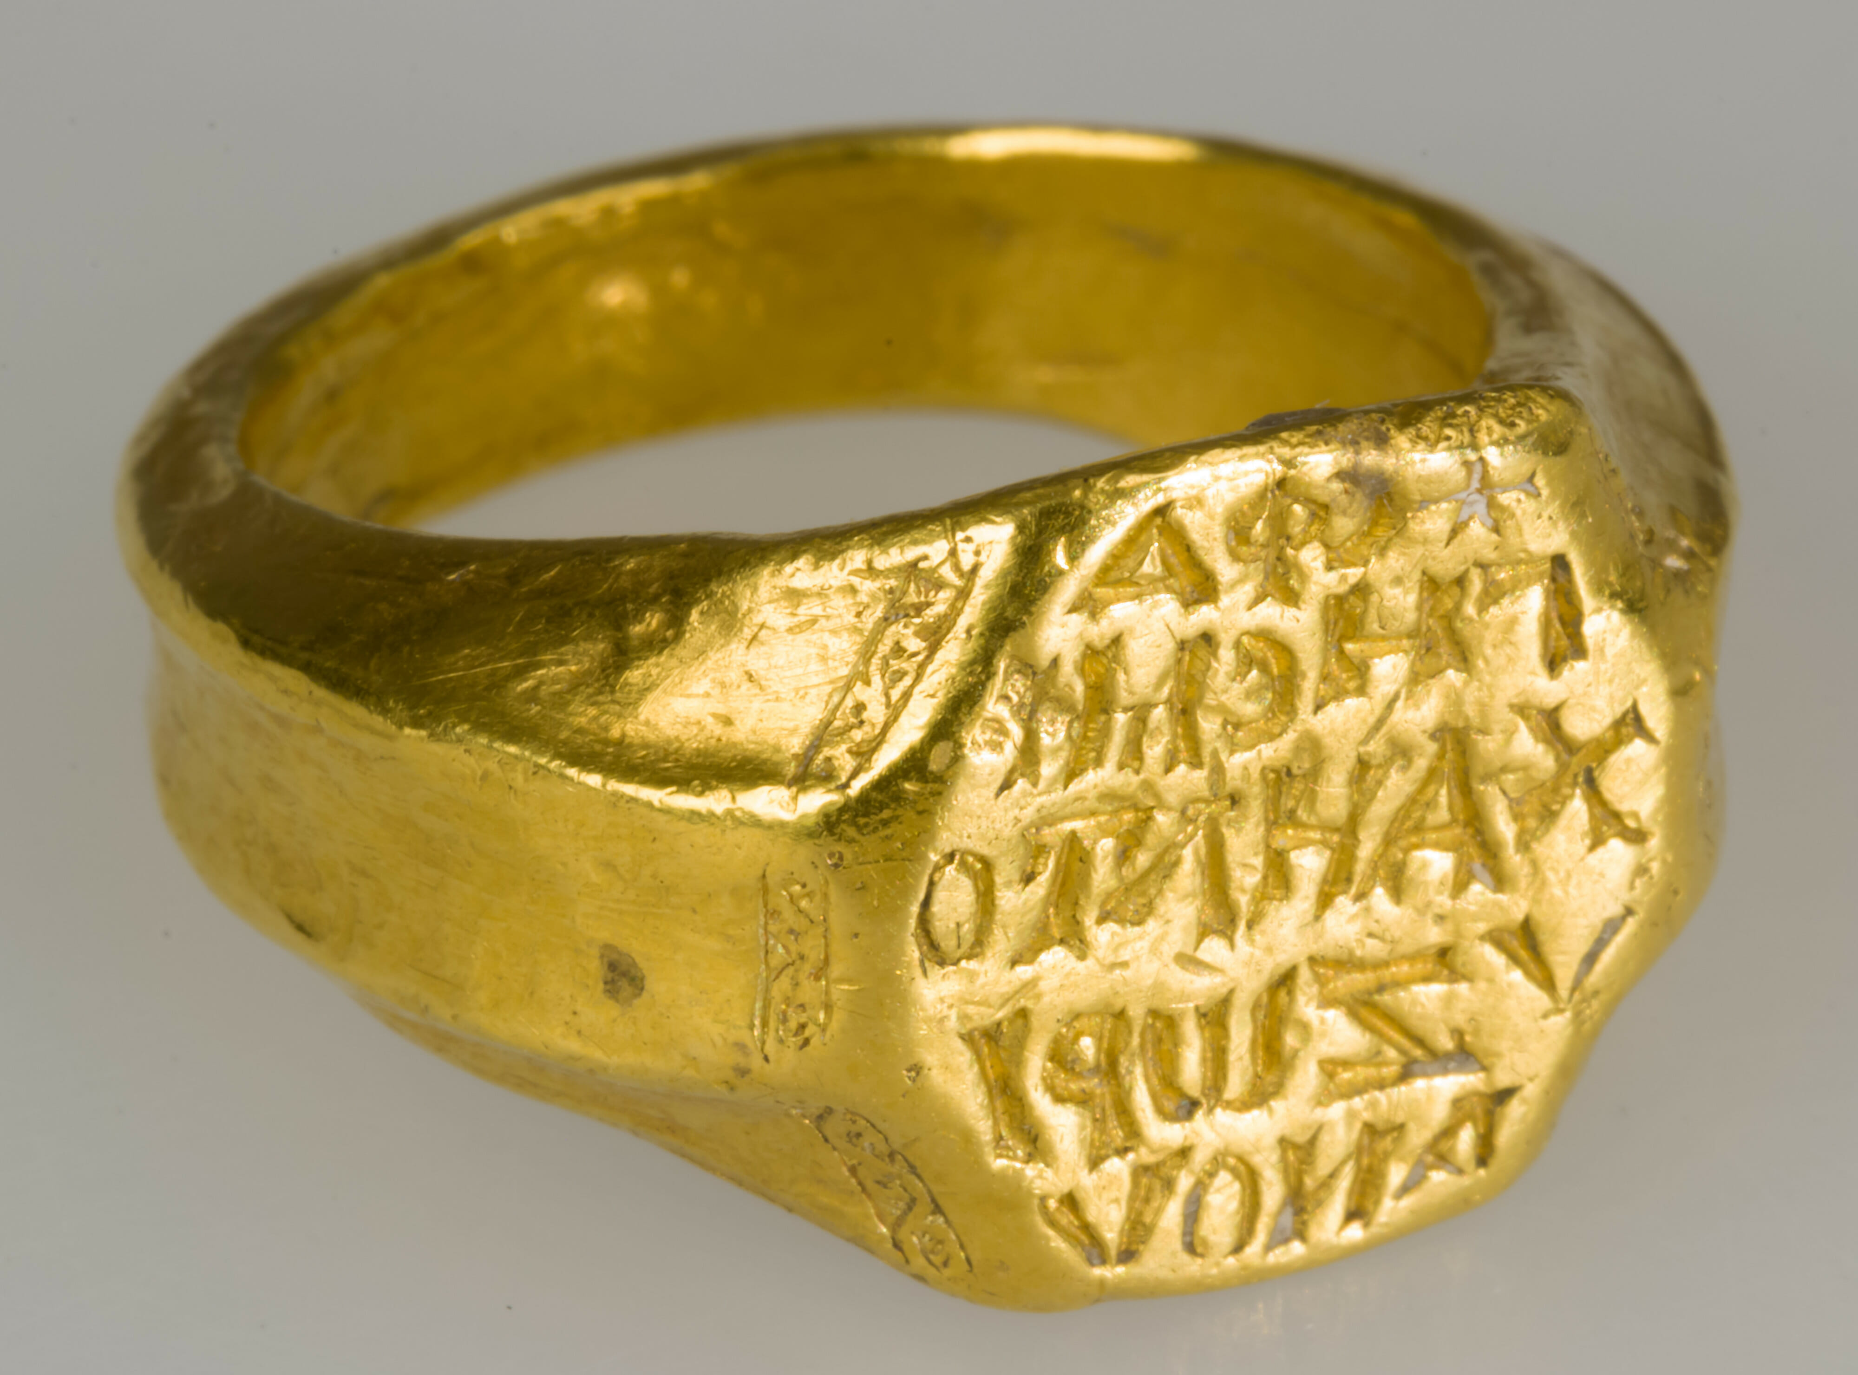

MASA
Registrar
Domain CA
basement
service
truck
7/21/2021
12

Slide 13
MASA
Registrar
Domain CA
basement
Voucher
Request
SN: 1234
LDevID EE (Reg)
Assertion:
agent-proximity
SN: 1234
2021-04-16
service
truck
7/21/2021
13

Slide 14
MASA
Registrar
Domain CA
Voucher request
Voucher
Request
SN: 1234
LDevID EE (Reg)
Assertion:
agent-proximity
SN: 1234
2021-04-16
basement
service
truck
7/21/2021
14

Slide 15
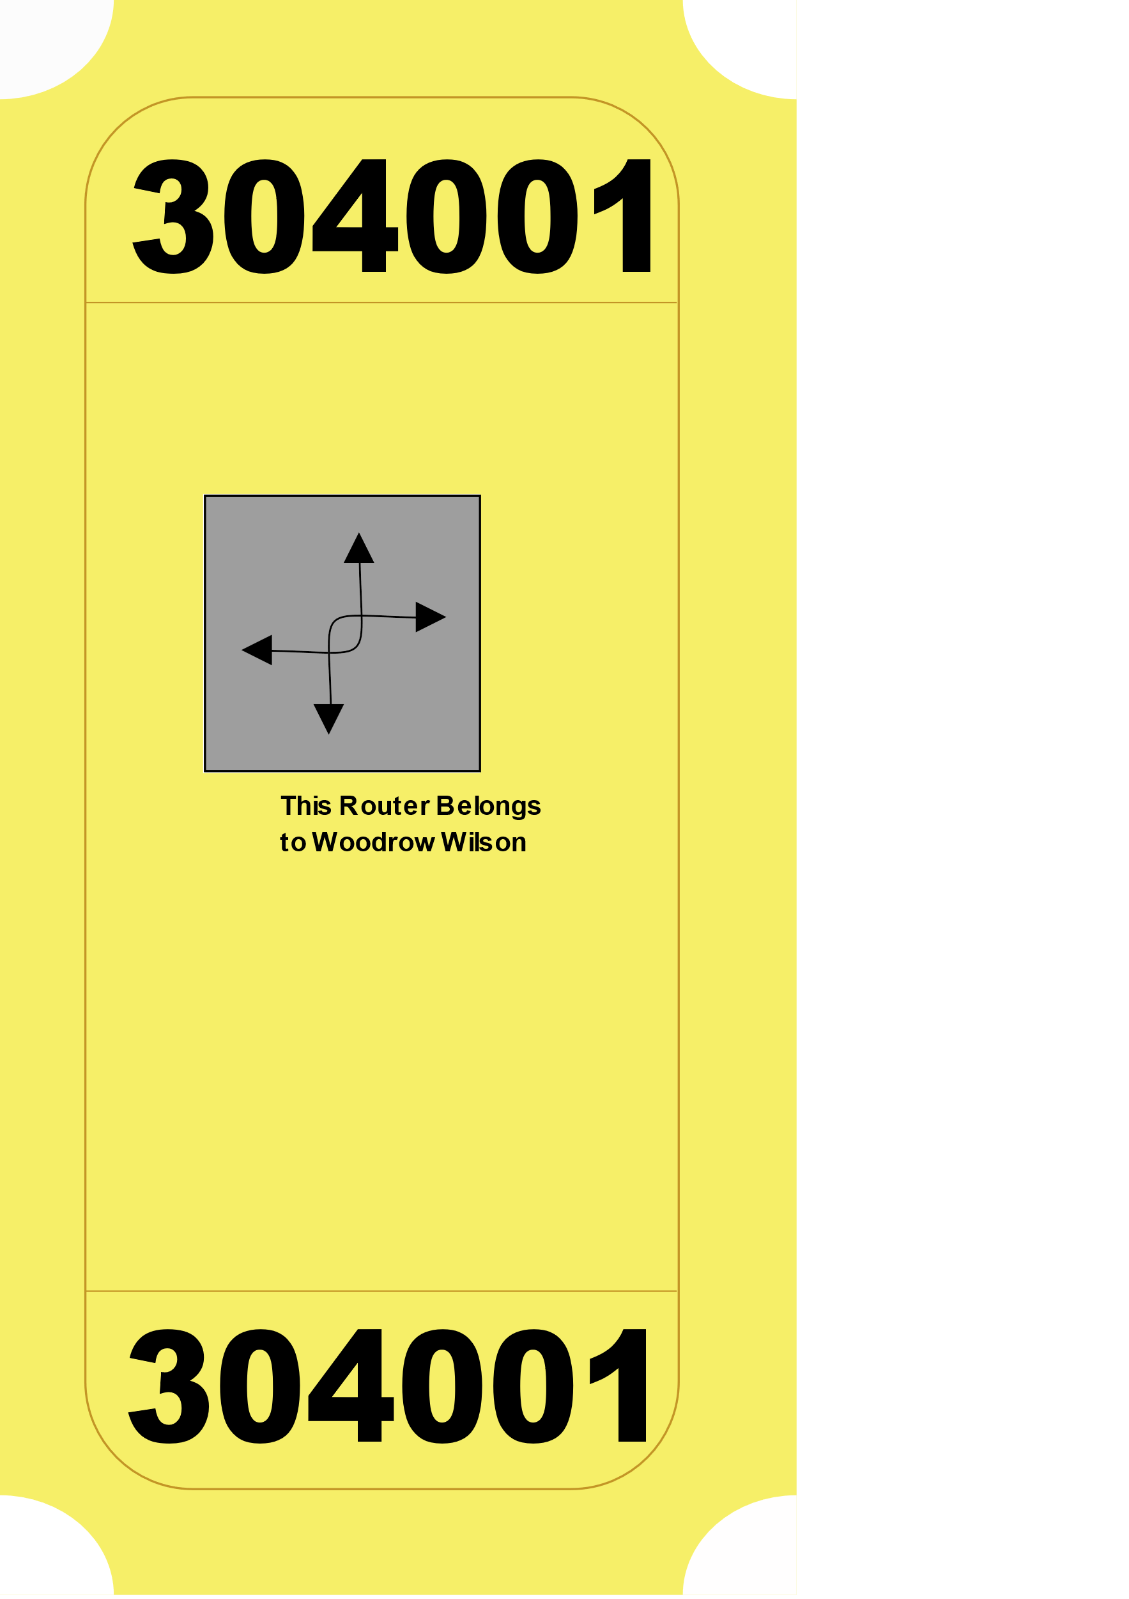
MASA
Registrar
Domain CA
basement
service
truck
7/21/2021
15

Slide 16
MASA
Registrar
Domain CA
basement
service
truck
7/21/2021
16

Slide 17
MASA
Registrar
Domain CA
basement
Enroll
Request
CSR
IDevID
service
truck
7/21/2021
17

Slide 18
MASA
Registrar
Domain CA
CSR
basement
service
truck
7/21/2021
18

Slide 19

MASA
Registrar
Domain CA
basement
service
truck
7/21/2021
19

Slide 20
MASA
Registrar
Domain CA
basement
service
truck
7/21/2021
20

Slide 21
Second Trip
basement
7/21/2021
21

Slide 22
Second Trip
basement
voucher
7/21/2021
22

Slide 23
Second Trip
basement
voucher
LDevID EE
7/21/2021
23

Slide 24
BRSKI-AE, Use Case 2 Verification of agent-proximity
Data exchange between registrar-agent and pledge based on signed objects (no TLS)
Enhancements in pledge voucher-request with a signed statement from registrar-agent
Allows registrar to identify, which registrar-agent is involved in the bootstrapping
Registrar includes LDevID EE(RegAgt) into registrar-voucher-request.
As pledge-voucher-request is included in registrar-voucher-request MASA can also verify agent-proximity and trust relation registrar-agent / registrar
MASA can issue assertion “agent-proximity”, which is weaker than “proximity” but stronger than “logged” or “verified”
"agent-proximity" is a statement that the proximity-registrar-certificate was provided via the registrar-agent and that the pledge could not verify proof-of-possession at the time of voucher-request creation
“proximity” is a statement that the proximity-registrar-certificate was received directly (via TLS) and that the pledge could verify proof-of-possession during the TLS handshake before voucher-request creation.
7/21/2021
24

Slide 25
Discussion: Open issues
Version 03 addresses most of the existing issues in the github/anima-wg
Current open issues
Early review of enhanced voucher-request in section 6 by YANG doctor
#10: YANG module for CSR to be used in enrollment-request (to allow for P10 and further formats)
#18: enhancement of YANG voucher with new assertion “agent-proximity” → discussion in the context of revising RFC 8366 to allow for enhancements of assertion types
7/21/2021
25

Slide 26
Discussion: Further draft handling
Currently, BRSKI-AE addresses two use cases with different target and different level of detail
Use Case 1 targets the definition of requirements for a communication architecture using the existing BRSKI components and call model (pledge-initiator-mode, formerly PULL) to enable the use of alternative enrollment protocols for certificate enrollment (voucher handling untouched).
Use Case 2 targets the specification of a reversed call model (pledge-responder-mode, formerly PUSH) in which the pledge has no or only limited connectivity to a registrar or cannot initiate requests to a registrar. To facilitate the interaction between pledge and registrar, the registrar-agent component is established. The interaction between pledge and registrar-agent results in new or enhanced data objects (voucher-request-trigger, voucher-request, voucher, enrollment-request-trigger, enrollment-request). Exchanges between registrar-agent and registrar follows BRSKI (RFC8995) and EST (RFC7030), with the enhanced objects.
Declaration of conformity to „AE“ is difficult, as the use cases have developed in different directions
Proposal to split the draft into two separate documents for use case 1 and use case 2
Is this a reasonable approach for the WG?
7/21/2021
26

Slide 27
Next Steps
Clarification of open issues stated in github/anima-wg and also in the draft
Split into two drafts concentrating on the distinct use cases, depending on WG view
Circulate outcome on the mailing list for further discussion
WG review appreciated
7/21/2021
27

Slide 28
Backup
28

Slide 29
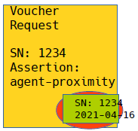


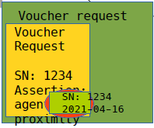

BRSKI-AE, Use Case 2 Abstract Protocol Overview
Pledge (callee)
IDevID
Registrar-Agent
LDevID (RegAgt)
LDevID Cert (Reg)
S/N Pledge
Domain Registrar
LDevID (Reg)
IDevID Cert CA
S/N Pledge
Domain CA
Domain CA credentials
MASA
MASA credentials
Trigger Voucher-request { {reg-cert, agent-signed-data, …}
Step1: Collect Bootstrapping request information from pledge
Voucher-request {S/N, reg-cert, agent-signed-data, …}
Trigger Enrollment-request
Enrollment-request {signature-wrapped CSR}
S/N verification
Verification „reg-cert“ in voucher is own cert
S/N verification
Verification „reg-cert“ in prior-signed-voucher
Issues voucher with assertion agent-proximity
Voucher-request {S/N, reg-cert, …}
Step2: Infrastructure Interaction based on BRSKI approach to collect voucher and LDevID Cert
Voucher-request {prior-signed-voucher, …}
Voucher {reg-cert, assertion, …}
Voucher {reg-cert, assertion, …}
Enrollment-request (CSR)-request
Enrollment-response (LDevID Cert)
Voucher {reg-cert, assertion, …}
Step3: Provisioning of voucher and LDEvID cert to pledge
Voucher-status
Enrollment-response {LDevID Cert}
Enrollment-status
Basement no connectivity to backend
First floor, connectivity to backend
29

Slide 30
Old slides (IETF 110)

Slide 31
BRSKI-AE Status, Use Case 2 Trust Establishment (Pledge/Pledge-agent/Registrar)
+--------------Drop Ship-------------------------------------------------------------------------------------+
| |
V |
+--------+ +-------+ .............................|......... |
| | | | . | . |
| | | | . +-----------+ +-----v-----+ . +------------------------+
| | |Pledge | . | | | | . | Vendor Service |
|Pledge(-| | Agent | . | Join | | Domain | . +------------------------+
|callee) | | | . | Proxy | | Registrar | . BRSKI- MASA | M anufacturer| |
| <-------------->.......<--------------->...........<-------> (PKI RA) <----------------------> A uthorized |Ownership|
| BRSKI-AE/PUSH | BRSKI-AE . | BRSKI-AE | | . | S igning |Tracker |
| | | | . | | +-----+-----+ . | A uthority | |
|IDevID | | | . +-----------+ e.g. RFC7030 . +------------------------+
| | |LDevID | . +-----------------+------+ .
| | | | . | Key Infrastructure | .
| | | | . | (e.g., PKI Certificate | .
+--------+ +-------+ . | Authority) | .
. +------------------------+ .
.......................................
"Domain" components
<<
<<<
Trigger Voucher-request {reg-cert}
Voucher-request {S/N, reg-cert, …}
Optional S/N verification
S/N verification
Verification „reg-cert“ in voucher is own cert
Voucher-request {S/N, reg-cert, …}
S/N verification
Verification „reg-cert“ in prior-signed-voucher
Issues voucher with agent-provided-registrar-cert assertion
Voucher-request {prior-signed-voucher, …}
Voucher {reg-cert, assertion, …}
Voucher {reg-cert, assertion, …}
Voucher {reg-cert, assertion, …}
Signed objects over http
Signed objects over TLS
Signed objects over TLS

Slide 32
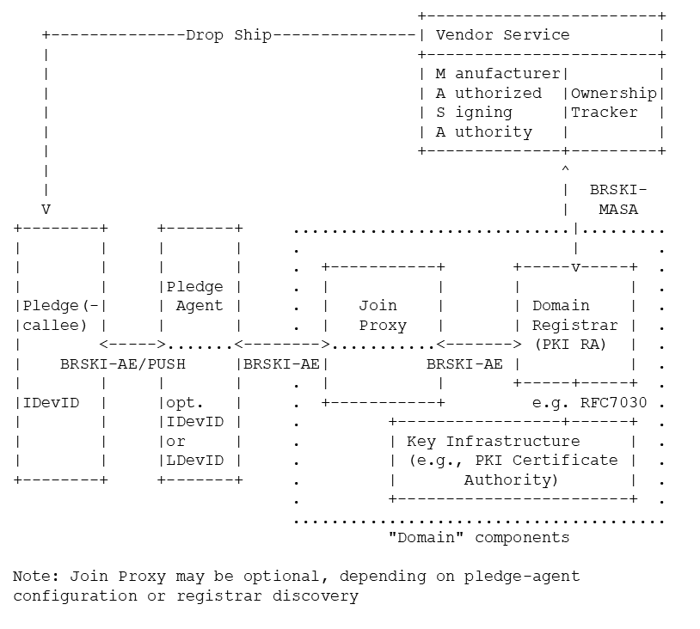
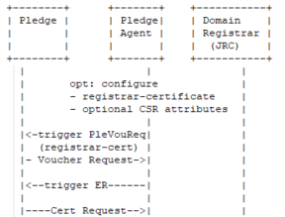
BRSKI-AE Status, Use Case 2 Trust Establishment (Pledge/Pledge-agent/Registrar)
Alternative proposal not using TLS between the pledge and the pledge-agent under the following assumptions
the TLS connection for DoS protection only necessary for the registrar endpoints
the registrar certificate is always included in the voucher request
the registrar and the MASA verify the certificate contained in the voucher-request (besides further verification like the serial number of the pledge)
Pledge-agent communicates with the pledge via plain http and provides registrar certificate to the pledge
Pledge constructs voucher-request, includes registrar certificate, signs with IDevID
Pledge-agent may verify the pledge serial number in the IDevID by information provided upfront QR code from the pledge and forwards voucher-request via https to registrar
Registrar verifies pledge serial number and its own certificate as part of the voucher-request

Slide 33
BRSKI-AE Status, Use Case 2 Trust Establishment (Pledge/Pledge-agent/Registrar)
Alternative proposal not using TLS between pledge and pledge-agent
DoS protection only for registrar endpoints → TLS between pledge-agent and registrar
Registrar certificate provided by pledge-agent to be included in the voucher-request → included in the (IDevID signed) voucher-request as new leaf “agent-provided-registrar-cert”
Enables the registrar (am I the right one) and the MASA verify the certificate contained in the voucher-request (besides further verification like the serial number of the pledge) → could use existing voucher assertion "verified" or "logged", or define a new assertion
Pledge-agent may verify pledge serial number in voucher-request with information provided upfront
Registrar verifies pledge serial number and its own certificate as part of the voucher-request
What do we loose? Proximity to registrar via mutually authenticated TLS (and assertion in voucher).
What do we gain? Flexibility in the bootstrapping approach by keeping the number of roundtrips.
Thoughts?

Slide 34
BRSKI-AE Status, Use Case 2 Trust Establishment (Pledge/Pledge-agent/Registrar), cont.
Trust Establishment between the pledge-agent and registrar may be with LDevID of pledge-agent (could be provided through an independent BRSKI run or by manual task). Enables distinction on the registrar side if a pledge connects or a pledge-agent.
Pledge-agent provides registrar certificate to pledge for inclusion into voucher-request provides the registrar to verify, it gets a voucher-request for a pledge to be bootstrapped and if it is the correct registrar. (see also slide before)
Discussion in the design team regarding a potential authorization token, which is provided in a pre-run to the pledge-agent and then forwarded to the pledge for inclusion into the voucher-request, to be checked by the registrar during voucher-request verification, but was not further followed.

Slide 35
BRSKI-AE Status, Use Case 2 Pledge endpoints, content types, and objects
Endpoints on pledge and potential object types (current state of discussion, first concrete example):
/triggervoucherrequest: initiates pledge(-callee) voucher request creation, potentially with additional information (e.g., registrar certificate) → application/json returns pledge(-callee) voucher request → to be discussed: e.g., JOSE object (application/voucher-jose+json)
/supplyvoucherresponse: provide voucher response to pledge(-callee) → to be discussed: e.g., JOSE object like the voucher-request (application/voucher-jose+json) returns pledge(-callee) voucher status → to be discussed: e.g., JWS
/triggerenrollrequest: initiates pledge(-callee) certification request creation → application/json returns certification request → PKCS#10-signed-with-IDevID (Format: e.g., JWS)
/supplyenrollresponse: provide domain credentials to pledge(-callee) → application/pkcs7-smime; smime-type=certs-only returns pledge(-callee) enroll status → to be discussed: e.g., JWS
Note that the object types need to be aligned with the existing object types on the registrar.

Slide 36
BRSKI-AE Status, Use Case 2 Terminology discussion
Pledge-agent vs. Registrar-agent
As the agent is intended to provide the interface to the registrar and also to be manufacturer independent, a better naming may be indeed registrar-agent.
Any objection to the renaming?
PULL/PUSH
Currently used to distinguish between pledge acting as client or server.
Better naming to ensure no confusion with the communication direction and other components requested.
Alternative may be client/server mode for the pledge or pledge-initiated/agent initiated bootstrapping
Thoughts?
+------------------------+
+--------------Drop Ship---------------| Vendor Service |
| +------------------------+
| | M anufacturer| |
| | A uthorized |Ownership|
| | S igning |Tracker |
| | A uthority | |
| +--------------+---------+
| ^
| | BRSKI-
V | MASA
+--------+ +-------+ .............................|.........
| | | | . | .
| | | | . +-----------+ +-----v-----+ .
| | |Pledge | . | | | | .
|Pledge(-| | Agent | . | Join | | Domain | .
|callee) | | | . | Proxy | | Registrar | .
| <----->.......<-------->...........<-------> (PKI RA) | .
| BRSKI-AE/PUSH |BRSKI-AE| BRSKI-AE | | .
| | | | . | | +-----+-----+ .
|IDevID | |opt. | . +-----------+ e.g. RFC7030 .
| | |IDevID | . +-----------------+------+ .
| | |or | . | Key Infrastructure | .
| | |LDevID | . | (e.g., PKI Certificate | .
+--------+ +-------+ . | Authority) | .
. +------------------------+ .
.......................................
"Domain" components
Note: Join Proxy may be optional, depending on pledge-agent configuration or registrar discovery

