Slide 1
Update on BRSKI with Pledge in Responder Mode (BRSKI-PRM)
draft-ietf-anima-brski-prm-09
Repo URL: https://github.com/anima-wg/anima-brski-prm
Steffen Fries, Thomas Werner, Elliot Lear, Michael Richardson
Shepherd: Matthias Kovatsch
IETF 117 – ANIMA Working Group

Slide 2
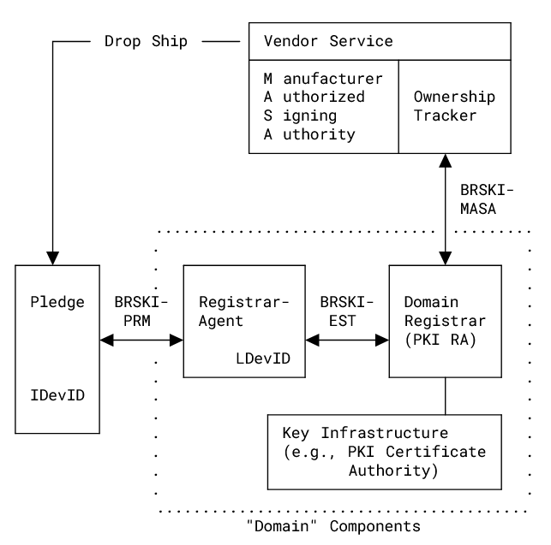
BRSKI-PRM Status History of main changes 08→ 09
Addressed almost all issues from WGLC in March 2023. Most resulted in structural improvements, clarifications in the text and the figures and additional examples.
Technical comments related to the following
Support of optional TLS protection of the communication link between registrar-agent and pledge (Section 4, Section 6.1, Annex B). This addresses several privacy related issues and also added in the Privacy and Security Considerations.
Included option that a separate HTTP connection may also be used to provide the PER (Section 6.2.6) to allow also for repeated/delayed enrollment attempts.
Shortened the utilized endpoint names to take constraint devices into account (example: /tpvr: Trigger pledge voucher-request creation).
7/14/2023
2

Slide 3
BRSKI-PRM Open Issues
Discovery of registrar with an enhanced feature set
#79 discovery of registrar with BRSKI-PRM feature set
#80 pledge discovery using GRASP
Discovery is discussed as common issue, which applies to BRSKI-PRM and BRSKI-AE
Current approach uses DNS-SD TXT parameters and intends to define 3 key-value pairs, which can also be mapped to GRASP (topic of separate slot):
mode of operation (Registrar/Pledge as responder)
engaged enrollment protocol (EST, CMP, …)
voucher format (CMS-signed JSON, JOSE-signed JSON, …)
Further clarification in the specification to avoid ambiguities
Restructure section 5 and 6 for clarity based on Shepherd review
7/14/2023
3

Slide 4
BRSKI-PRM Status Next Steps
Clarify remaining open issues (see ANIMA git) in design team meetings
Interop testing with others welcome ☺, PoC implementations of all components available, please get in touch
Shepherd writeup
Finalization of document
7/14/2023
4

Slide 5
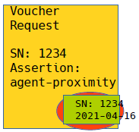


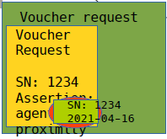


Backup: BRSKI-PRM – Abstract Protocol Overview
Pledge (callee)
IDevID
Manufacturer trust anchor
Registrar-Agent
LDevID (RegAgt)
LDevID Cert (Reg)
S/N Pledge
Domain Registrar
RA
LDevID (Reg)
IDevID Cert CA
S/N Pledge
Domain CA
Domain CA credentials
MASA
MASA credentials
Trigger Voucher-request { {reg-cert, agent-signed-data}
Step1: Collect Bootstrapping request information from pledge
Pledge-Voucher-Request (PVR) {S/N, reg-cert, agent-signed-data, …}
Trigger Enrollment-request
S/N verification
Verification „reg-cert“ in voucher is own cert
S/N verification
Verification „reg-cert“ in prior-signed-voucher
Verification of “agent-signed-cert” and “agent-signed-data”
Issues voucher with assertion agent-proximity
Pledge-Enrollment-Request (PER) {signature-wrapped CSR}
Pledge-Voucher-Request {S/N, reg-cert, …}
Registrar-Voucher-Request {prior-signed-voucher, …}
Provisional accept of registrar certificate
Step2: Infrastructure Interaction based on BRSKI approach to collect voucher and LDevID Cert
Voucher {reg-cert, assertion, …}
Voucher {LDevID(Reg), assertion, …}, signed
Pledge-Enrollment-Request (CSR)
Issue operational certificate for pledge for target domain
Enrollment-response (LDevID cert)
Request CA certificates
Request CA certificates
CA Certificates, signed
CA certificates
Voucher {reg-cert, assertion, …}, signed
Step3: Provisioning of voucher, CA certs, and LDevID cert to pledge
Voucher-status
CA Certificates, signed
Enrollment-response {LDevID cert}
Enrollment-status
Voucher status
Device audit log
Enrollment status
Basement no connectivity to backend
First floor, connectivity to backend
5

