Slide 1
JOSE signed Vouchers
draft-richardson-anima-jose-voucher-00
Michael Richardson, Thomas Werner
mcr+ietf@sandelman.ca
thomas-werner@siemens.com
IETF 110
ANIMA Working Group

Slide 2
JOSE Voucher
RFC8366 specificies CMS signed JSON
This draft proposes
      JOSE signed JSON
BRSKI: Bootstrapping of Remote Secure Key Infrastructures
JOSE: JSON Object Signing and Encryption (RFC 7515)
CMS: Cryptographic message Syntax (RFC 5652)

Slide 3
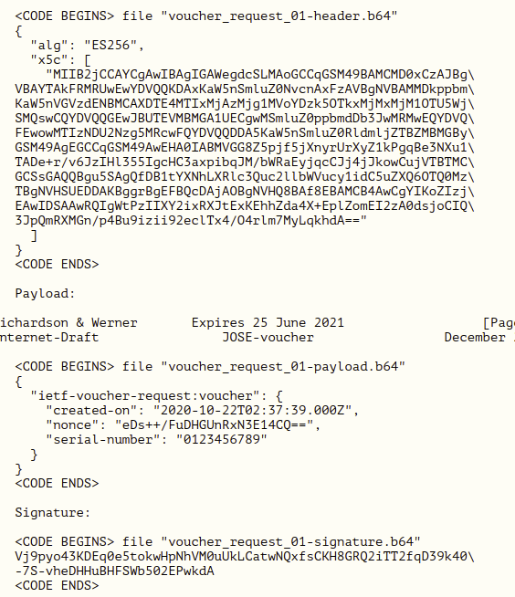
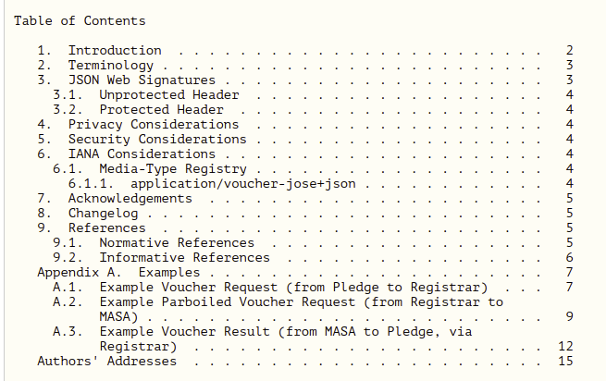
Overview of Document
pretty much complete
examples from operational system

Slide 4
Options
Uses the JWS Compact serialization.
This format encodes the three pieces (protected headers, payload and signature) in Base64URL, appropriate for use in a URL.
This choice was arbitrary, but was driven by being easier to use with available libraries.
  This layer of Base64 encoding was not necessary, since HTTPS is 8-bit clean.

Slide 5
Conclusion
Adopt?
Very short and sweet.
draft-richardson-anima-jose-voucher-00

