Slide 1
Update on JWS signed Vouchers
JWS signed Voucher Artifacts for Bootstrapping Protocols
draft-ietf-anima-jws-voucher-04
Michael Richardson, Thomas Werner
mcr+ietf@sandelman.ca
thomas-werner@siemens.com
IETF 114
ANIMA Working Group

Slide 2
Recap: JWS Voucher
RFC 8366 specifies CMS-signed JSON for Voucher artifacts
This draft proposes JWS-signed JSON as another option
Makes no YANG changes to RFC 8366
Can be used by BRSKI RFC 8995
BRSKI-PRM relies on JWS form factor
BRSKI: Bootstrapping of Remote Secure Key Infrastructure (RFC 8995)
BRSKI-PRM: BRSKI with Pledge in Responder Mode (draft-ietf-anima-brski-prm)
CMS: Cryptographic Message Syntax (RFC 5652)
JWS: JSON Web Signature (RFC 7515)
Voucher (CMS-signed JSON ): A Voucher Artifact for Bootstrapping Protocols (RFC 8366)
7/12/2022
2

Slide 3
Recap: JWS Options
JWS JSON Serialization (RFC 7515 #3.2), concrete “General JWS JSON Serialization”
Switch from JWS Compact Serialization to “General JWS JSON Serialization”
Opens up the support of further use cases requiring more than one signature to the Voucher object
Multiple signatures are already supported by existing voucher form factors:
JSON-in-CMS - RFC 8366
CBOR-in-COSE_Sign - draft-ietf-anima-constrained-voucher
Voucher in JSON-in-JWS - draft-ietf-anima-jws-voucher (this draft)
should support same feature set as other Voucher forms (e.g. JSON-in-CMS), without limitation
7/12/2022
3

Slide 4
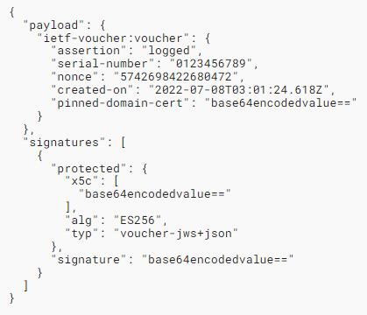
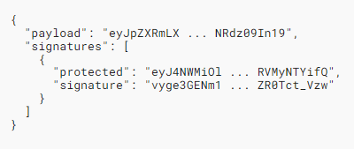
Voucher Representation General JWS JSON Serialization syntax and example
anima-jws-voucher.html#figure-4:
Example Voucher Response
anima-jws-voucher.html#figure-1:
Voucher Representation in General JWS JSON Serialization Syntax
Added optional header parameter „typ“ (register with IANA, see section 6.1.1)
7/12/2022
4

Slide 5
History of changes - draft-ietf-anima-jws-voucher-04
Update chapter: "1. Introduction"
Rework chapter: "3. Voucher Artifact with JSON Web Signature"
Added optional header parameter "typ": "voucher-jws+json" and updated examples (PVR, RVR, Voucher)
7/12/2022
5

Slide 6
JWS Voucher - Next Steps
Finalize writing of this draft (content should be complete)
Alignment in BRSKI design team calls
Circulate outcome on the mailing list for further discussion
Interop testing with others welcome ☺
Could happen in combination with BRSKI-PRM interop
WG review and shepherd appreciated
BRSKI-PRM: BRSKI with Pledge in Responder Mode (draft-ietf-anima-brski-prm)
7/12/2022
6

Slide 7
Time for Discussion! Questions? Feedback! Thanks for your attention
7/12/2022
7

Slide 8
Abbreviations, References
BRSKI Bootstrapping of Remote Secure Key Infrastructure (RFC 8995)
BRSKI-PRM BRSKI with Pledge in Responder Mode (draft-ietf-anima-brski-prm)
CMS Cryptographic Message Syntax (RFC 5652)
JWS JSON Web Signature (RFC 7515)
Voucher (JWS-signed JSON) JWS signed Voucher Artifacts for Bootstrapping Protocols (this draft, draft-ietf-anima-jws-voucher)
Voucher (CMS-signed JSON) A Voucher Artifact for Bootstrapping Protocols (RFC 8366)
PVR Pledge-voucher-request
RVR Registrar-voucher-request
7/12/2022
8

