Slide 1
JOSE JWS signed Vouchers
draft-ietf-anima-jws-voucher-00
Michael Richardson, Thomas Werner
mcr+ietf@sandelman.ca
Thomas Werner
thomas-werner@siemens.com
IETF 111
ANIMA Working Group

Slide 2
JWS Voucher
RFC8366 specificies CMS signed JSON
This draft proposes
      JWS signed JSON
Document renamed from JOSE-signed, to JWS-signed.
BRSKI: Bootstrapping of Remote Secure Key Infrastructures
JOSE: JSON Object Signing and Encryption (RFC 7515)
CMS: Cryptographic message Syntax (RFC 5652)

Slide 3
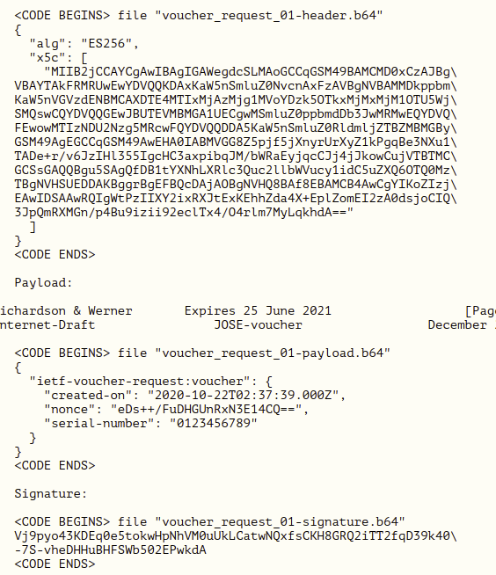
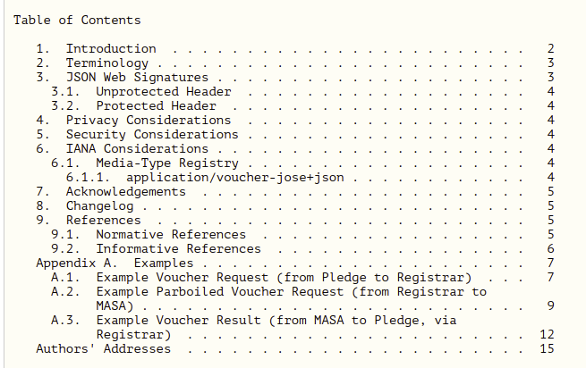
Overview of Document
pretty much complete
examples from operational system

Slide 4
Options
Uses the JWS Compact serialization.
This format encodes the three pieces (protected headers, payload and signature) in Base64URL, appropriate for use in a URL.
This choice was arbitrary, but was driven by being easier to use with available libraries.
  This layer of Base64 encoding was not necessary, since HTTPS is 8-bit clean.

Slide 5
Conclusion
Adopted July 2021
Very short and sweet.
Makes no YANG changes to RFC8366.
draft-ietf-anima-jws-voucher-00

