Slide 1
Update on JWS signed Vouchers
draft-ietf-anima-jws-voucher-02
Michael Richardson, Thomas Werner
mcr+ietf@sandelman.ca
thomas-werner@siemens.com
IETF 113
ANIMA Working Group

Slide 2
JWS Voucher
RFC 8366 specifies CMS-signed JSON for Voucher artifacts
This draft proposes JWS-signed JSON as another option
Makes no YANG changes to RFC 8366
Can be used by BRSKI RFC 8995
BRSKI-PRM relies on JWS form factor
BRSKI: Bootstrapping of Remote Secure Key Infrastructure (RFC 8995)
BRSKI-PRM: BRSKI with Pledge in Responder Mode (draft-ietf-anima-brski-prm)
CMS: Cryptographic Message Syntax (RFC 5652)
JWS: JSON Web Signature (RFC 7515)
Voucher: A Voucher Artifact for Bootstrapping Protocols (RFC 8366)
3/7/2022
2

Slide 3
JWS Options
JWS Compact Serialization (RFC 7515 #3.1) was used initially
Encodes the three pieces (header.payload.signature) in Base64URL
This choice was arbitrary
To be replaced by “General JWS JSON Serialization”
JWS JSON Serialization (RFC 7515 #3.2), concrete “General JWS JSON Serialization”
Switch from JWS Compact Serialization to “General JWS JSON Serialization”
Opens up the support of further use cases requiring more than one signature to the Voucher object
Multiple signatures are already supported by existing voucher form factors:
JSON-in-CMS - RFC 8366
CBOR-in-COSE_Sign - draft-ietf-anima-constrained-voucher
Voucher in JSON-in-JWS - draft-ietf-anima-jws-voucher (this draft)
should support same feature set as other Voucher forms (e.g. JSON-in-CMS), without limitation
3/7/2022
3

Slide 4
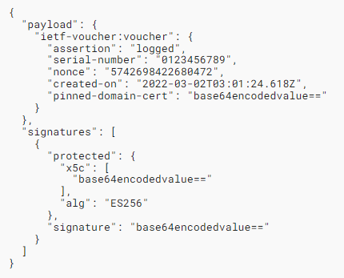
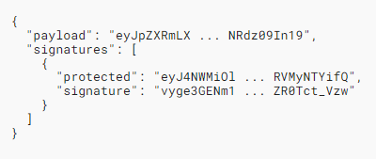
Voucher Representation General JWS JSON Serialization syntax and example
anima-jws-voucher.html#figure-1:
Voucher Representation in General JWS JSON Serialization Syntax
anima-jws-voucher.html#figure-4:
Example Voucher Response
3/7/2022
4

Slide 5
History of changes - draft-ietf-anima-jws-voucher-02
Mainly switch from “JWS Compact Serialization” to “General JWS JSON Serialization”
Include syntax and examples for Voucher request and response objects (PVR, RVR, Voucher)
3/7/2022
5

Slide 6
JWS Voucher - Next Steps
Further enhance description of “General JWS JSON Serialization”
Alignment in BRSKI design team calls
Circulate outcome on the mailing list for further discussion
PoC implementation and interop in combination with BRSKI-PRM
WG review appreciated
BRSKI-PRM: BRSKI with Pledge in Responder Mode (draft-ietf-anima-brski-prm)
3/7/2022
6

Slide 7
Abbreviations
JWS - JSON Web Signature
PVR - Pledge voucher-request
RVR - Registrar voucher-request
3/7/2022
7

