Slide 1
Stable Connectivity
IETF 91 11/2014 Honolulu
draft-eckert-anima-stable-connectivity-00
T.Eckert
M. Behringer

Slide 2
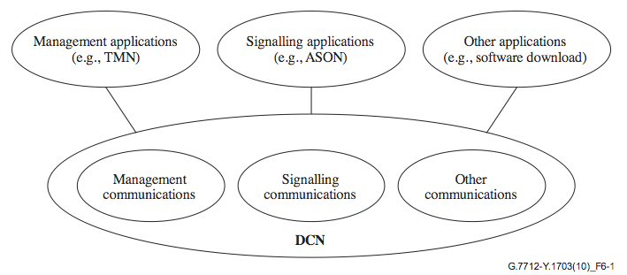
Overview
  AN components: ACP… enables…
    Stable, secure connectivity for (un)configured device
    Immediately after enrolling devices in into AN Domain
  Solutions: How do we use it ?
    Enrollment proxy (not in scope)
    Inband “DCN” for NOC/OAM
      Connectivity NOC / network devices
      Assuming ACP has better connectivity properties than “data-plane
    Connectivity between distributed “AN” “agents”
      TBD (not in rev -00)

Slide 3

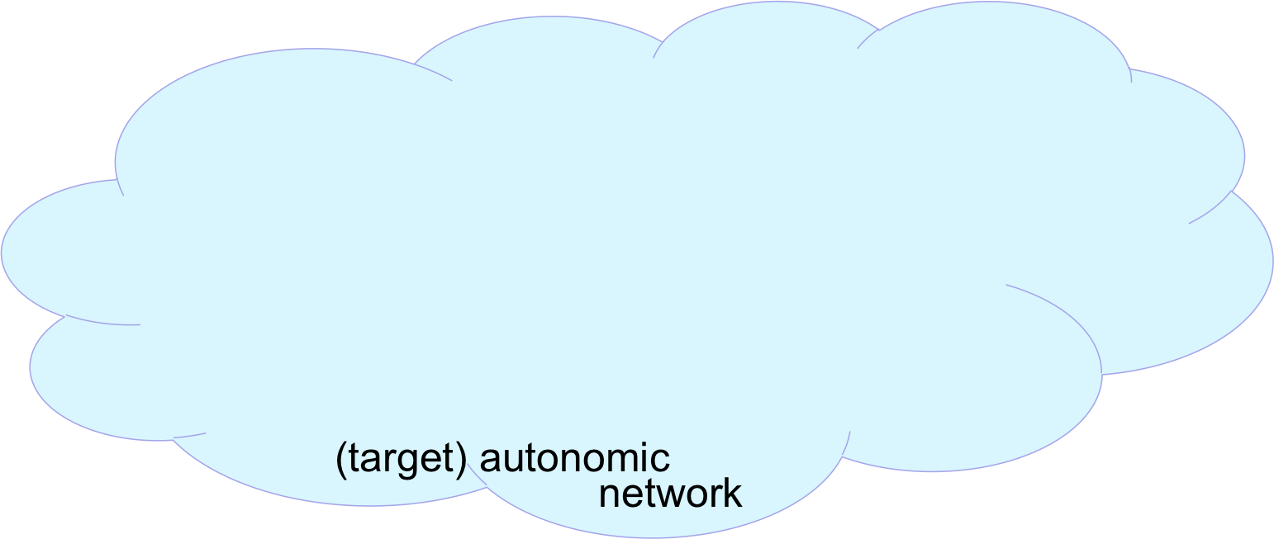

Context
NOC
AN
Registrar
Certificate
Authority
(CA)
  Day 1: Deploy
  Day 1: Enroll, build ACP
Autonomic
Control Plane

Slide 4
Context
NOC
AN
Registrar
Certificate
Authority
(CA)
NOC backend
systems
NMS, controller
Apps..
…
  Day 1: Deploy
  Day 1: Enroll, build ACP
  Day 1..N: Provision, Manage,…
Autonomic
Control Plane

Slide 5


Scope of -00 document
NOC
AN
Registrar
Certificate
Authority
(CA)
NOC backend
systems
NMS, controller
Apps..
…
  Communication between
  NOC (backend, CA, Registrar)
  OAM/MGMT plane of autonomic devices
ACP exists/connects as soon as AN device is physcially rechable and enrolled
  But potentially slow (hop-by-hope encryption)
Data plane exists only after provisioning
  Likely faster than ACP, likely more often not-working (mistakes, failure, during policy change provisioning)
Special case of dual-path
end-to-end system
Autonomic
Control
Plane
autonomic network
Autonomic
Control
Plane
OAM/Mgmt plane
ssh/SNMP Netconf/YANG
ftp/tftp/traceroute
CLI/XMPP MPLS-OAM,

Slide 6
Solution (1)
NOC
IPv6
only
NOC
Backend
for AN
IPv4 only
Certificate
Authority
(CA)
IPv4 only
NOC backend
systems
NMS, controller
Apps..
…
  Network devices OAM supports multi-context (eg: VRF) connectivity.
    But not necessarily all desired path policies (not an issue in first phases).
  Registrar:
    Needs ACP connectivity for enrollment of AN devices.
    Needs CA connectivity (likely data-plane).
    Initially most easily put into AN network device.
  NOC Backend/CA
    Assume IPv4 only NOC today.
    Pass ACP unencrypted/native to the New IPv6 only NOC devices/VMs/apps.
AN
Registrar
Autonomic
Control
Plane
autonomic network
Autonomic
Control
Plane
OAM/Mgmt plane
ssh/SNMP Netconf/YANG
ftp/tftp/traceroute
CLI/XMPP MPLS-OAM,

Slide 7
Solution (2)
NOC
Certificate
Authority
(CA)
Dual-Stack
NOC backend
systems
NMS, controller
Apps..
…
  Once NOC can be Dual-Stack:
    IPv6 could simply provide access to ONLY the ACP, and IPv4 ONLY to the data-plane
    Requires NOC-edge AN router to put an interface into two different routing contexts for IPv4/IPv6
  Use DNS names to help select right address depending on purpose of NOC/OAM action:
    Device-acp:
      IPv6 only == only ACP
    Device-ipv4:
      IPv4 only == test data plane reachability
    IPv4 + IPv6 = ACP or data plane.
  Not a sufficient solution to work with a network that wants an IPv6 data plane
AN
Registrar
Autonomic
Control
Plane
autonomic network
Autonomic
Control
Plane
OAM/Mgmt plane
ssh/SNMP Netconf/YANG
ftp/tftp/traceroute
CLI/XMPP MPLS-OAM,

Slide 8



Solution (3)
NOC
Certificate
Authority
(CA)
Dual-Stack
NOC backend
systems
NMS, controller
Apps..
…
  To leverage ACP in a v6-data-plane or dual-stack data plane network:
    Edge IPv6 routing function to select path for IPv6 packet: via data-plane or ACP.
    Can be separate router (workaround) or edge-function in AN edge device.
  Separate ACP and Data-Plane IPv6 addresses on NOC devices:
    No need to inject non-ACP wanted addresses into ACP IPv6 routing.
    Leverage “normal” IPv6 host stack policies. Also on AN devices OAM stack:
    Select source-IPv6 addr of initiator based on destination address
    Select routing context based on source IPv6 addres prefix.
V6 ACP address
V6 data-plane addr
(V4 data-plane addr)
V6 (source) routing
function/device
AN
Registrar
Autonomic
Control
Plane
autonomic network
Autonomic
Control
Plane
OAM/Mgmt plane
ssh/SNMP Netconf/YANG
ftp/tftp/traceroute
CLI/XMPP MPLS-OAM,

Slide 9
Solution (4)
NOC
AN
Registrar
Certificate
Authority
(CA)
Dual-Stack
NOC backend
systems
NMS, controller
Apps..
…
  Implement ACP on NOC devices/Hypervisors
    AN-enrollment, setup of encrypted ACP channel.
  Benefits:
    Security all the way into the NOC app
    Leverage AN Certificate on NOC application to also secure OAM messages going across data-plane (TLS/dTLS).
    Eliminates need of “routing function” workaround at edge of AN network. Allows full non-network-device registrar.
    Avoids need for in-network “routing function to route into ACP/data-plane. Now job of the NOC endpoint.
  Same policy options as in step 3 with dual IPv6 addresses on NOC device
Autonomic
Control
Plane
autonomic network
Autonomic
Control
Plane
OAM/Mgmt plane
ssh/SNMP Netconf/YANG
ftp/tftp/traceroute
CLI/XMPP MPLS-OAM,

Slide 10
Solution - more
  Bad: Connect IPv4 only NOC systems
    Requires NAT to ACP/IPv6 – should only consider as temporary workaround.
  Good: Leverage MP-TCP for OAM connections
    Example:
      Assume DNS is set up to only have ACP address of AN devices
      NOC device connects to AN network device via ACP address of device == uses ACP
      When only ACP is up and running, it will stay on ACP
      If data-plane running, MP-TCP can negotiate the data-plane addresses, and MP-TCP starts to (also) use data-plane (higher performance.
    Would work with solution step 3 or 4.
    Need to check what is necessary to set up MP-TCP policies to eg: prefer data-plane over ACP when available.
  Hybrid step 3 / 4:
    NOC device enrolls into AN gets AN certificate, but does not build ACP natively.
    Permits to leverage AN Certificate for TLS/dTLS communication across data-plane.

Slide 11
Thank You

