Slide 1
Stable Connectivity
IETF 93 07/2015 Prague
draft-eckert-anima-stable-connectivity-01
T.Eckert
M. Behringer

Slide 2
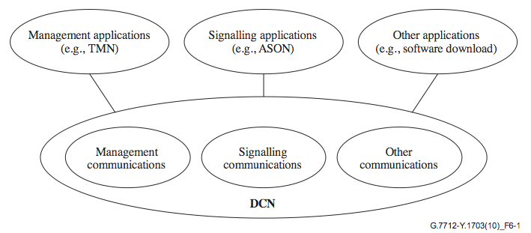
Overview
  Refresher
    Covers important details helpful to
    remember during ongoing WG work (ACP / reference model)
  Stable-connectivity:
    Use-cases for ACP
  Centralized NOC using ACP
    Virtual inband “out-of-band” network
    Virtual “Data Communications Network” (DCN)
    Describe options how to use it
  Distributed agents using ACP
    Out of scope today

Slide 3

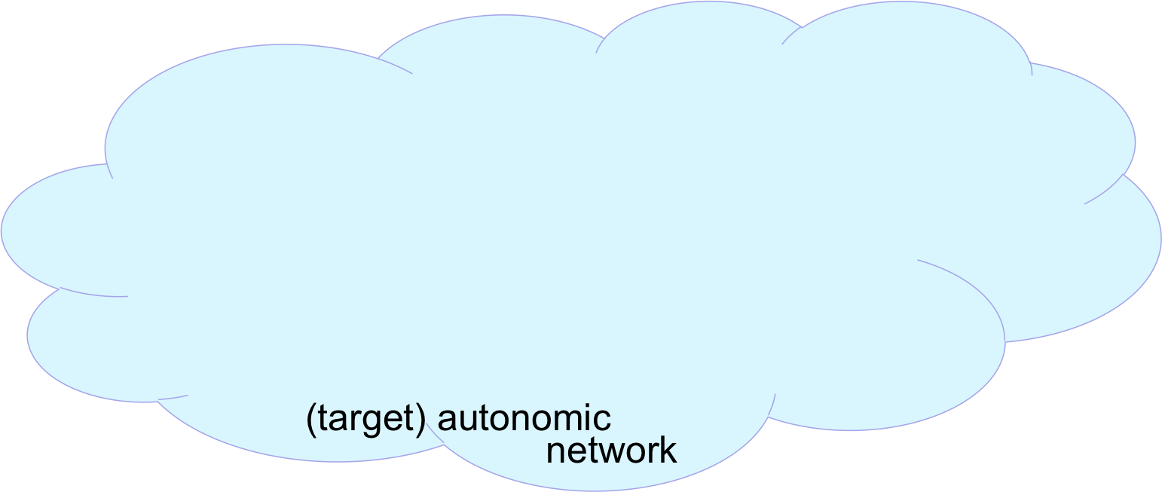

Context
NOC
AN
Registrar
Certificate
Authority
(CA)
  Day 1: Deploy
  Day 1: Enroll, build ACP
Autonomic
Control Plane

Slide 4

Context
NOC
AN
Registrar
Certificate
Authority
(CA)
NOC backend
systems
NMS, controller
Apps..
…
  Day 1: Deploy
  Day 1: Enroll, build ACP
  Day 1..N: Provision, Manage,…
ACP -Autonomic
Control Plane

Slide 5


Scope
NOC
AN
Registrar
Certificate
Authority
(CA)
NOC backend
systems
NMS, controller
Apps..
…
  Communication
  NOC ⬄ OAM/MGMT
  Using DP to modify DP can be self-destructive
  Workijng around that can make provisioning complex
Day 0/1: Use ACP to build DP
Day N: Use ACP to change DP
  Dual-path:
    ACP reliable, secure, potentially slow
    DP fast, insecure, ?unreliable?
  How to monitor DP ? Inband (DP), out-of-band..
Autonomic
Control
Plane
autonomic network
Autonomic
Control
Plane
OAM/Mgmt plane
ssh/SNMP Netconf/YANG
ftp/tftp/traceroute
CLI/XMPP MPLS-OAM,

Slide 6
Solution (1)
NOC
IPv6
only
NOC
Backend
for AN
IPv4 only
Certificate
Authority
(CA)
IPv4 only
NOC backend
systems
NMS, controller
Apps..
…
  Jumpstart
  IPv4 only network
  Start IPv6 ONLY to access ACP with new/limited NOC functions
  Registrar needs to access DP to get to IPv4 only CA
AN
Registrar
Autonomic
Control
Plane
autonomic network
Autonomic
Control
Plane
OAM/Mgmt plane
ssh/SNMP Netconf/YANG
ftp/tftp/traceroute
CLI/XMPP MPLS-OAM,

Slide 7
Solution (2)
NOC
Certificate
Authority
(CA)
Dual-Stack
NOC backend
systems
NMS, controller
Apps..
…
  BAD ?!
  Dual-Stack NOC option 1
    IPv6 ONLY ACP
    IPv4 ONLY DP
  ACP to NOC router setup
  Use DNS to select ACP/DP
  Not a sufficient solution to work with a network that wants an IPv6 data plane
AN
Registrar
Autonomic
Control
Plane
autonomic network
Autonomic
Control
Plane
OAM/Mgmt plane
ssh/SNMP Netconf/YANG
ftp/tftp/traceroute
CLI/XMPP MPLS-OAM,

Slide 8



Solution (3)
NOC
Certificate
Authority
(CA)
Dual-Stack
NOC backend
systems
NMS, controller
Apps..
…
  The real solution
  IPv6 access to DP AND ACP
  Single address NOC devices for both ACP/DP:
    Requires source/dest routing for return traffic (OAM->NOC)
  Recommend separate ACP and DP address on NOC devices.
  Automatic source-address selection based on dest-address as standard in IPv6
V6 ACP address
V6 data-plane addr
(V4 data-plane addr)
V6 (source) routing
function/device
AN
Registrar
Autonomic
Control
Plane
autonomic network
Autonomic
Control
Plane
OAM/Mgmt plane
ssh/SNMP Netconf/YANG
ftp/tftp/traceroute
CLI/XMPP MPLS-OAM,

Slide 9
Solution (4)
NOC
AN
Registrar
Certificate
Authority
(CA)
Dual-Stack
NOC backend
systems
NMS, controller
Apps..
…
  Extends ACP security into NOC
  Moves ACP/DP selection from ACP edge-router (3) into each NOC device.
Autonomic
Control
Plane
autonomic network
Autonomic
Control
Plane
OAM/Mgmt plane
ssh/SNMP Netconf/YANG
ftp/tftp/traceroute
CLI/XMPP MPLS-OAM,

Slide 10
More
  MP-TCP
    DP+ACP – automatically select best connectivity
    Implementation challenge: both paths are in two VRFs – needs some shim-layer work in autonomic devices.
  Hybrid step 3 / 4:
    NOC devices do not have full ACP.
    Just AN certificates
    Can rely on ACP security if they are fine to only use TLS protocols across DP
    Use legacy insecure protocols (tftp, DNS, SNMP, …) only across ACP
  -01 rev:
    Discussion about use of ULA addresses and unused lower bit part of ULA space:
    Conclusion: Registered ULA addresses not necessary. “Self-publish” might be helpful

Slide 11
Thank You

